Slide 1

Welcome
To

Slide 2
KEY DATA
TURNED PART SUPPLIER
SINCE 2000
COVERED AREA: 1200 m²
NUMBER OF MACHINES: 16 Turning Machines
11 Swiss Type Machines
5 CNC Machines
SHIFTS: 3 Shifts / 6 Days
- working 3 shifts 6 days meaning 48 machines/day
- moreover CNCs are almost double speed
NUMBER OF EMPLOYEES: 20
PARTS PRODUCED: 1.0 Million / month
TURNOVER: 1.150.000 EURO

Slide 3
HISTORY
All empoyees are graduated from minimum technical high school and all managers are graduated from technical university.
Quality management system has established and implemented since 2005.

Slide 4


OUR MISION
Manufacturing parts suitable for different requests of our customers according to international standards is adopted as our mission.
OUR VISION
Increasing our product quality by following technological developments and adding potential customers to our portfolio by providing best service are adopted as our vision. Also, contributing country economy by investments and employment opportunities is another part of our vision.

Slide 5
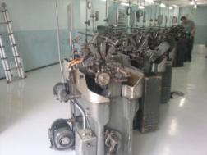
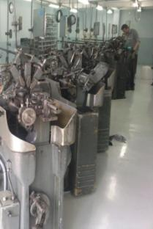
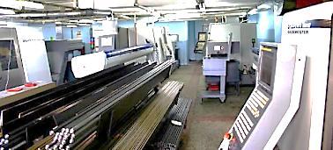
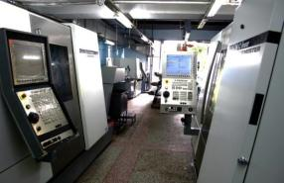
MANUFACTURING SKILLS
Manufacturing turned parts from Ø2 mm to Ø 42 mm
Machining stainless steel, brass, aluminum and cutting steel
Turning, drilling, threading, milling, broaching
Heat treatment, coating, grinding (by approved subcontractors)
CNC machines
Swiss type machines

Slide 6
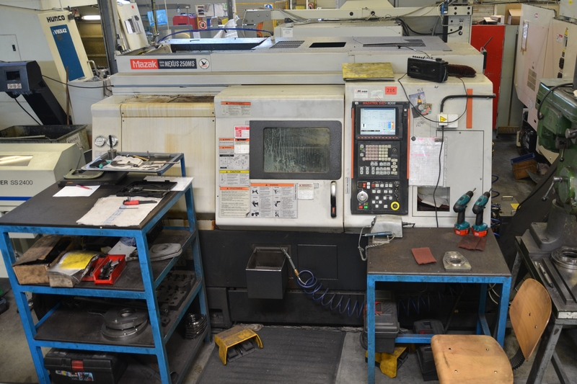
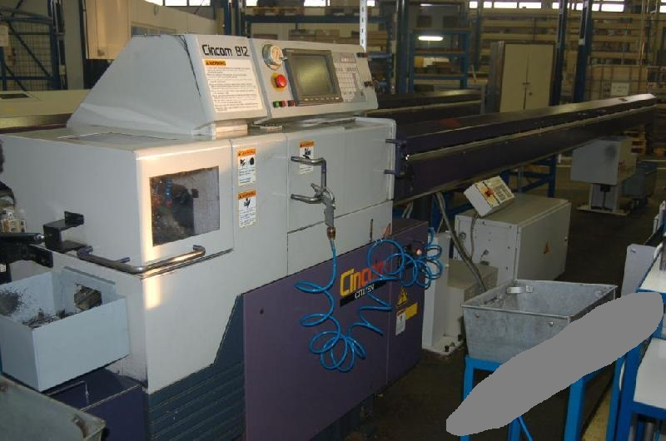
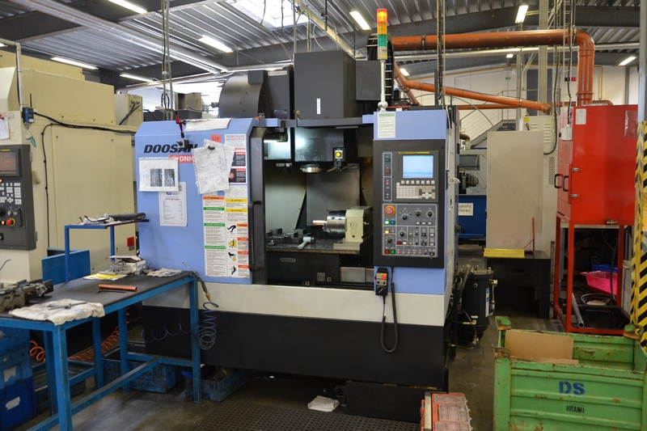
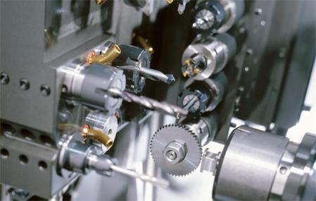

Slide 7
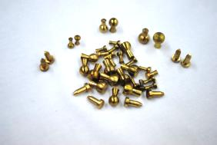
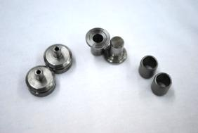
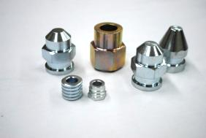
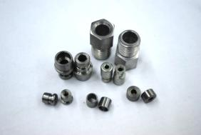
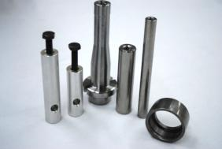
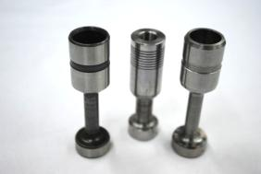
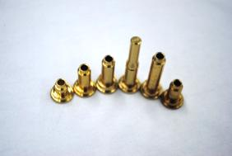
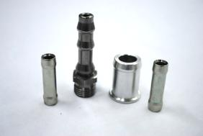
PRODUCT CATEGORY
Automotive parts
White good parts
Combine boiler parts
Locks & Security System parts
Electric parts
Power hydraulic parts
Motor bike parts

Slide 8
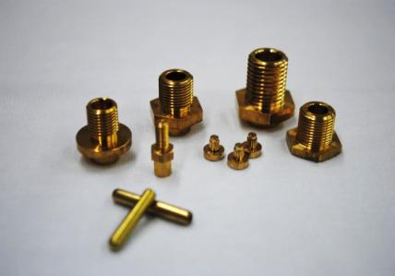
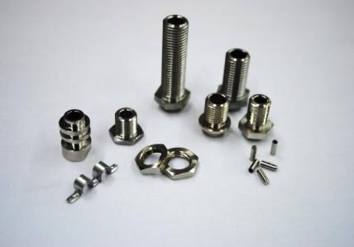
PRODUCT CATEGORY
Automotive parts
White good parts
Combine boiler parts
Locks & Security System parts
Electric parts
Power hydraulic parts
Motor bike parts

Slide 9
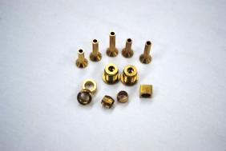
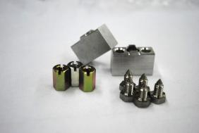
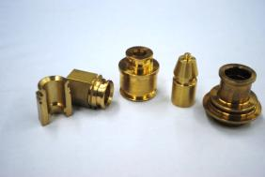
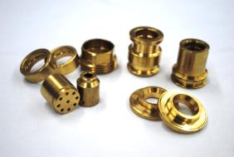
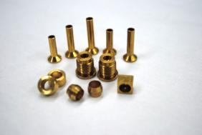
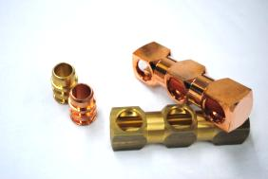
PRODUCT CATEGORY
Automotive parts
White good parts
Combine boiler parts
Locks & Security System parts
Electric parts
Power hydraulic parts
Motor bike parts

Slide 10
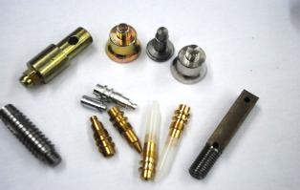
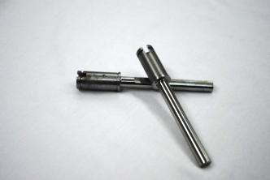
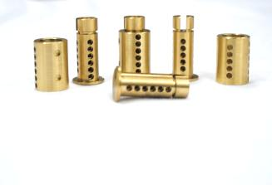
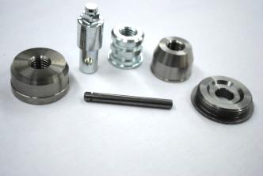
PRODUCT CATEGORY
Automotive parts
White good parts
Combine boiler parts
Locks & Security System parts
Electric parts
Power hydraulic parts
Motor bike parts

Slide 11
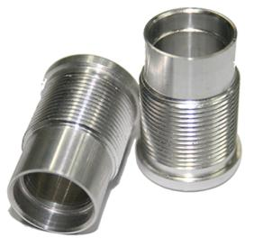
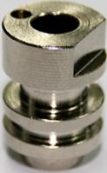
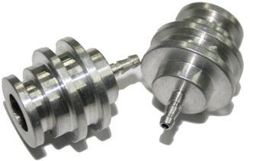
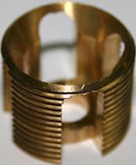
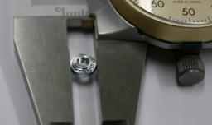

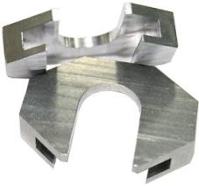
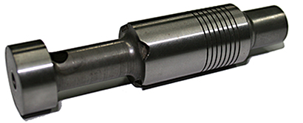
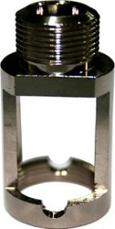
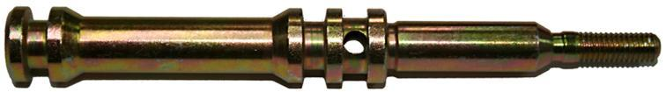

Slide 12
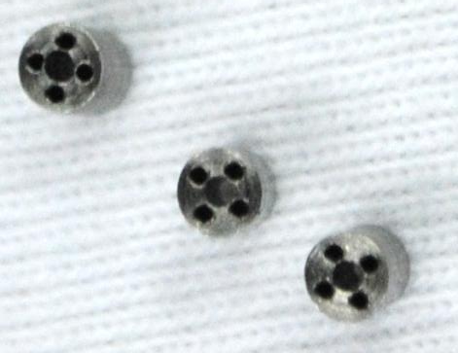
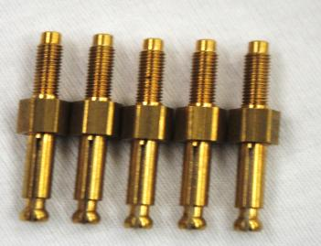
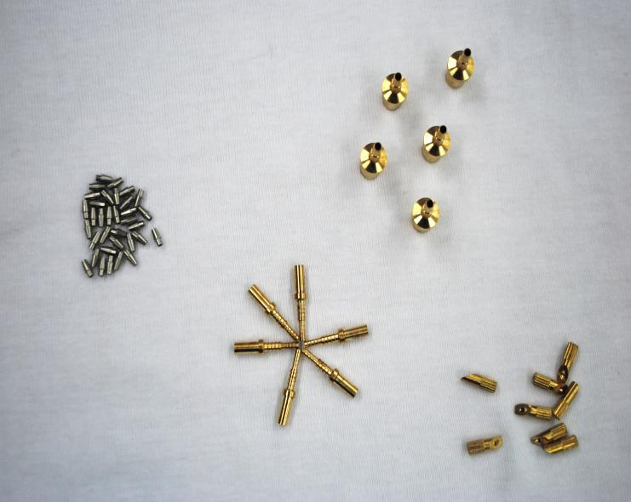
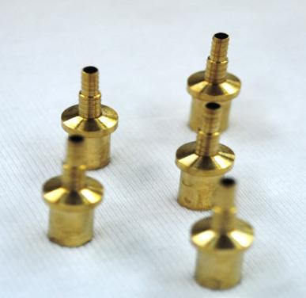
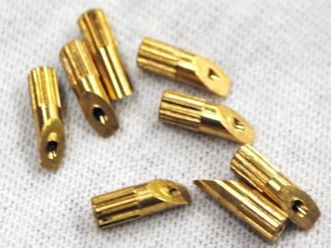

Slide 13
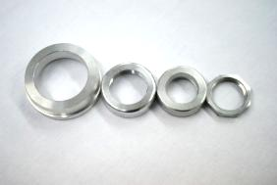
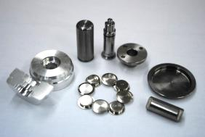
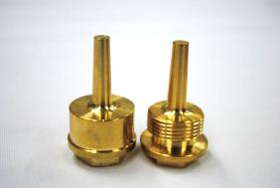
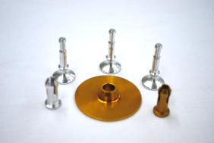
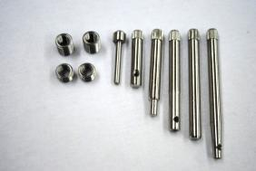
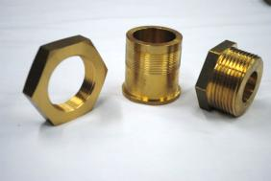
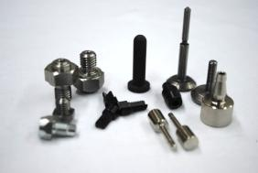

Slide 14
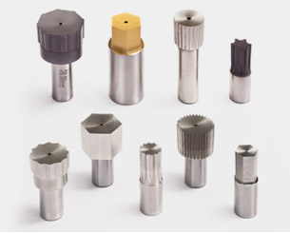





Slide 15




Slide 16
THANK YOU
ITP - INDUSTRIAL TOOL PRODUCTS
GAZIEMİR-IZMIR
PHONE : +90 (0) 507 754 35 45
Email: info@itp.com.tr
Web: www.itp.com.tr

