Slide 1
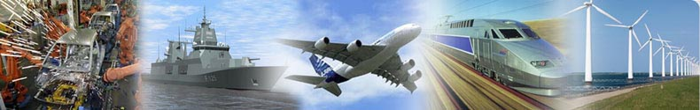



Design and Production of
Tools, Fixtures and Plant Equipments for
The Automotive, Defense & Aviation
Industries

Slide 2

Products:
Automotive
Checking Fixtures
Welding and Assembly Jigs
Auto Glass Production Tools
Sheet Metal Stamping Tools
Plant Equipments
Defence & Aeronautics
Composite Tools
Stretch Forming Tools
Assembly Jigs
Plant Auxiliary Equipments
On Site Commisionning by Laser Tracker

Slide 3
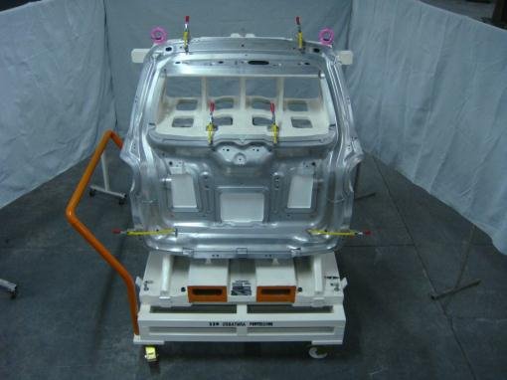
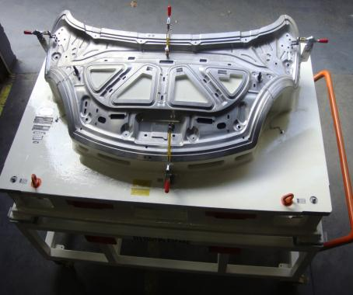
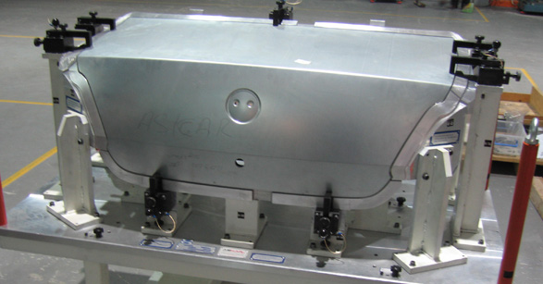

Panel Checking Fixtures

Slide 4
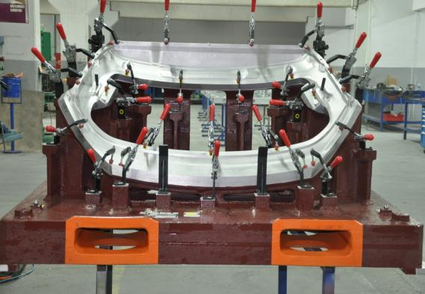


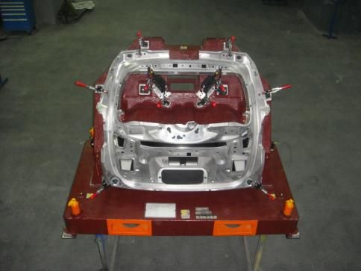
Panel Checking Fixtures

Slide 5

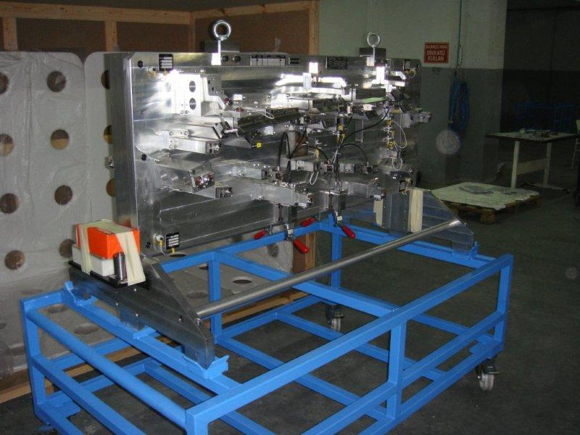
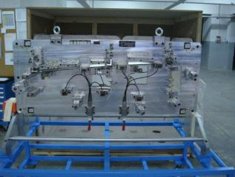
Door Inner Panel
Checking Fixture

Slide 6


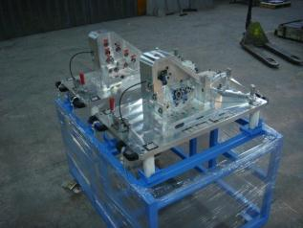
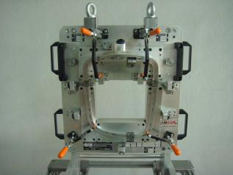
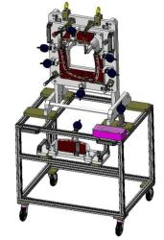
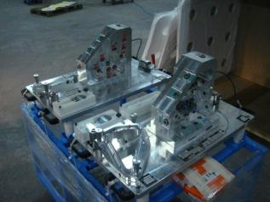
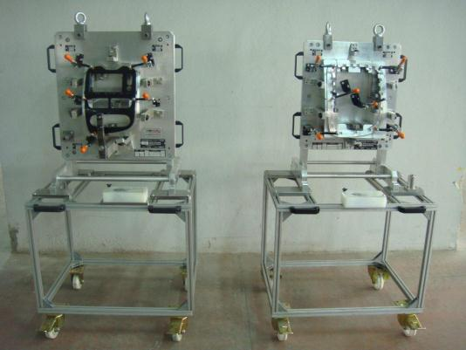
Mirror Checking Fixture
Totem Checking Fixtures

Slide 7
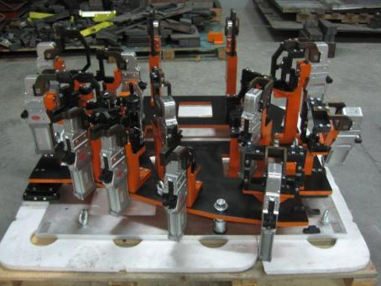
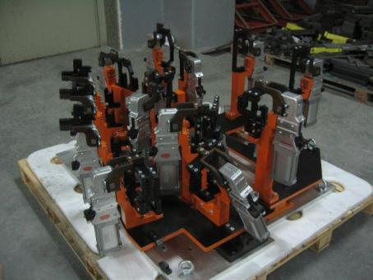
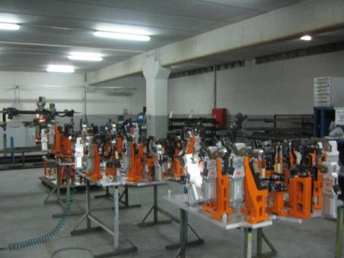
Welding Fixtures

Slide 8
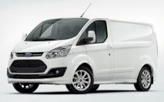
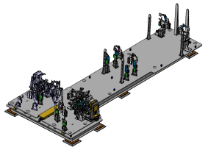
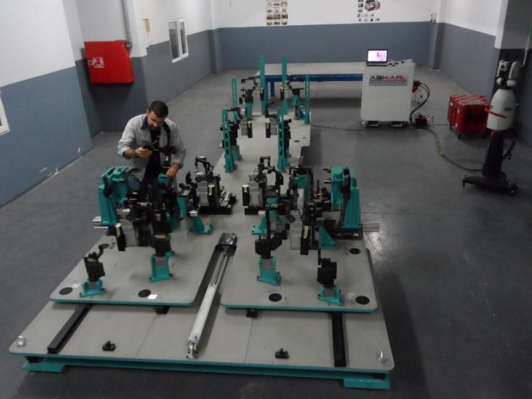

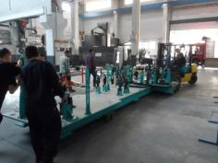
Ford Transit Jumbo
Welding Fixture

Slide 9
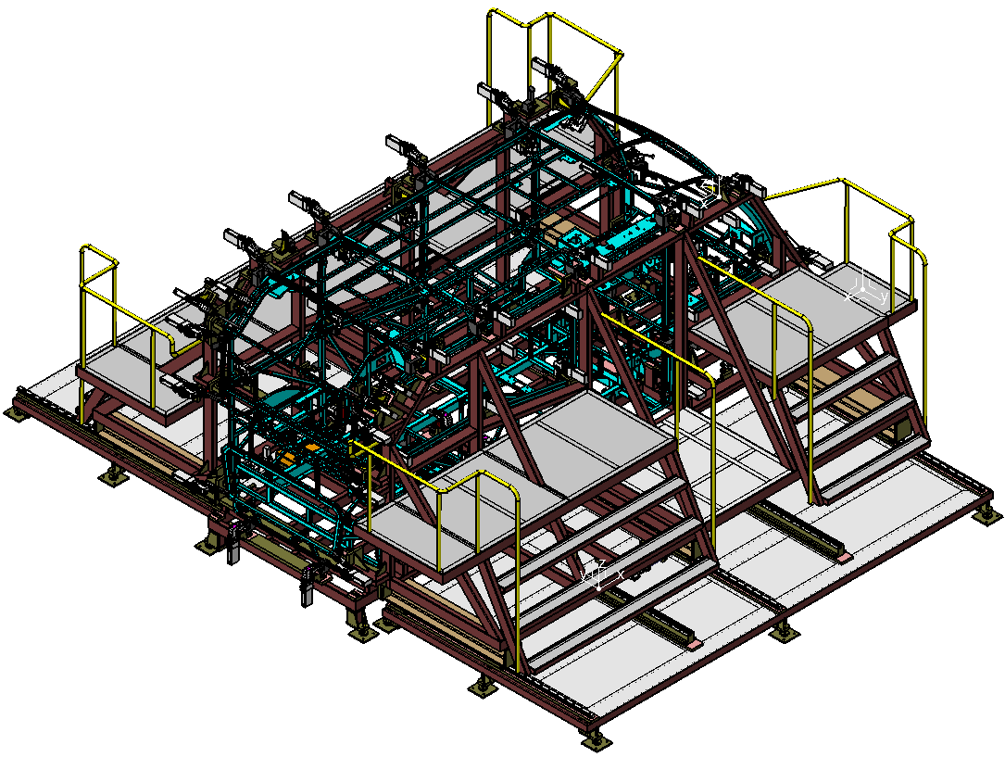


Slide 10
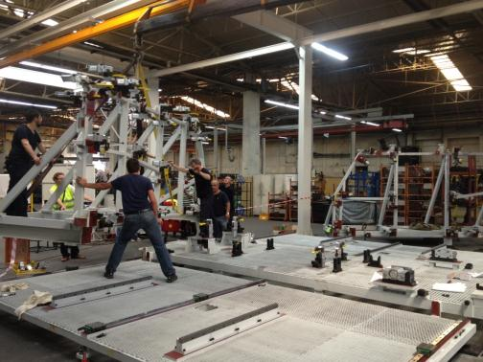
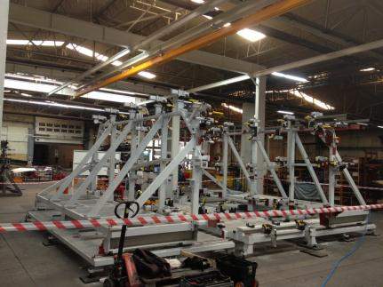
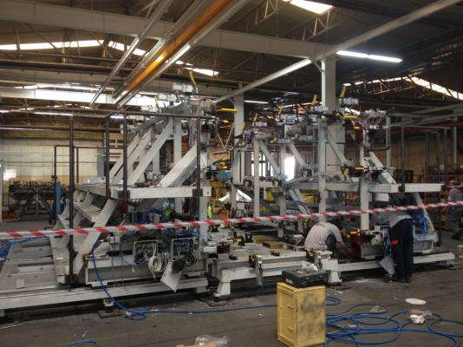
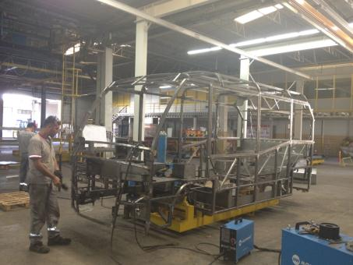
Main Frame Station

Slide 11

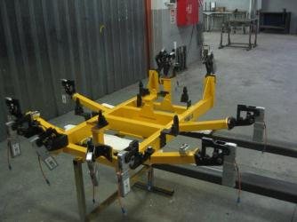
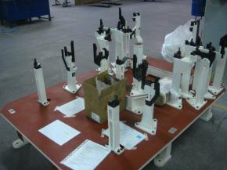
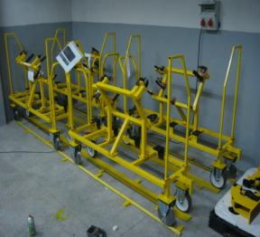
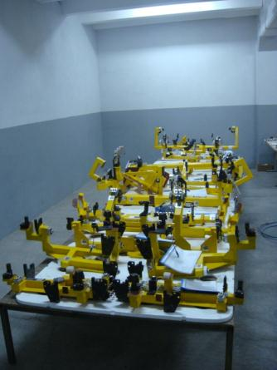
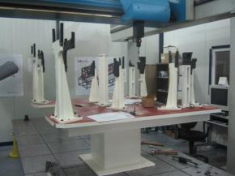
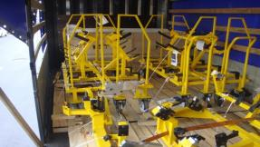
Robot hands
Welding Jigs
Plant equipments

Slide 12

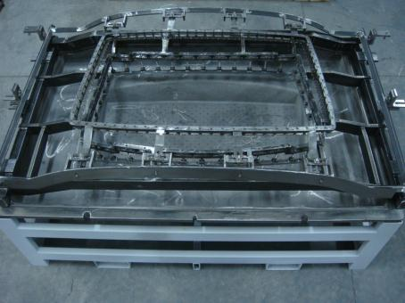
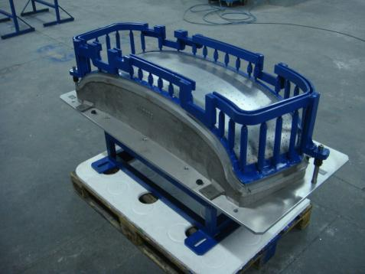
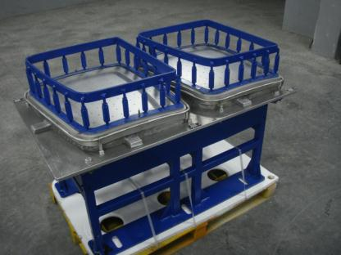
Auto Glass Production Tools

Slide 13
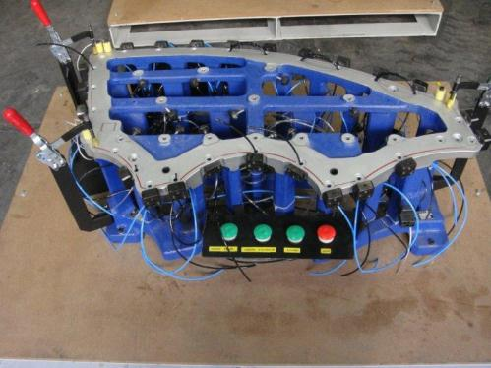
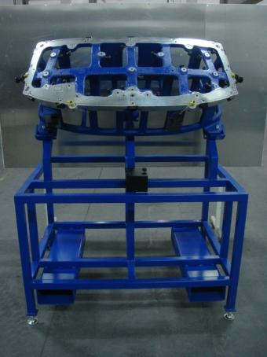
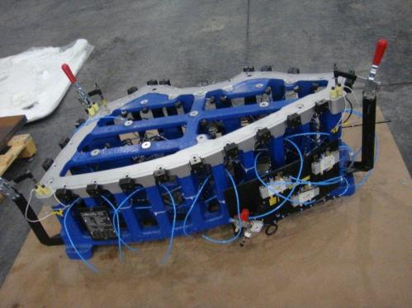
Auto Glass Checking Fixtures

Slide 14
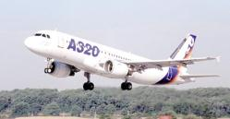

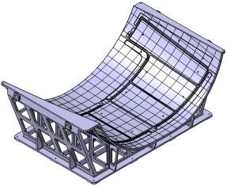
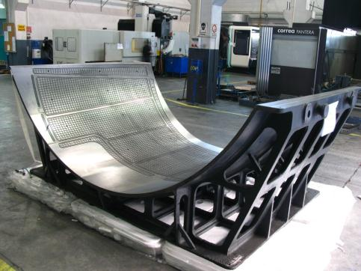
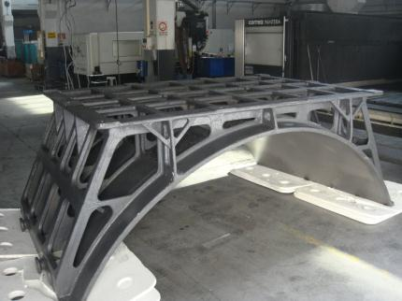
Airbus A320
Vacuum Machining Jig

Slide 15
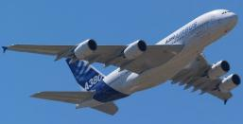
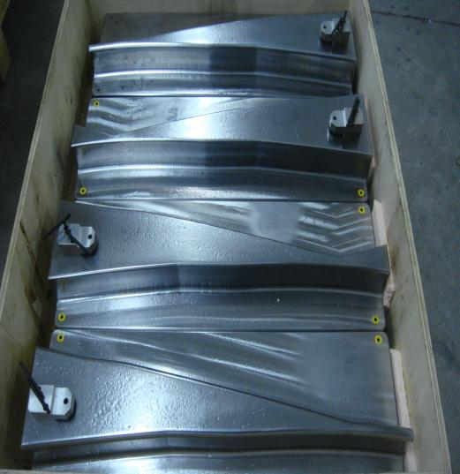
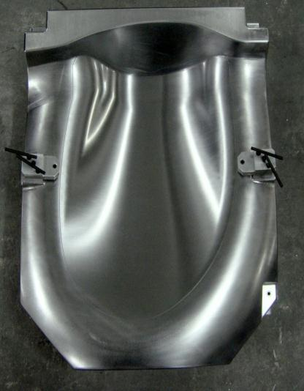
Airbus A350
Composite Lay Up Tools

Slide 16
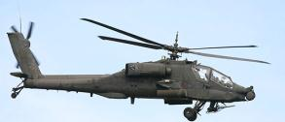

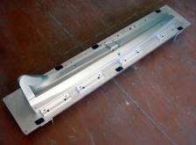
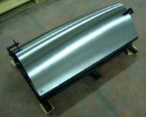
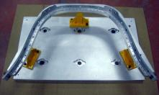
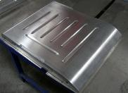
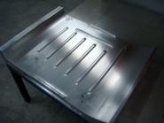





Atak Helicopter
Composite Tools
Stretch Forming Tools
Water Jet Cutting Jigs
Hot Forming Tools

Slide 17



BOMBARDIER
Composite Lay Up Tools

Slide 18





TAI HURKUS
Balancing Tool
RTM Composite Tool

Slide 19




TAI ANKA UAV
Main Test Rig

Slide 20



BOEING 787-9
Drilling Jigs

Slide 21





CAD / CAM :
Catia V5
Tebis
8 CAD stations
3 CAM stations
Competences:
Design CAD/CAM/CAE
Machining CNC ve Conventional Machining
Welding Mig/Mag/Tig
Assembly On site commissioning
Quality 3D Inspection by CMMs & Laser Tracker

Slide 22








Production and Inspection Equipments
 | Brand | X (mm) | Y (mm) | Z (mm) | Remarks
1 | CORREA | 6.000 | 3.000 | 1.600 | 5 axis, 3 heads
2 | ZAYER | 5.000 | 2.500 | 1.350 | 5 axis, 2 heads
3 | DMF 180 | 1.800 | 700 | 700 | 5 axis
4 | KAO MING | 3.200 | 1.400 | 700 | 3 axis , 2 heads
5 | SORALUCE | 2.000 | 800 | 800 | 3 axis, Indexable head
6 | MAZAK | 1.020 | 510 | 460 | 3 axis
7 | DMU50 ECO | 500 | 450 | 400 | 3+2 axis
8 | SODİK | 750 | 500 | 500 | Wire EDM
9 | DEA ALFA | 3.300 | 2.000 | 1.500 | CMM
10 | LEICA AT901 MR | 18 m/ 50 m |  |  | Laser Tracker
11 | DEA PIONEER | 1.200 | 800 | 600 | CMM

Slide 23


Zayer KPC 5000 - AR
Table surface: 5,000 x 2,000 mm
Width between columns: 2,800 mm
Travels:
• Longitudinal (X axis): 5,000 mm
• Cross (Y axis): 3,550 mm
• Vertical (Z axis): 1,250 mm
Rpm: 6,000 min⁻¹ / 18,000 min⁻¹
Power: 40 kW
Working Feed: 15 - 25 m/min
Table capacity: 25.000 kg
Correa PANTERA
Table surface: 6,000 x 3,000 mm
Width between columns: 4,470 mm
Travels:
• Longitudinal (X axis): 5,300 mm
• Cross (Y axis): 3,200 mm
• Vertical (Z axis): 1,350 mm
Rpm: 6,000 min⁻¹ / 16,000 min⁻¹
Power: 32 kW
Working Feed: 15 - 30 m/min
Table capacity: 200.000 kg

Slide 24


Slide 25




Inspection
2 CMMs
1 Laser Tracker

Slide 26


Project Management is key to Success
Quality Products
&
Competitive Costs
&
Delivery on Time

Slide 28


Slide 29





Our Clients

Slide 30

Questions
&
Answers...

