Slide 1
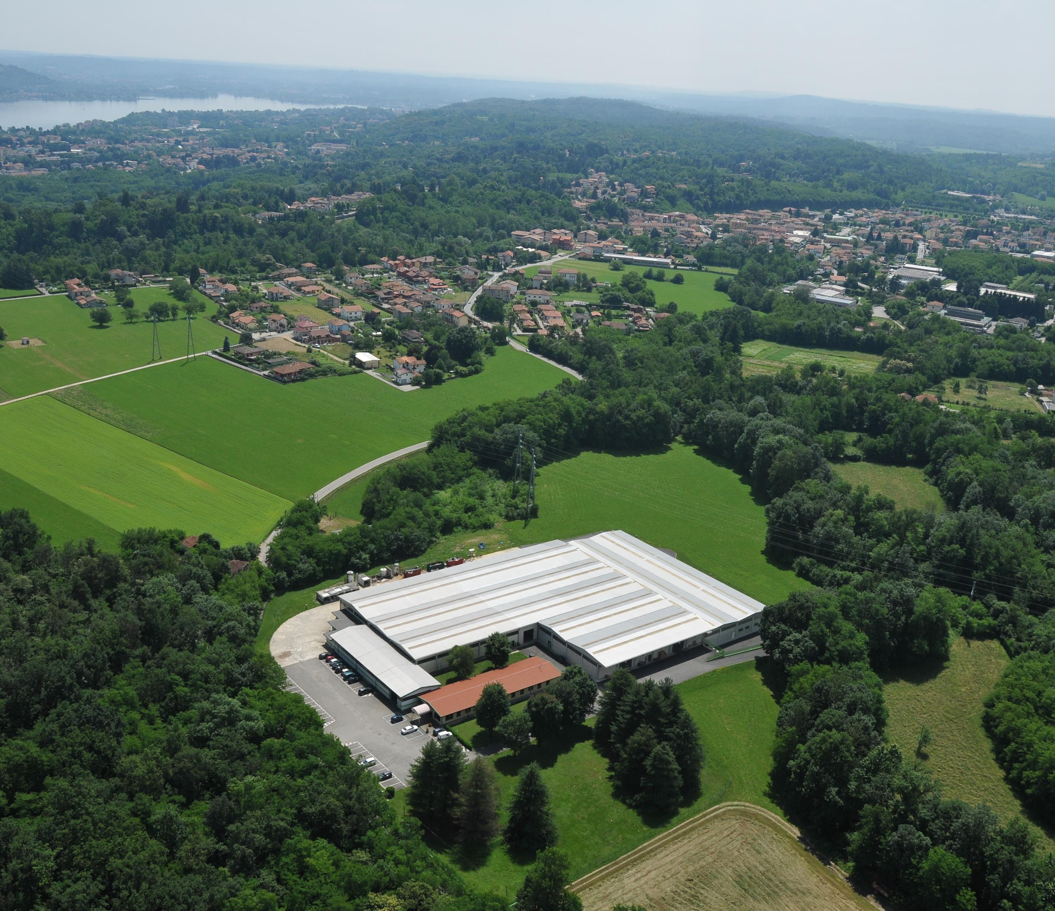


GMB SRL LAVORAZIONE LAMIERE
Tell us the idea, we think about the rest
Founded in 2013 GMB Srl is
synonymous with ideas, design, cutting-edge technology and research
constant quality.
Thanks to the use of innovative and customized management software
the entire production chain has an on-time control

Slide 2
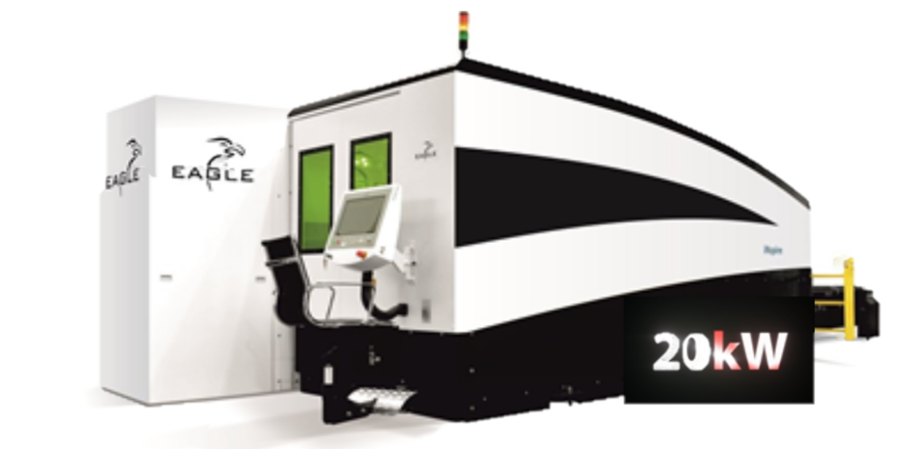

Eagle 20 kw
Cutting speed : max 150 m/min.
Interpolated speed : 350 m/min.
Acceleration : 6G.
IPG Laser Sources: from 1 to 20 kW.
Fiber laser source.

Slide 3
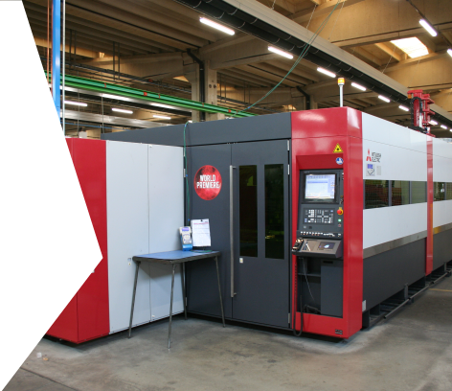
Mitsubishi Fiber laser
with 4050 x 2060 mm work top and 8 KW power
Higher performance at the same power
Efficiency and speed in machining
Flexibility in machining
Lower energy consumption at the same power

Slide 4
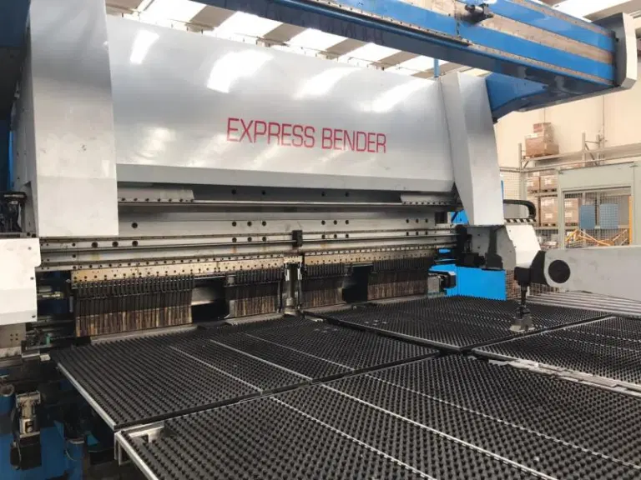
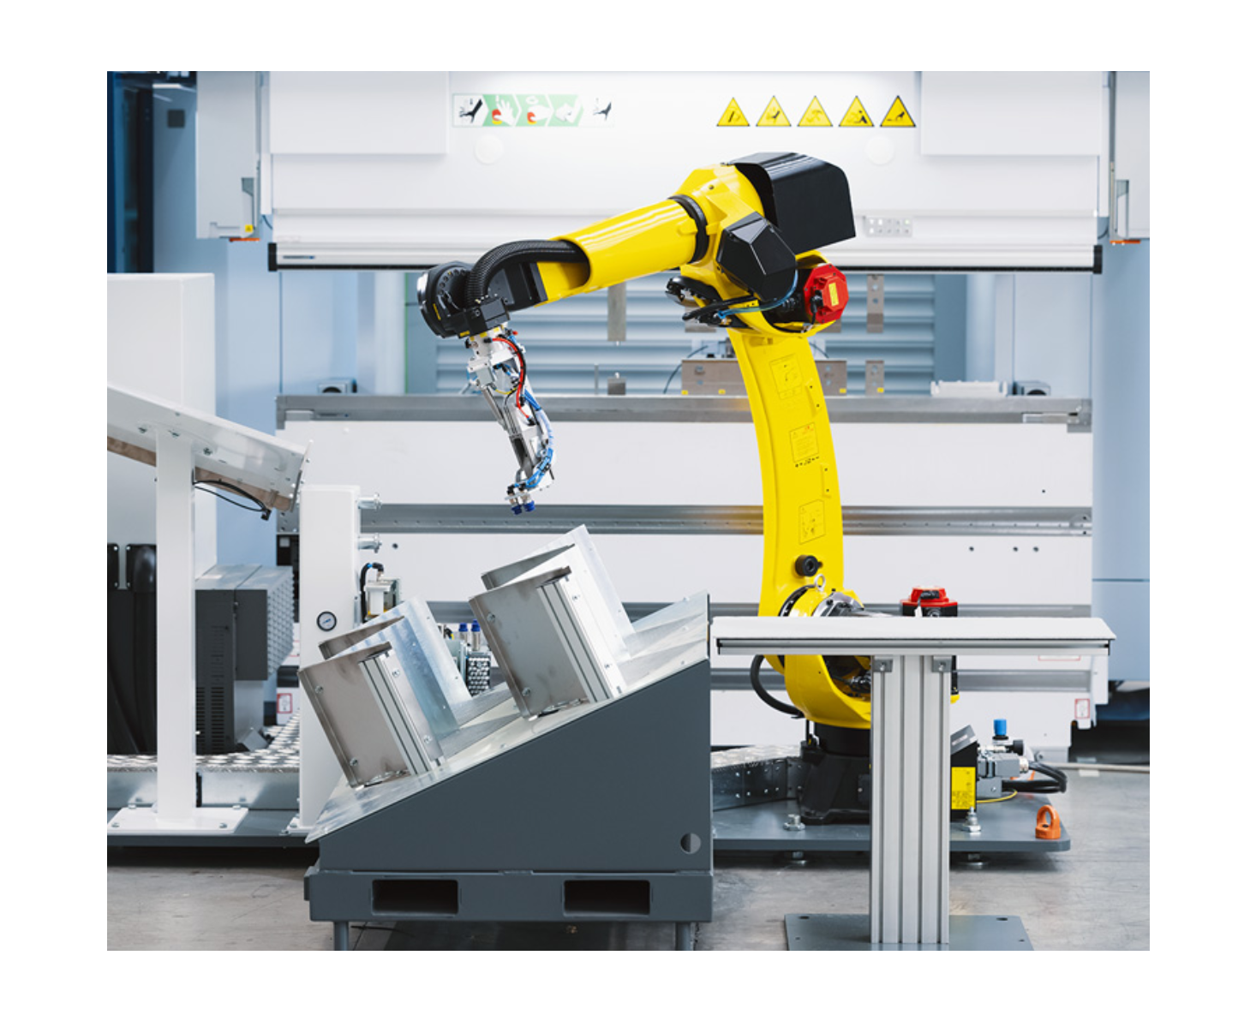
BENDING
We have 9 hydraulic bending machines and an Express Bender paneling machine that automates all phases, reducing time
New Starmatik
Robotic solution designed for the creation of a standard bending cell with high productivity for small parts.

Slide 5
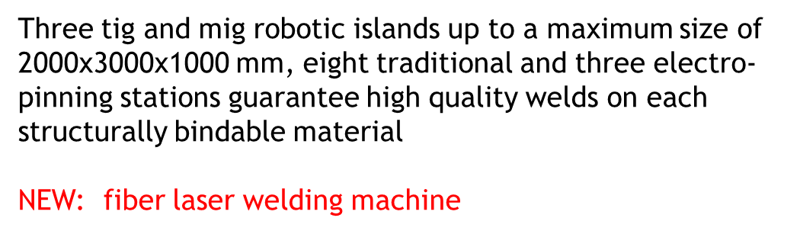
WELDING

Slide 6
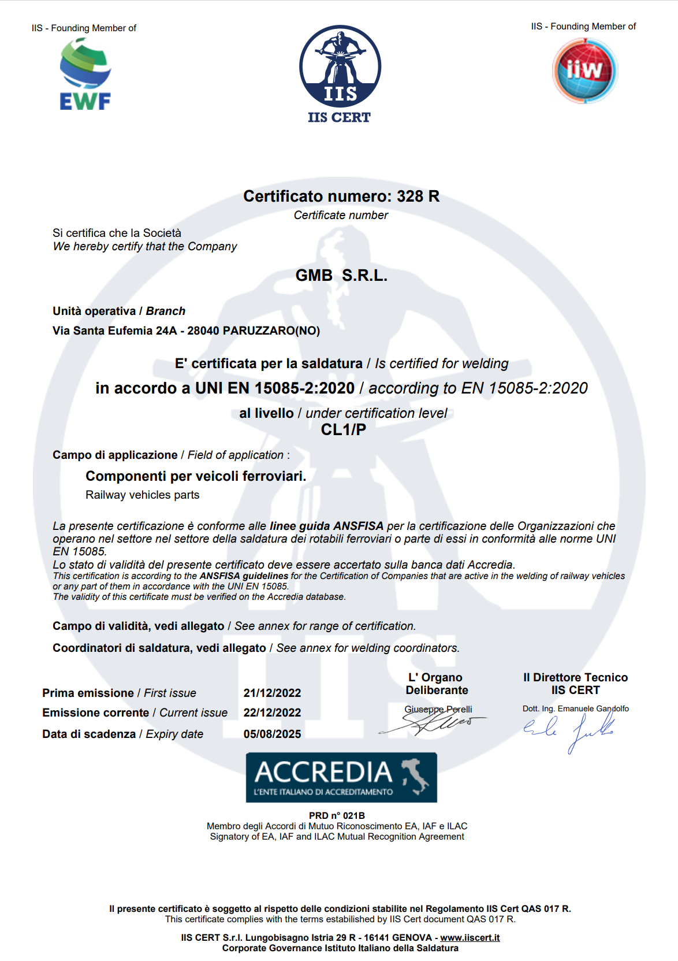
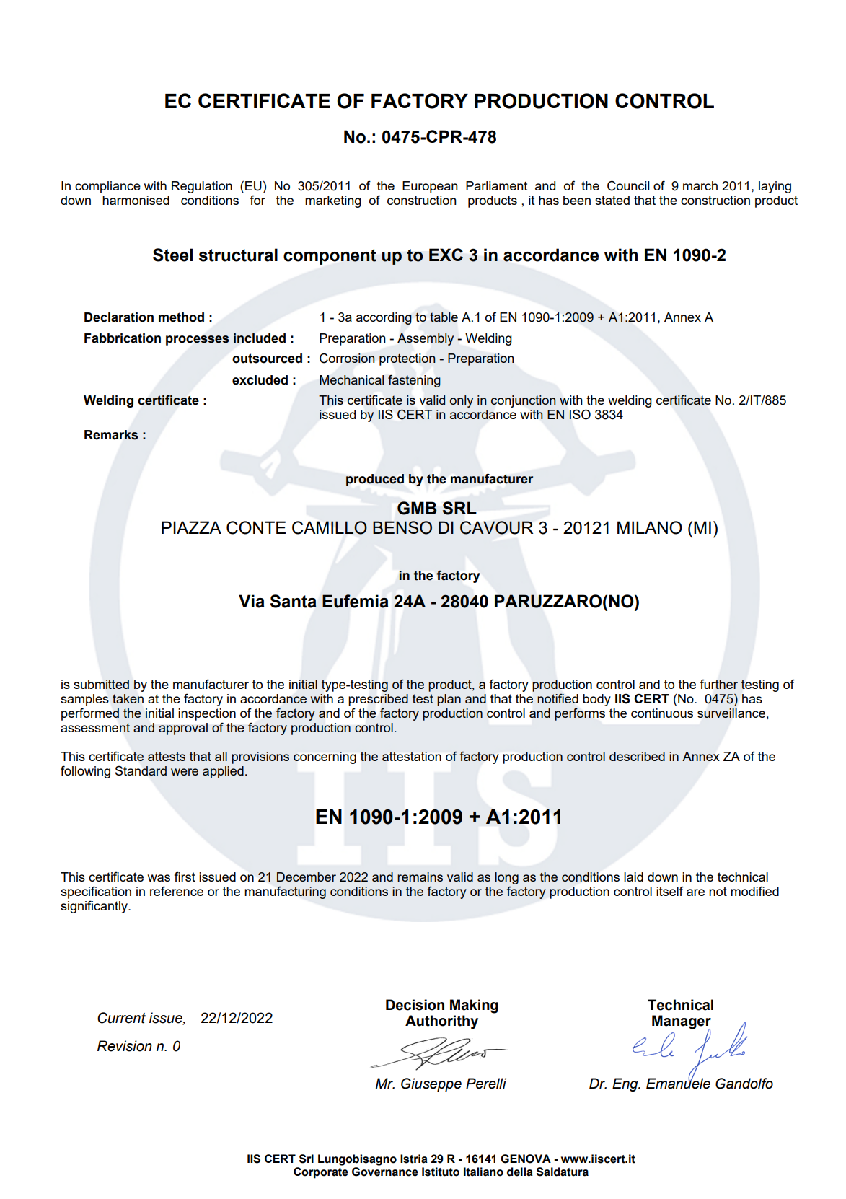
Contact: +390322063440
gmb@gmb-lavorazione-lamiere.com

Slide 7
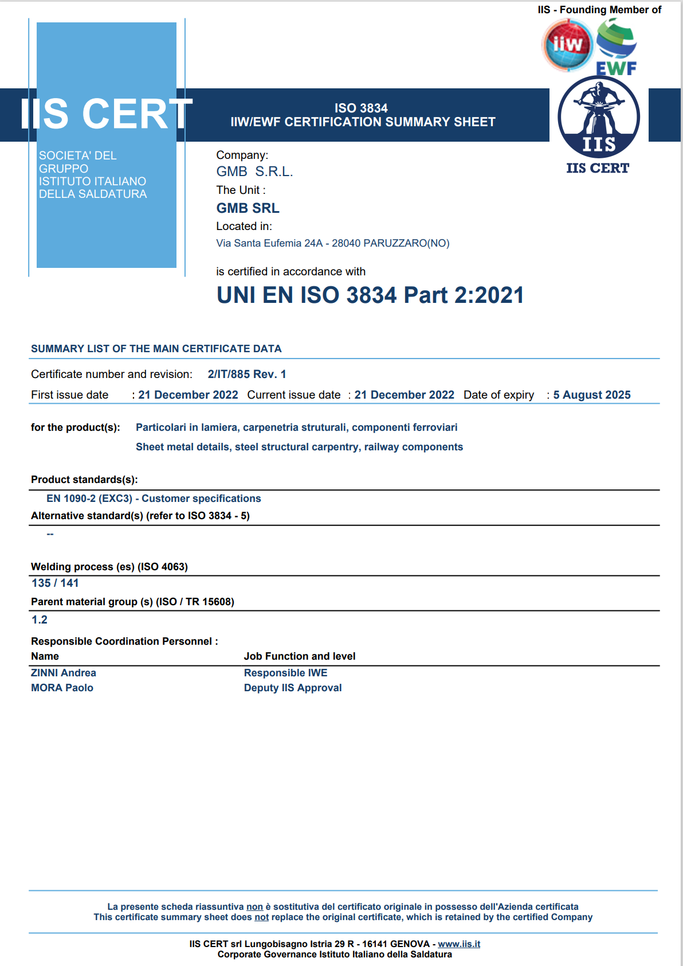
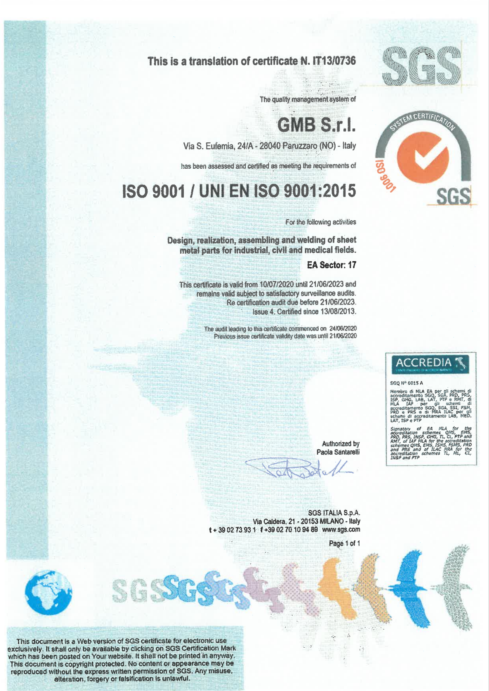
Contact: +390322063440
gmb@gmb-lavorazione-lamiere.com

