Slide 1


www.officinesefa.it

Slide 2
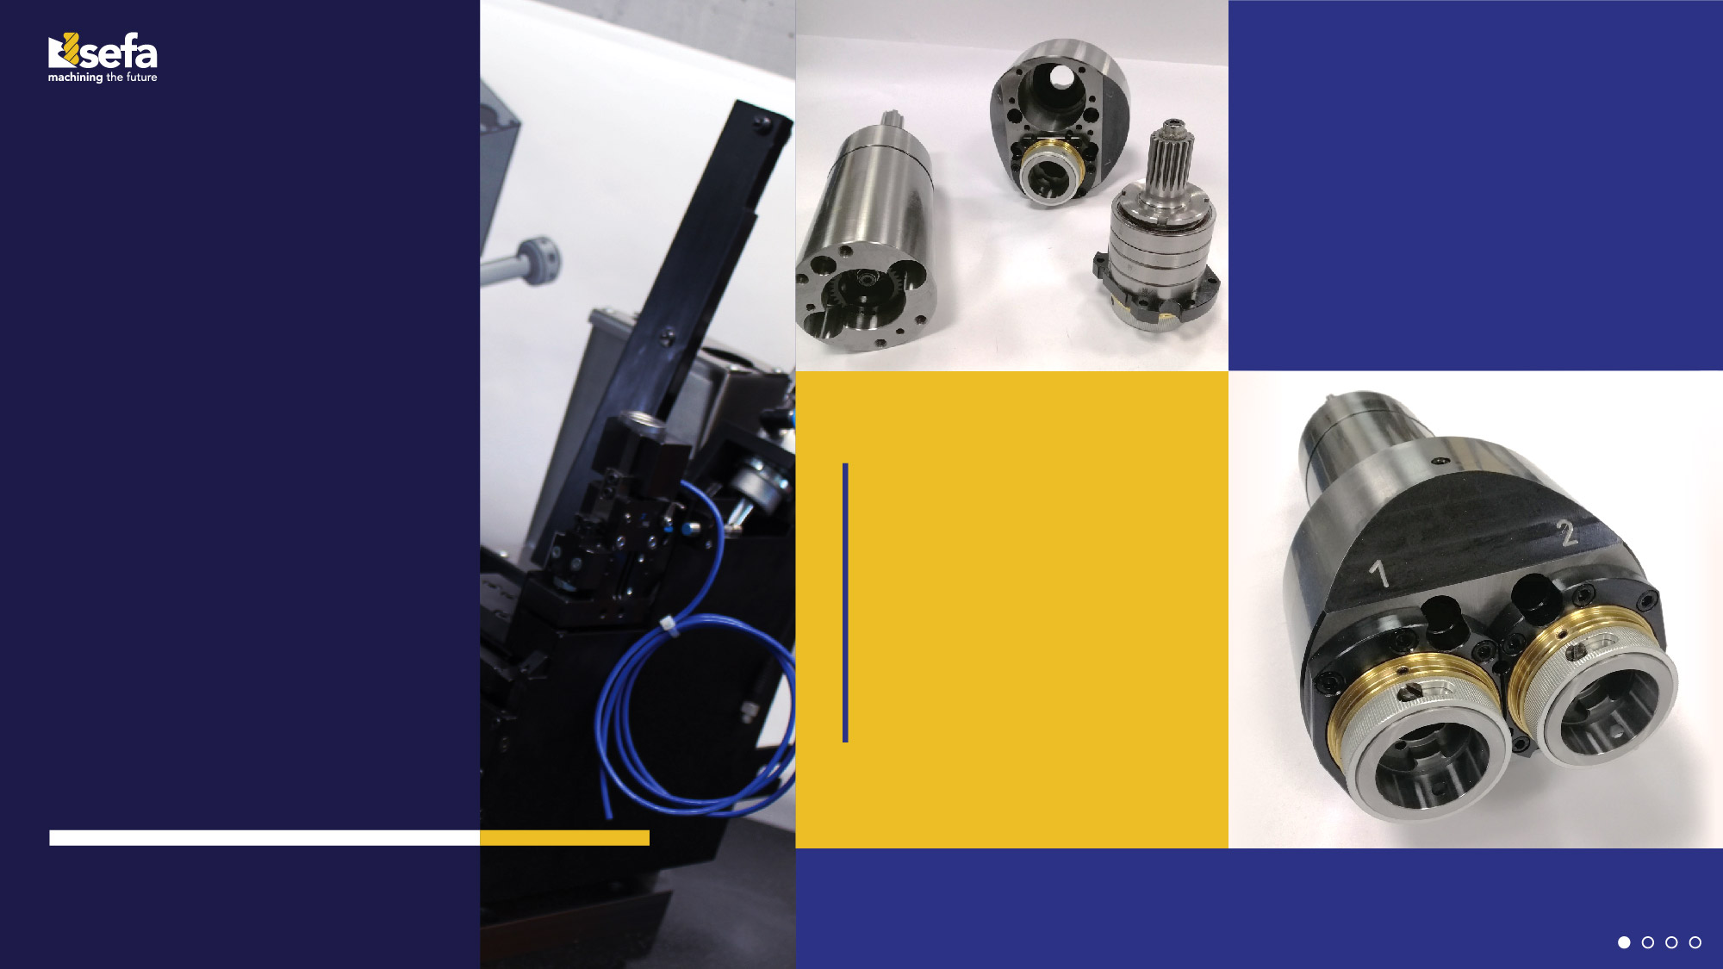
We want to be your ideal partner, not just a supplier.
Flexibility and skill are our trademark so that we can personalize our services based on your needs, with precision and a guarantee of excellence.
Thanks to a dynamic team of experts and enthusiasts, we are capable of tackling any challenges with determination and professionality, to ensure the highest quality and precision of our services.
We strongly believe that building a partnership with our clients is essential for achieving joint success, and it's this that sets us apart from other providers.
Technology,
innovation, ideas

Slide 3
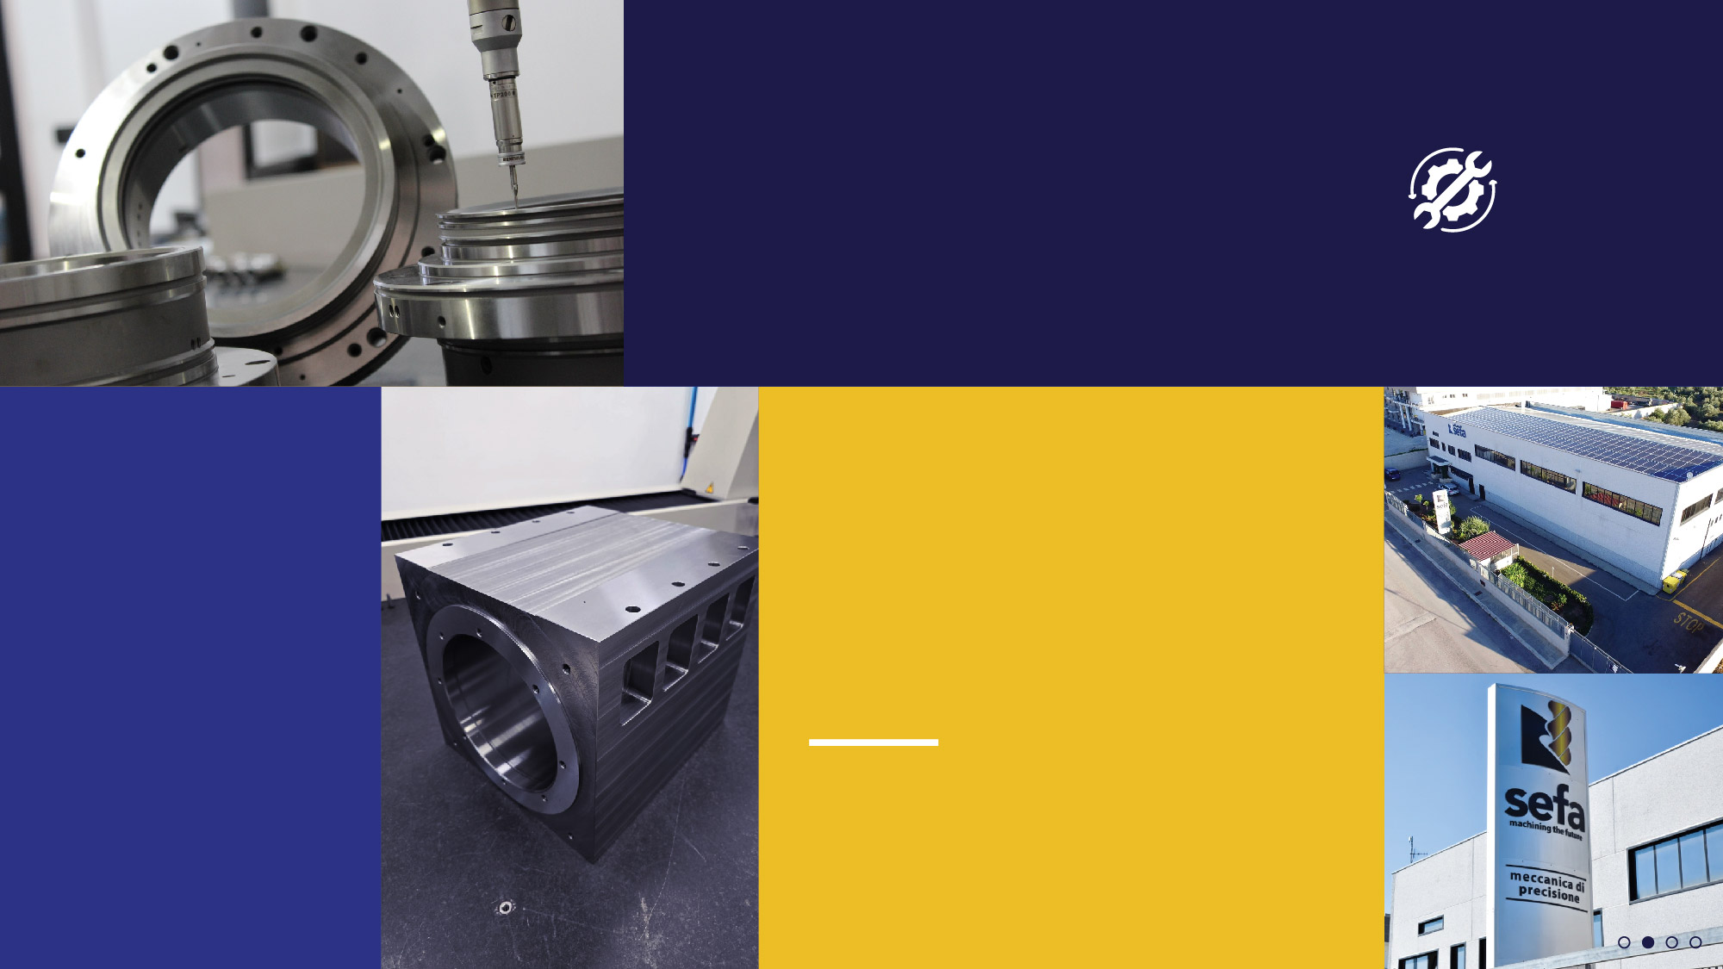
Products and services
Why choose us as your ideal partner?
Our facilities
SEFA has grown continuously since 2001 and now
boasts over 80 collaborators and 2 production sites,
both located in Molfetta (BA), Italy: the first covering
2800 m2, was opened in 2009 and the second, encompassing 1200 m2, was opened in 2018. These spaces allow us to maximize our efficiency and productivity, creating a comfortable working environment, affording our employees safety, quality and flexibility.
These are the basic principles underpinning the formation of SEFA.
SEFA is ISO 9001:2015 certified, thus meeting international management standards in terms of production, quality, environment and safety.
Because we offer full support at every step of the process, from planning right up to delivery of the finished and/or assembled product.
We manufacture all types of material and carry out turning, milling, grinding and
electrical discharge machining including heat treatments and coatings.

Slide 4
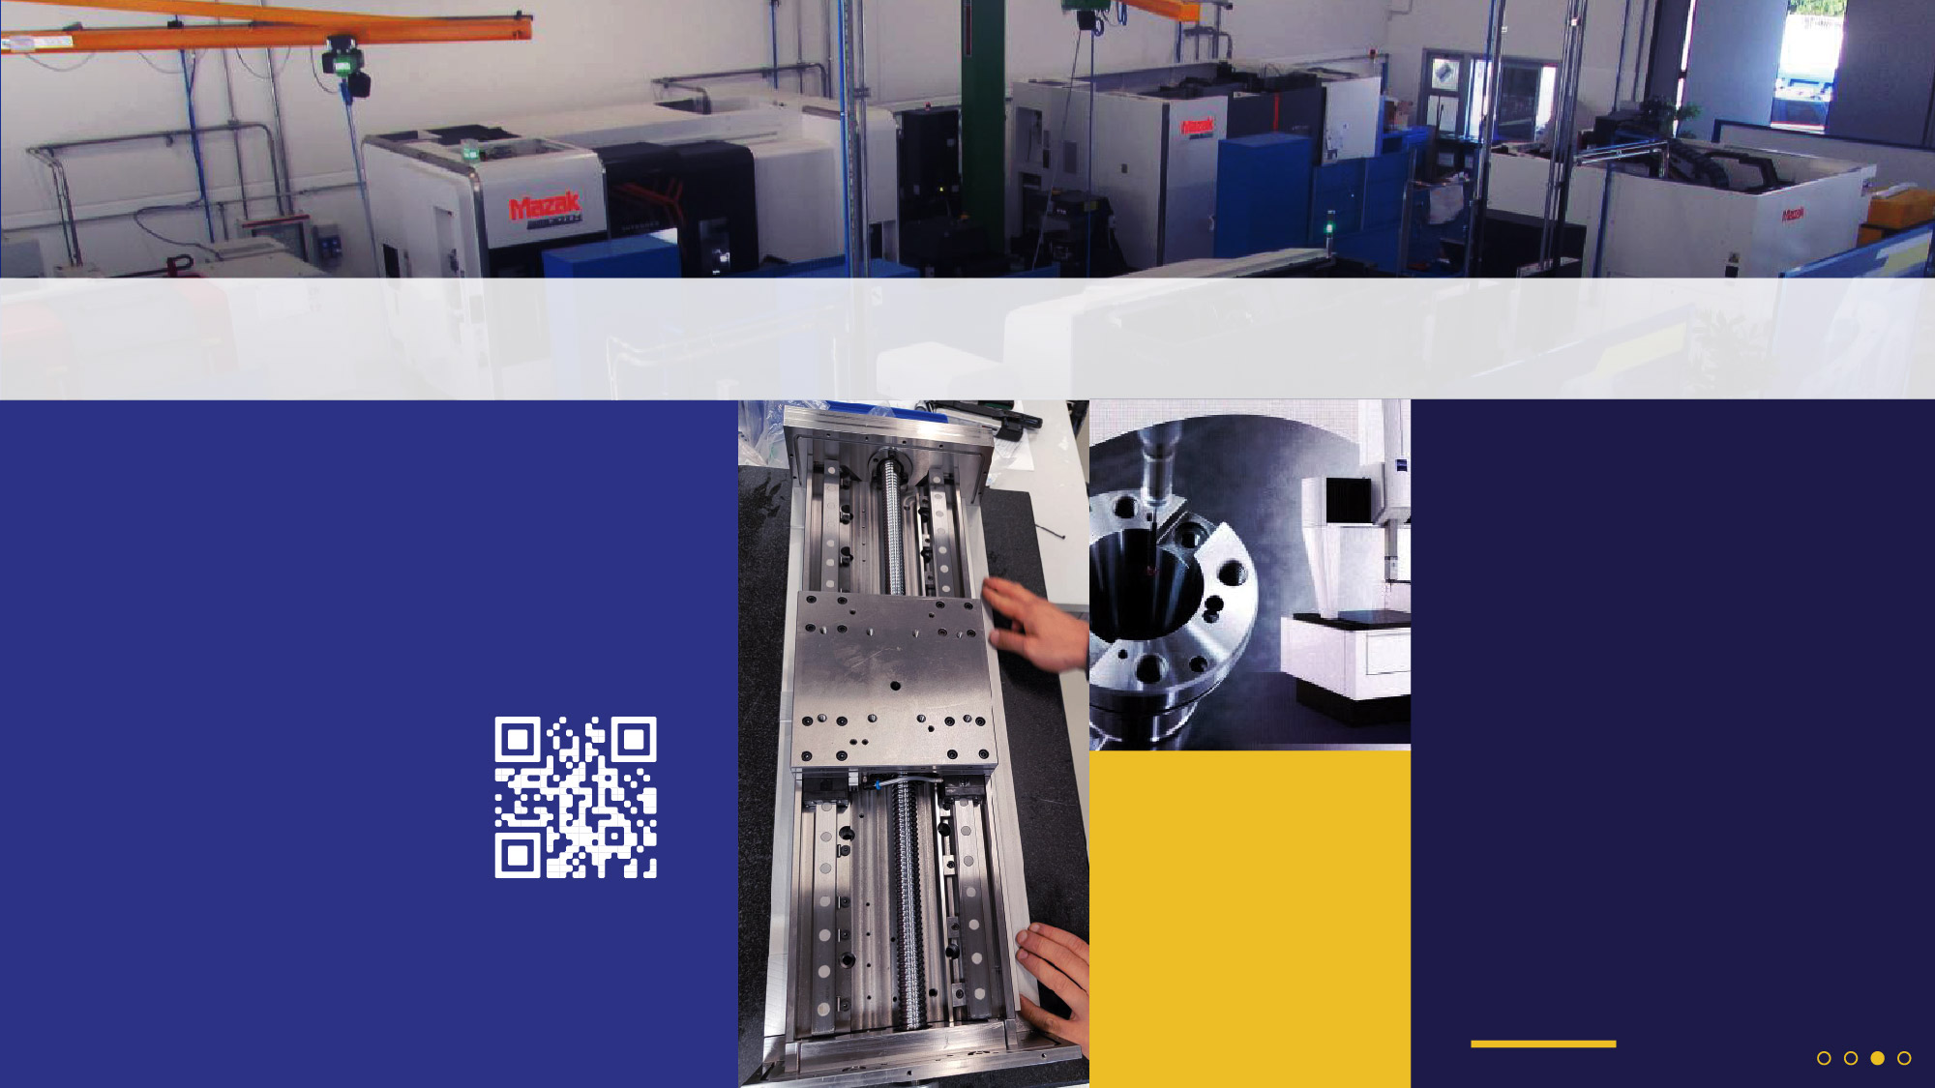

Our fleet of machinery
Thanks to a wide range of technologically advanced machinery, we are able to meet our clients' most specific requirements.
With our 2 high-tech measurement rooms, we optimize the efficiency and quality of our products using advanced, specific instrumentation.
SEFA's testing room includes 3 three-dimensional measuring machines (including 2 Mitutoyo machines and 1 ZEISS PRISMO-ULTRA) and a Mahr
formtester. Two advanced devices ensuring extremely accurate and reliable quality control.
Putting your trust in us means choosing high standards of quality, flexibility and precision. The client at the forefront.
Our fleet of machinery comprises over 40 units and is
made up of:
Turning: 3 to 5 axes Ømax 850 x 2000 mm
Milling: 3 to 5 axes max length 1650 mm
Grinding:
Cylindrical Ø450 x 1500 mm
vertical up to Ø1200 mm
surface grinding up to 1600 mm
Die sinking and wire cutting
EDM Machines
Small hole driller
You can view our entire machinery range on our website.

Slide 5
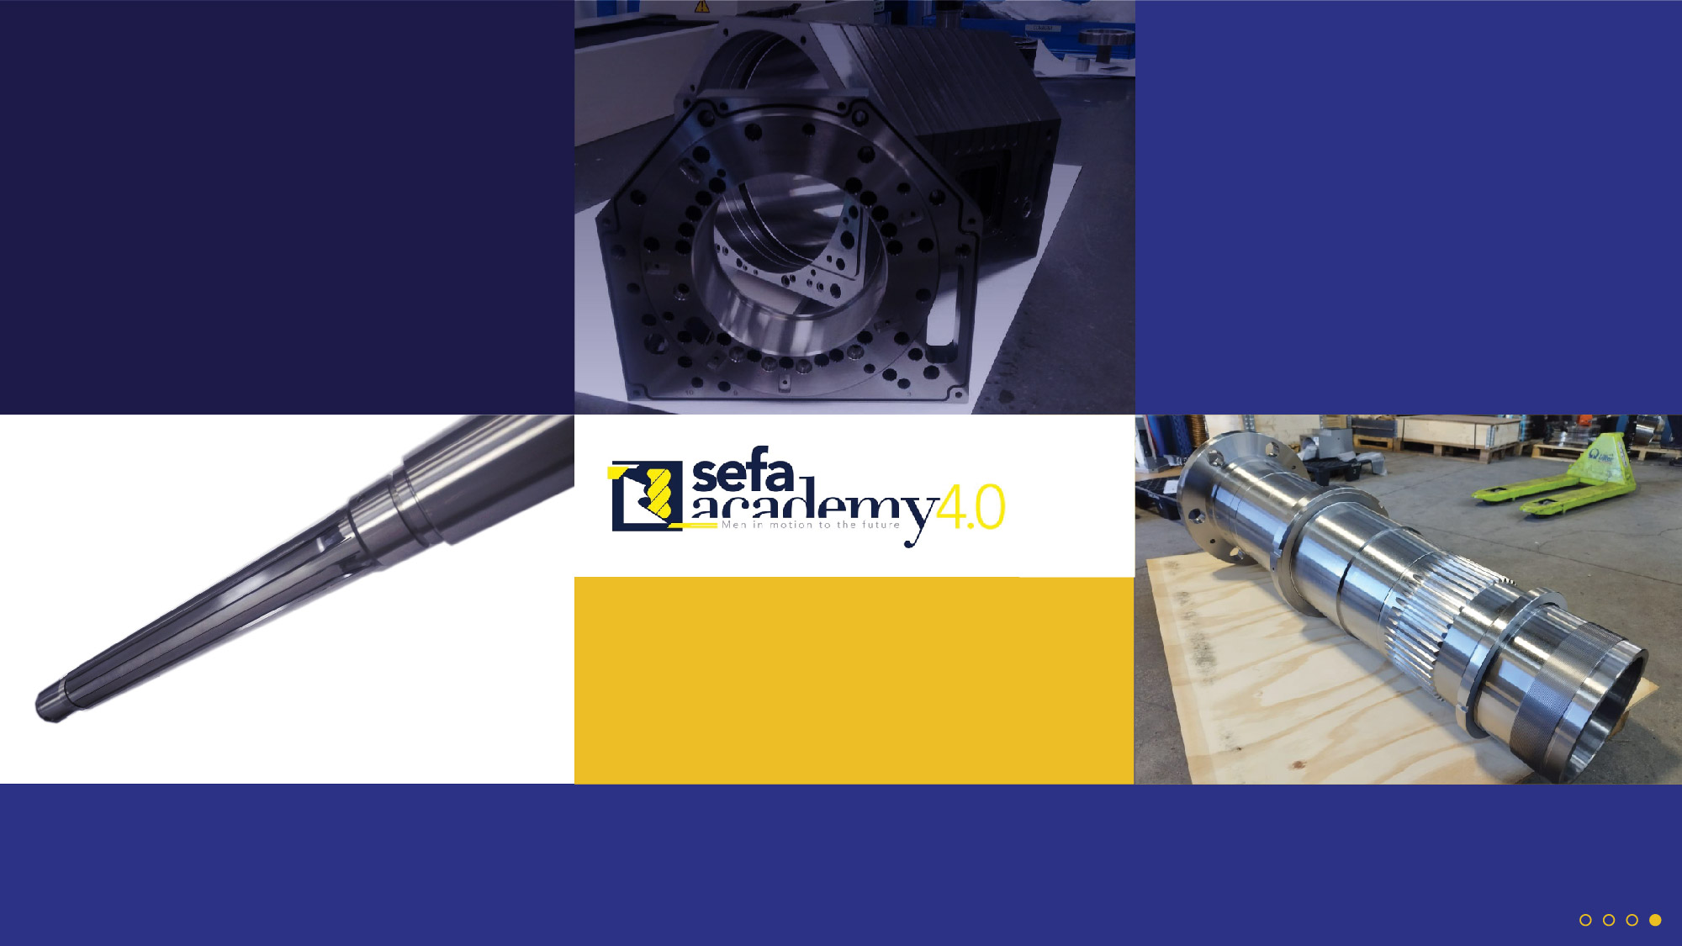
SEFA's evolution is primarily guided by the requirements of its clients. Our commitment to maintaining excellence and our desire for continual improvement are underpinned by our readiness to fulfil any requirements set out by our clients.
SEFA's focus is long-term strategies involving the provision of small production batches with the assembly of key components.
Constantly growing and innovating, SEFA is able to successfully handle any production challenges and always provide the best results possible.
It's true that we rely on a range of high-performance machines, but it's the human touch that is at the forefront of everything we do.
A training centre of excellence, the SEFA Academy works in collaboration with Italy’s Training and Consultancy Centre of the Chamber of Commerce (IFOA), a certifying body, to issue students with "Product and Processes Development Techniques" certification.
Basic and specialist subjects are covered with a focus on safety, with the aim of training professionals who are as skilled as they are meticulous.
It's precisely this continuous growth that has led to the creation of an Academy dedicated to training our
future workforce.
BECAUSE, HERE AT SEFA, WE LOOK TO THE FUTURE

Slide 6

PARCO MACCHINE / MACHINERY
TIPO DI MACCHINA / TYPE OF MACHINE
DESCRIZIONE / DESCRIPTION
CORSE / GUIDES
TORNIO CNC / CNC TURNING MACHINE
TORNIO CNC / CNC TURNING MACHINE
TORNIO CNC / CNC TURNING MACHINE
TORNIO CNC / CNC TURNING MACHINE
TORNIO CNC / CNC TURNING MACHINE
TORNIO CNC / CNC TURNING MACHINE
FRESATRICE CNC / CNC MILLING MACHINE
FRESATRICE CNC / CNC MILLING MACHINE
FRESATRICE CNC / CNC MILLING MACHINE
FRESATRICE CNC / CNC MILLING MACHINE
FRESATRICE CNC / CNC MILLING MACHINE
FRESATRICE CNC / CNC MILLING MACHINE
FRESATRICE CNC / CNC MILLING MACHINE
FRESATRICE CNC / CNC MILLING MACHINE
MULTITASKING CNC / CNC MULTITASKING MACHINE
MULTITASKING CNC / CNC MULTITASKING MACHINE
DOOSAN PUMA V8300M
DOOSAN PUMA 5100 LY
DOOSAN PUMA GT3100
DOOSAN PUMA 3100 LY
DMG NLX 2500
MAZAK VTC 530C 3X
DOOSAN MYNX 7500-II 3X
OKUMA GENOS M660-VE
MAZAK NEXUS 510C 3X
OKUMA MU6300VL 5X
MAZAK VARIAXIS j600 5X
OKUMA MB-5000HII
MAZAK VARIAXIS 730 5X
FRESATRICE CNC / CNC MILLING MACHINE
MAZAK INTEGREX 400 IV
MAZAK INTEGREX 400 IVX 1500U
max Ø830mm; max L=690mm
max Ø650mm; L=2000mm
max Ø480mm; L=750mm
max Ø420mm; max L=1280mm
max Ø400mm; max L=700mm
max Ø380mm; L=575mm
X=1740mm; Y=530mm; Z=510mm
X=1525; Y=770mm; Z=625mm
X=1500mm; Y= 660mm; Z=660mm
X=1050mm; Y=510mm; Z=510mm
X=925mm; Y=1050mm; Z=600mm
X=850mm; Y=660mm; Z=610mm
X=760mm; Y=760mm; Z=810mm
X=730mm; Y=850mm; Z=560
max Ø760 ; max L=1500
max Ø760 ; max L=1500

Slide 7

PARCO MACCHINE / MACHINERY
TIPO DI MACCHINA / TYPE OF MACHINE
DESCRIZIONE / DESCRIPTION
CORSE / GUIDES
MULTITASKING CNC / CNC MULTITASKING MACHINE
MULTITASKING CNC / CNC MULTITASKING MACHINE
2 X RETTIFICA VERTICALE CNC / 2 X VERTICAL CNC GRINDING
RETTIFICA CNC / CNC GRINDING
RETTIFICA CNC / CNC GRINDING
RETTIFICA CNC / CNC GRINDING
RETTIFICA MANUALE / CONVENTIONAL GRINDING MACHINE
RETTIFICA MANUALE / CONVENTIONAL GRINDING MACHINE
RETTIFICA MANUALE / CONVENTIONAL GRINDING MACHINE
RETTIFICA MANUALE / CONVENTIONAL GRINDING MACHINE
RETTIFICA TANGENZIALE CNC / CNC FLAT GRINDING MACHINE
RETTIFICA TANGENZIALE CNC / CNC FLAT GRINDING MACHINE
AFFILATRICE / SHARPERNING GRINDING MACHINE
ELETTROEROSIONE / EDM
ELETTROEROSIONE / EDM
ELETTROEROSIONE / EDM
MAZAK INTEGREX 400IS
OKUMA MULTUS B400II 2000 4.0
MAS VGM
TACCHELLA ELEKTRA PLUS 1523
STUDER S33
STUDER S30 LEAN PRO
GIORIA RHN 1000
TACCHELLA 1018U
TACCHELLA R3
TACCHELLA 1018UM
ZIERSCH ZT612
ROSA ERMANDO LR16
MAJEVICA OM 600 / TACCHELLA
MITSUBISHI MV 2400 R
AGIE PROGRESS 2
AGIE TUFFO MONDO STAR 50
max Ø760 ; max L=1500
max Ø710mm; max L=2000
max Ø1250mm; max H=700mm
max Ø450mm; max L=1500mm
maxØ300; max L=1000mm
max Ø300; max L=300mm
max Ø330mm; max L=1000mm
max Ø360mm; L=1000mm
X=430mm; Y=220mm; Z=350mm
max Ø360mm; L=1000mm
X=1000mm; Y=600mm; Z=600mm
X=1650mm; Y=720mm; Z=550mm
X=400mm; Y=300mm; Z=300mm
X=600mm; Y=400mm; Z=425mm
X=350mm; Y=250mm; Z=250mm
X=500mm; Y=350mm; Z=350mm

Slide 8

PARCO MACCHINE / MACHINERY
TIPO DI MACCHINA / TYPE OF MACHINE
DESCRIZIONE / DESCRIPTION
CORSE / GUIDES
EDM MICROFORATRICE / EDM DRILLING MACHINE
4 X TORNIO MANUALE / CONVENTIONAL TURNING MACHINE
4 X FRESATRICE MANUALE / CONVENTIONAL MILLING MACHINE
OCEAN RIVER 35HP1 / MICRO EDM DRILLING
OMG ZANOLETTI / CMT URSUS HP300 / CMT URSUS HP200 / CASTOR 255VS
ITAMA FV15 VS / BONZA IT 2 VS / BONZA IT 2 VS / WIKERS PBM-4VS
X=350mm; Y=250mm; Z=330mm
max Ø600mm; max L=1500mm
X=730mm; Y=300mm; Z=400mm
MACCHINE DI MISURA / MEASURING MACHINES
MACCHINA DI MISURA 3D / 3X 3D MEASURING MACHINE
MACCHINA DI MISURA 3D / 3X 3D MEASURING MACHINE
MACCHINA DI MISURA 3D / 3X 3D MEASURING MACHINE
3D ROTONDIMETRO / 2X 3D ROUNDNESS MEASURING MACHINE
3D ROTONDIMETRO / 2X 3D ROUNDNESS MEASURING MACHINE
RUGOSIMETRO/ ROUGHNESS TESTER
PROIETTORE DI PROFILI / MEASUREMENT PROJECTOR
COMPUTER DI MISURA COMPATTO / COMPACT GAUGING COMPUTER
9 X TESA ALTIMETRO / 9 X TESA HEIGHT GAUGES
3D ZEISS PRISMO ULTRA
3D MITUTOYO CRYSTA-APEX EURO C
3D MITUTOYO CRT-AS7106
MARFORM MMQ 400
MIYUTOYO ROUNDTEST RA-120
MAHR SURFACE TESTER SURFTEST
MITUTOYO PROFILE PROJECTOR
NEMO MARPOSS FOR CONE
TESA MICRO-HITE
X=900mm; Y=1300mm; Z=650mm
X=280mm; Z=900; Axial run-out 0,0002
TYPE: SJ-201
TYPE: PH-A14
DIN 69893 E DIN ISO 7388-1
MICRO-HITE 600 manual

Slide 9



SEFA S.r.l.
Via degli Scalpellini, 9 / 70056 Molfetta (Ba) / Italy
www.officinesefa.it/ info@sefaweb.it
t. 080 337 5025 / 080 338 2389 / fx. 080 338 2316
PEC: sefasrl@pec.sefaweb.it

