Slide 1

ASSEMBLY SERVICES & GRAVITY CASTING FOUNDRY

Slide 2
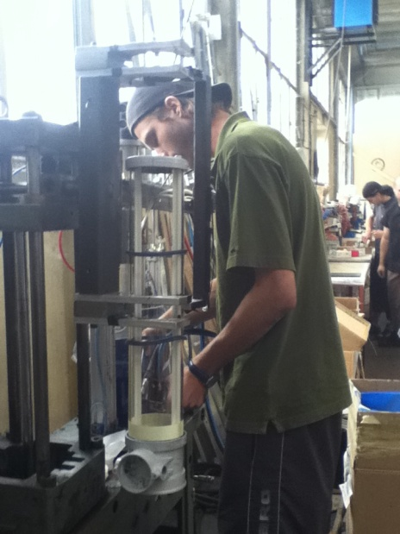
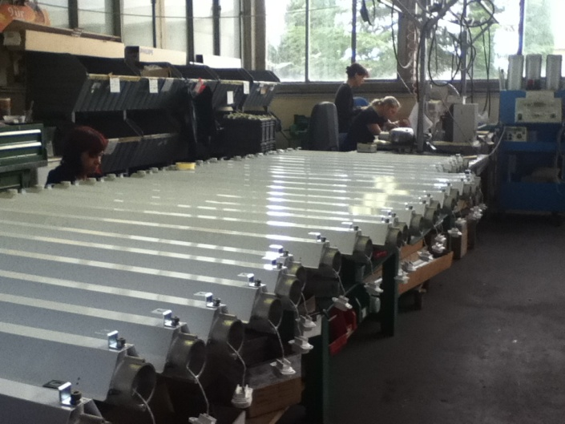
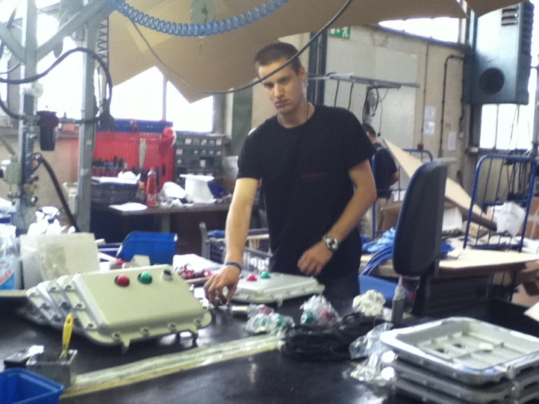
LIGHTING ASSEMBLY LINE
For our customers we assembly:
  Industrial lighting
  Atex lighting
  Indoor and outdoor lighting
  Special pourpose lighting

Slide 3
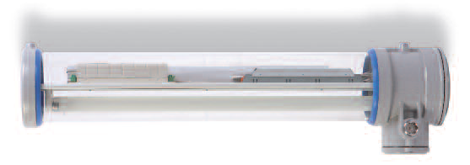
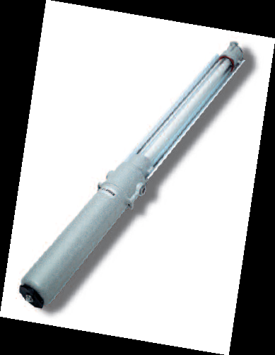
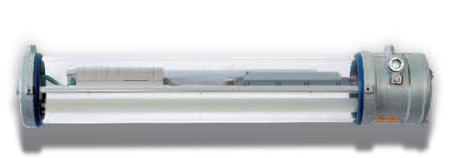
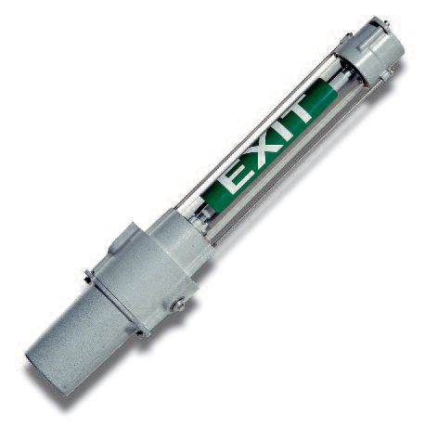
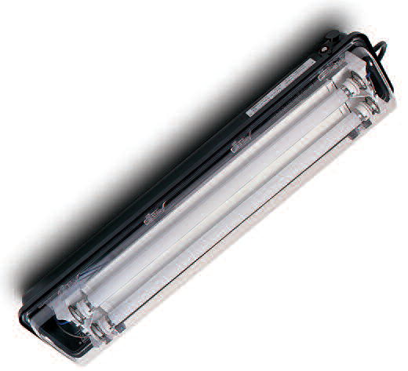
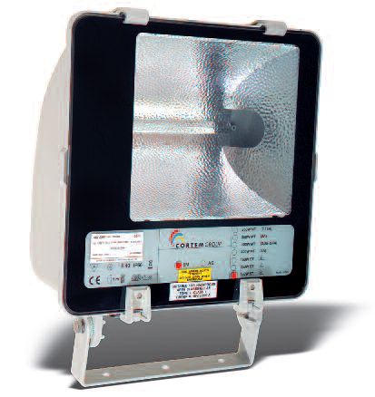
Products:

Slide 4
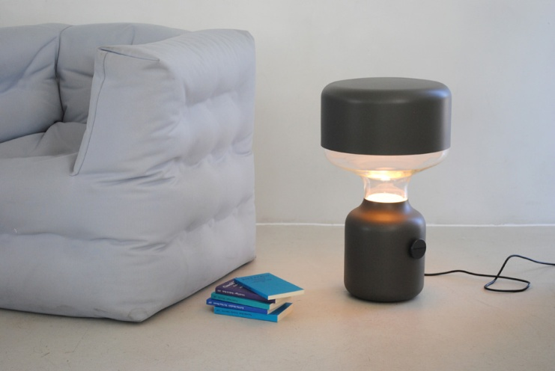
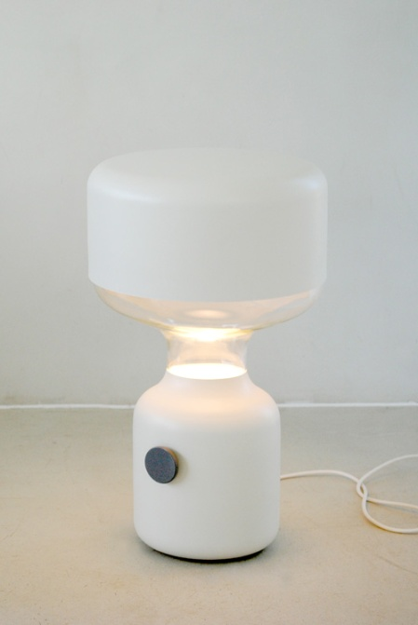
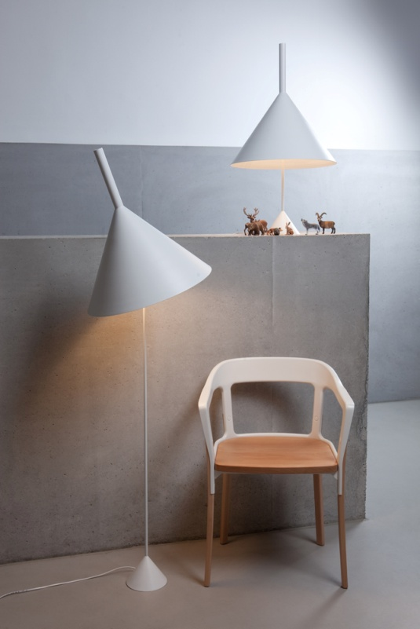
PRODUCTS:

Slide 5
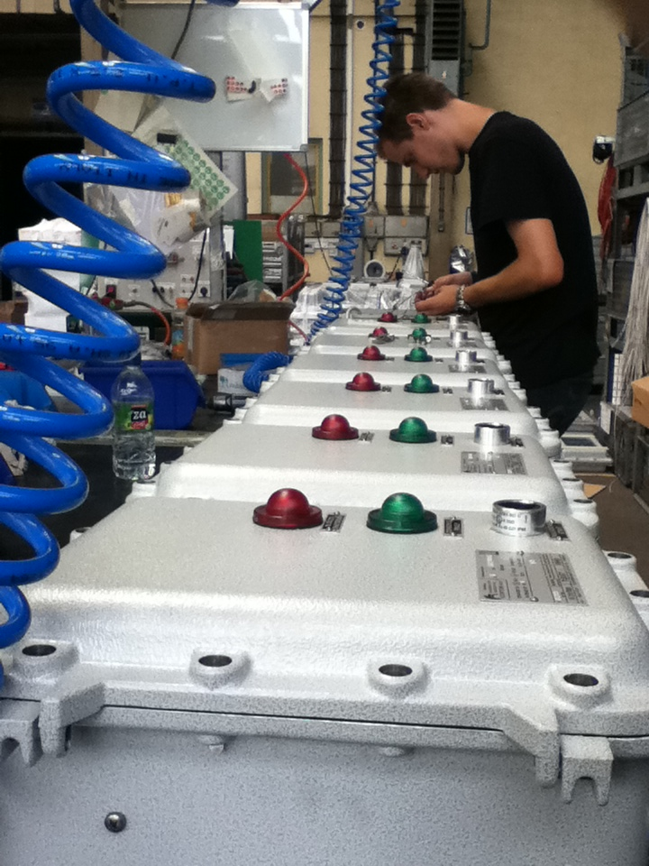
references
CORTEM GROUP S.P.A.
INTRA LIGHTING D.O.O.
FENEX SRL – Bartec group
VERTIGO BIRD D.O.O.

Slide 6
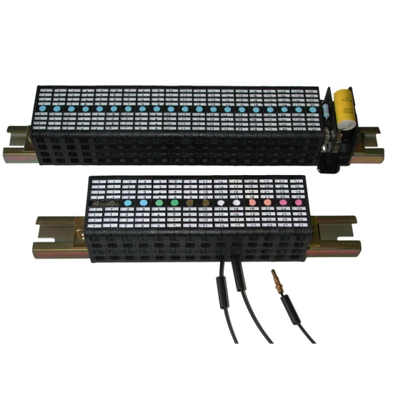
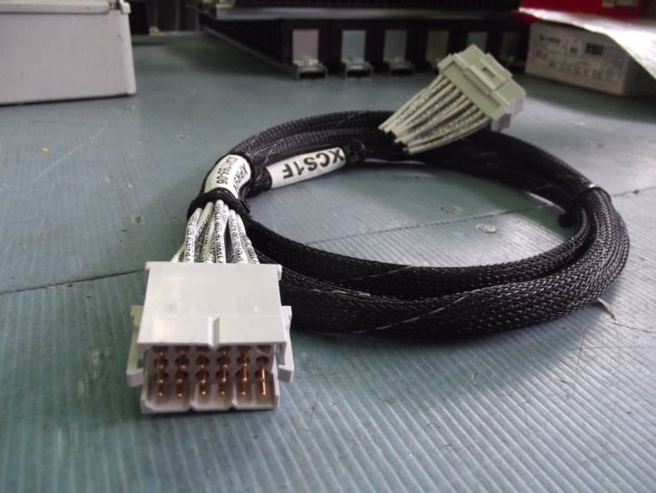
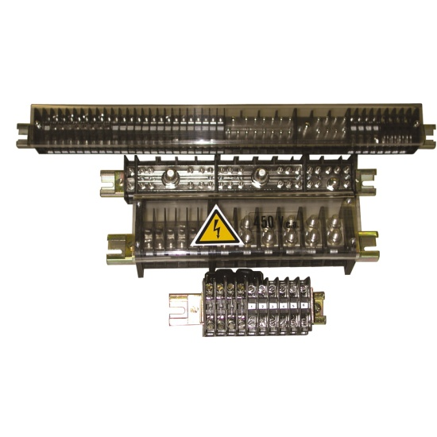
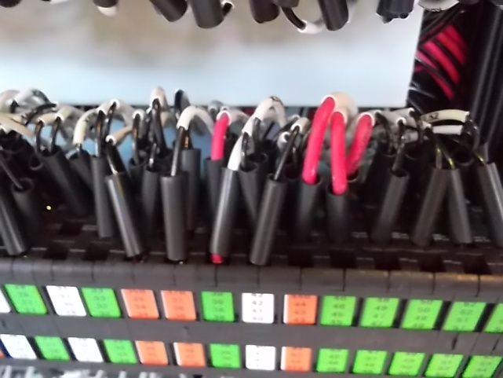
RAILWAY ASSEMBLY LINE
integrated driver desks, control panels and components for trains

Slide 7
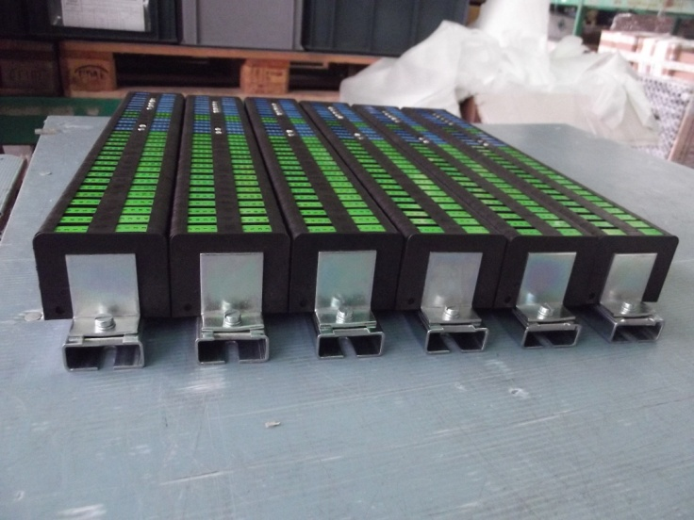
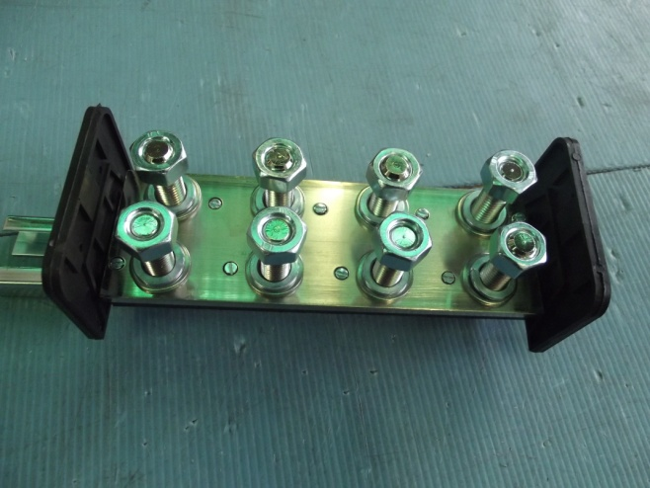
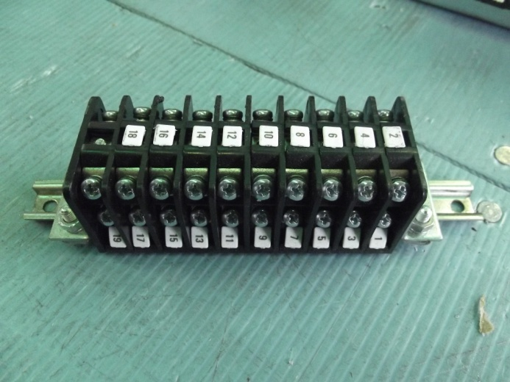
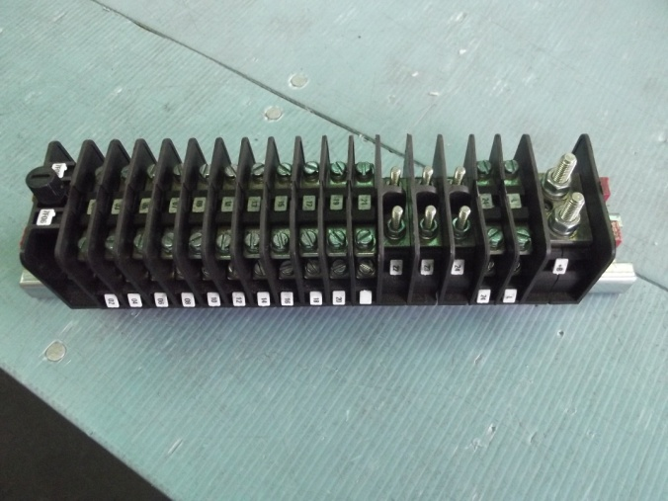
Terminal boards

Slide 8
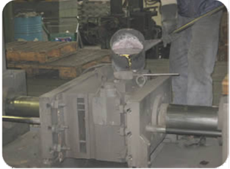
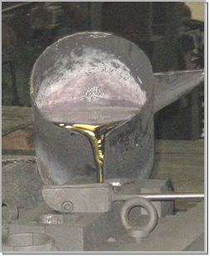
FOUNDRY DIVISION
Fimtech is specialised in casting of aluminium components, using the automatic PLC gravity casting technology, with full respect of customers’ needs and quality standards. Three various-sized casting machines allow us to produce different types of castings in shape and weight, from 0,1 – 5 kg. The materials used are EN certified primary or secondary aluminium alloys, currently available on the market.

Slide 9
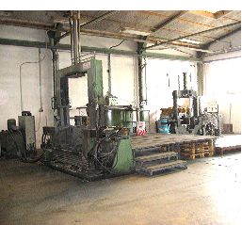
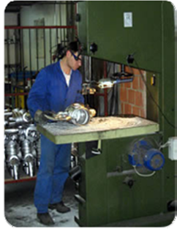
Technology
1 Pour casting machine with 8+1 movements (platens 350 x 700 mm)
2 Pour casting machines with 4+1 movements (platens 300 x 600 mm)
1 Electric holding furnace with constant digital temperature control – 300 kg
1 Electric holding furnace with constant digital temperature control – 600 kg
In addition, FIMTECH has developed a comprehensive range of services;
processing of castings at the CNC automatic lathe and processing centres
“powder coating” surface treatment

Slide 10
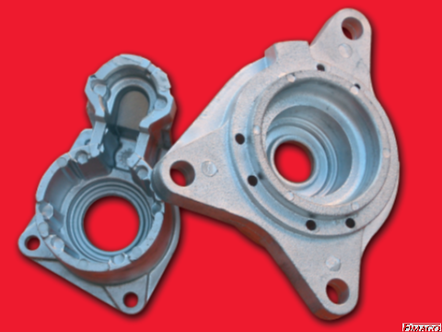
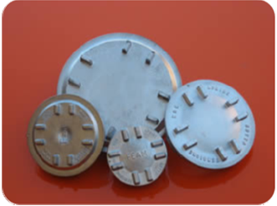
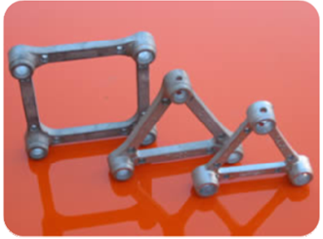
Products:

Slide 11
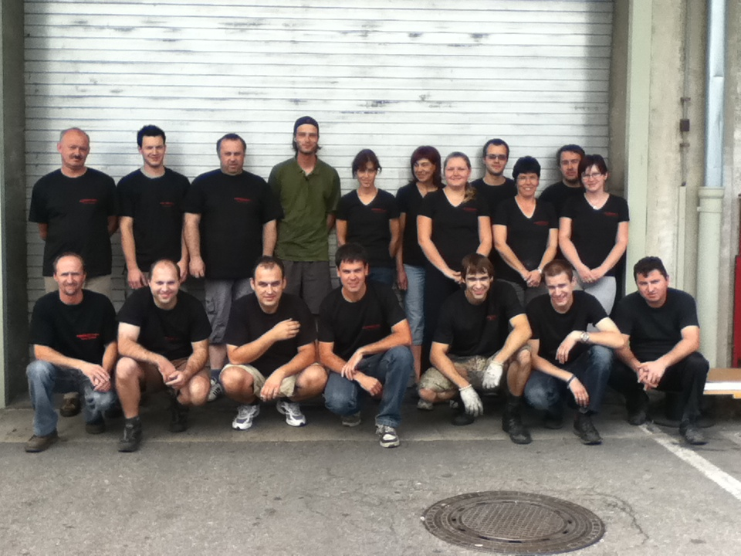
Location:
Nova Gorica, Slovenia
    Production unit: 1000 m2
    15 specialised employes

Slide 12
Location:
Vipavska 68
SI-5000 Nova Gorica
Tel: 003865 9931077
00386 31 365334
E-Mail: Fimtech@siol.net
www.fimtech.si

