Slide 1
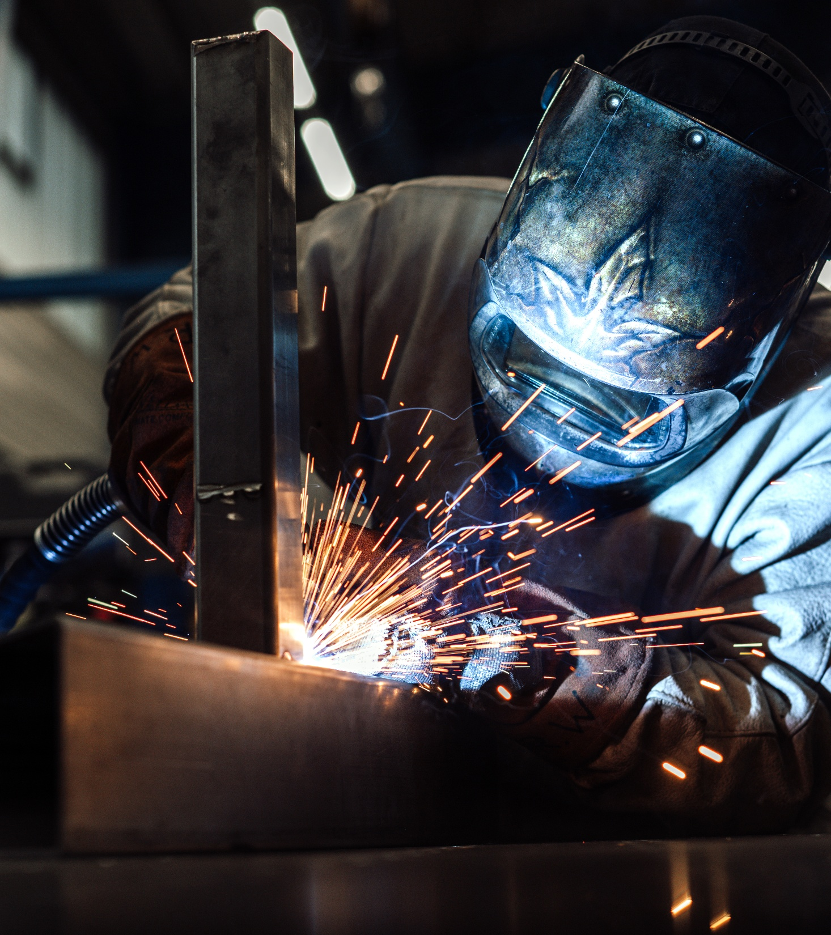
metal in top form
Woll.
Slide is saved in the SlideLizard CREATOR library
This message is for information purposes only.
It's not visible while presenting.
Deleting it does NOT remove the slide from the library.
SHEET METAL, TUBE AND PROFILE PROCESSING / WELDING /
CNC-PROCESSING

Slide 2
100 % EXPERTISE
AND PRECISION
Slide is saved in the SlideLizard CREATOR library
This message is for information purposes only.
It's not visible while presenting.
Deleting it does NOT remove the slide from the library.
  HEADQUARTERS
  SAARBRÜCKEN
  + SITE
  Östringen / BAWÜ
TAILOR-MADE
INTELLIGENT, WORLDWIDE
SPECIAL MACHINE ENGINEERING
AUTOMATION TECHNOLOGY
PROCESS ENGINEERING
1960
FOUNDED
70
MILLIONS €
TURNOVER PER YEAR
430
EMPLOYEES
19.750
SQUARE METERS OF ASSEMBLY
& MANUFACTURING AREA
Starting as a small locksmith‘s shop in a garage in Saarbrücken, Germany, WOLL has been family-owned for over 60 years and has always focused on manufacturing good, reliable products. Today, the WOLL.Group brings together three specialized divisions at two locations in Germany: Automation, Manufacturing, and Semicon.

Slide 3
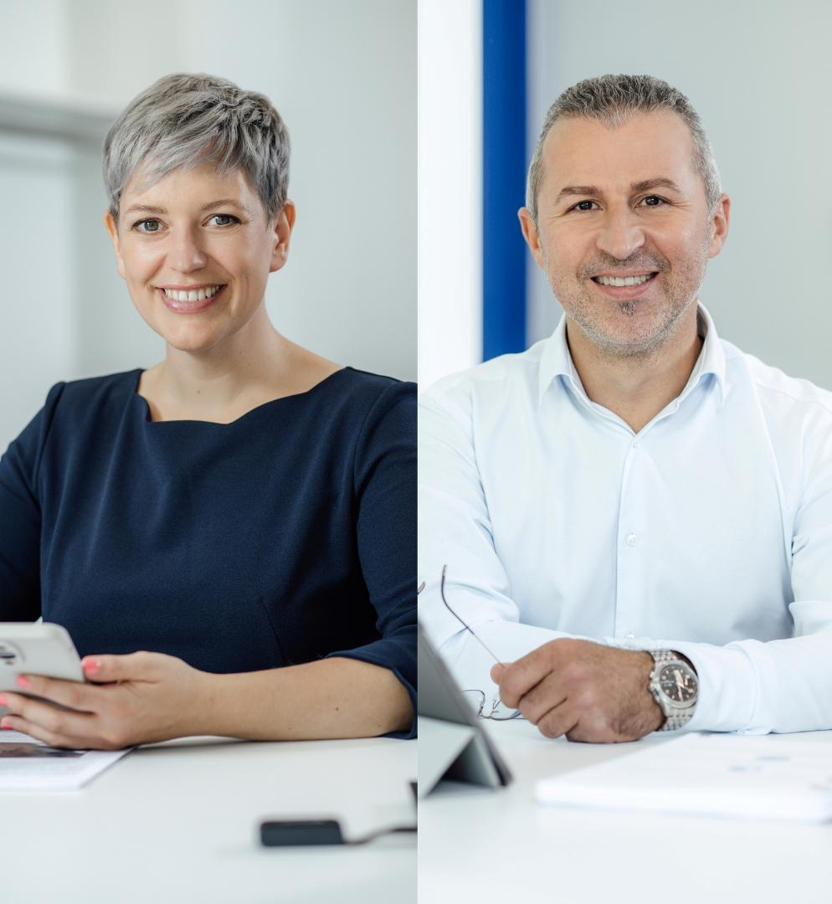
WE UNDERSTAND WHAT DRIVES OUR CUSTOMERS, AND WE DO EVERYTHING WE CAN TO TURN THEIR VISIONS INTO REALITY.
Slide is saved in the SlideLizard CREATOR library
This message is for information purposes only.
It's not visible while presenting.
Deleting it does NOT remove the slide from the library.
Christina Woll & David Seiler
Geschäftsführung

Slide 4
YOUR COMPLETE SOLUTION
IN METALWORKING:
FROM THE IDEA TO
IMPLEMENTATION.
Slide is saved in the SlideLizard CREATOR library
This message is for information purposes only.
It's not visible while presenting.
Deleting it does NOT remove the slide from the library.
Everything from a single source

Slide 5
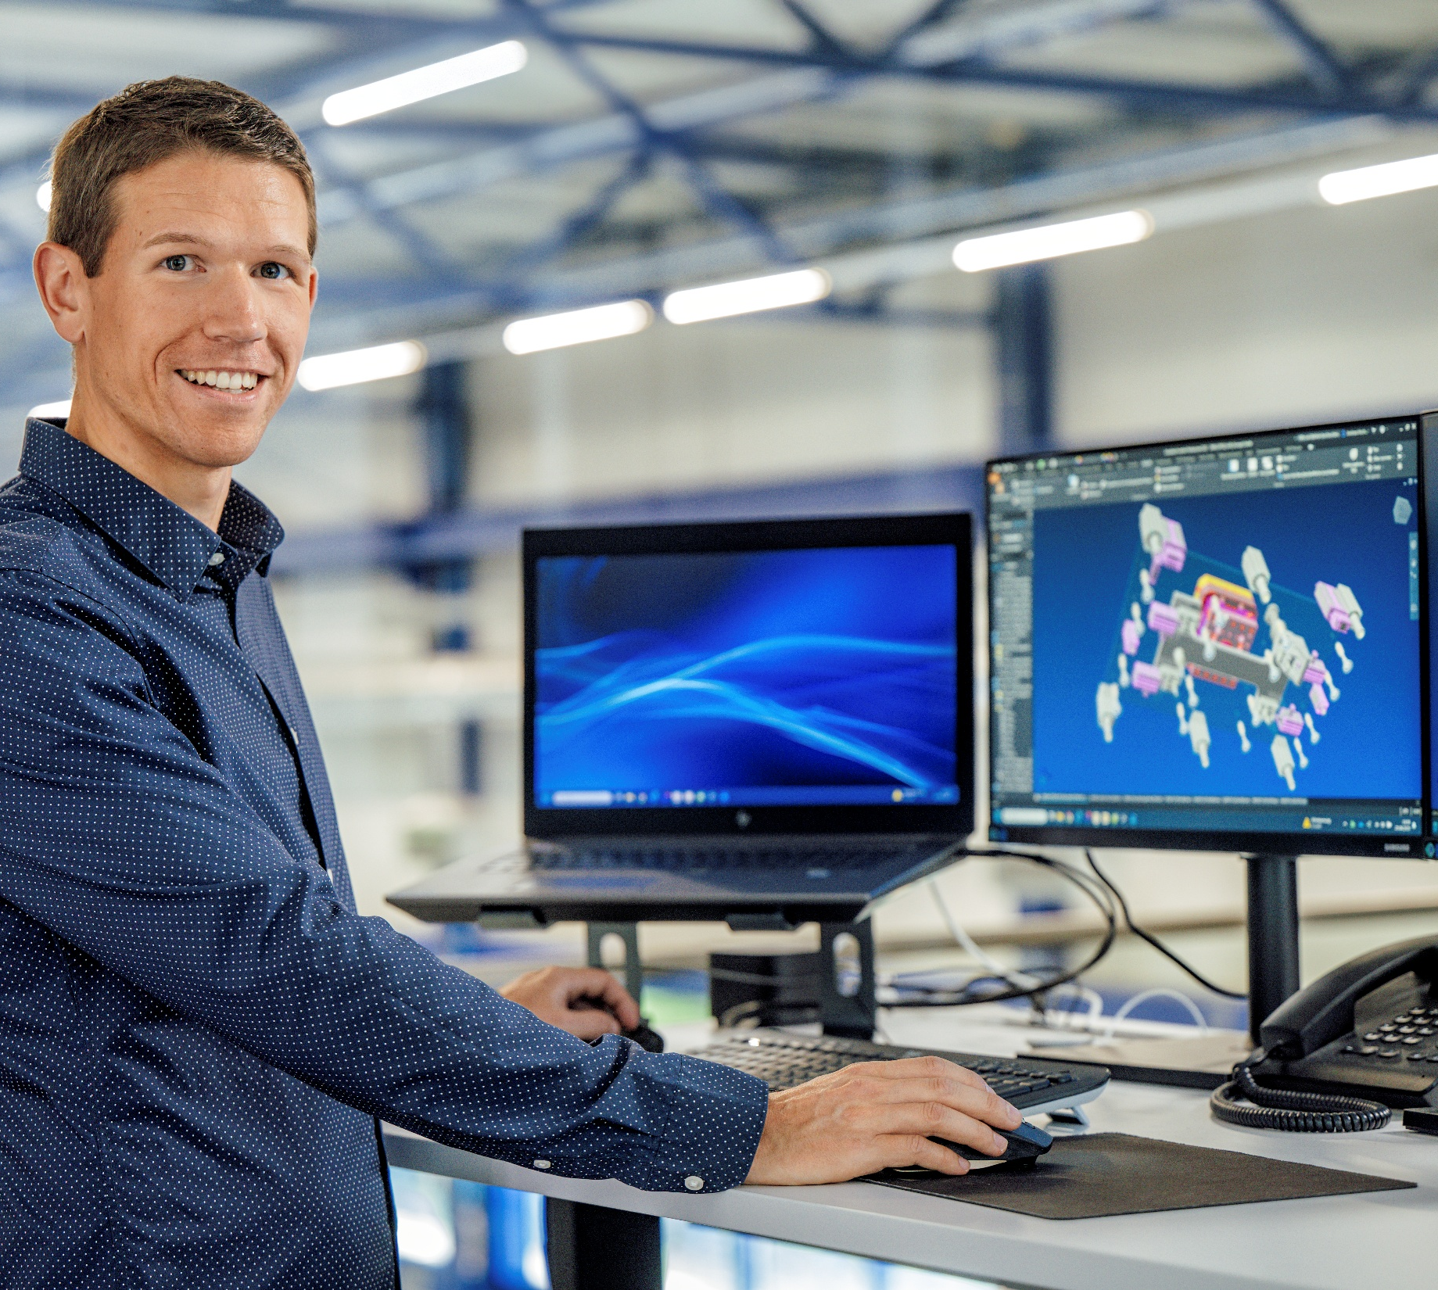
design
Slide is saved in the SlideLizard CREATOR library
This message is for information purposes only.
It's not visible while presenting.
Deleting it does NOT remove the slide from the library.
70 employees
Mechanical design in accordance with CE,
UL & customer guidelines
Various CAD systems, e.g. lnventor 2 D / 3 D
Development and production of prototypes and
small series

Slide 6
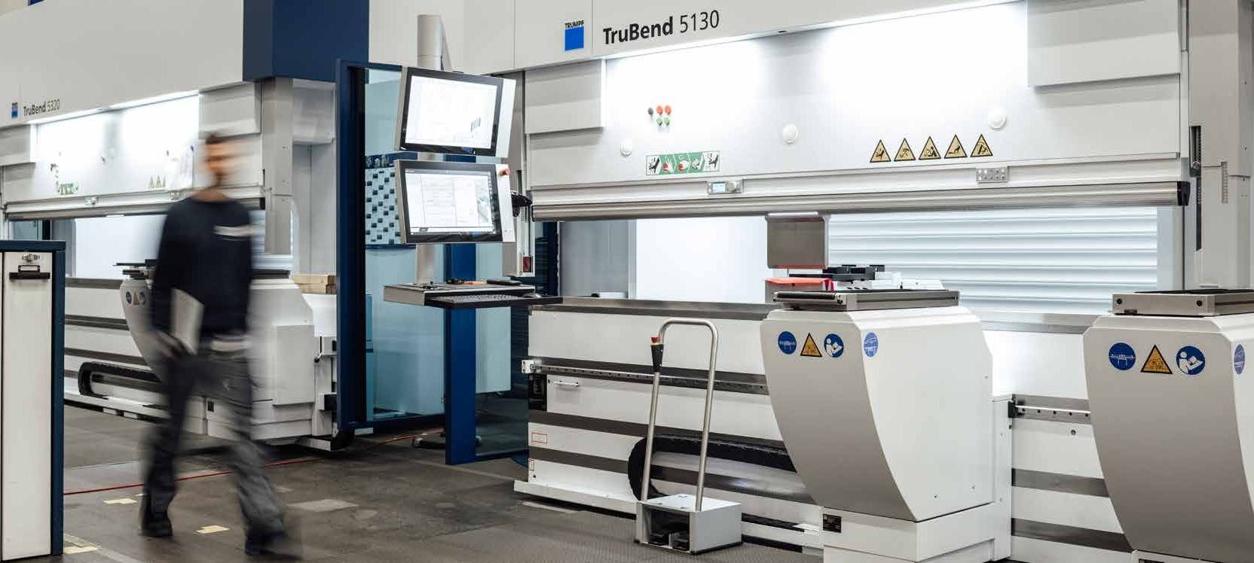
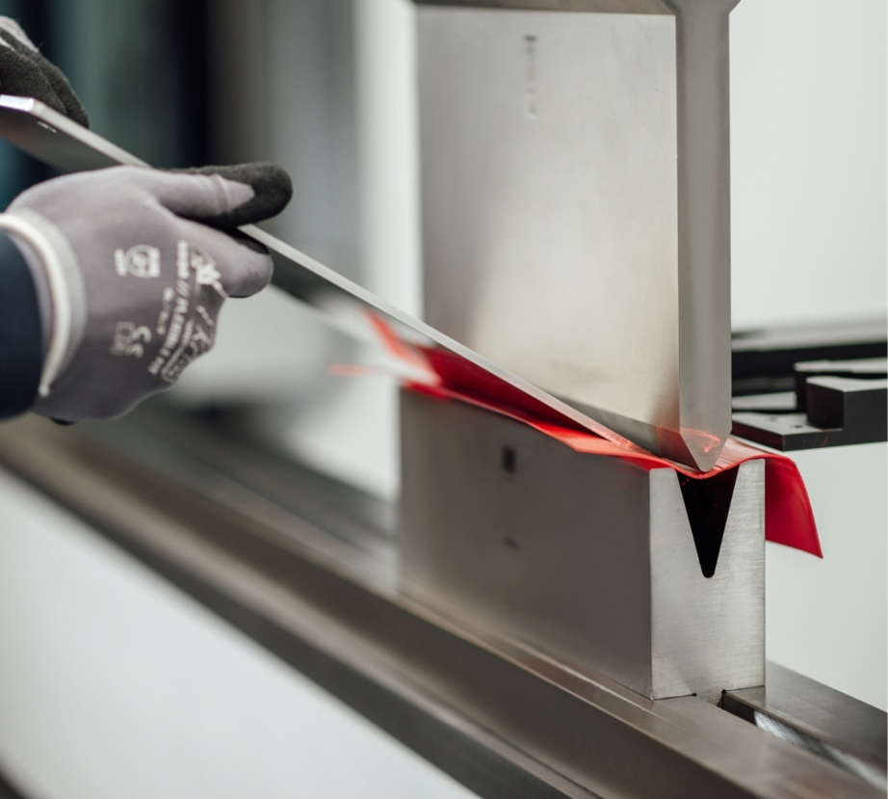
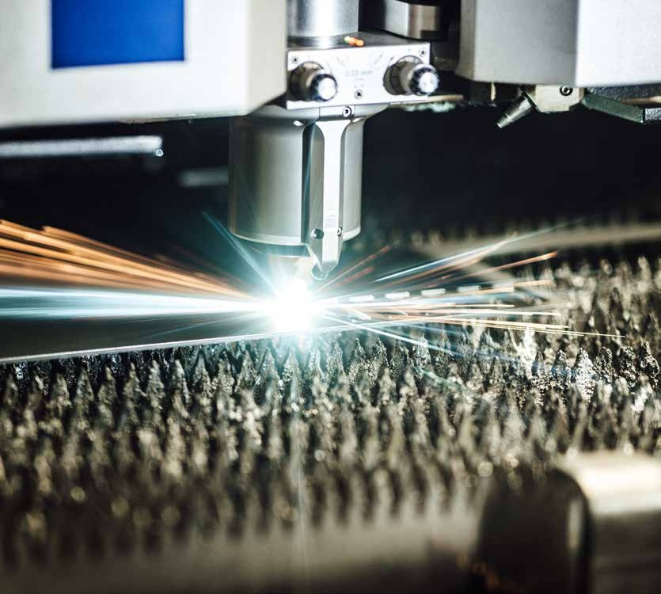
sheet metal processing
Slide is saved in the SlideLizard CREATOR library
This message is for information purposes only.
It's not visible while presenting.
Deleting it does NOT remove the slide from the library.
Laser cutting
2 x TruLaser 3040
Folding & bending
2 x Trubend 5320
1 x Trubend 7050
1 x Trubend 5130
Bending length: 4,000 mm
Sheet thicknesses: 0.5 - 20 mm
Deburring
Maximum sheet width: 1.500 mm
Minimum sheet metal part size: 20 x 20 mm
Benefit from our extensive, in-house stock. This allows us to
offer flexible and fast delivery times.

Slide 7
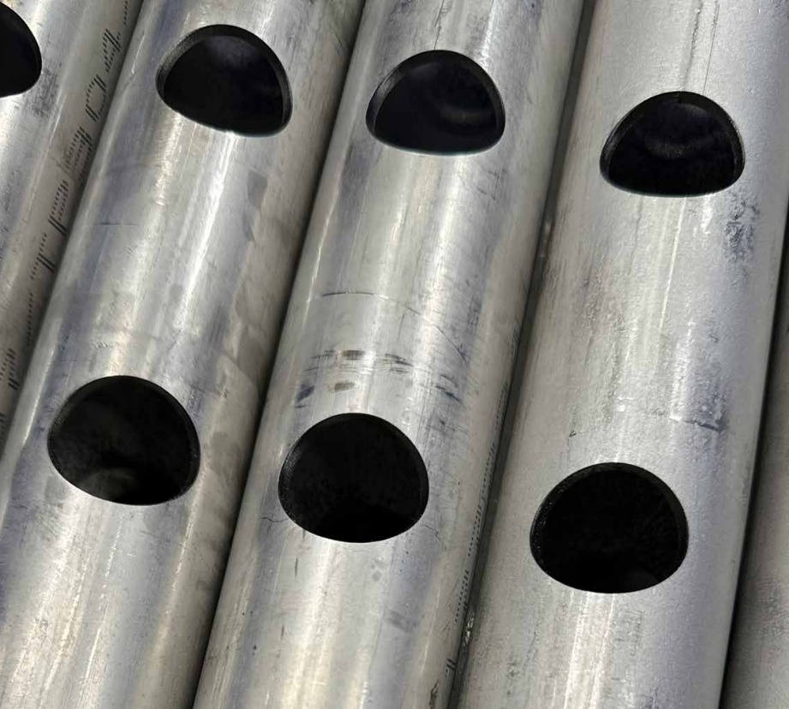
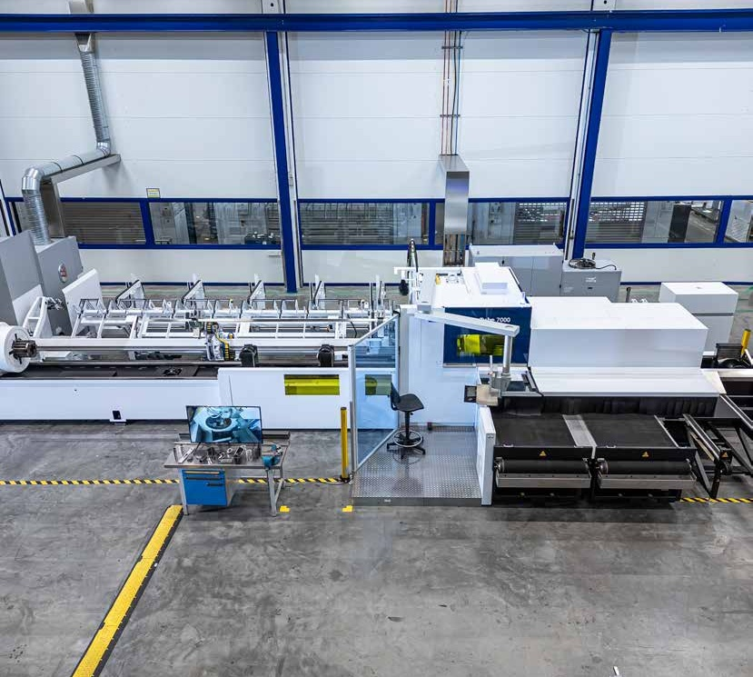
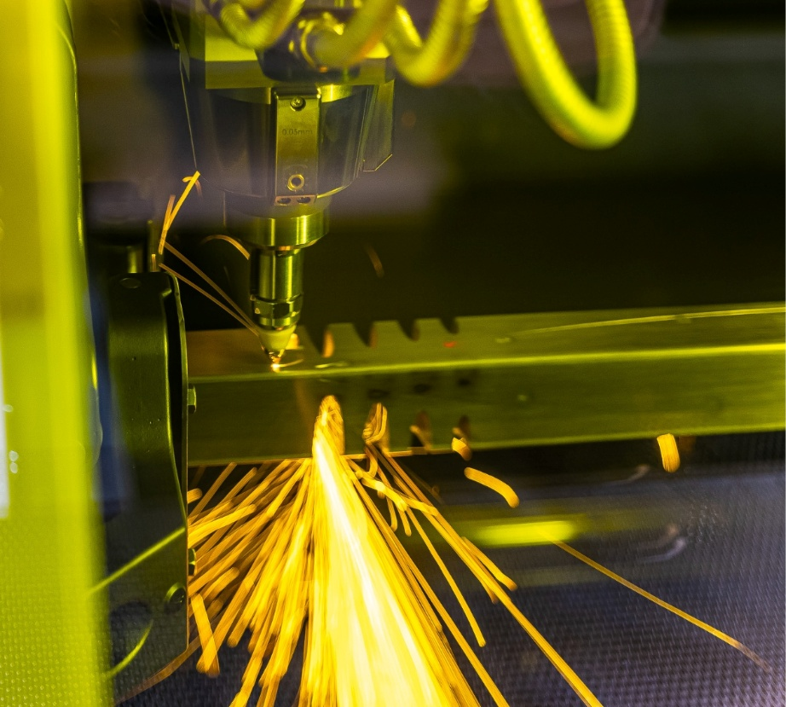
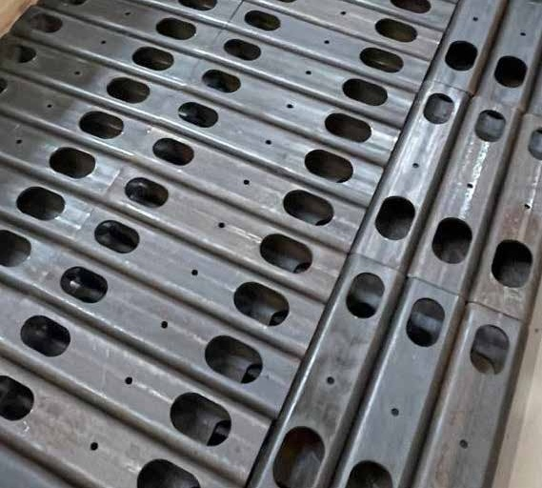
Tube and profile processing
Slide is saved in the SlideLizard CREATOR library
This message is for information purposes only.
It's not visible while presenting.
Deleting it does NOT remove the slide from the library.
Tube laser TruLaser Tube 7000
Clean cuts = minimal post-processing
Maximum cost savings
Minimal material usage
Repeat accuracy
New design options / joining geometries

Slide 8
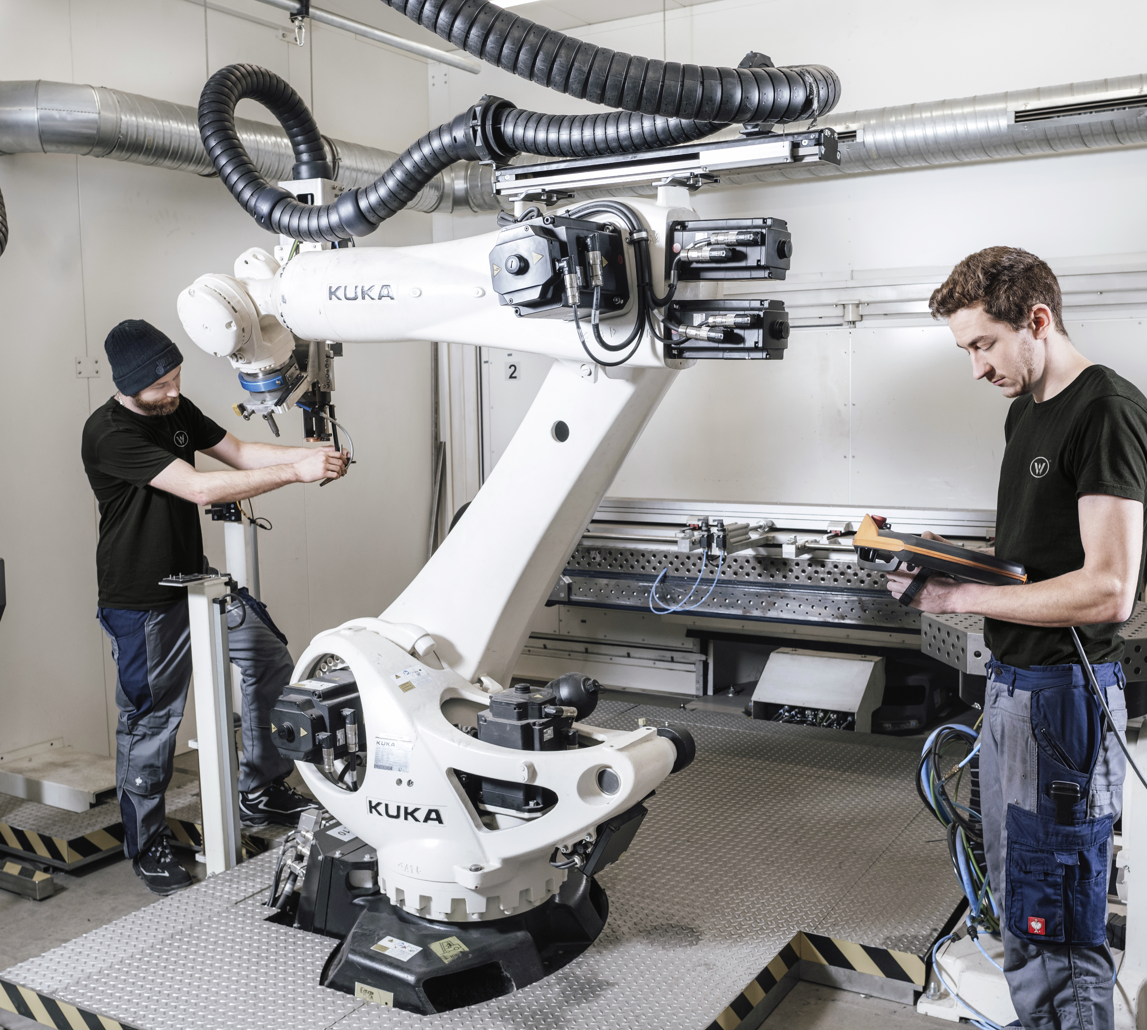
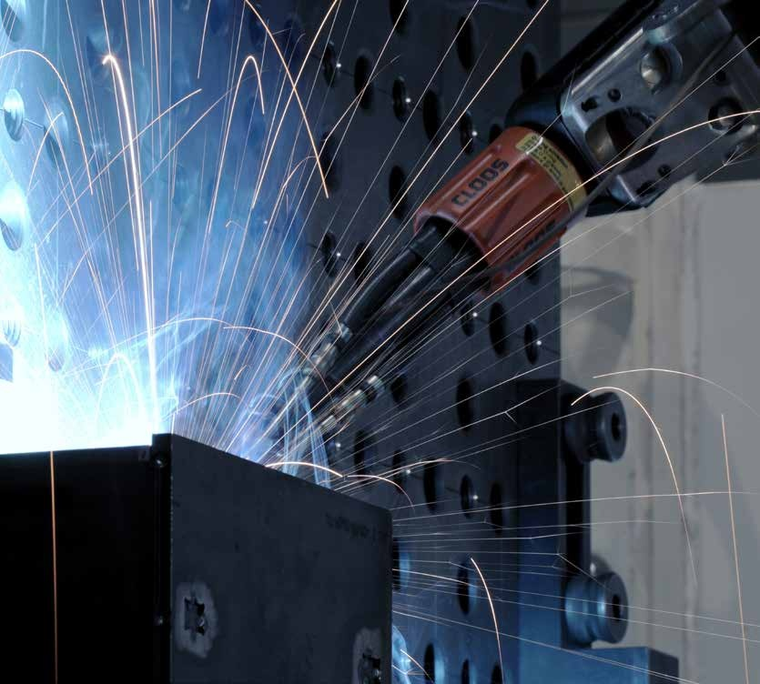
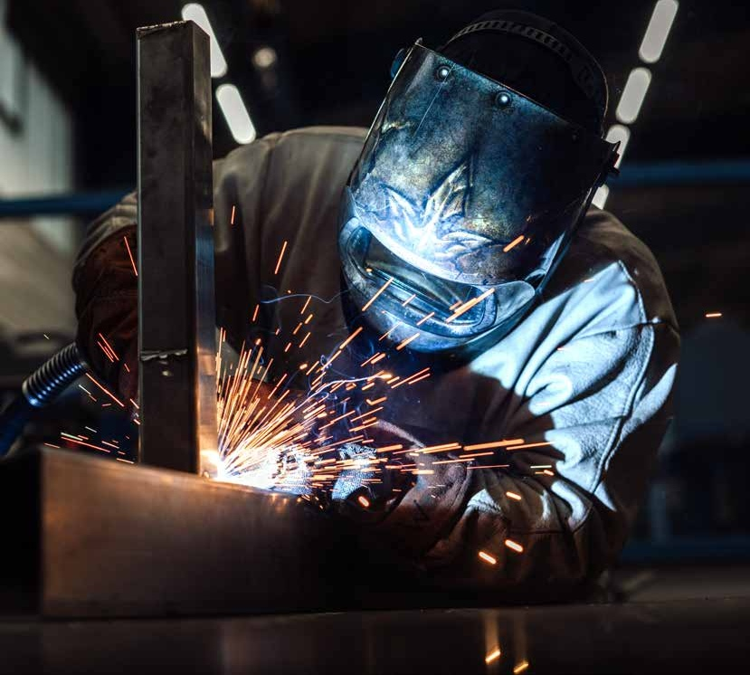
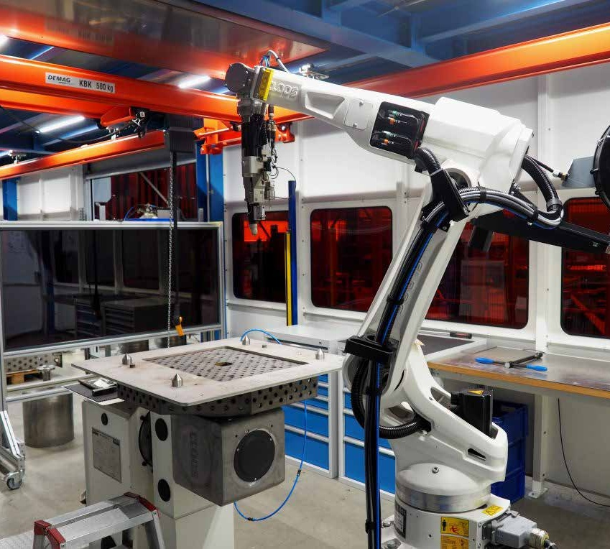
welding
Slide is saved in the SlideLizard CREATOR library
This message is for information purposes only.
It's not visible while presenting.
Deleting it does NOT remove the slide from the library.
Laser welding
automated
Plasma welding
automated
TIG welding
manual, orbital & automated
MIG/MAG welding
manual & automated
DIN EN ISO 3834 2 | AD 2000 MERKBLATT HP0
DIN EN 1090 2 EXC3 | DIN EN 1090 3 EXC2 |
DIN EN 15085 2 CL1 | Certificate of professional competence
Water Resources Act | DVS corporate membership

Slide 9
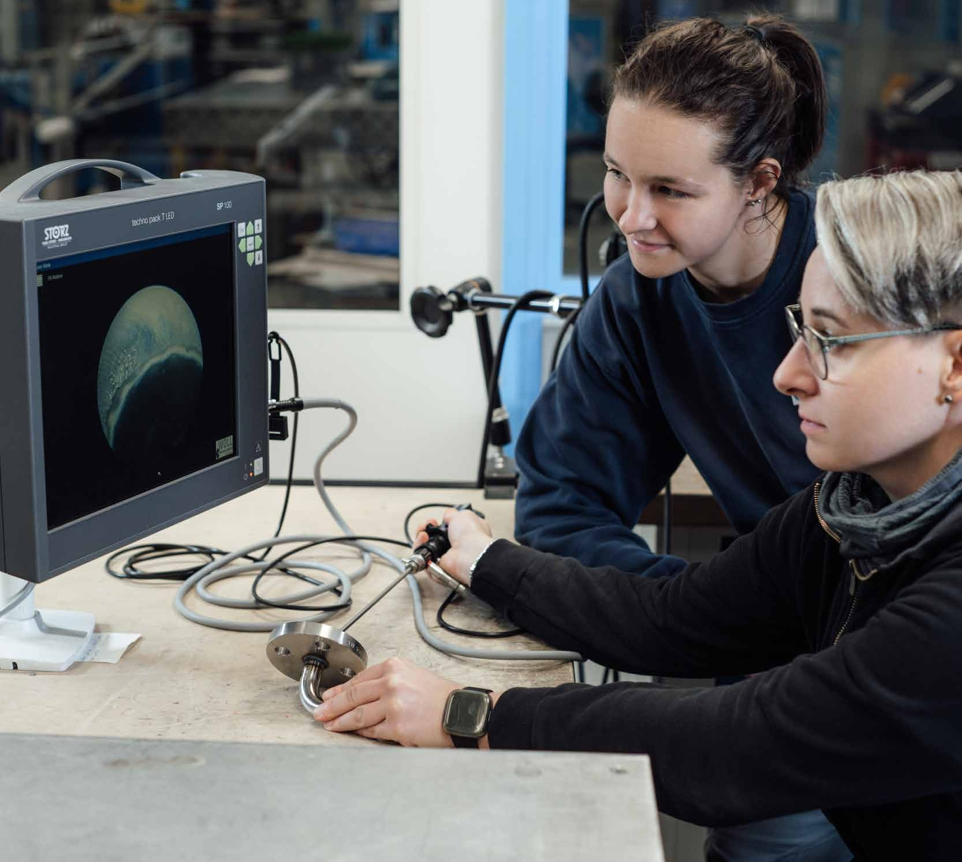
Non-destructive testing
Slide is saved in the SlideLizard CREATOR library
This message is for information purposes only.
It's not visible while presenting.
Deleting it does NOT remove the slide from the library.
Visual inspection
according to DIN EN ISO 17637 (VT 2)
Dye penetrant testing
according to DIN EN ISO 3452 (PT 2)
Magnetic particle testing
according to DIN EN ISO 17638 (MT 2)
Leak test (pressure or vacuum test)
Hardness test with Sonodur3
Grinding preparation

Slide 10
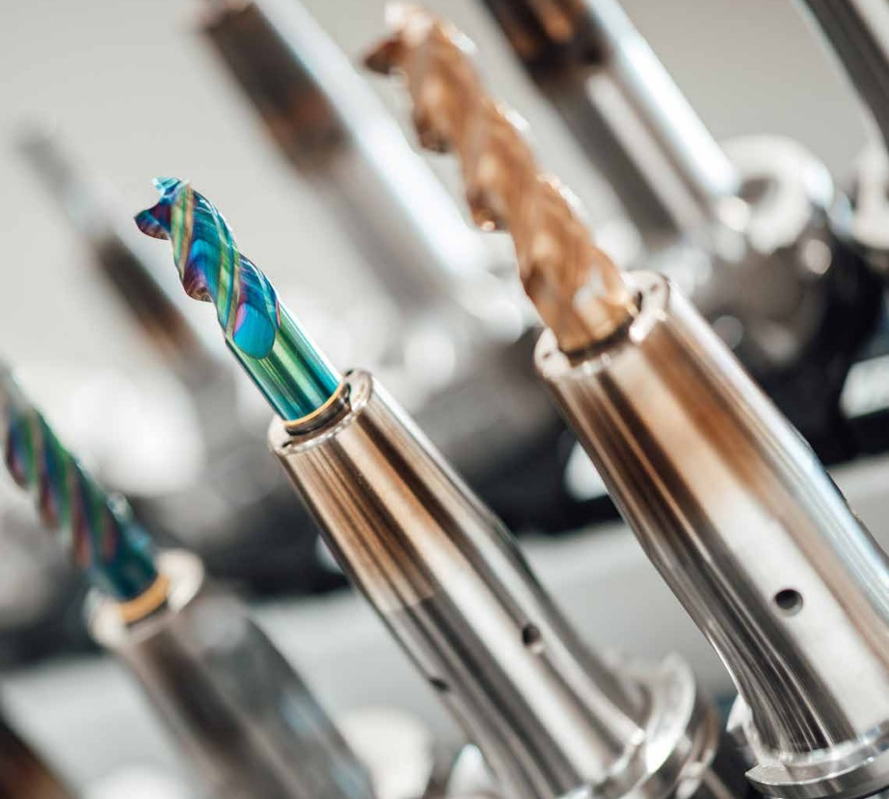
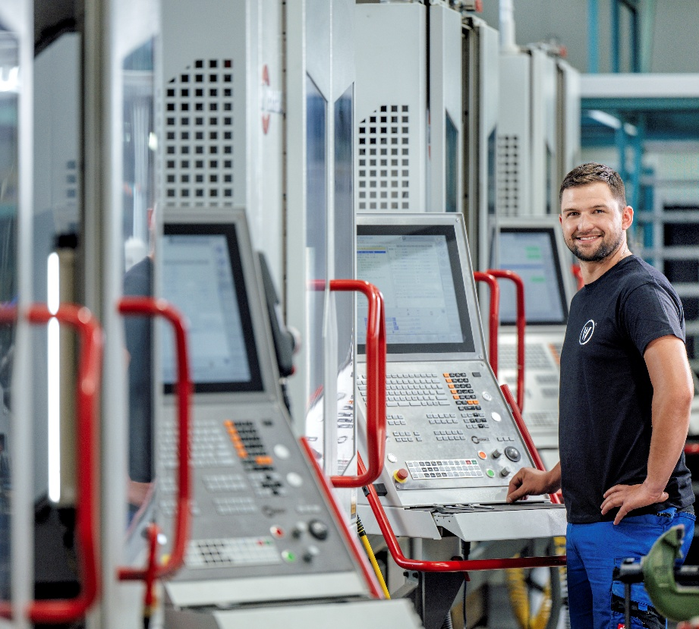
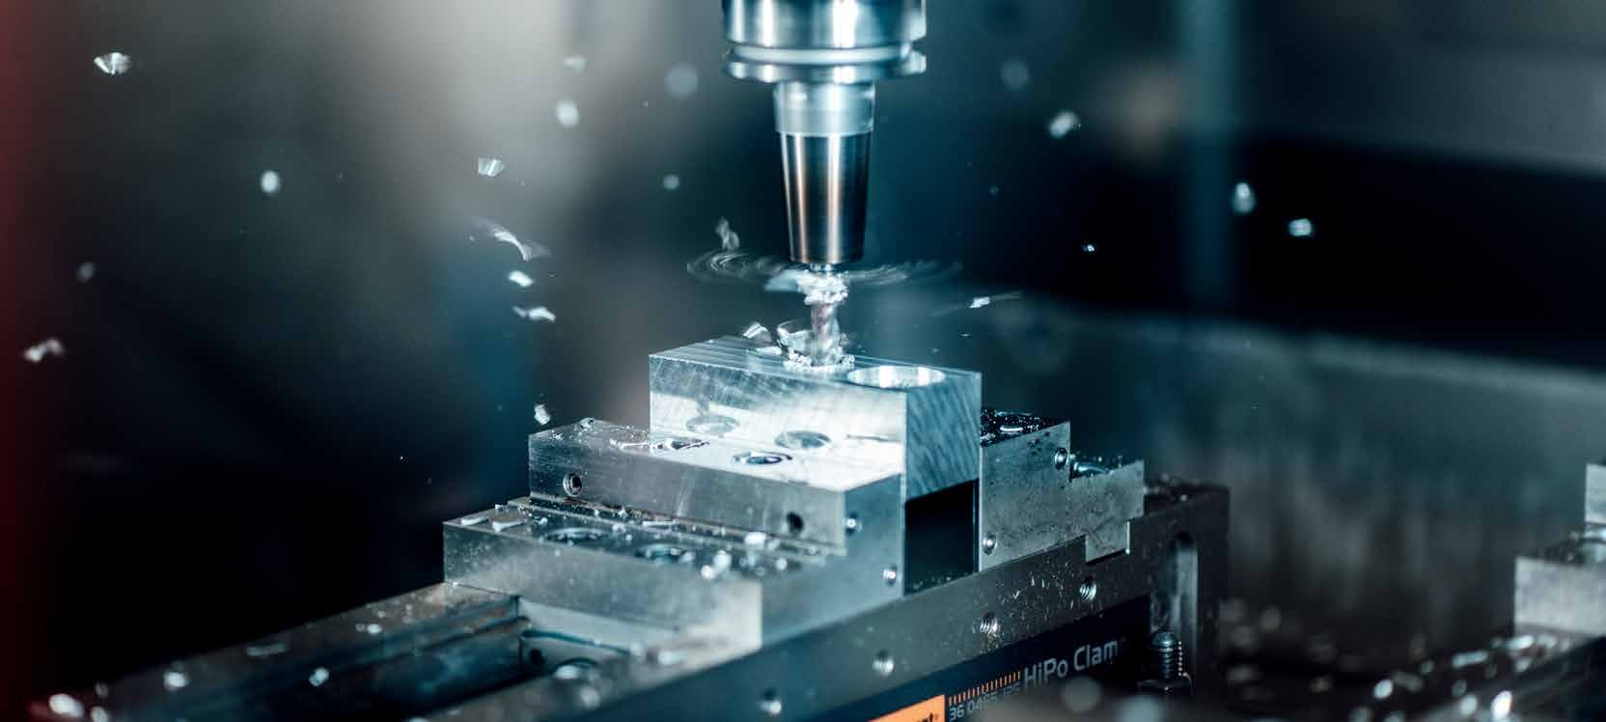
CNC machining
Slide is saved in the SlideLizard CREATOR library
This message is for information purposes only.
It's not visible while presenting.
Deleting it does NOT remove the slide from the library.
Milling machines, including
4 x Hermle C400
1 x Hermle U1130 5-axis
1 x MAHO MH600E
Lathes, including
2 x DMT Kern CD480 (center length 1000 +
1500 mm)
1 x DMT Kern CD650 (center length 3000 mm)
Surface grinding
Drilling machines
Band sawing machines
Labeling

Slide 11
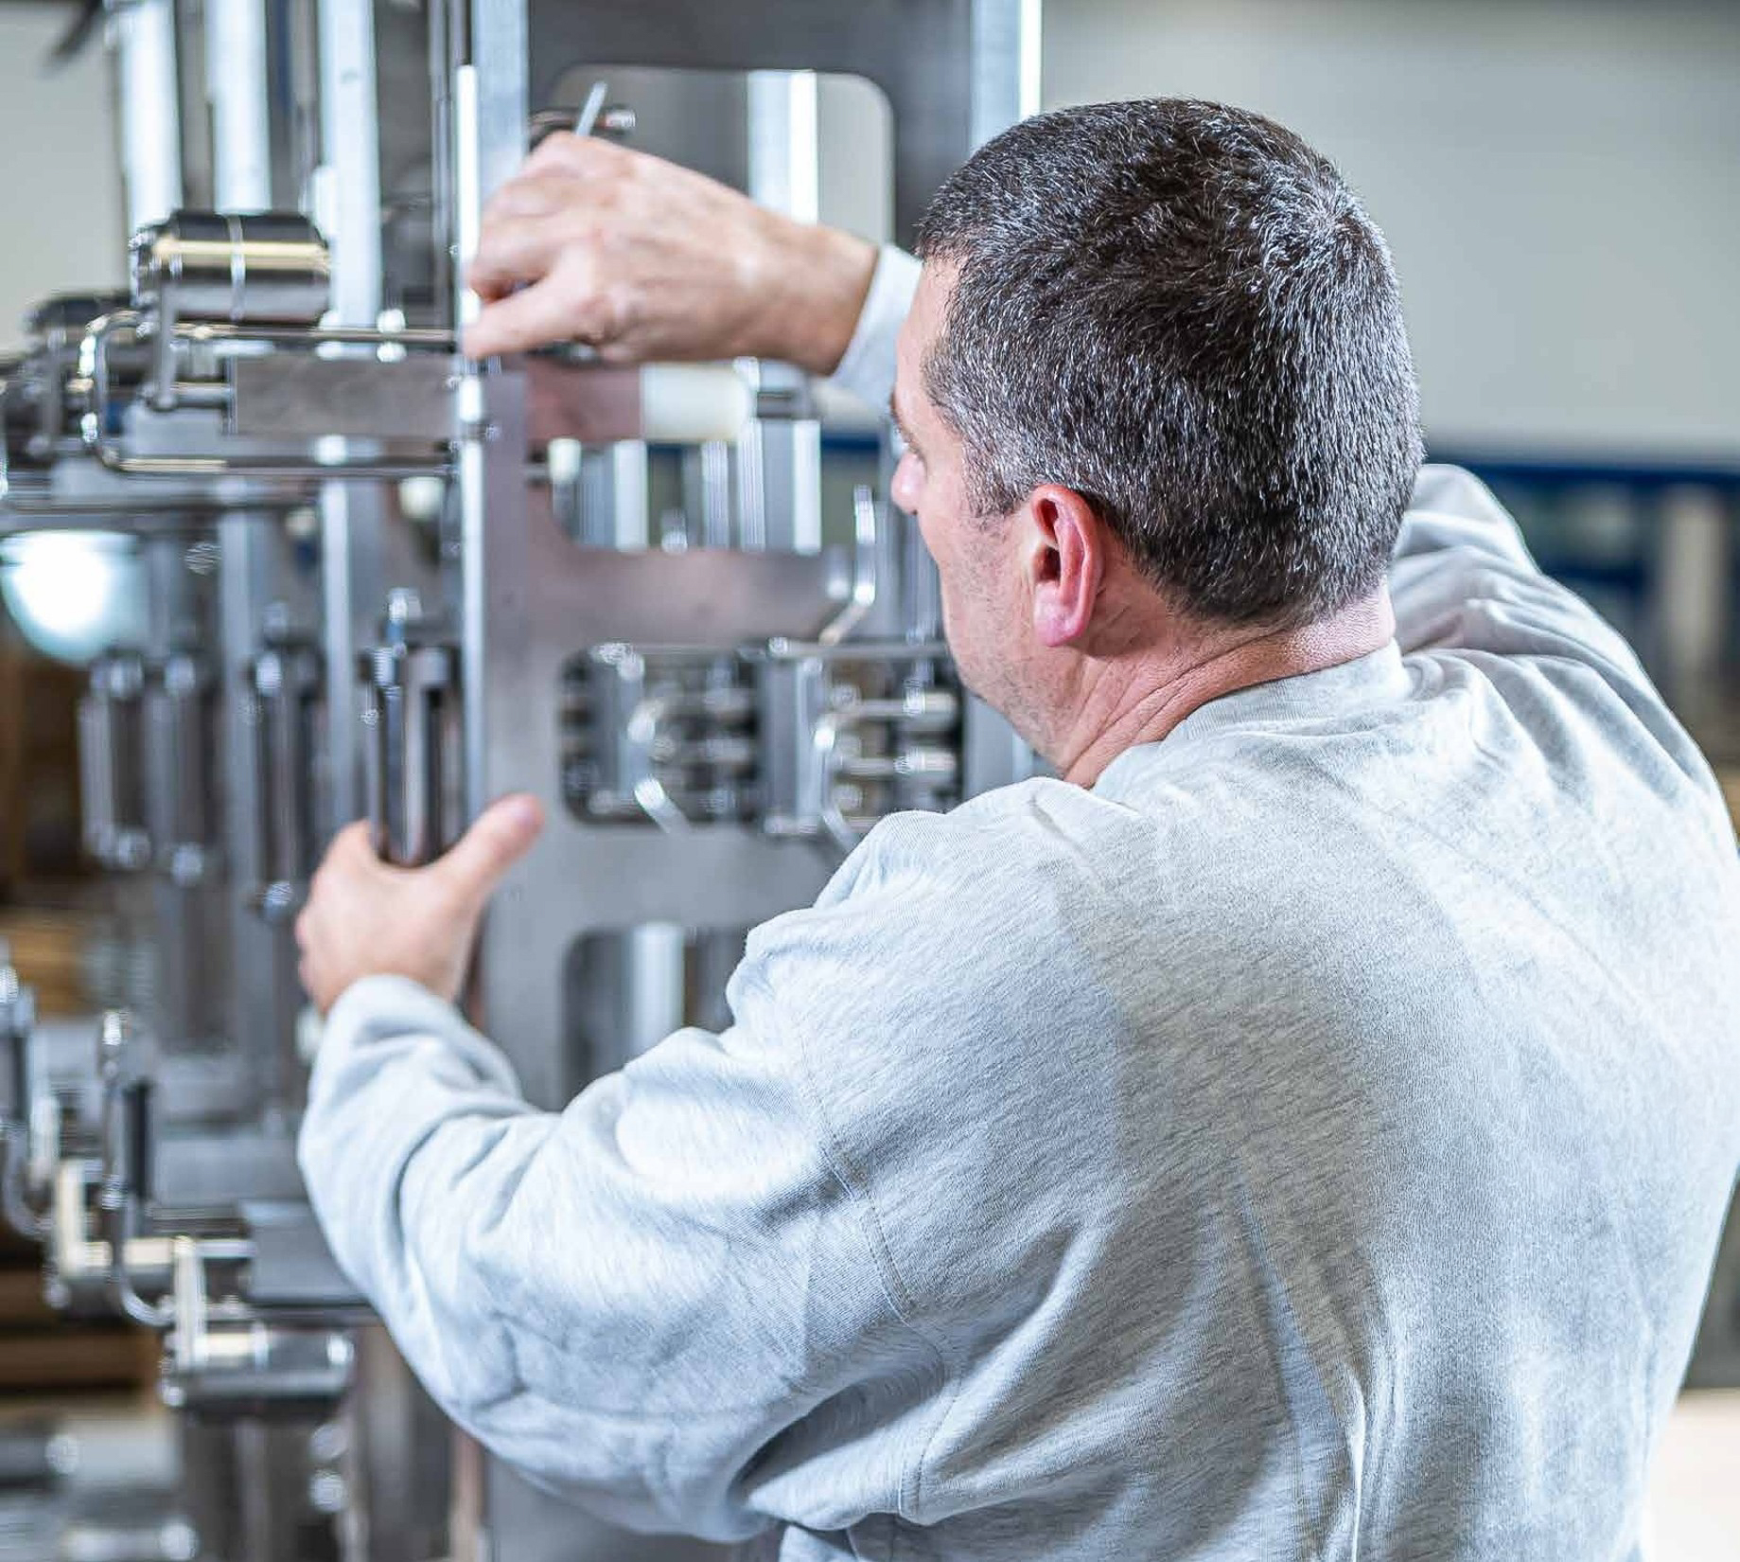
component assembly
Slide is saved in the SlideLizard CREATOR library
This message is for information purposes only.
It's not visible while presenting.
Deleting it does NOT remove the slide from the library.
Complete solution or contract manufacturing
From pre-assembly to final assembly

Slide 12
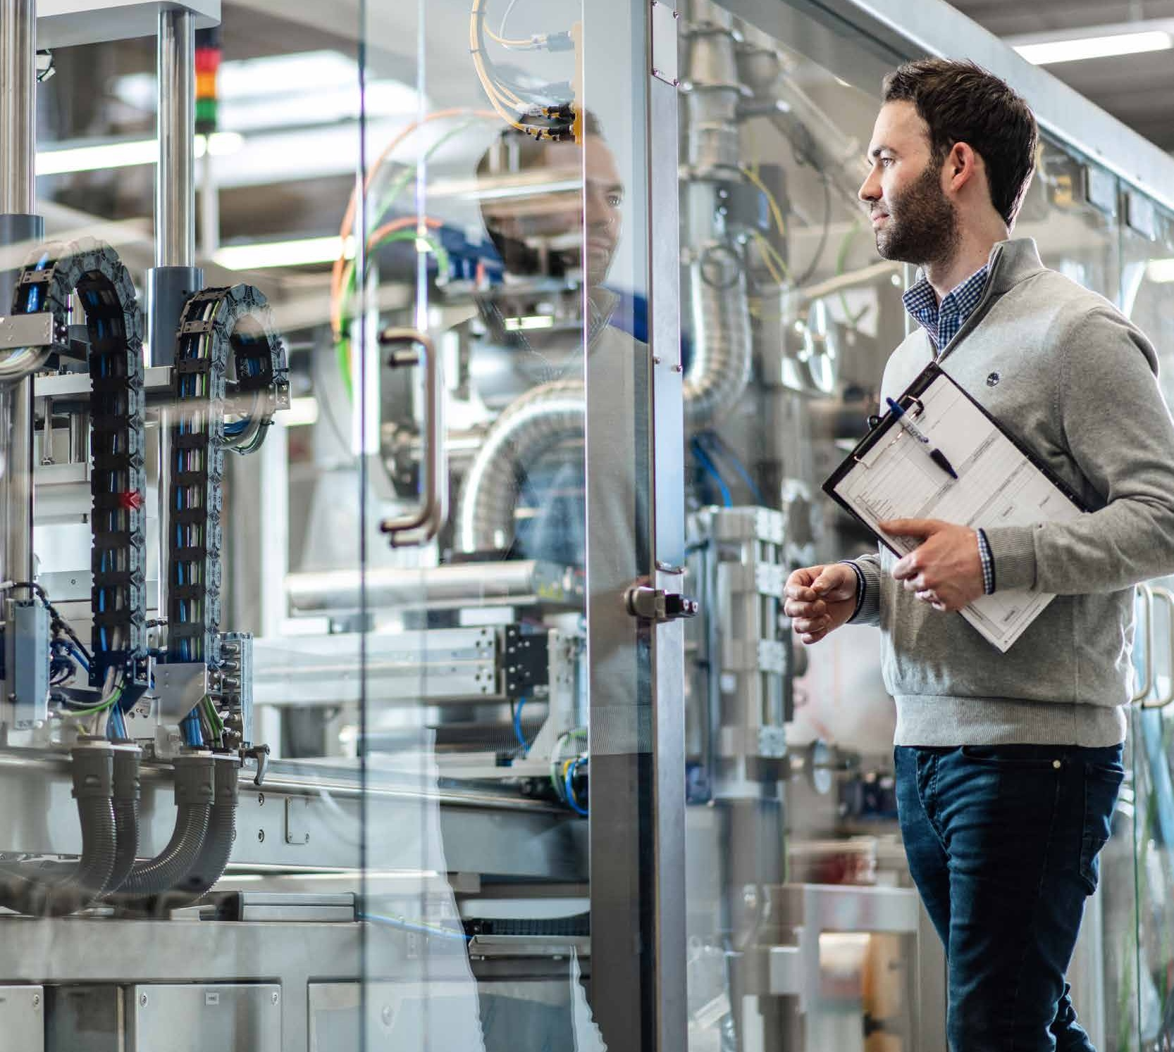
Certifications
Slide is saved in the SlideLizard CREATOR library
This message is for information purposes only.
It's not visible while presenting.
Deleting it does NOT remove the slide from the library.
Not just a piece of paper for us, but commitments, which we take seriously.
DIN EN ISO 9001
DIN EN ISO 14001
DIN ISO 45001
DIN EN ISO 3834 2
AD 2000 - leaflet HP0
WPKDIN EN 1090 2 EXC3
DIN EN 1090 2 EXC3
DIN EN 1090 3 EXC2
DIN EN 1090 3 EXC2
DIN EN 15085 2 CL1
Specialist company certificate
Water Resources Act
DVS certificate WOLL
DIN 2303 - Q1 BK2

Slide 13

Sustainability
Slide is saved in the SlideLizard CREATOR library
This message is for information purposes only.
It's not visible while presenting.
Deleting it does NOT remove the slide from the library.
Sustainability as a corporate principle
Innovation, quality, and responsibility — including toward the environment and society
EcoVadis certification
Participation in the globally recognized sustainability assessment for continuous improvement
Assessment areas
Environment • Labor & Human Rights • Ethics • Sustainable Procurement
Goal
Designing sustainable processes and supply chains, adhering to standards, and taking responsibility.
Our commitment
To be a reliable, responsible partner for customers and society.

Slide 14
SOLUTIONS IN METAL AND STEEL CONSTRUCTION: PRECISION FOR EVERY REQUIREMENT
Slide is saved in the SlideLizard CREATOR library
This message is for information purposes only.
It's not visible while presenting.
Deleting it does NOT remove the slide from the library.
Customized, individual

Slide 15
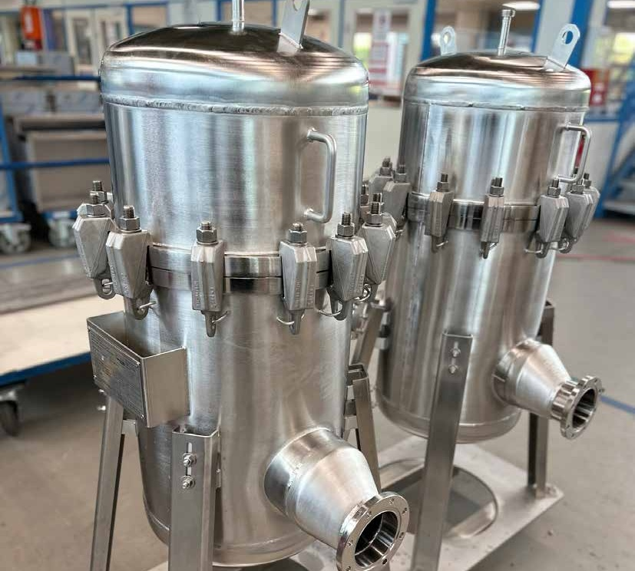
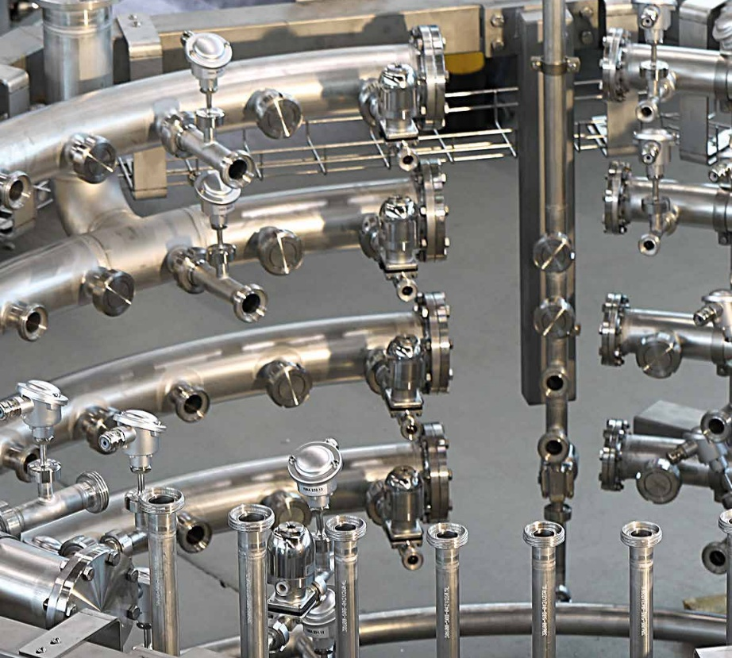
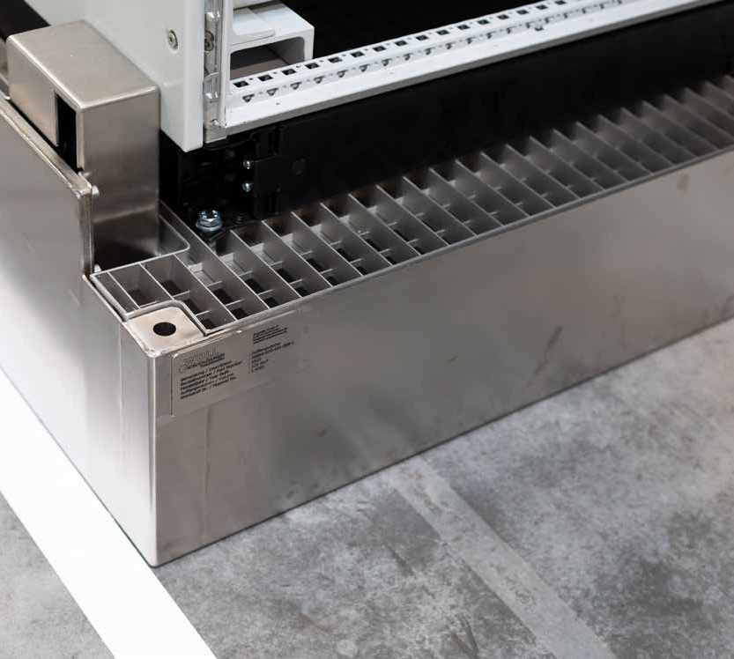
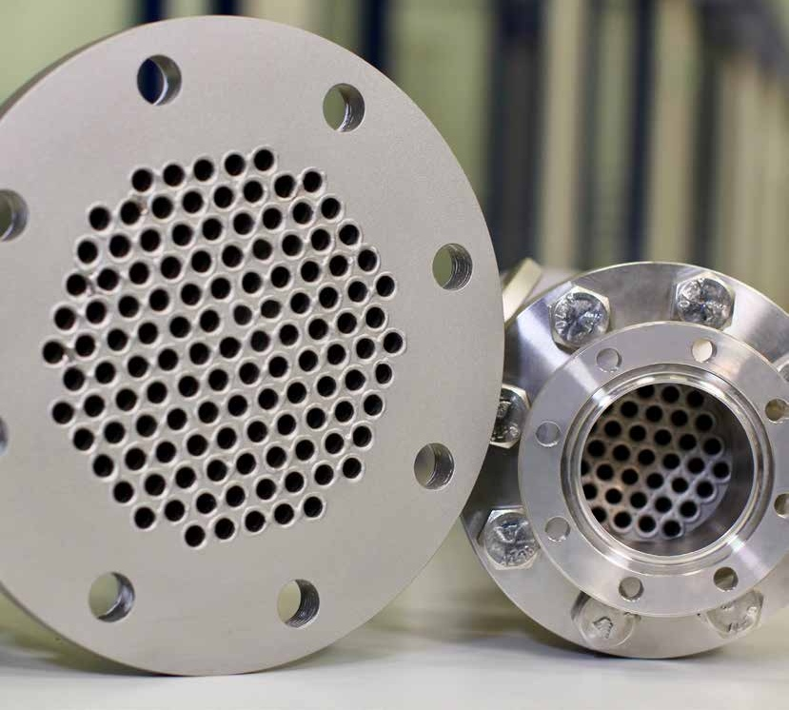
APPARATUS, CONTAINERS AND PIPELINE CONSTRUCTION,
DRIP PANS
Slide is saved in the SlideLizard CREATOR library
This message is for information purposes only.
It's not visible while presenting.
Deleting it does NOT remove the slide from the library.
Apparatus, tanks, pressure vessels, plant components for tanks subject to approval
Planning & production
Piping systems
Project planning, complete plant production, conversions and integration of new fittings
Customized steel and stainless steel drip pans and oil pans
Production, assembly & certification according to Water Resources Act

Slide 16
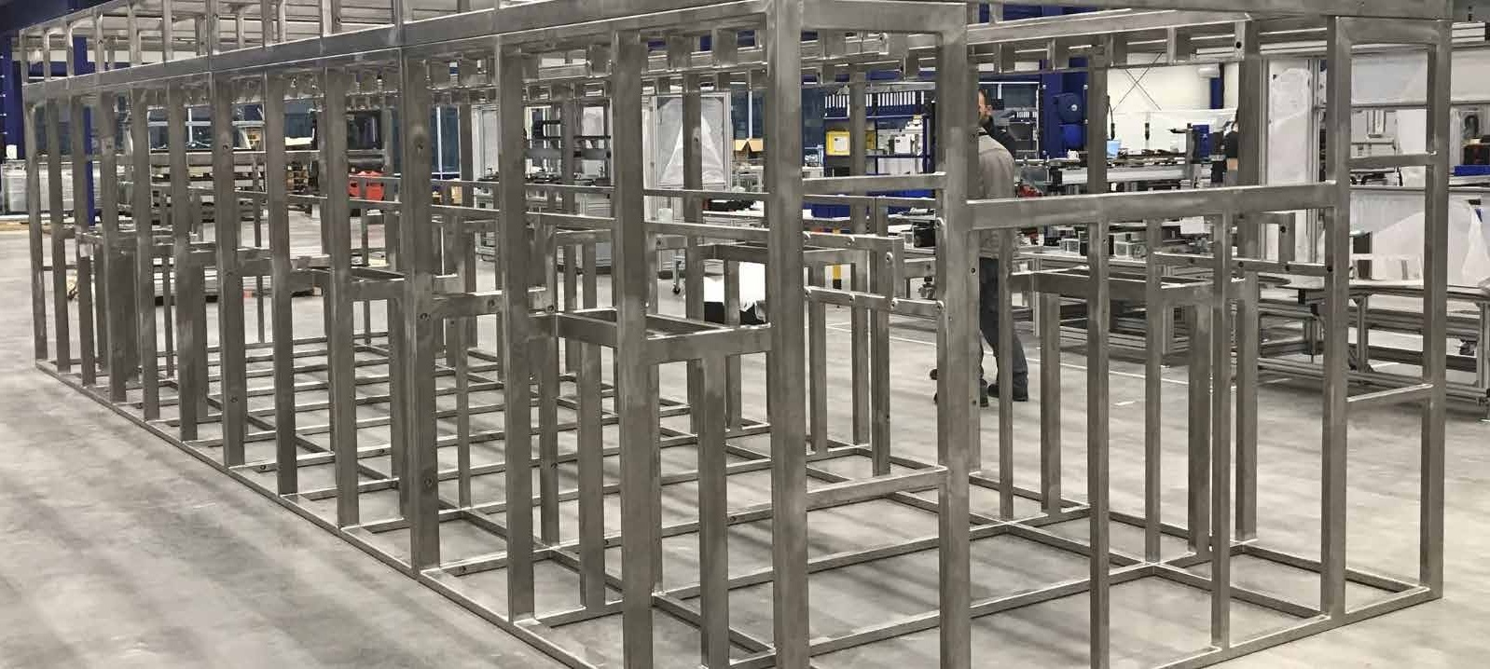
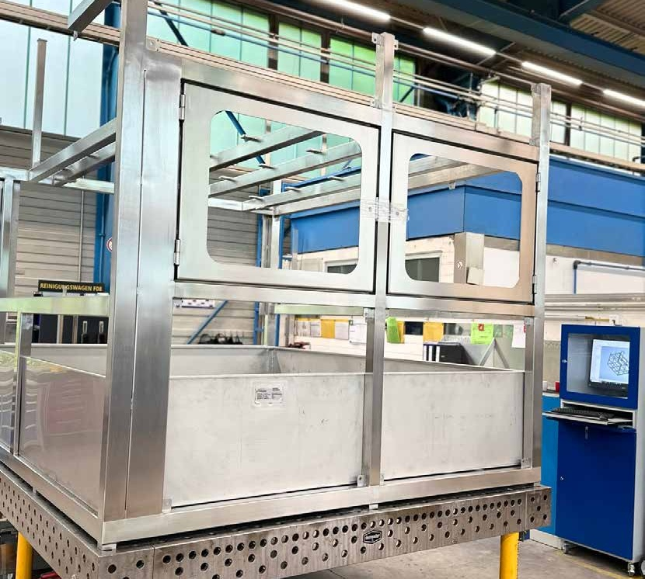
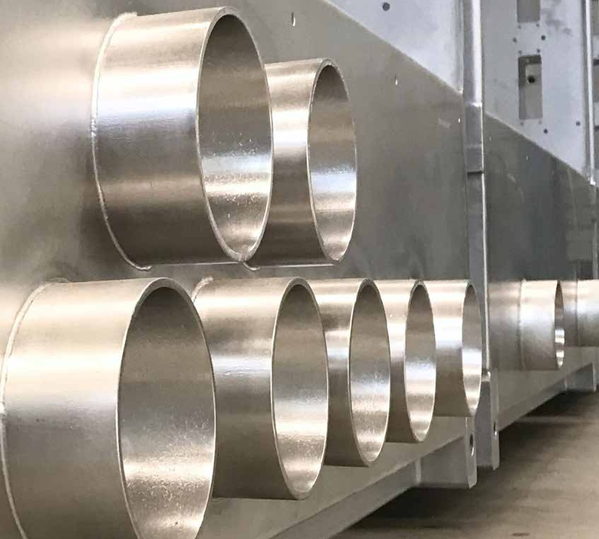
WELDED ASSEMBLIES
Slide is saved in the SlideLizard CREATOR library
This message is for information purposes only.
It's not visible while presenting.
Deleting it does NOT remove the slide from the library.
Frames | housings | enclosures | consoles | control cabinets | other devices
Complete in-house production & assembly
In-house design department for customized solutions
Wide range of welding processes such as TIG, MAG, laser welding, manual welding & more
Certifications including DIN EN ISO 3834 & DIN EN 1090 for the highest quality standards

Slide 17
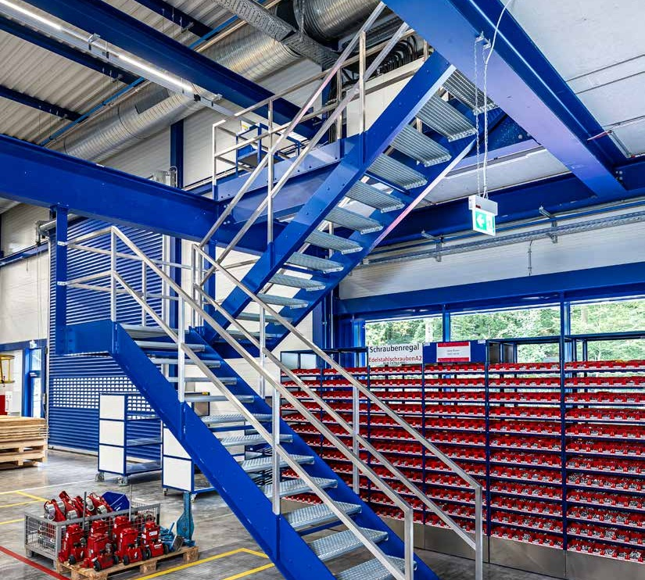
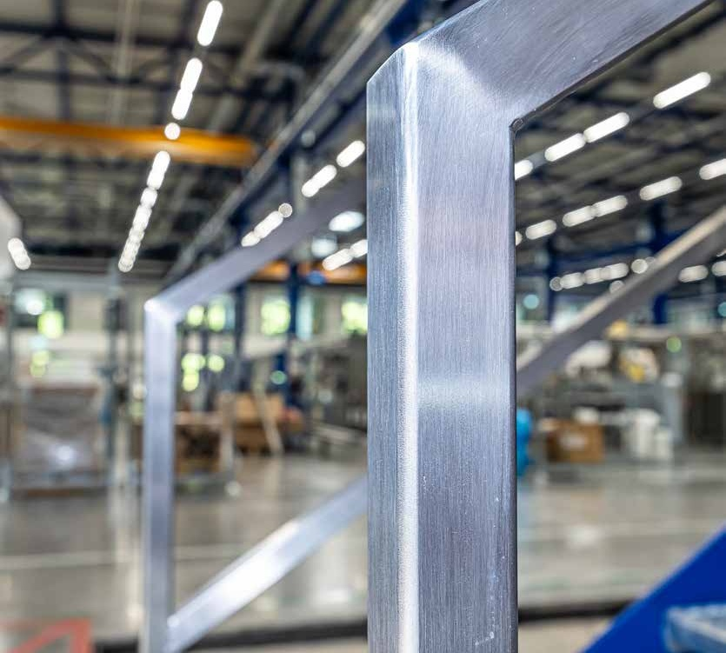
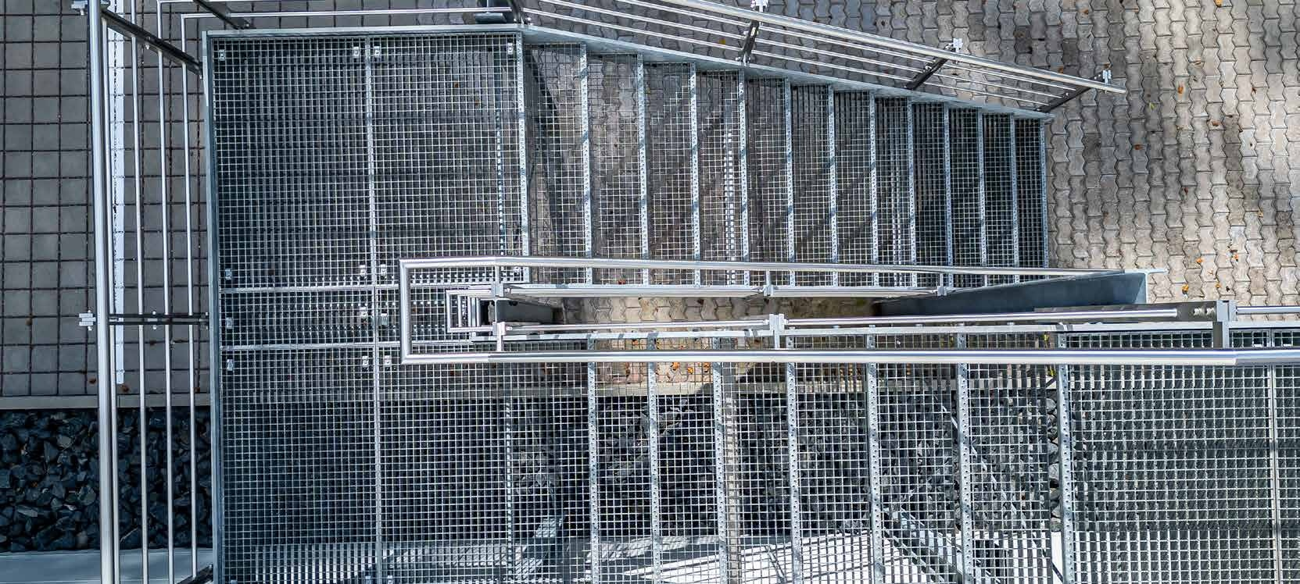
STEEL & METAL CONSTRUCTION
Slide is saved in the SlideLizard CREATOR library
This message is for information purposes only.
It's not visible while presenting.
Deleting it does NOT remove the slide from the library.
Steel construction
Façade components | Columns | Platforms | Landings | Suspensions
From planning to production to on-site assembly
Certification according to DIN EN 1090 2 to EXC3 & DIN EN 1090 3 to EXC2
Metal construction
Railings | Balconies | Roofing | Stairs | Gates
Stainless steel | Aluminum | Brass | Copper | Plastics

Slide 18
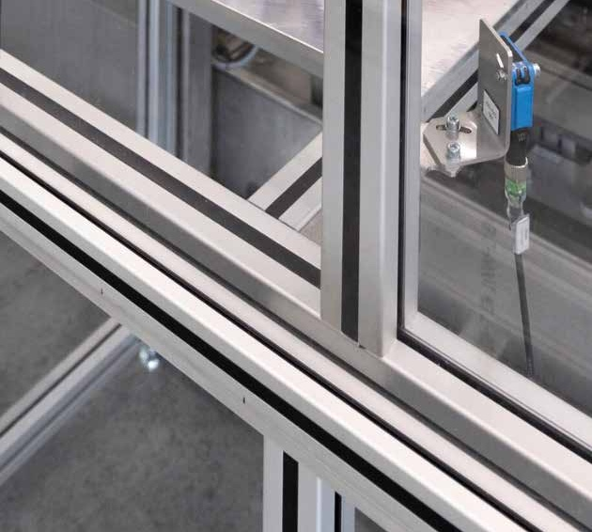
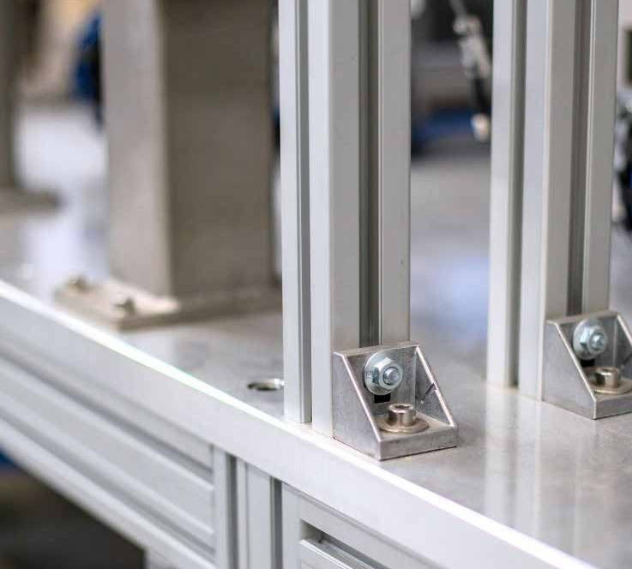
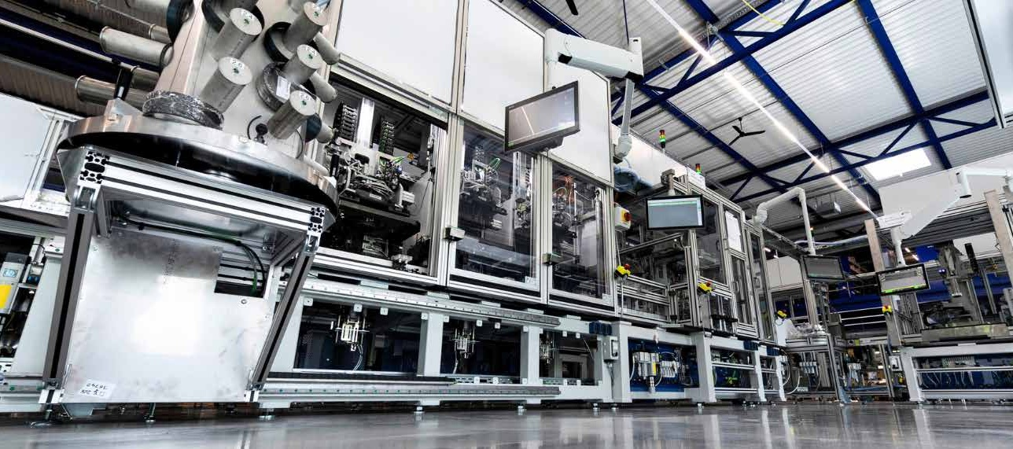
PROFILE & SHEET METAL TECHNOLOGY
MADE OF ALUMINUM
Slide is saved in the SlideLizard CREATOR library
This message is for information purposes only.
It's not visible while presenting.
Deleting it does NOT remove the slide from the library.
From simple frames to fully automated production lines
Frames for
Safety equipment
Industrial workstations
Stairs & platforms
Work platforms such as assembly & maintenance platforms
Integration of electrical components on request

Slide 19
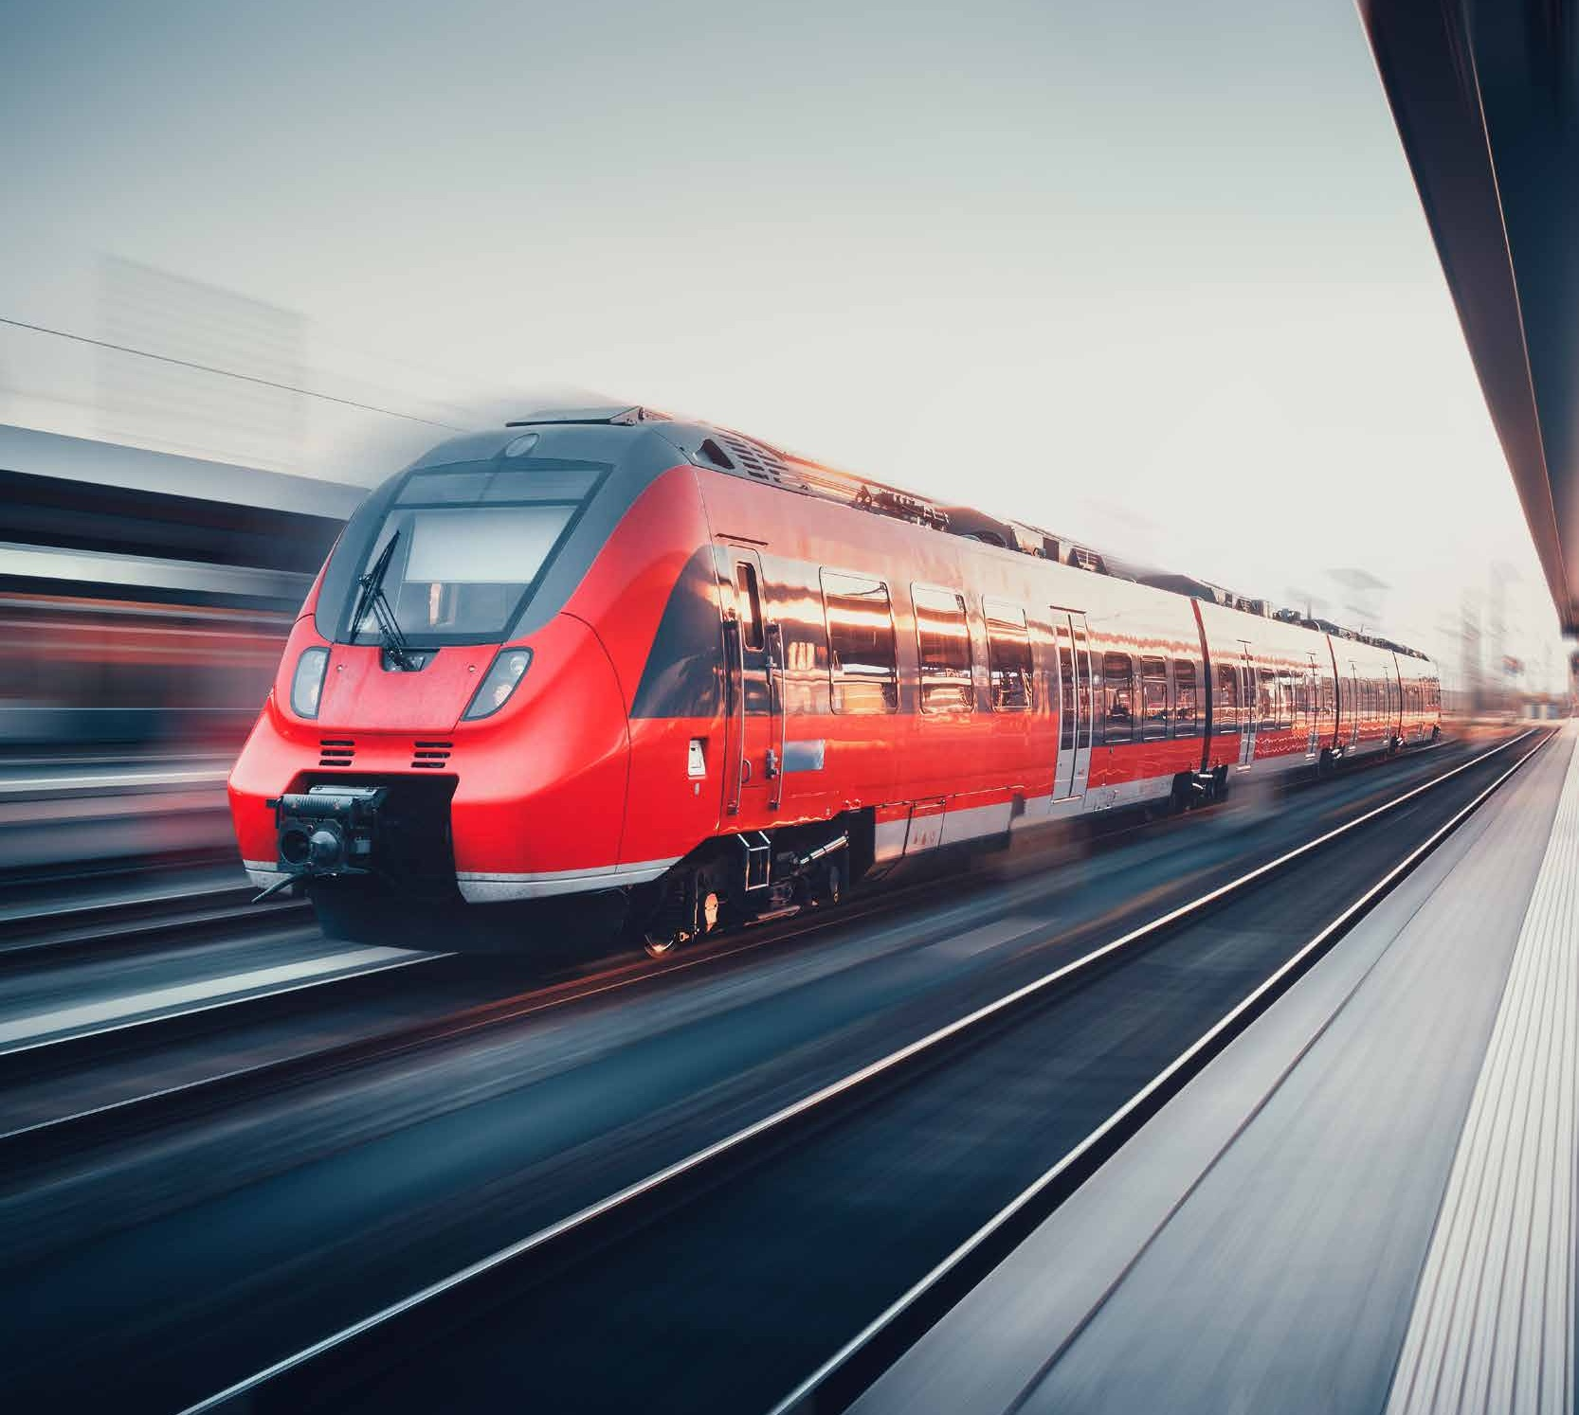
RAIL VEHICLE CONSTRUCTION
Slide is saved in the SlideLizard CREATOR library
This message is for information purposes only.
It's not visible while presenting.
Deleting it does NOT remove the slide from the library.
Certification in accordance with DIN EN 15085 Part 2 for activity area P (production), classification level CL 1, i.e. the manufacture, modification & testing of welded rail vehicles & vehicle parts (including spare parts)
Range of services, including
Manufacture and adaptation of vehicle parts
Production of components for bogies
Manufacture of piping for air conditioning units
Couplings
Pull & push units and much more.

Slide 20
WHAT CHALLENGES
CAN WE SOLVE FOR YOU IN METAL-WORKING?
Slide is saved in the SlideLizard CREATOR library
This message is for information purposes only.
It's not visible while presenting.
Deleting it does NOT remove the slide from the library.
And finally

Slide 21
Florian philipp
Slide is saved in the SlideLizard CREATOR library
This message is for information purposes only.
It's not visible while presenting.
Deleting it does NOT remove the slide from the library.
#PROBLEMSOLVER
Head of Manufacturing
T+49 681 970 24 946
+49 151 543 100 73
florian.philipp@woll-group.com

Slide 22
Slide is saved in the SlideLizard CREATOR library
This message is for information purposes only.
It's not visible while presenting.
Deleting it does NOT remove the slide from the library.
#PROBLEMSOLVERD
WWW.WOLL-GROUP.COM
Krughütter Straße 93 · 66128 Saarbrücken · T +49 681 970 24 - 0 · info@woll-group.com

