Slide 1

Office :Barboros Cad. Pirireis Mah. Darıca Küçük San.Sit B Blk. No:25 Darıca/KOCAELİ-TÜRKİYE
Workshop : İDOSB Vakum Cad.Antik Sk.No:23 Tuzla/İSTANBUL
Tel: +902626780088
Tel:+902626780098
GSM:+905493717117
E-MAIL: murat@mrtmekatronik.com

Slide 2
MRT Mechatronics has established in 2013. Our company offers engineering solutions about robotics & automation.
MRT Mechatronics specializes in precision CNC machining of small to large size parts in steel, stainless steel, aluminum and other alloys.

Slide 3
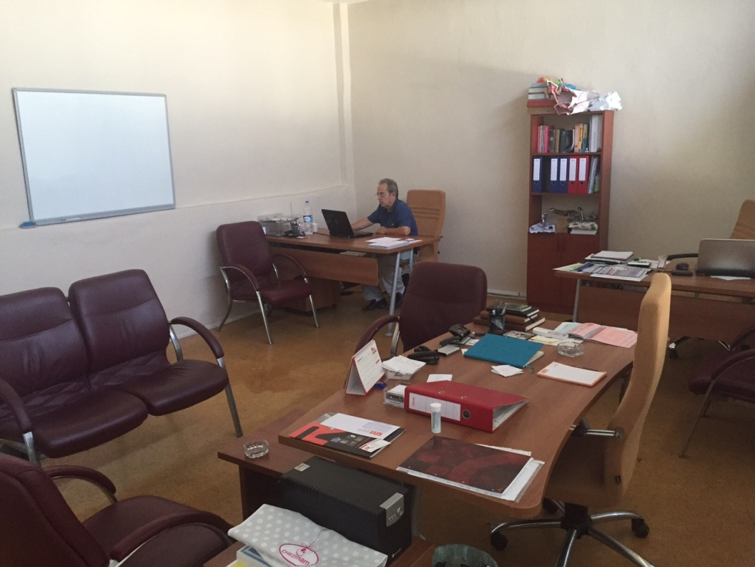
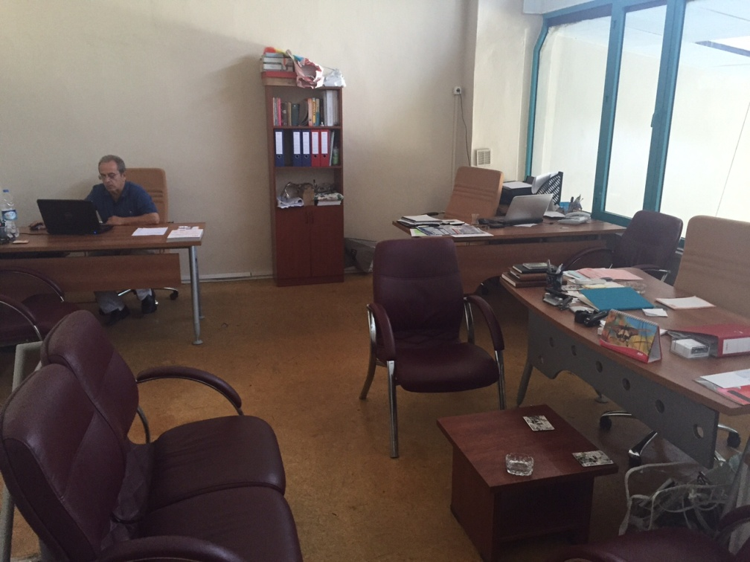
Office
Our team is 7 Employes
2 Engineer
5 Mechenical Technican

Slide 4
Our machines park ;
SMTCL 1600M 3 axis CNC Vertical Machining Center
Spinner MVC 1000 3 axis CNC Vertical Machining Center
Universal Milling Machine
Radial Drilling Machine
We also ordered;
SMTCL VMC 1000B 3 axis CNC Vertical Machining Center which will install 01.03.2017.

Slide 5
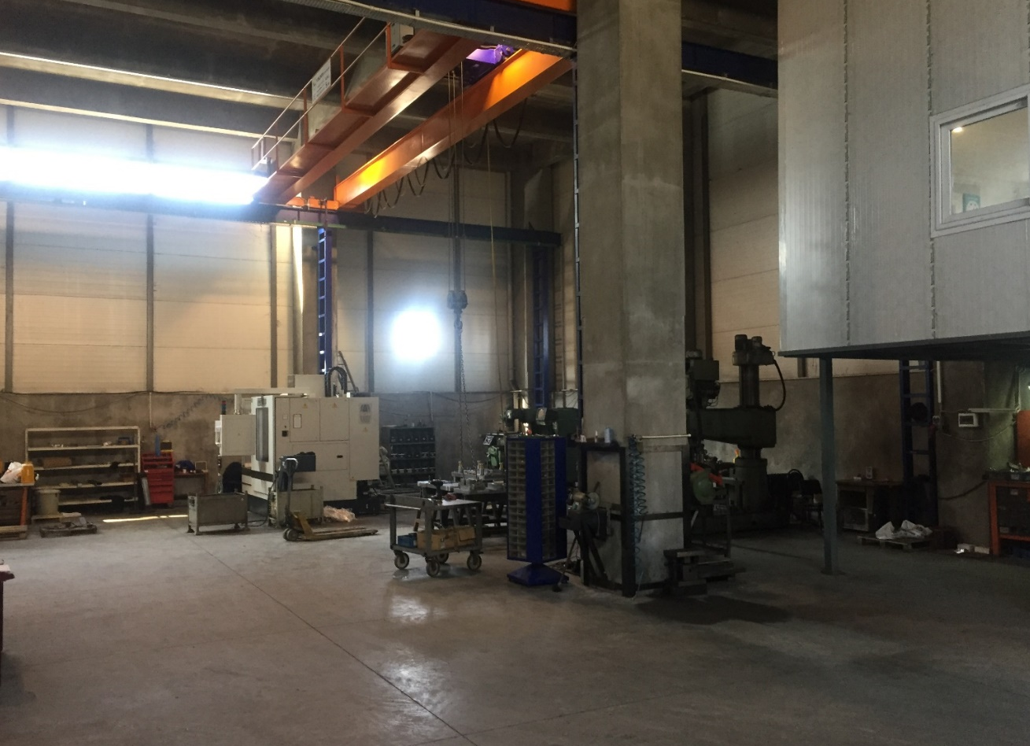
Workshop

Slide 6
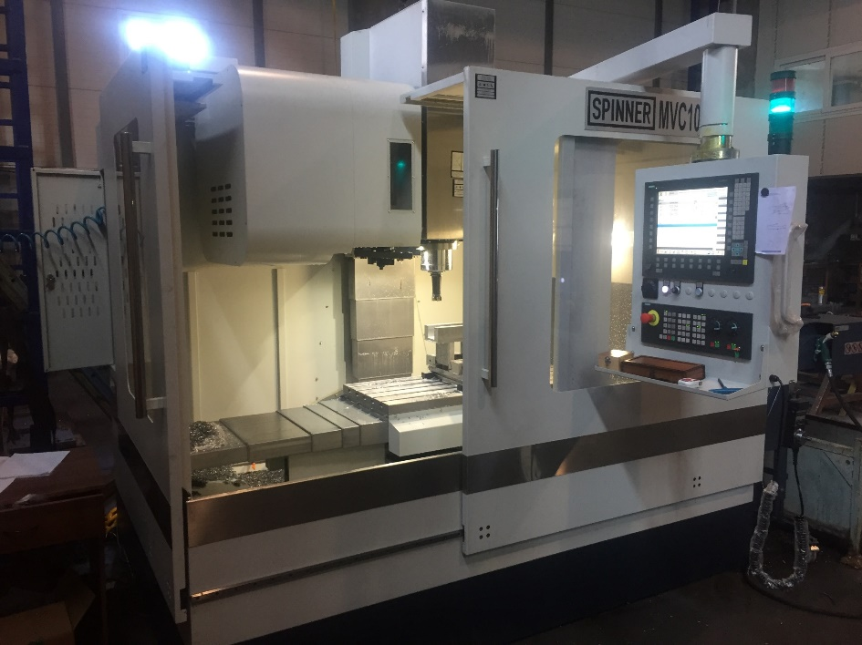
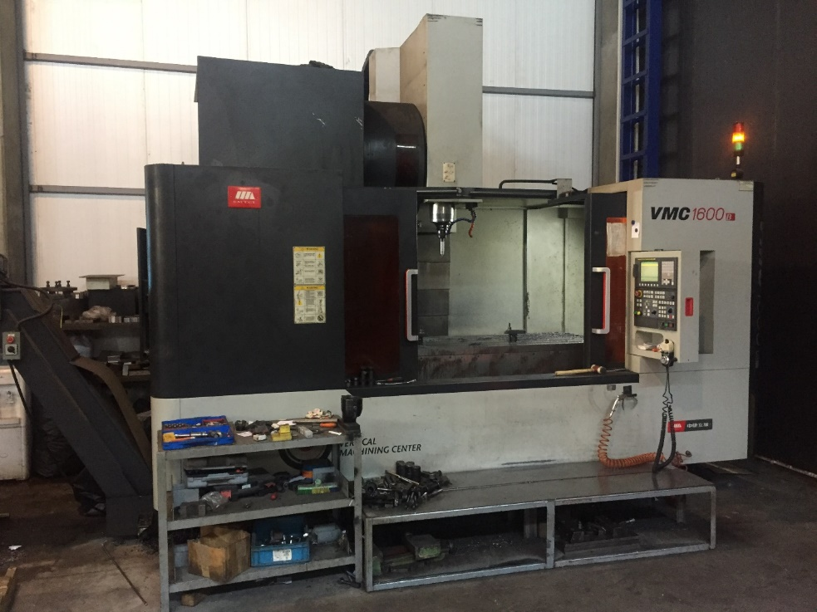
Workshop

Slide 7
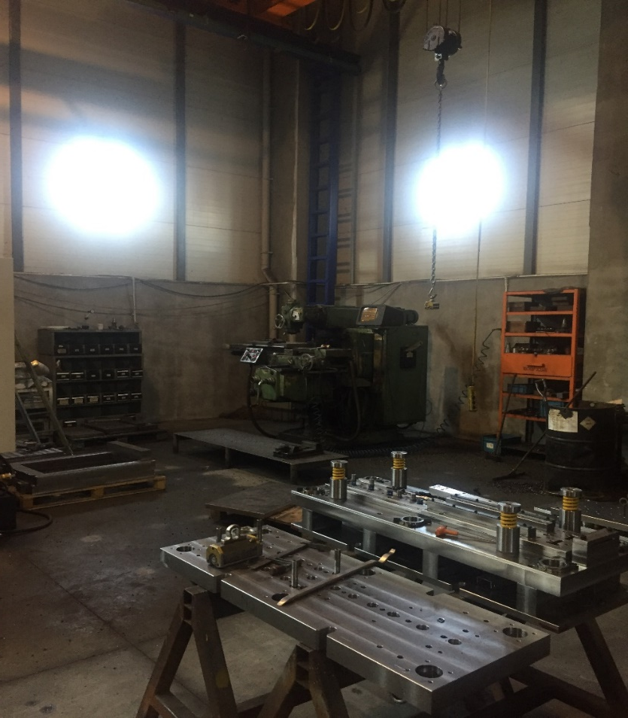
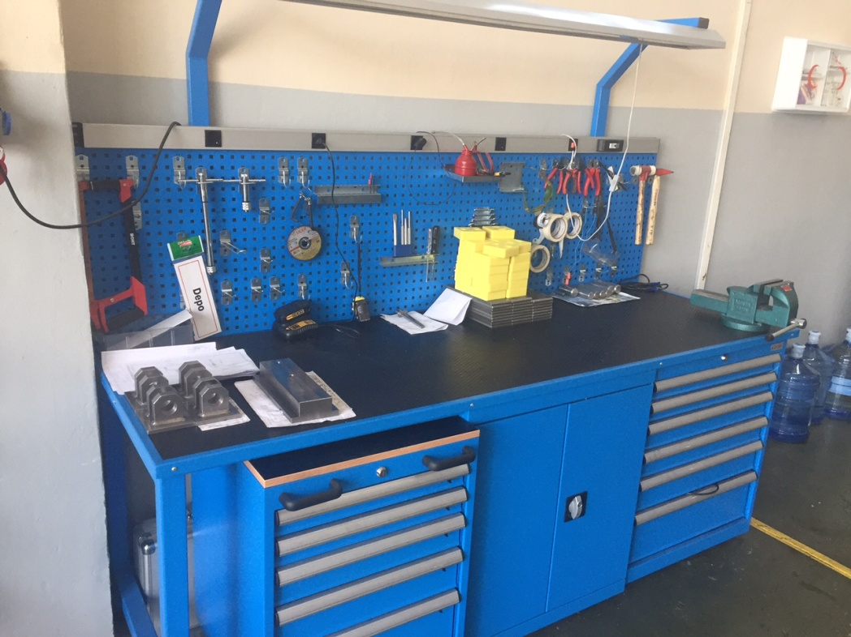
Workshop

Slide 8
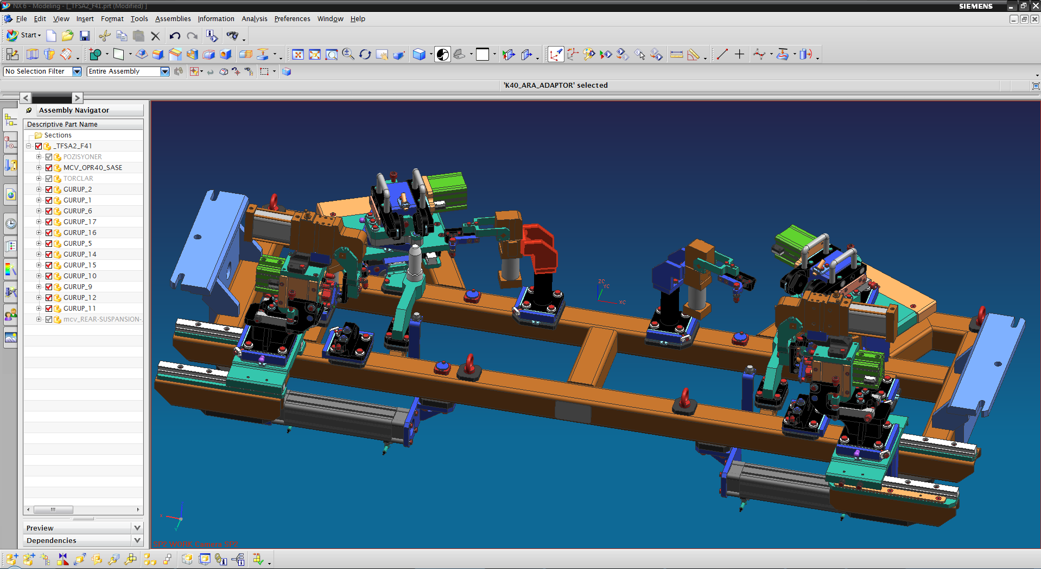
3D Design
1 Unigraphics NX9.5 Station
1 CIMETRON CAM Station

Slide 9
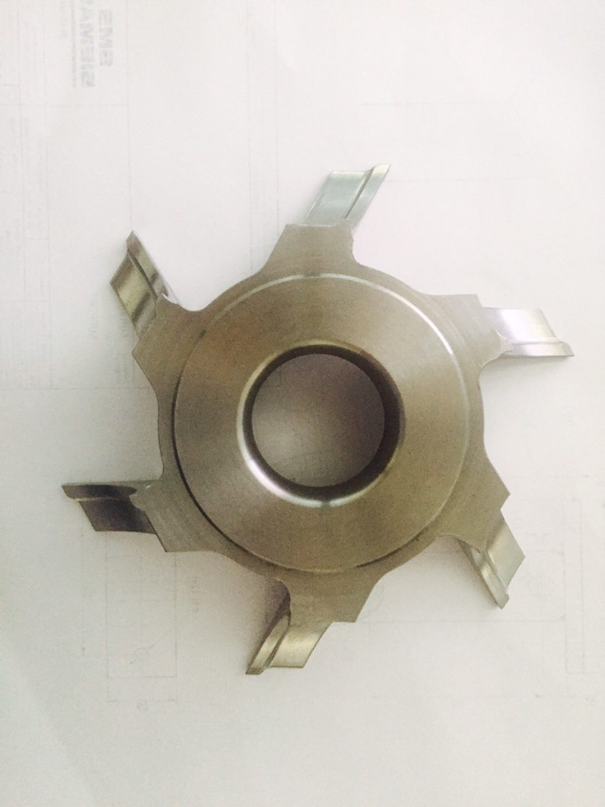
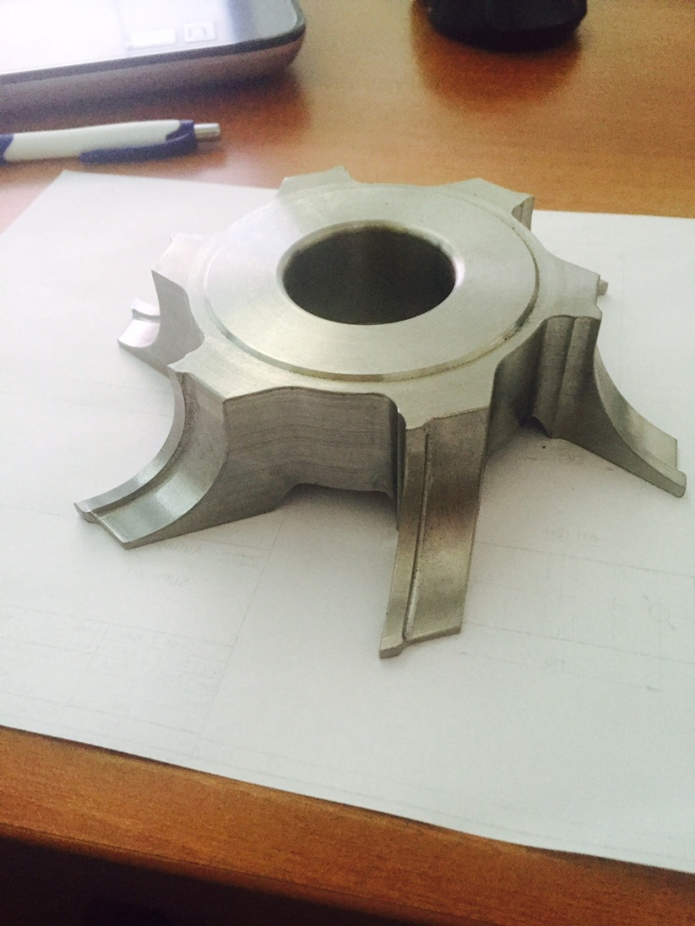
Product

Slide 10
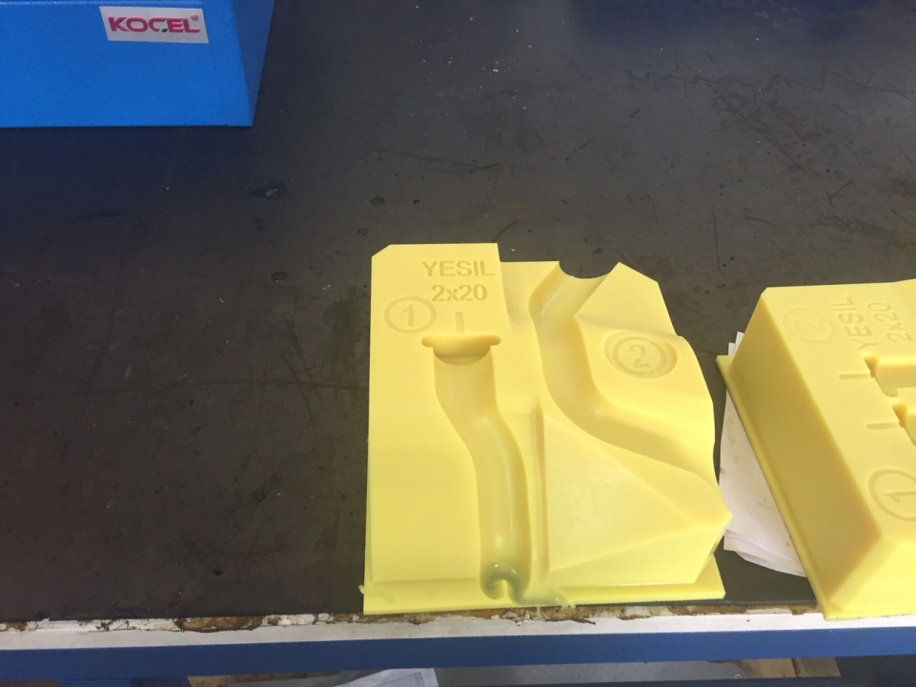
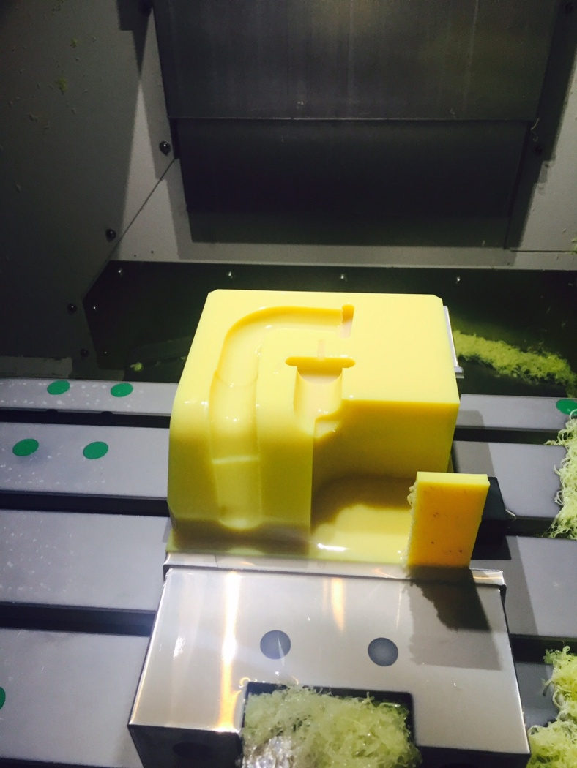
Product

Slide 11
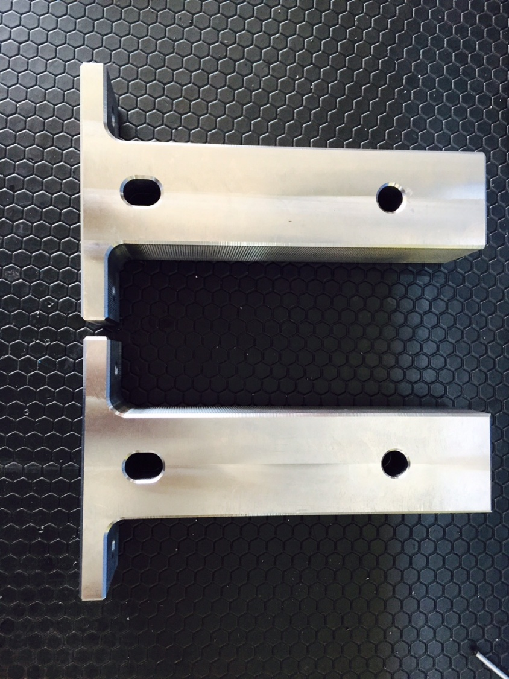
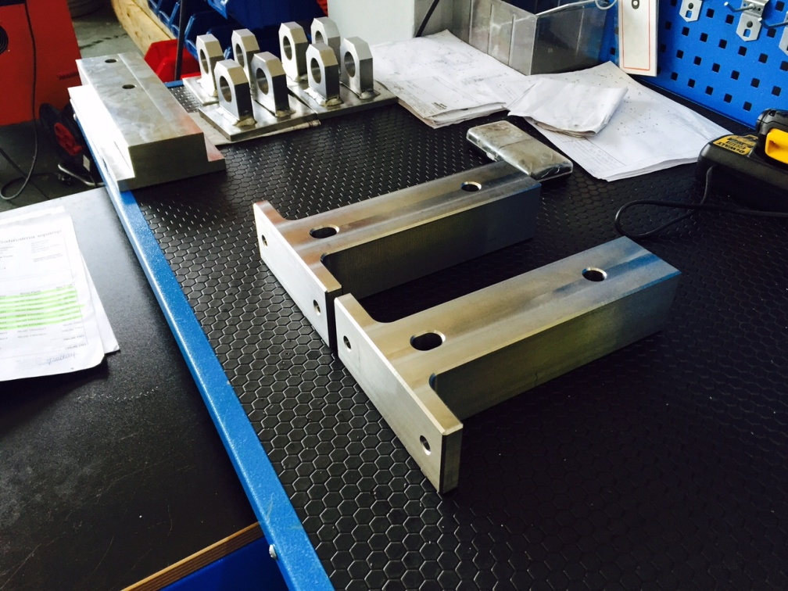
Product

Slide 12
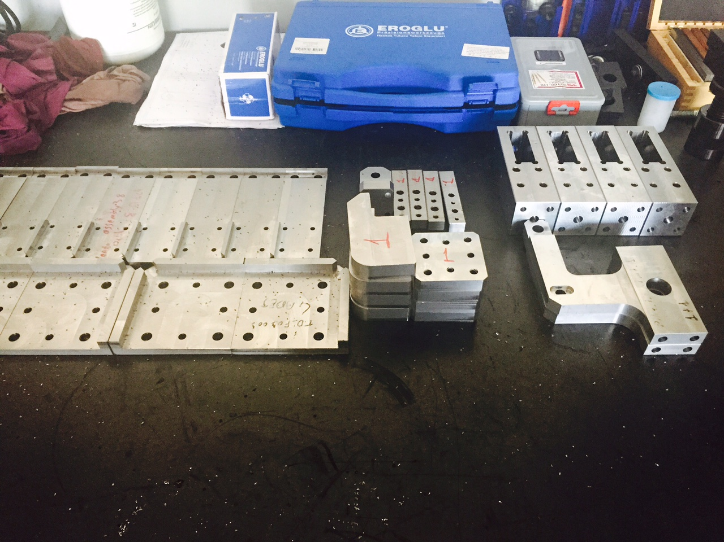
Product

Slide 13
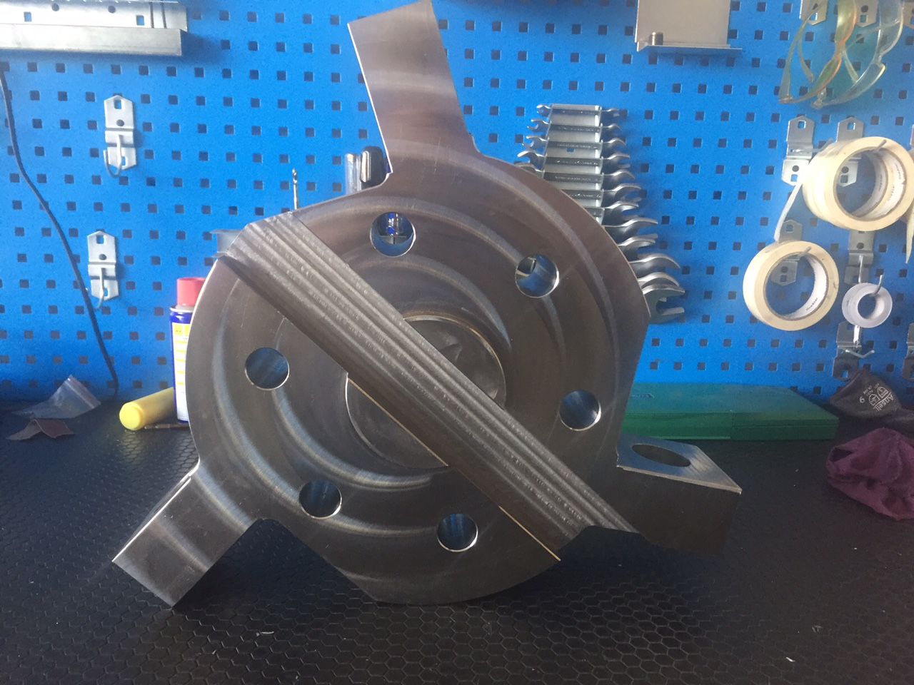
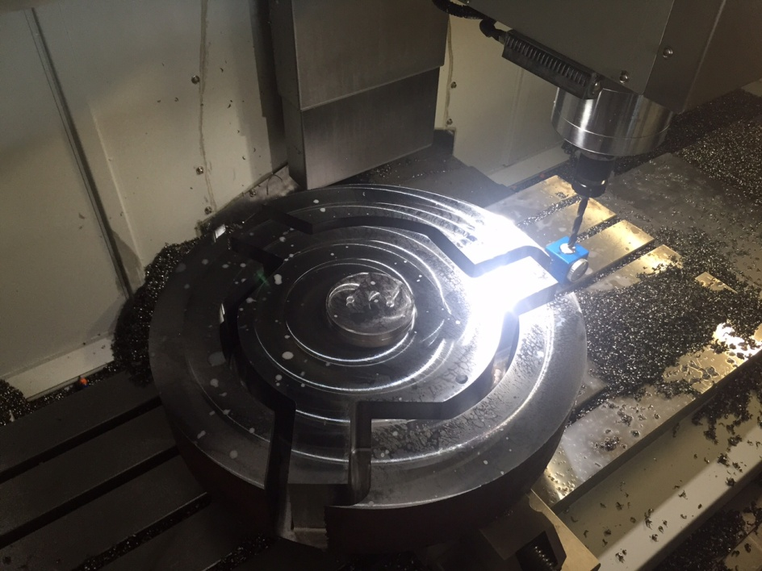
Product

Slide 14
Reference
FORD OTOSAN
TEKLAS A.Ş
SMS-SIEMAG
LEITZ – BÖHLER
COMAU - TURKEY

