Slide 1
NBHX TRIM GROUP
LOCATION: HEILSBRONN
.
Jan 2019

Slide 2
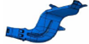
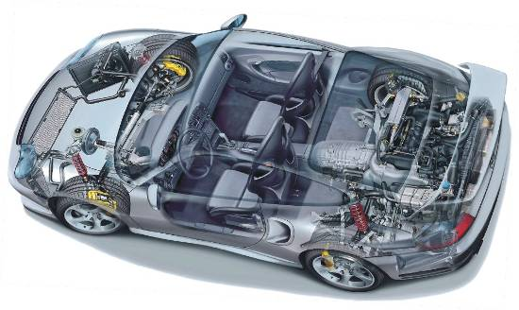
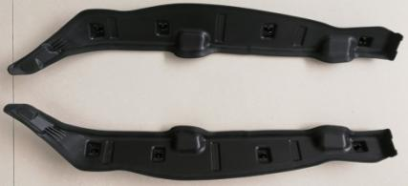
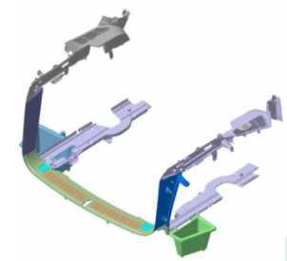

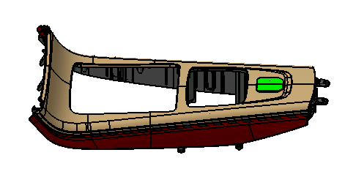
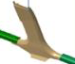
NBHX PORTFOLIO
MAJOR PRODUCTS
Air Duct
IP Decor
Tailgate
Side Frame Sealing
DP Decor
Trunk Trim
Console Decor
Pillars

Slide 3





















CUSTOMERS
GLOBAL

Slide 4



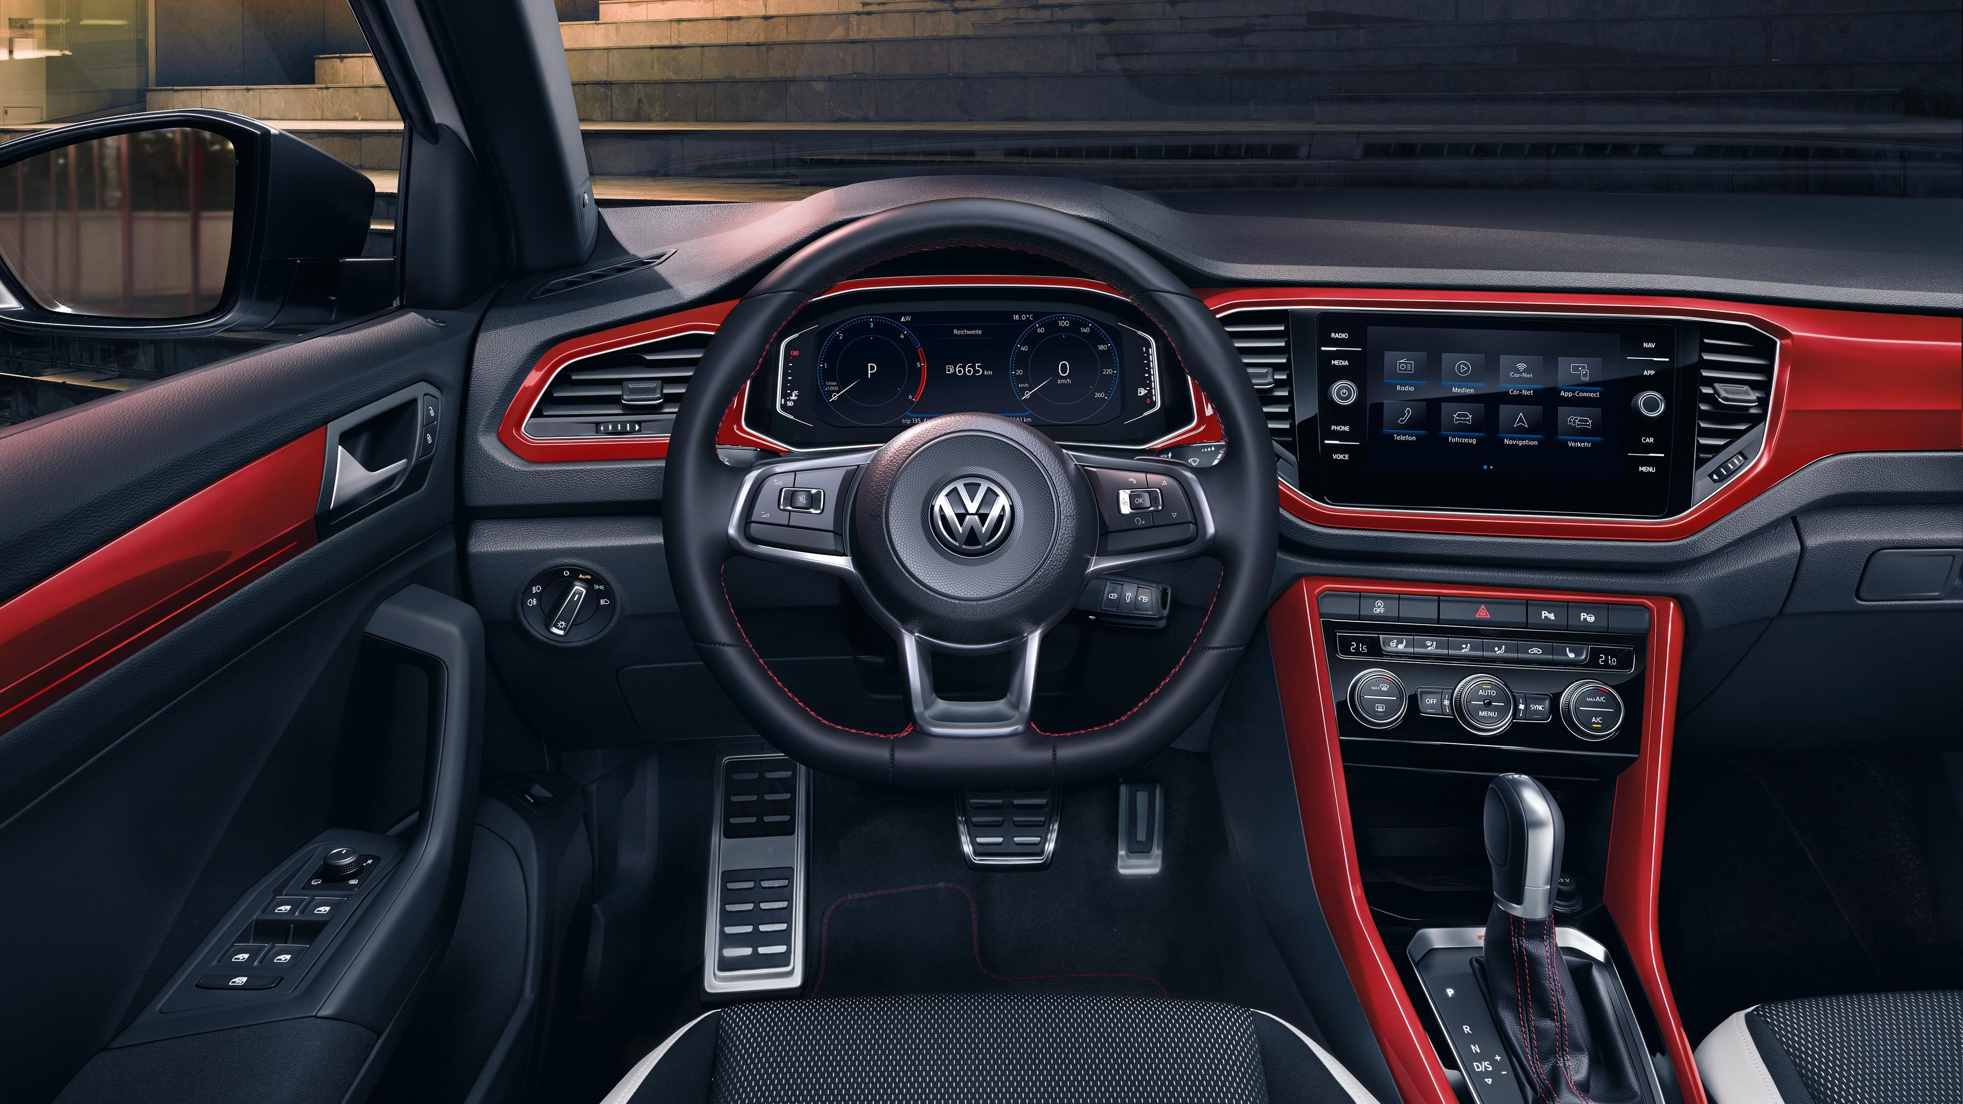
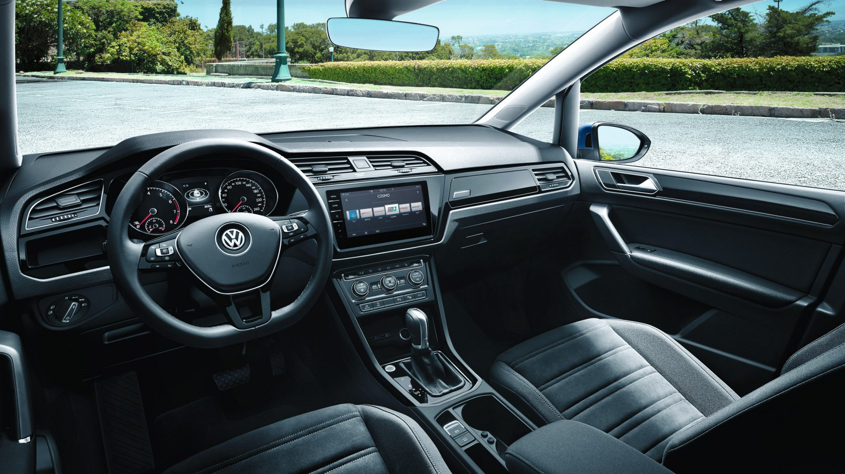

REFERENCES: Running Projects, Plant Heilsbronn
Volkswagen T-Roc Interior - Lacquering
Volkswagen Passat
Volkswagen Touran

Slide 5
Competencies Plant Heilsbronn
Spritzguss 1K / Injection Molding
Spritzguss 2K / Injection Molding 2 Component
Spritzguss mit online Montage / Injection Molding inclusive Assembly Line
Montage / Assembly Line
IML / IMD Hinterspritzen / IML / IMD Back Injection
Teppich Hinterspritzen / Carpet Back Injection
Gas Innendruck / Gas Injection Technology
Kunststofspritzen und Beflocken / Plastic Injection and Flocking
Aluminium Hinterspritzen / Aluminium Back Injection
Krisensupport: Sofortübernahem von Krisenprojekten anderer Lieferanten innerhalb kürzester Zeit (z.B. VW T-Roc Lackierung)
Crisis Support (eg: VW T-Roc Surface Painting), Quickresponse in overtaking Crisis Project from other supplier in shortest time possible

Slide 6
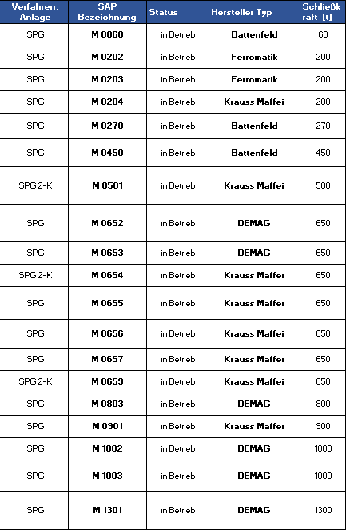
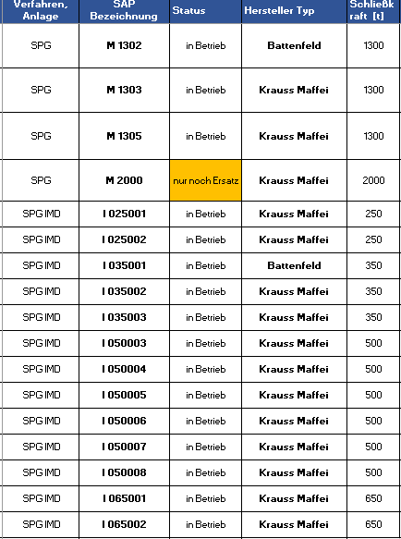
Injection molding machines Plant Heilsbronn

Slide 7
Painting line Plant Heilsbronn

Slide 8
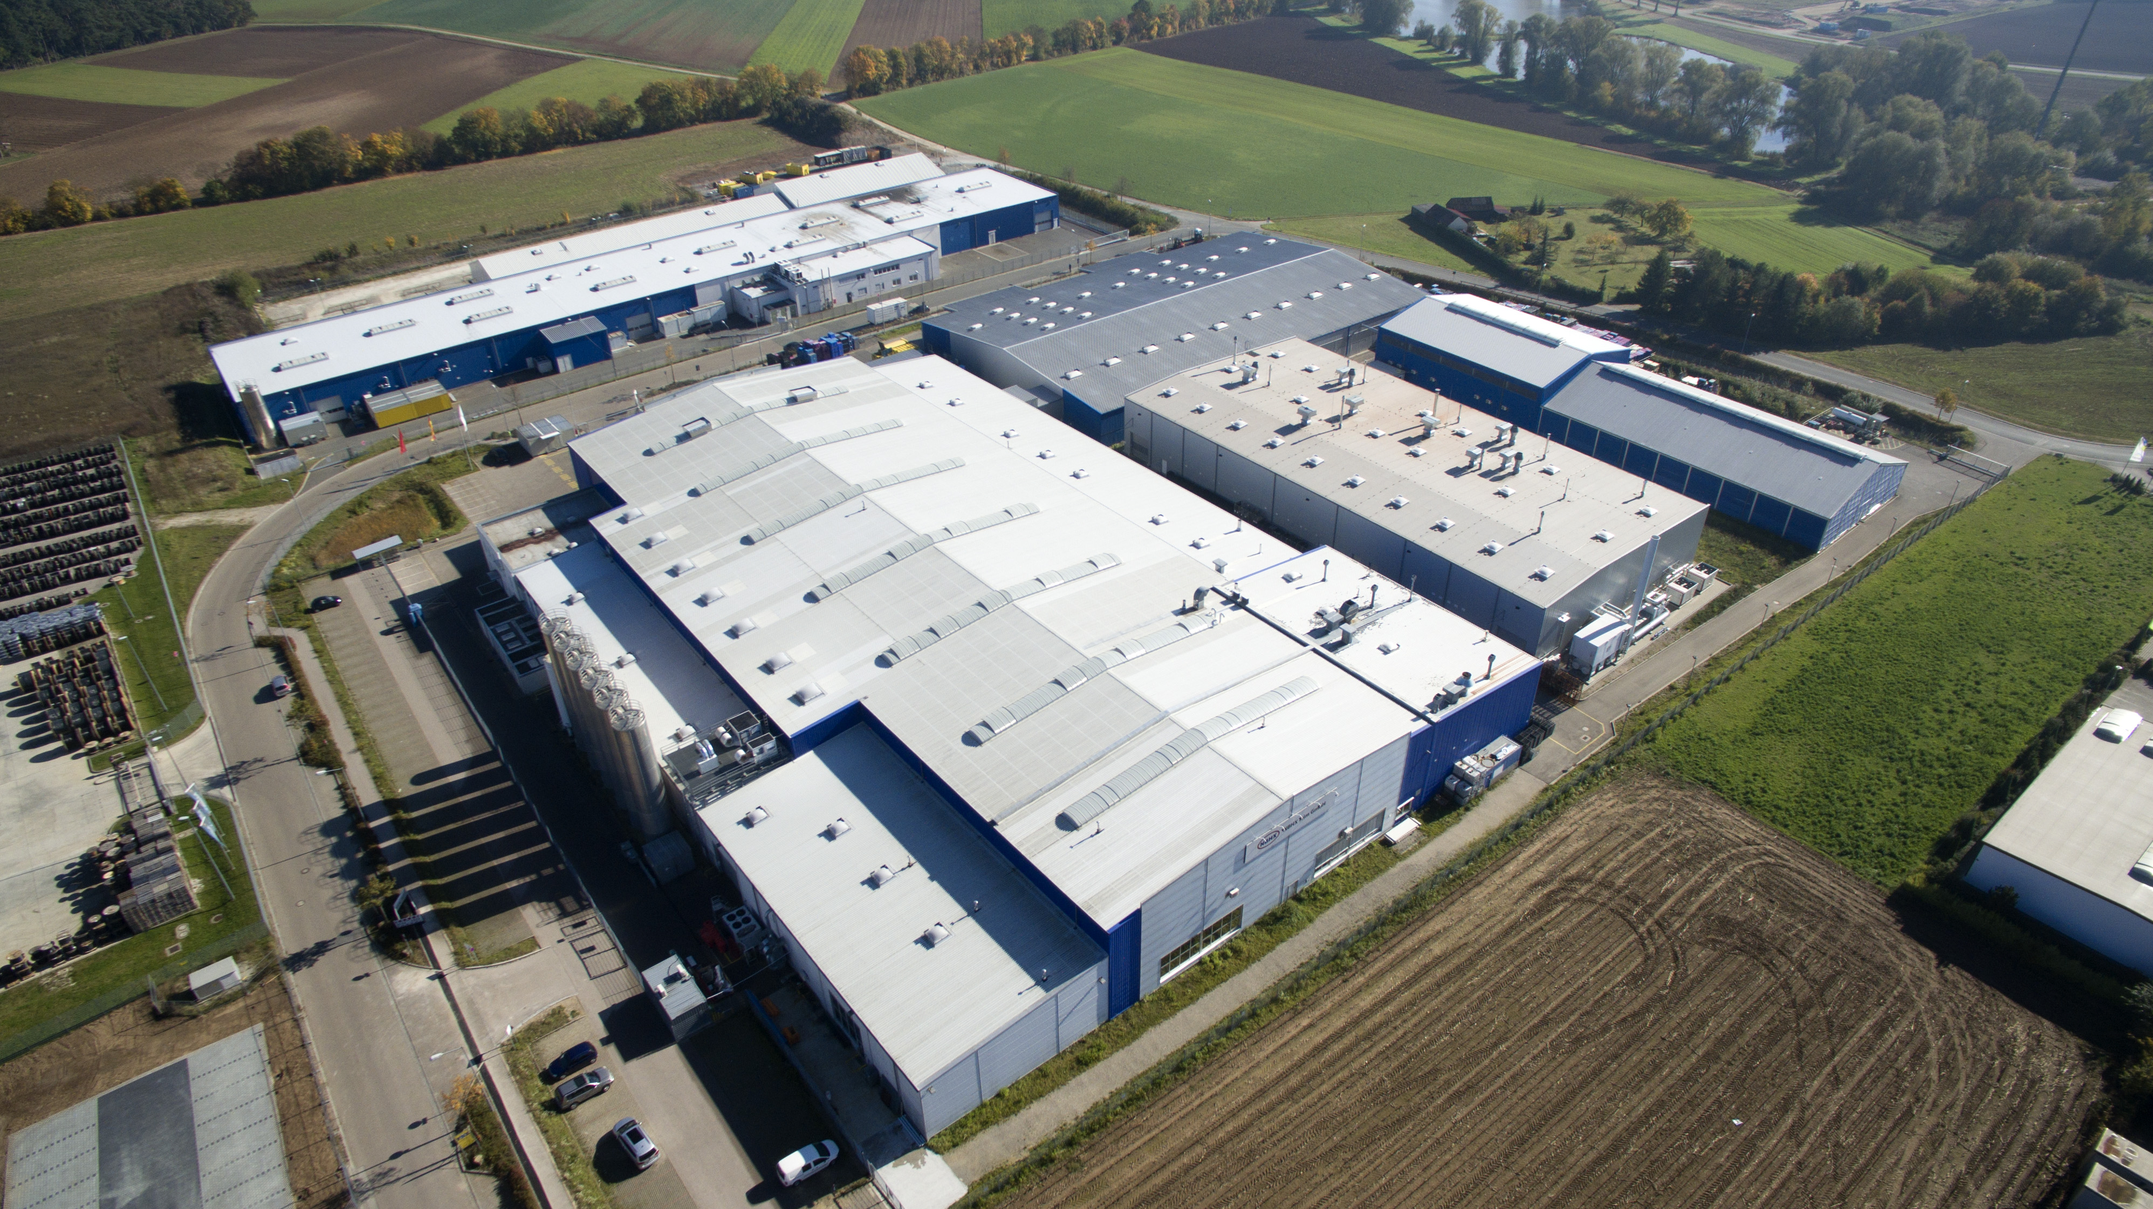
Aerial View: PLANT Heilsbronn
Ca. 70.000m²

Slide 9
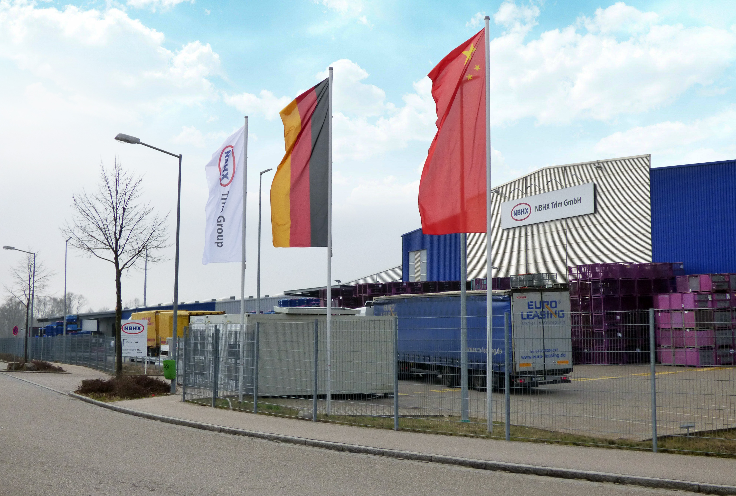

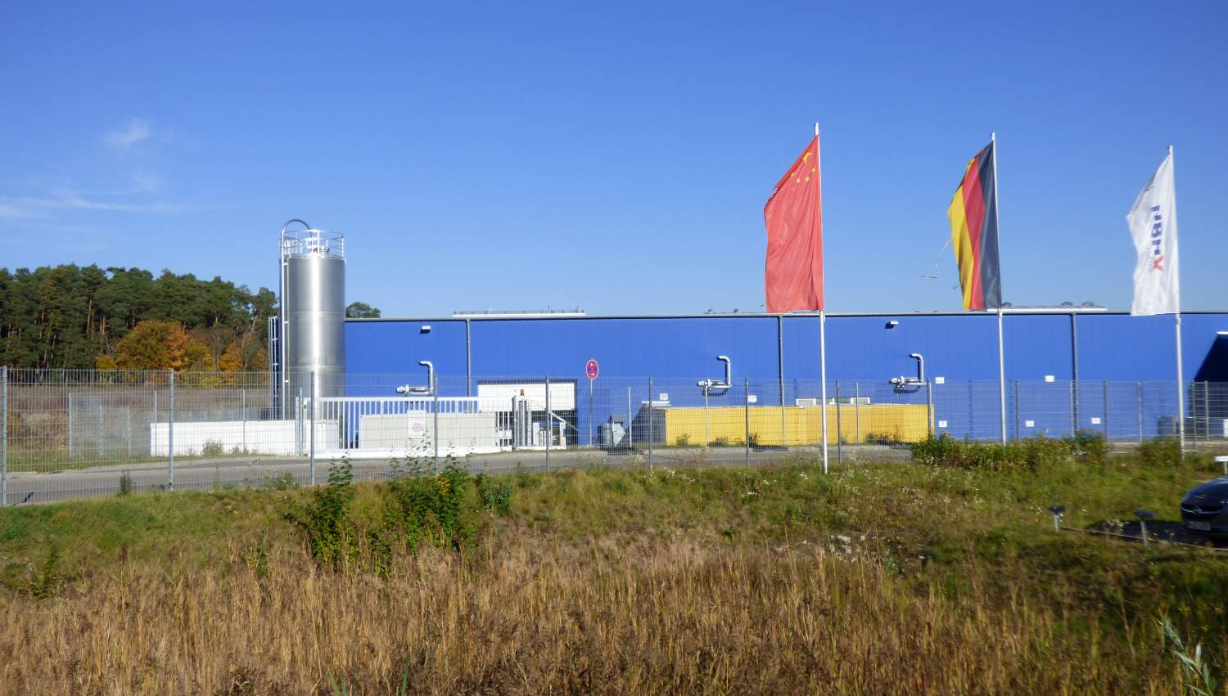


NBHX Trim GmbH, Plant Heilsbronn
NBHX Trim GmbH
Heilsbronn, Germany
Ca. 350 (Stand 2018)
1945
Plastics injection molding Plastics lacquered IMD In Mold Decoration IML In Mold Layer
ISO 50001:2011 ISO 14001:2004 IATF 16949
VW Passat, VW Touran, VW Touareg, VW T- Roc BMW: 2er Grand Tourer, 5er, Mini Countryman, Rolls Royce, X1, X2 Mercedes: E-class Volvo: S80, V40 Audi: A6, A7

Slide 10
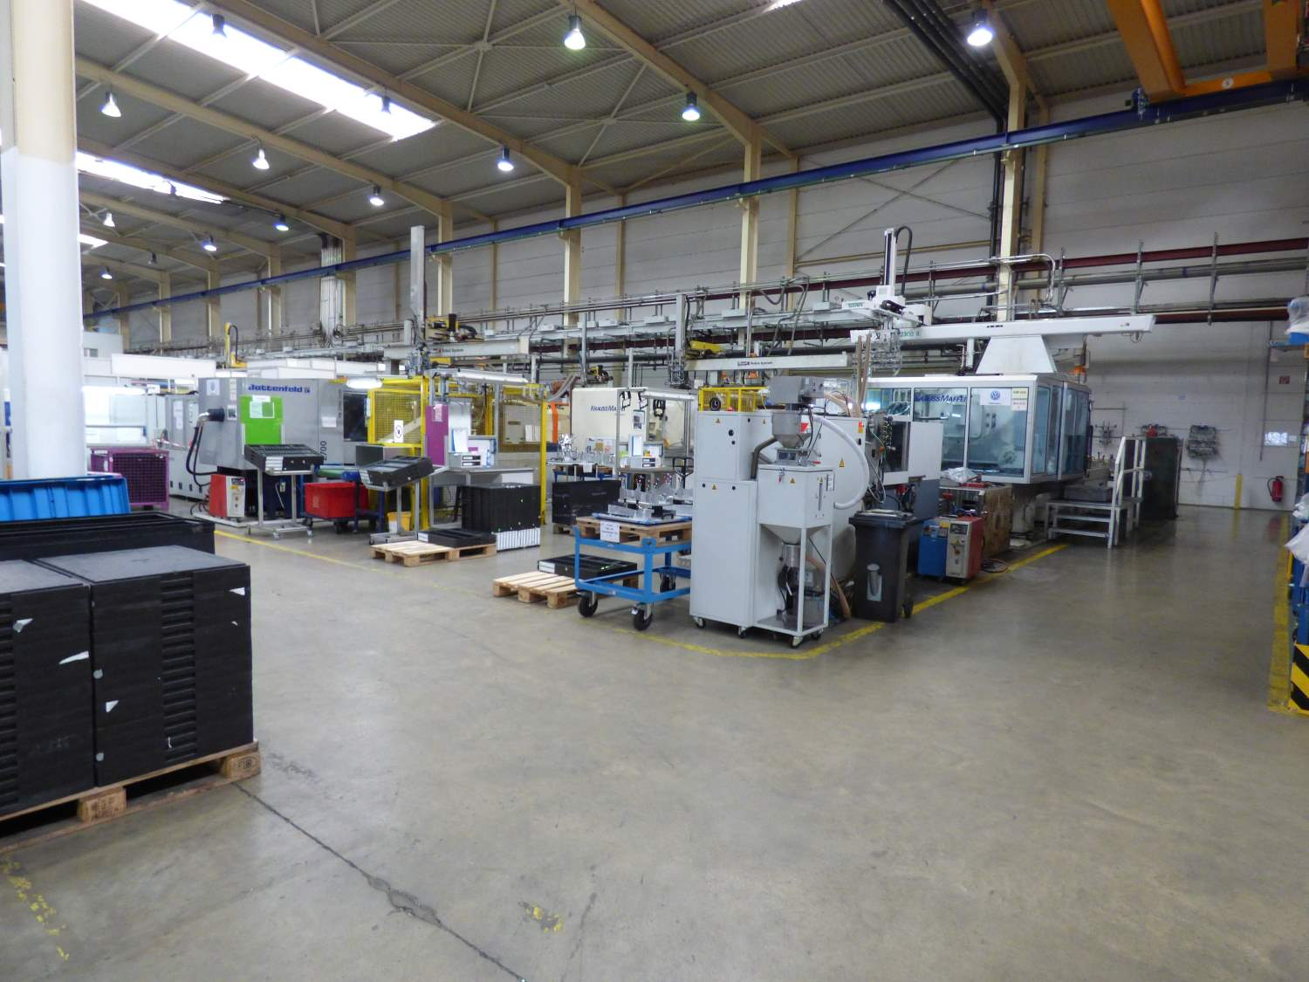
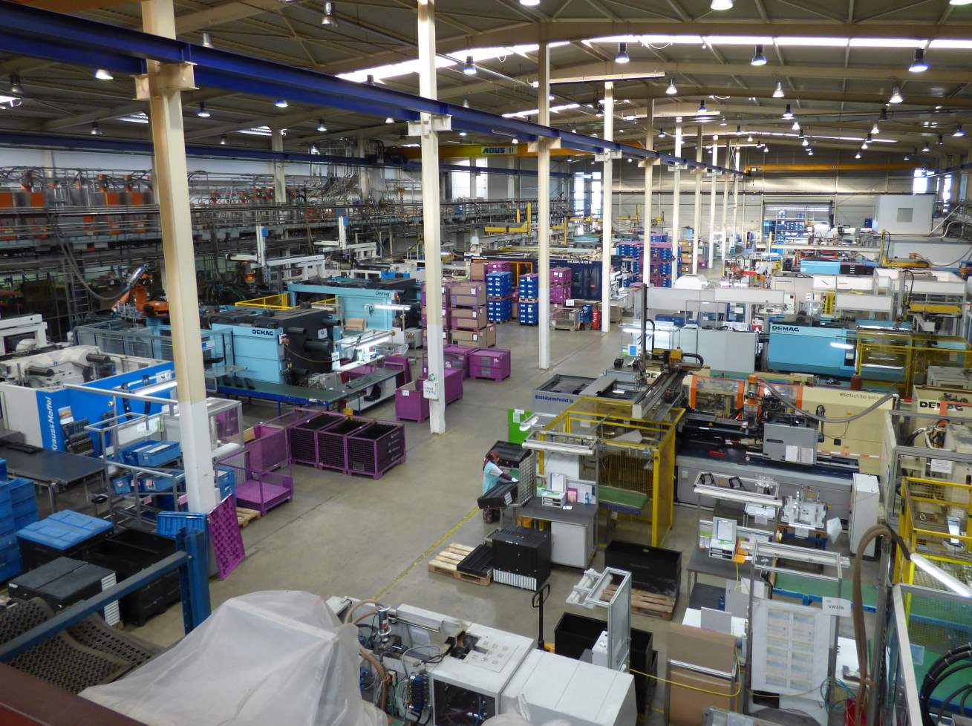
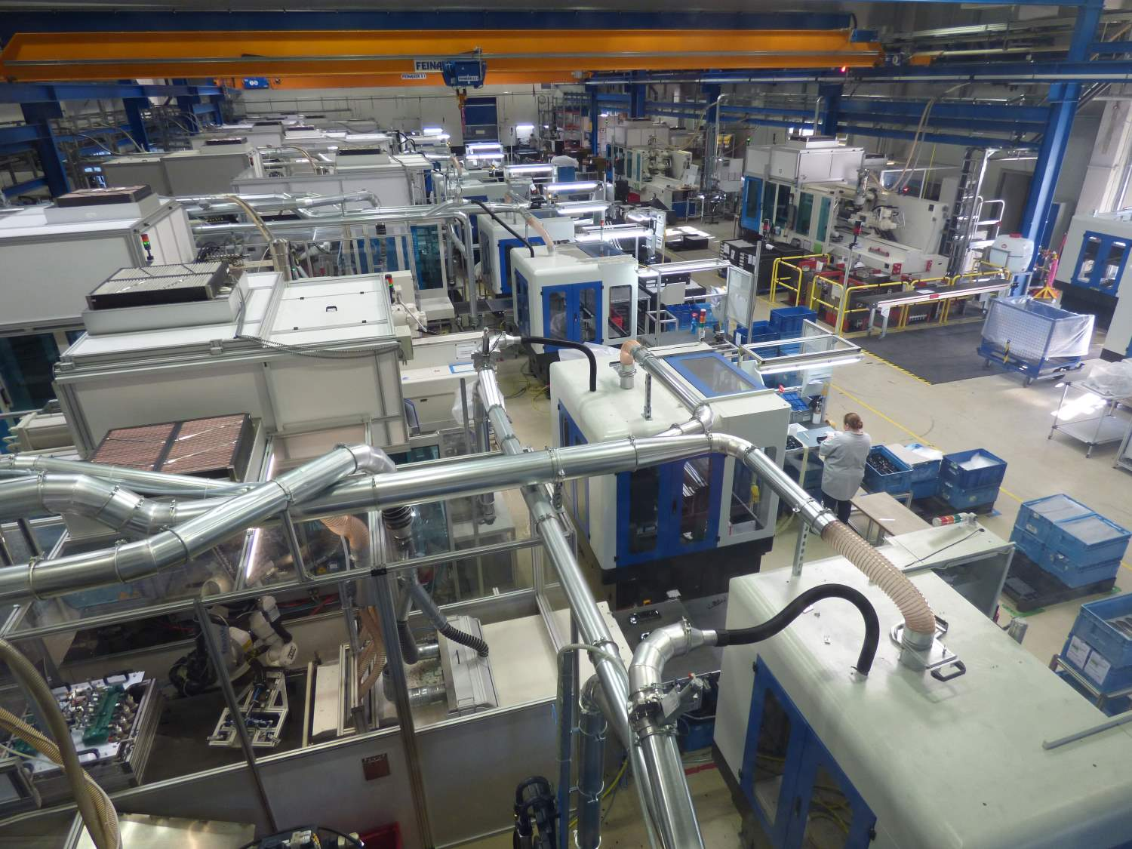
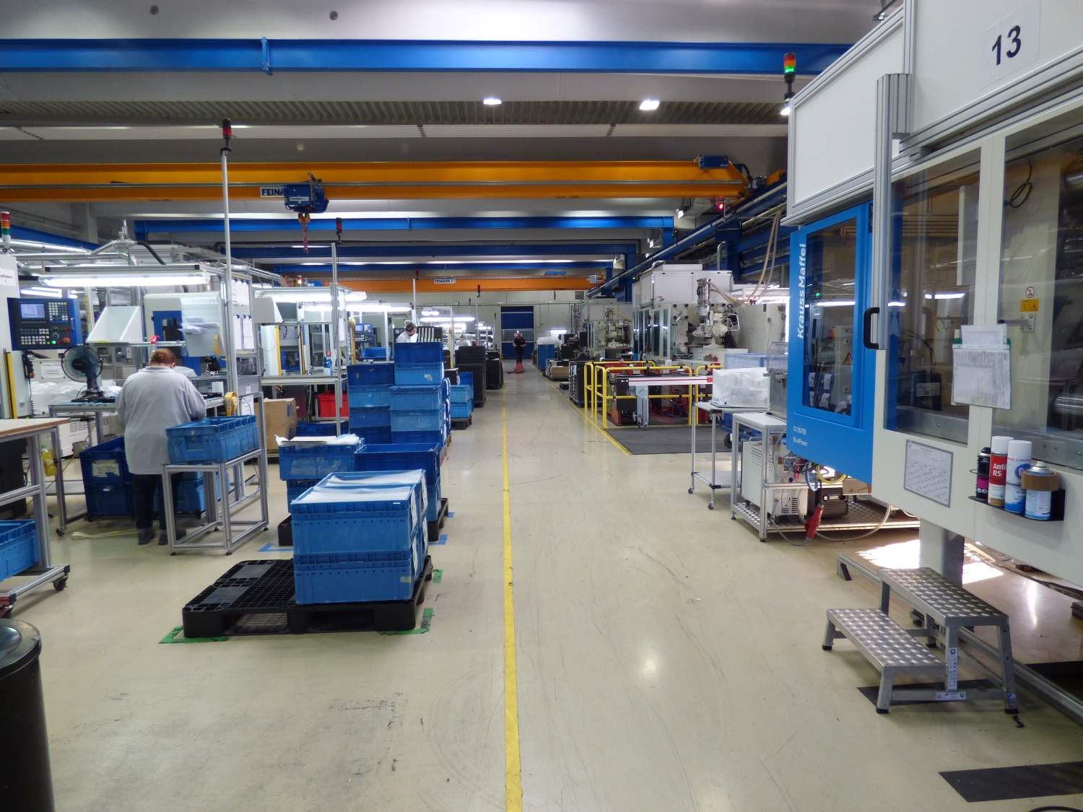
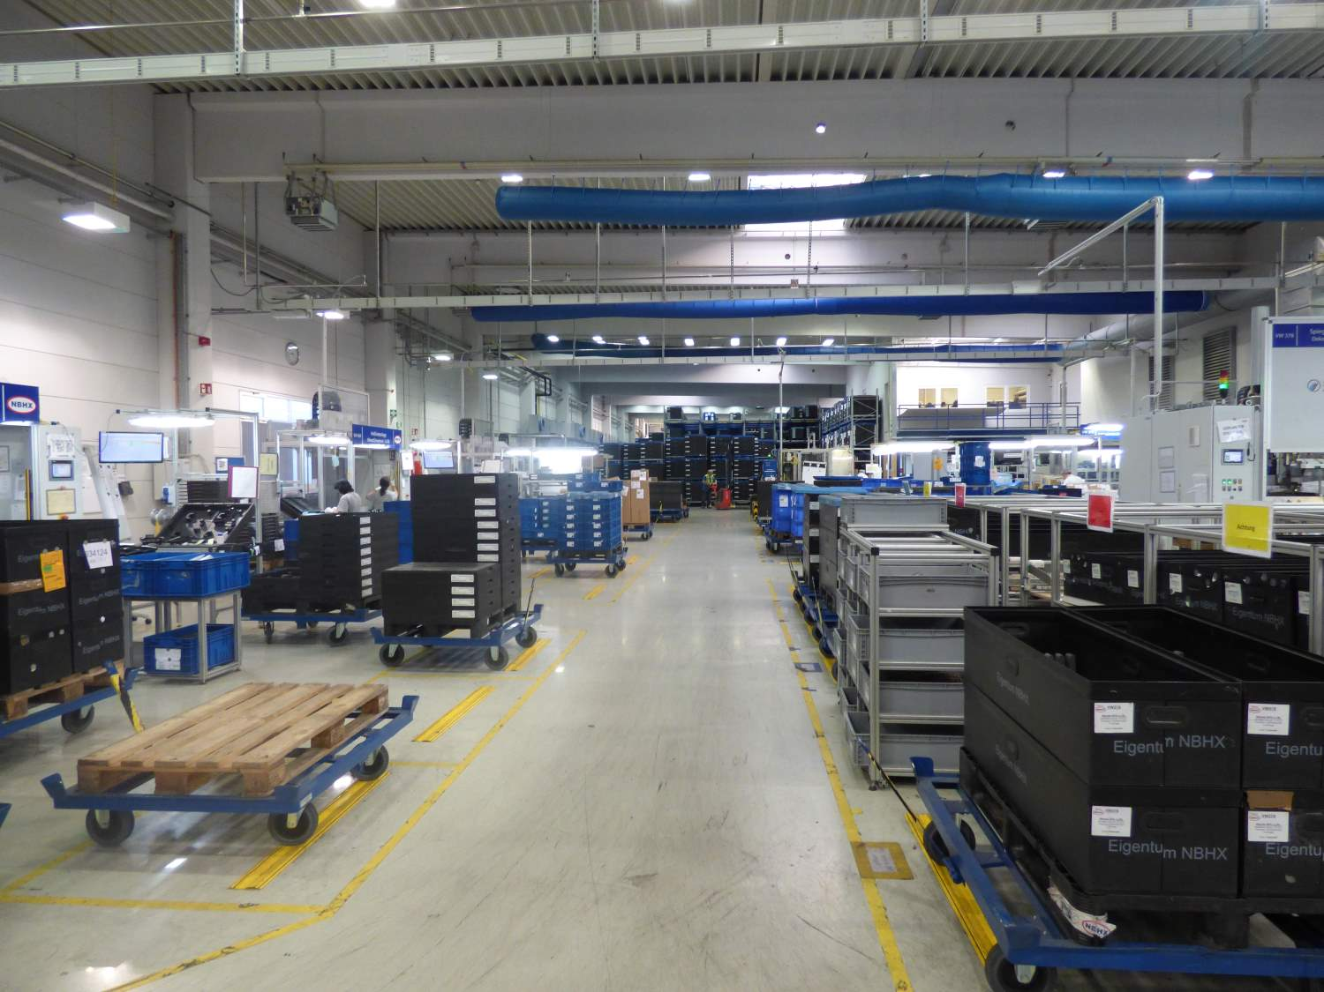
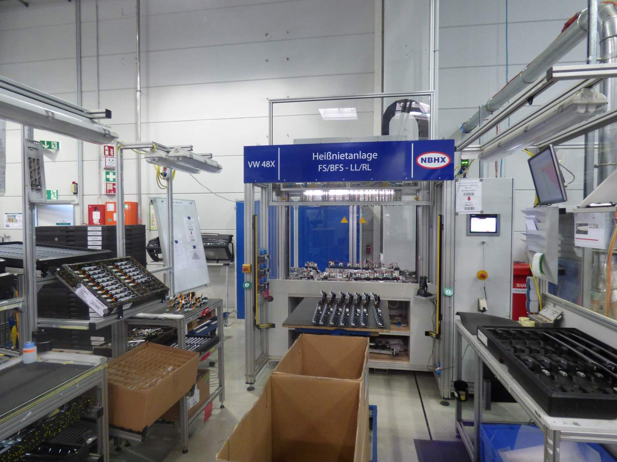
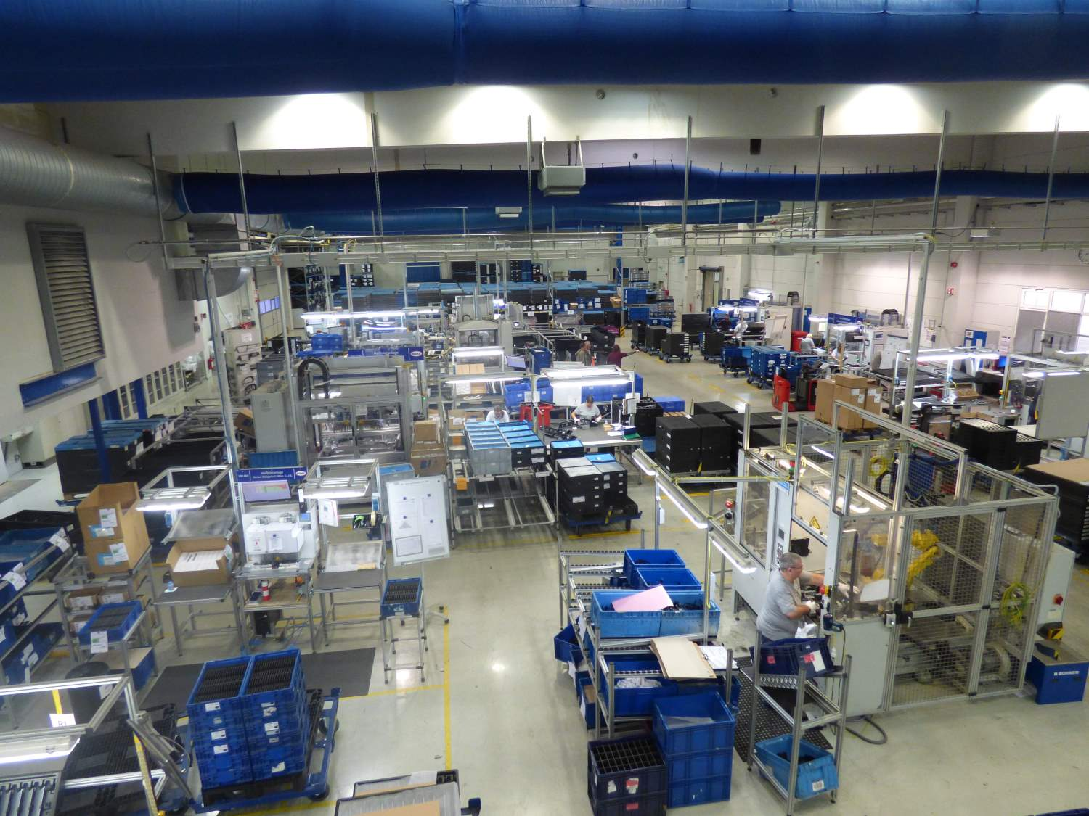
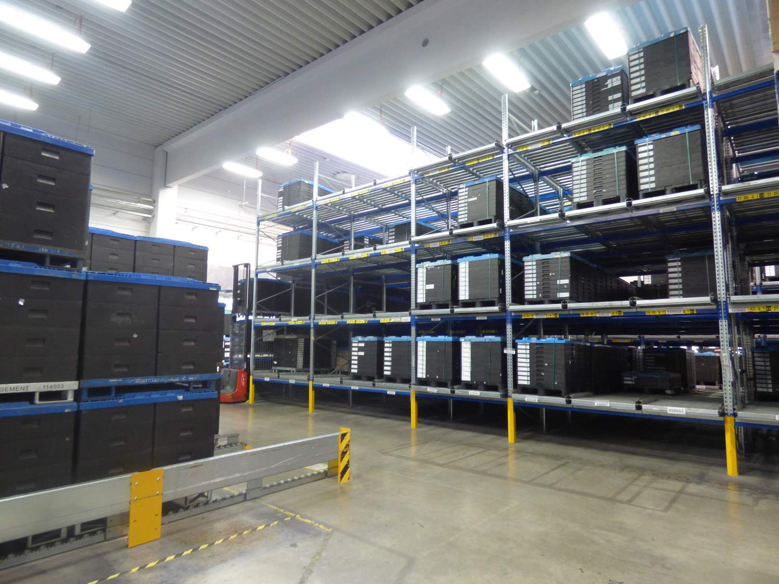
IMPRESSIONS: Plant Heilsbronn
INJECTION MOLDING
Plastic
Plastic
IMD
IMD
ASSEMBLY (One Piece Flow, „U" Assembly Line, FIFO)

Slide 11
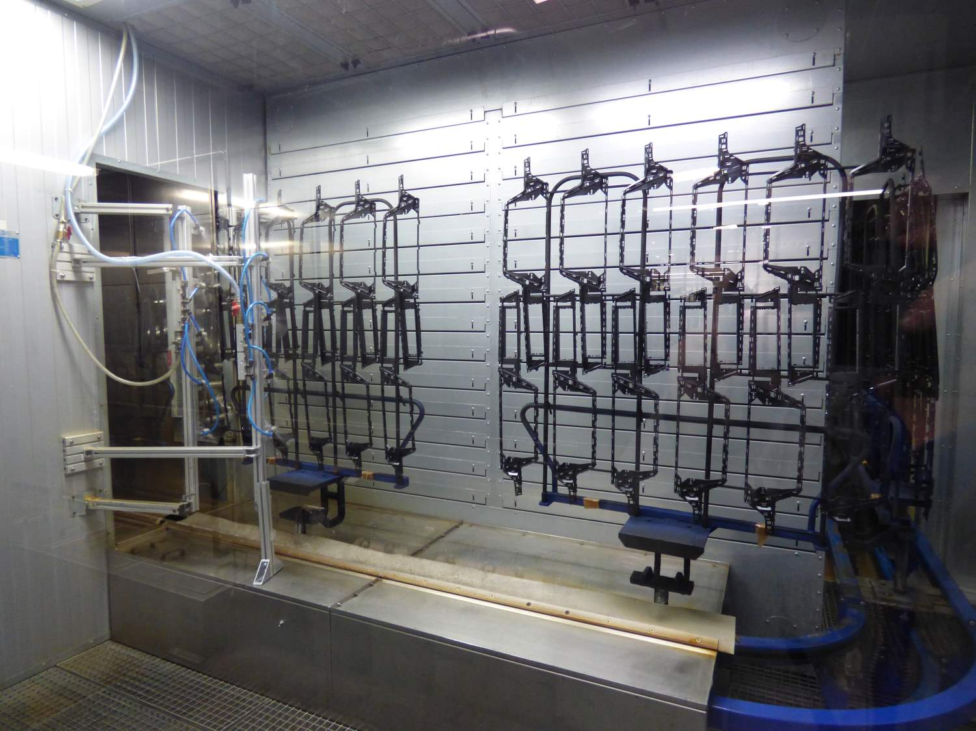
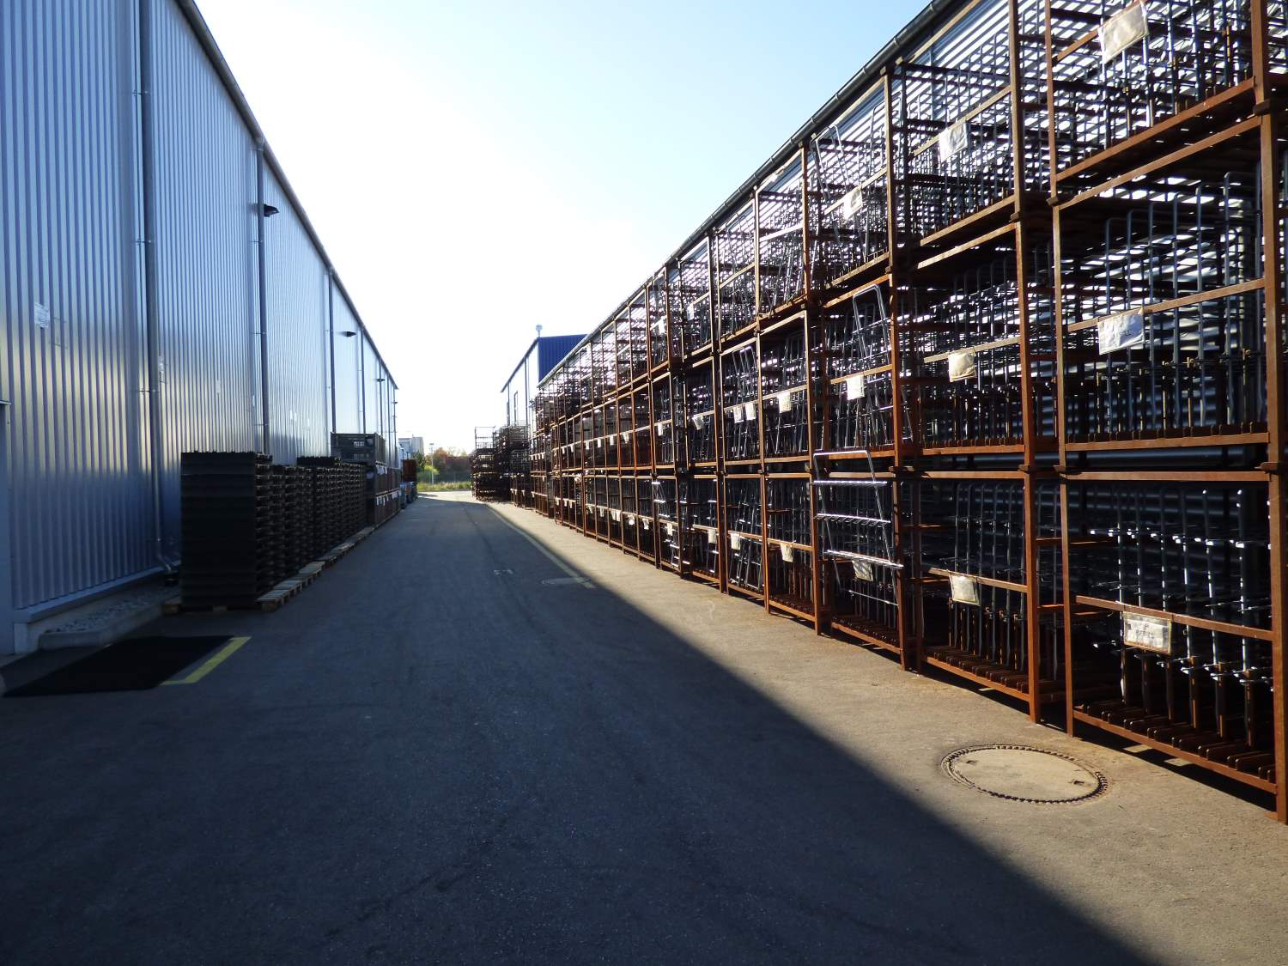
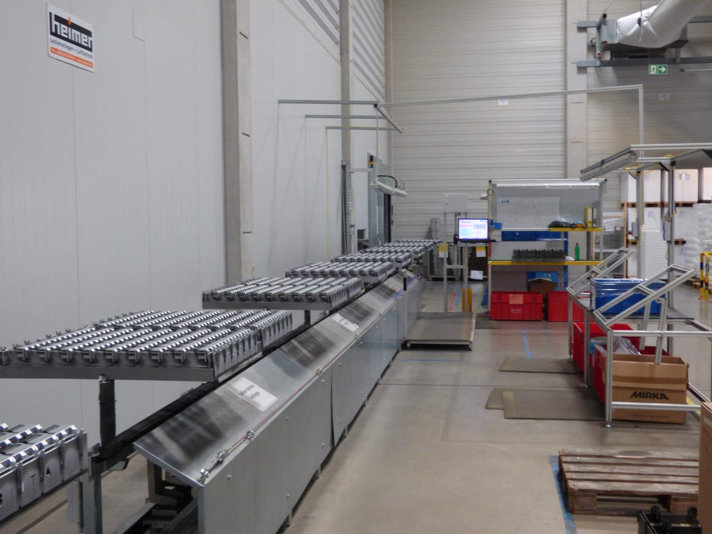
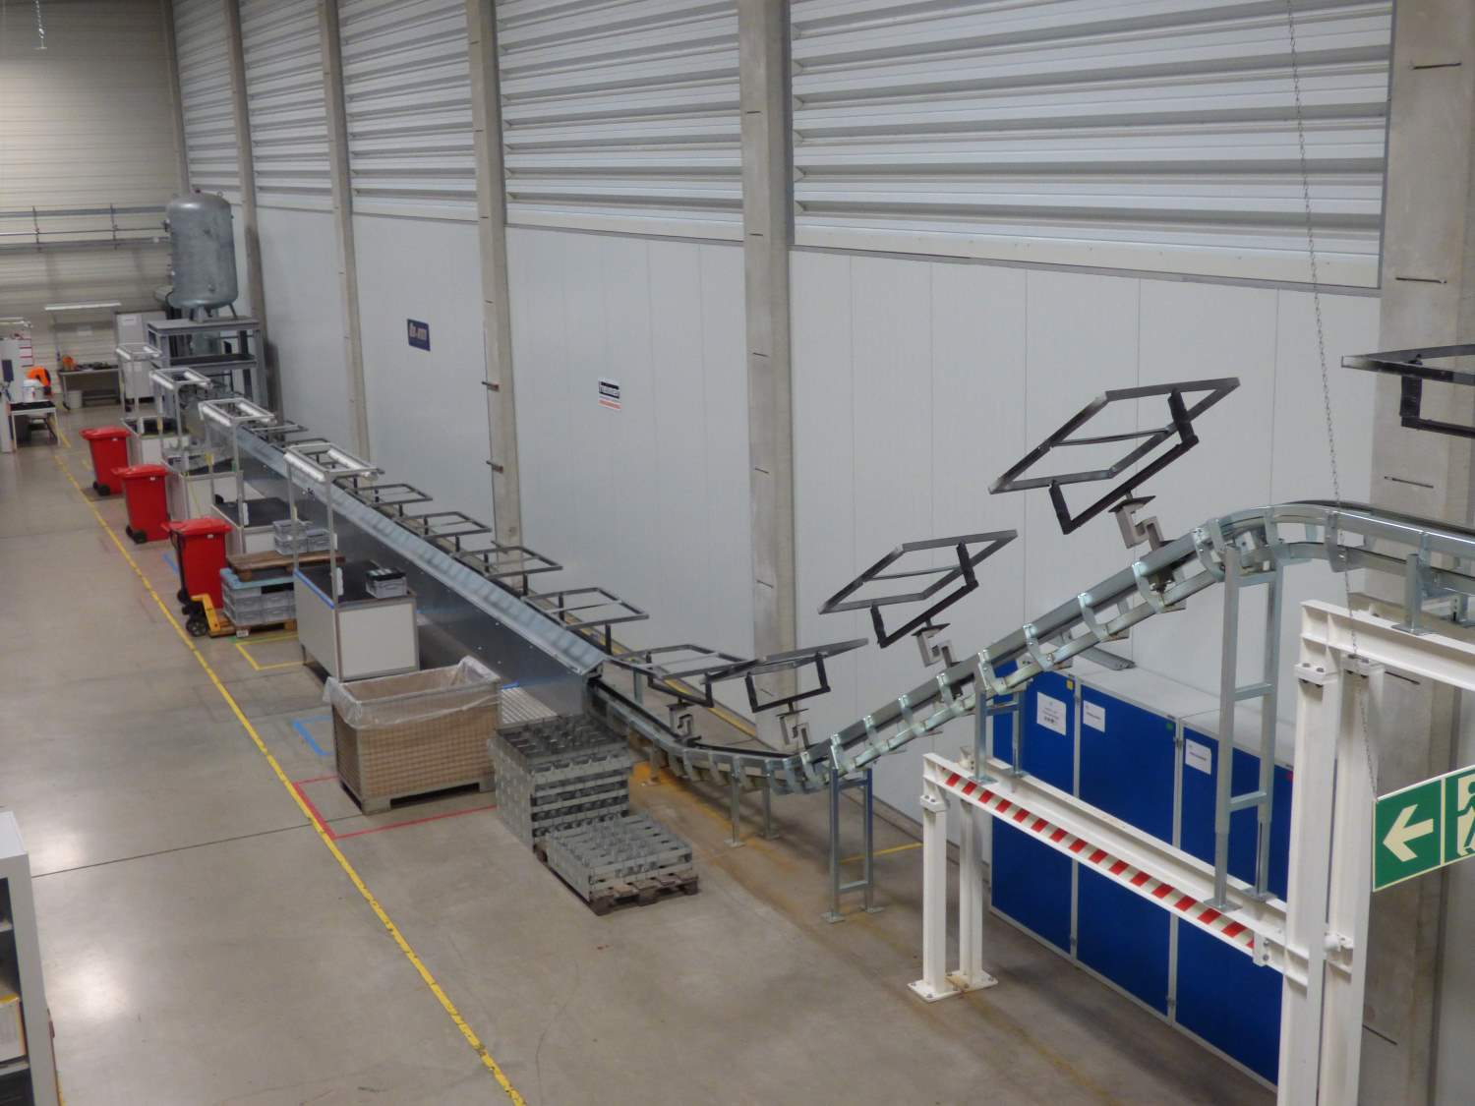
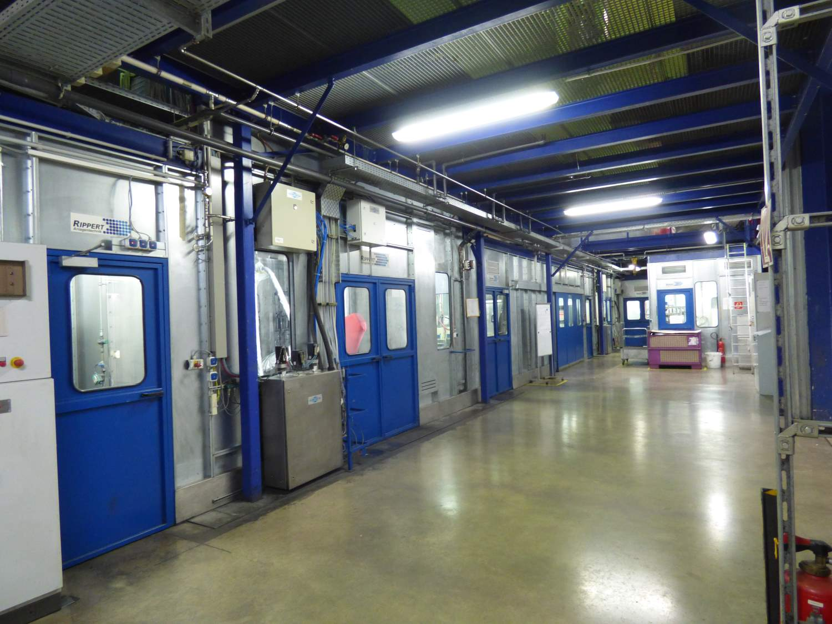
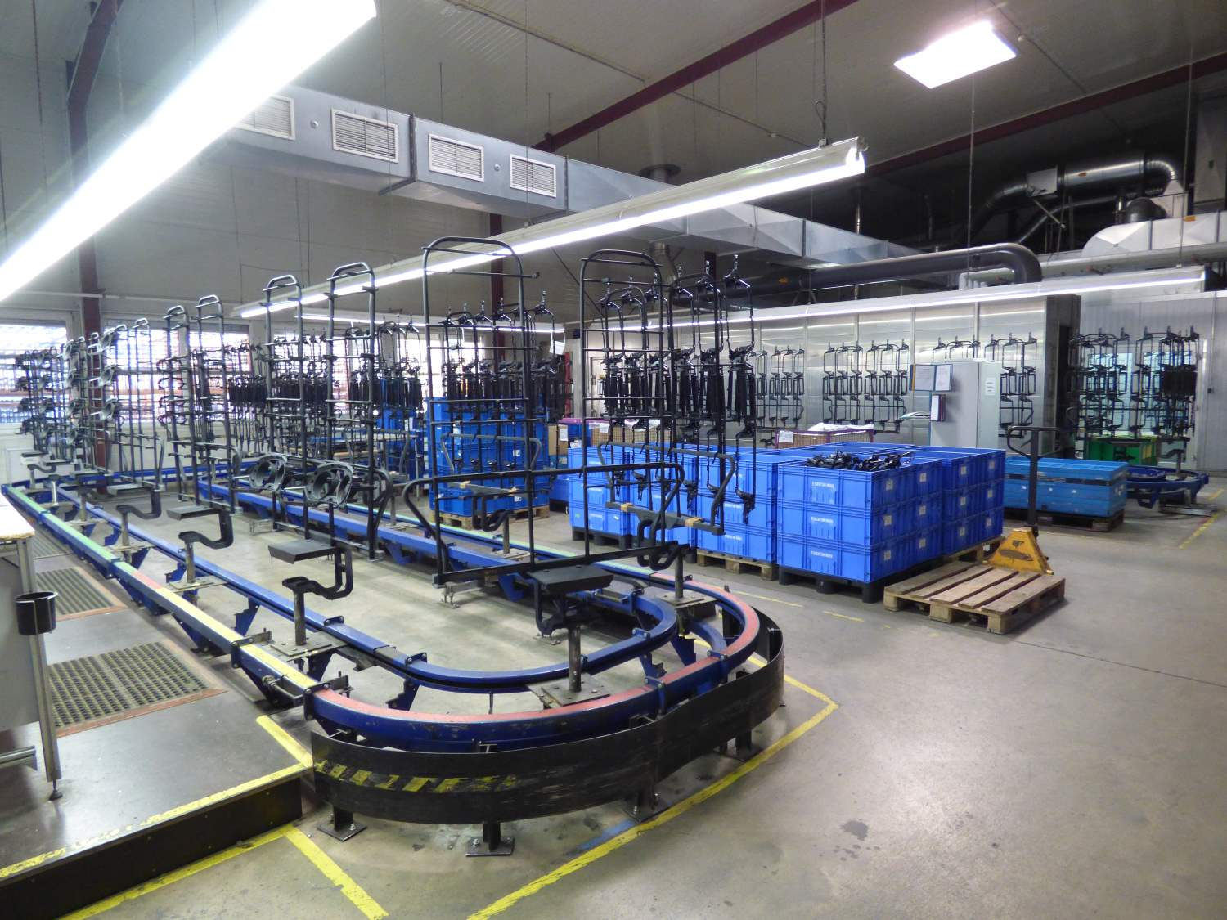
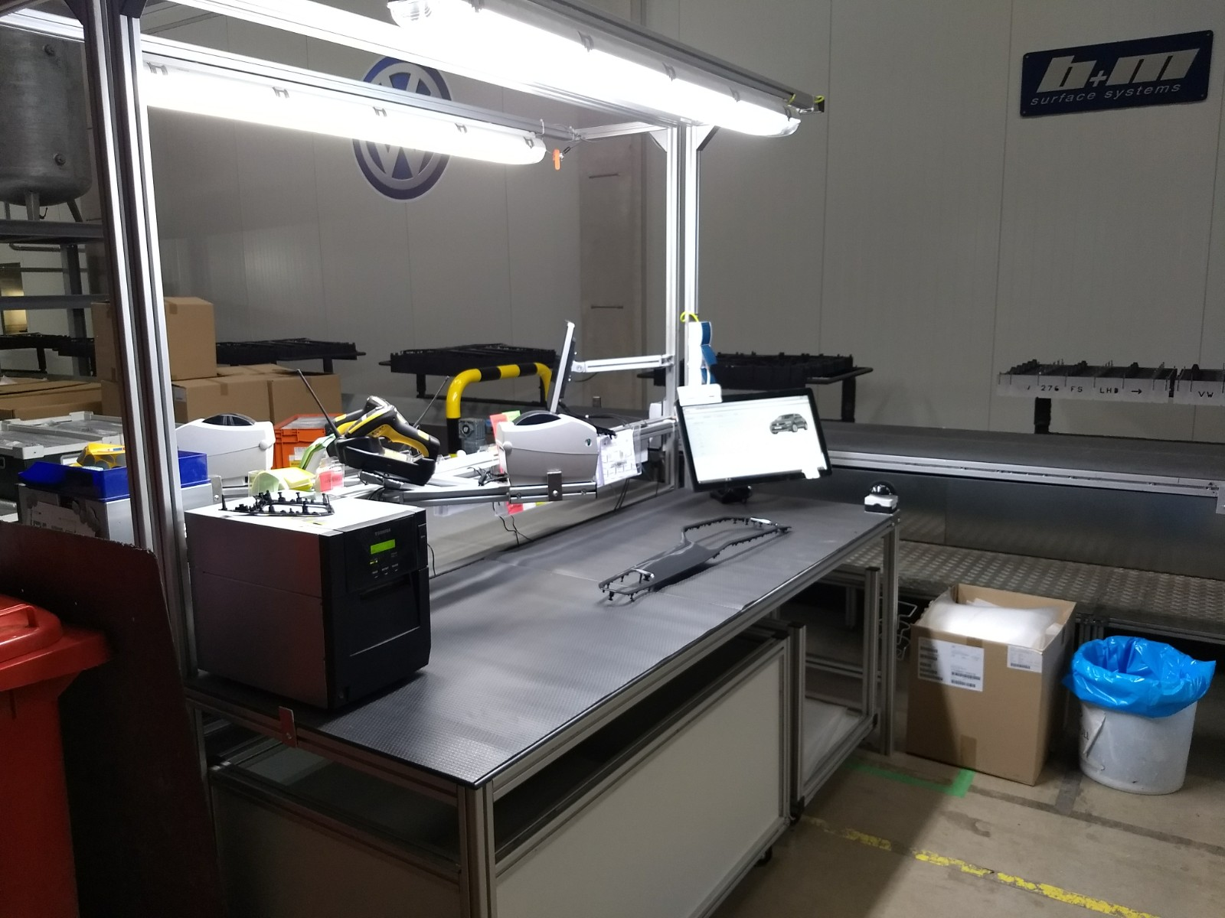
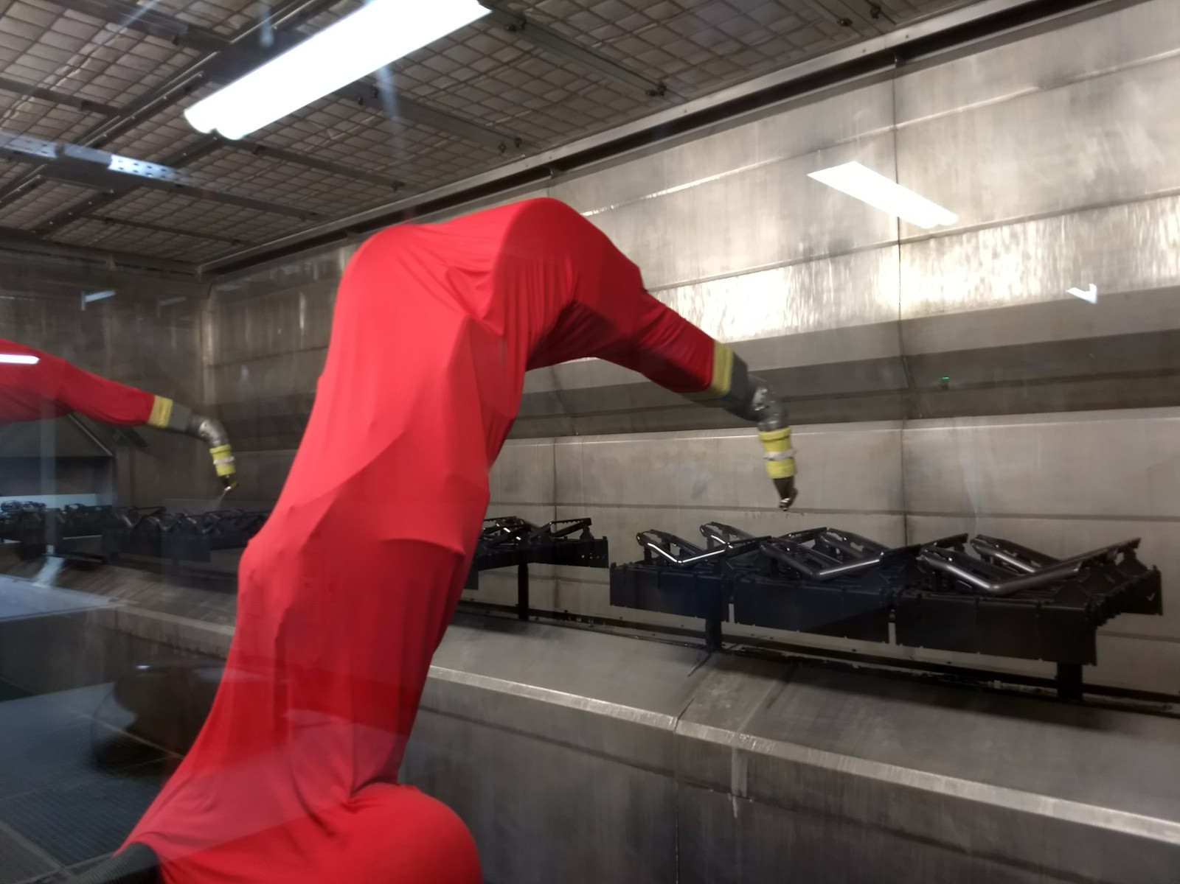
IMPRESSIONS: Plant Heilsbronn
Hall 1: Water Solvent Painting
Hall 2: Enamel Solvent Painting
Drying
Painting Fixtures
Part Fix
Conveyor System
Painting Cabin
Fix and Pick
Quality Check
(Computersied Booking)
Painting Cabin

Slide 12
We make your future

Slide 13
THANK YOU!
NBHX TRIM GROUP - NBHX Trim GmbH
Gutenbergstr. 30 | 91560 Heilsbronn | Germany
info@nbhx-trim.com | www.nbhx-trim.com
phone: +49 9872 80228 0

