Slide 1

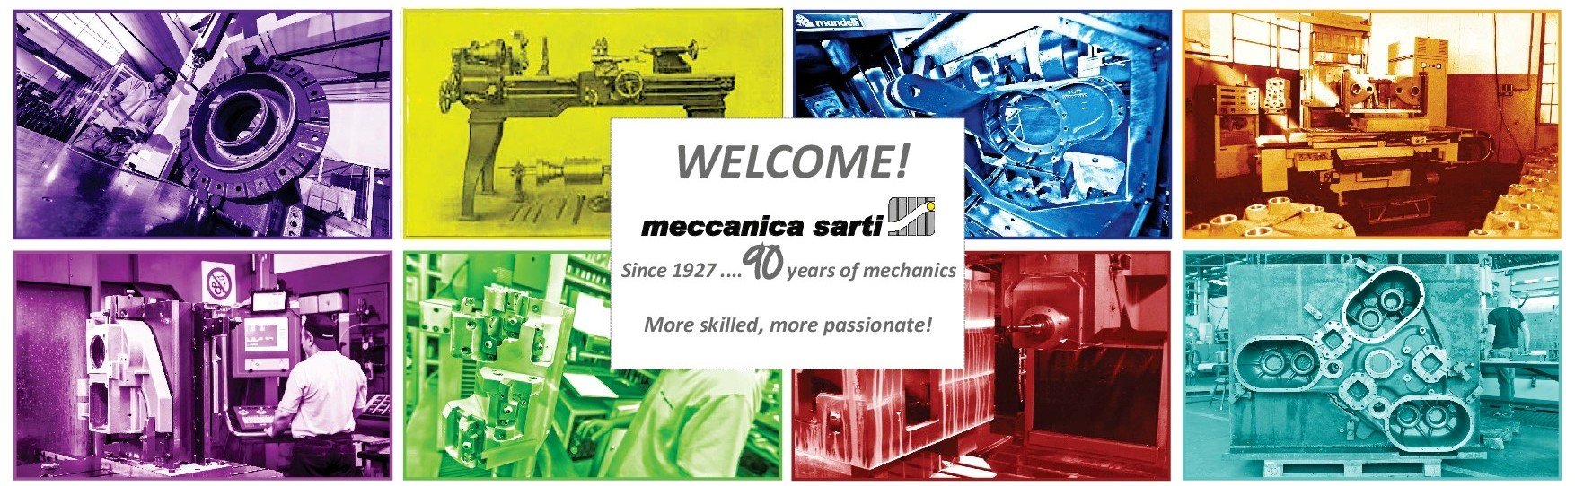

Slide 2
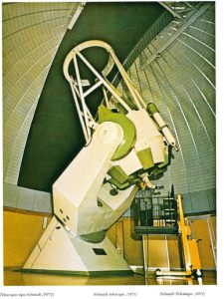
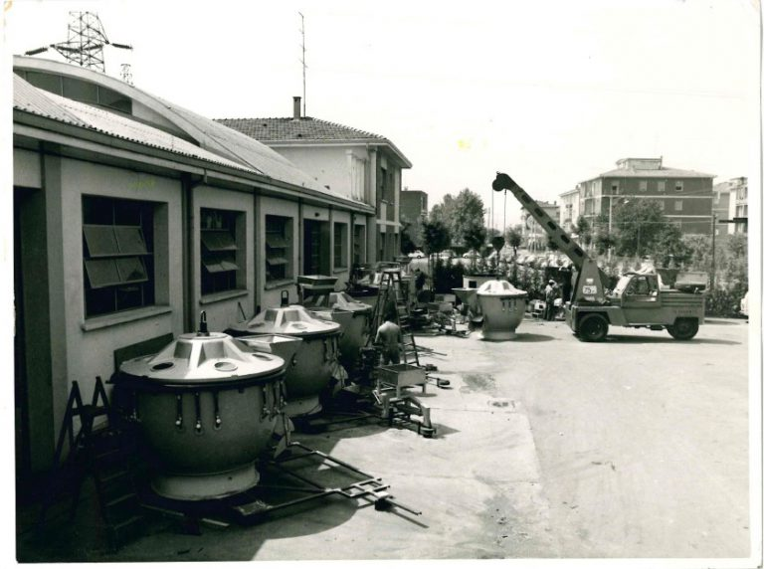
Meccanica Sarti was born in 1927 and dedicated its first decades to scientific and special productions
Today the 3rd and 4th generation of the family work together to serve costumers in different industrial sectors.

Slide 3
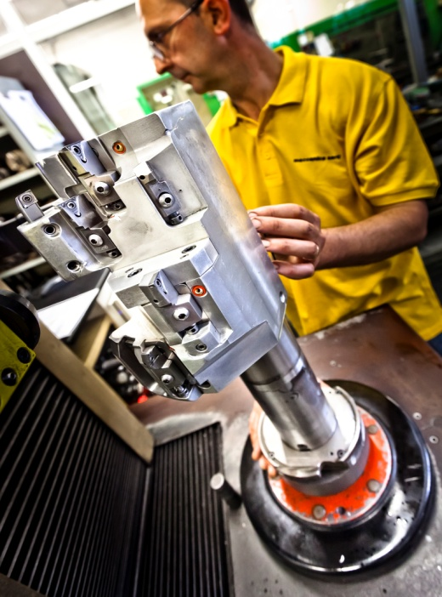
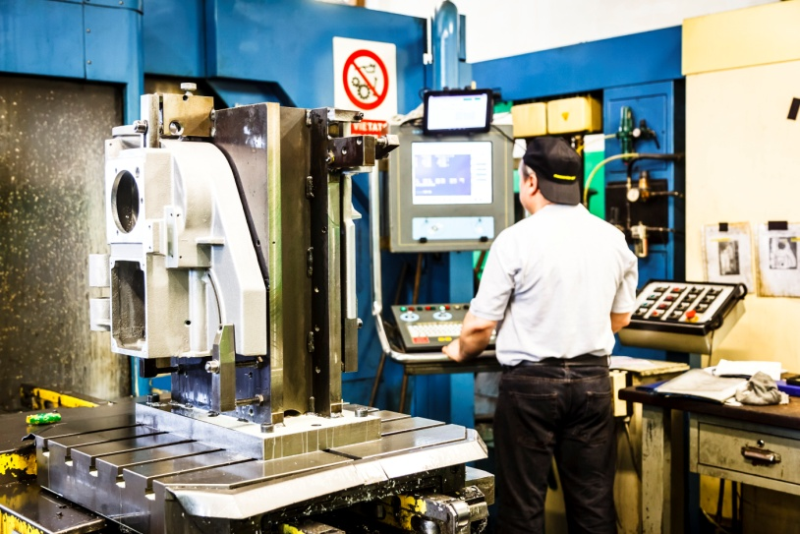
Since the ‘70 we introduced numerical control machines and today we dispose of the most modern technologies in our sector, accomplying Industry 4.0

Slide 4
Ownership
Production
Quality
Prevention and Safety
Maintenance
IT
CN study and program
Tool room
Operators
Dimensional controls
Logistics
Administration
Finance
Production control account→ accounting
Sales
Order handling
Marketing
Purchasing
Suppliers researches
Cost containment
Flow Chart

Slide 5
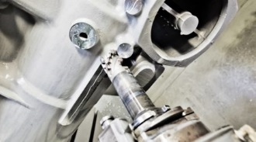
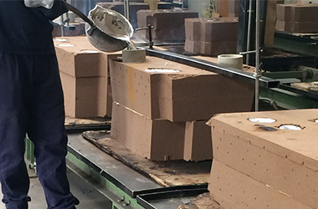
Today we are able to manage the entire supply chain to serve our customers from the drawing to the part ready to be assembled:
STEP 2
Machining
4 Work centers 800x800x800
4 Work centers 1400x1400x900
4 Work centers 2800x2800x1500
STEP 1
Patterns and castings
We have no problems on the size of the parts to be made, up to a maximum weight of 2 tons.
We manage batches from of 4-5 pcs up to 150-200 pcs / month, and we can achieve higher quantities.
Grey and spheroidal cast iron - Alluminium
Mechanical Carpentry
Coengeneering with pattern makers and foundries
Study and internal execution of clamping tools, working cycles and special tools.

Slide 6
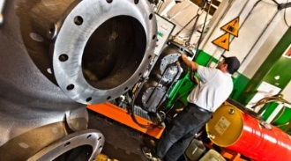
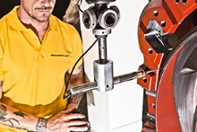
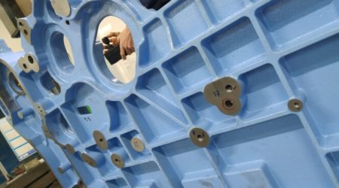
STEP 4
Leaking tests internally carried out
STEP3
Dimensional checking
3 Three-dimensional geometric testing machines → Testing comparisons always available by customer
Testing machine for prototypes of castings and welded production.
STEP 5
Painting and treatments
Management of external suppliers

Slide 7
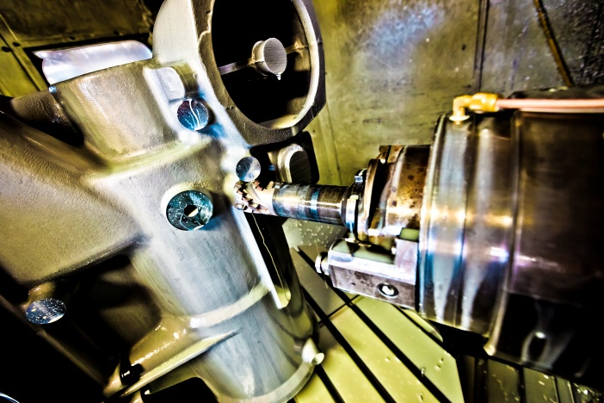
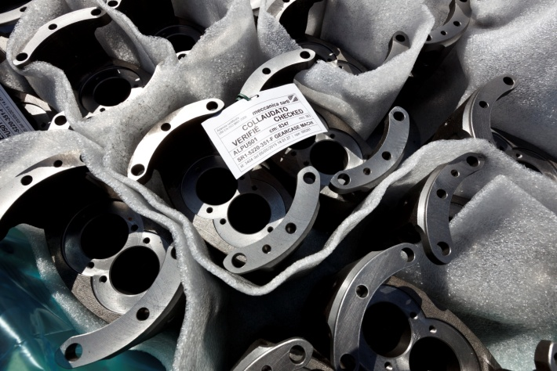
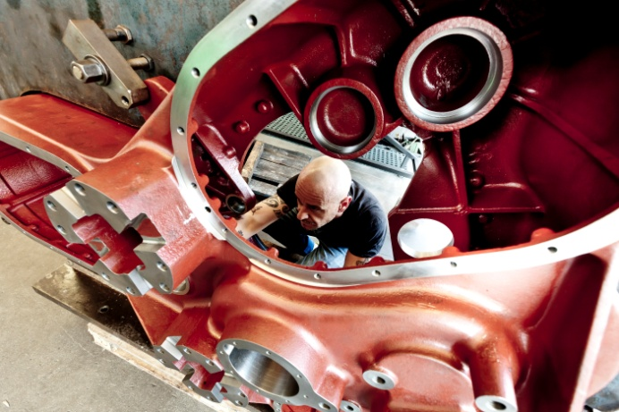
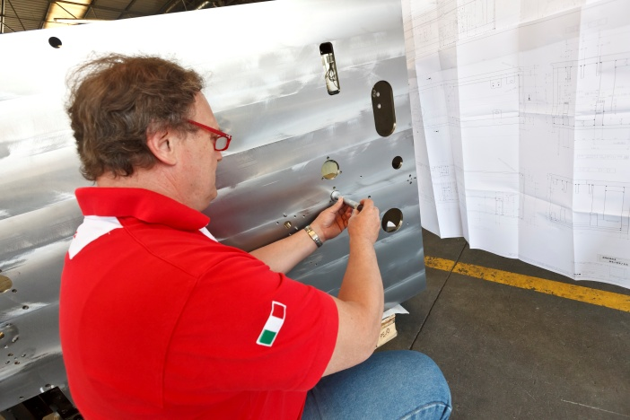
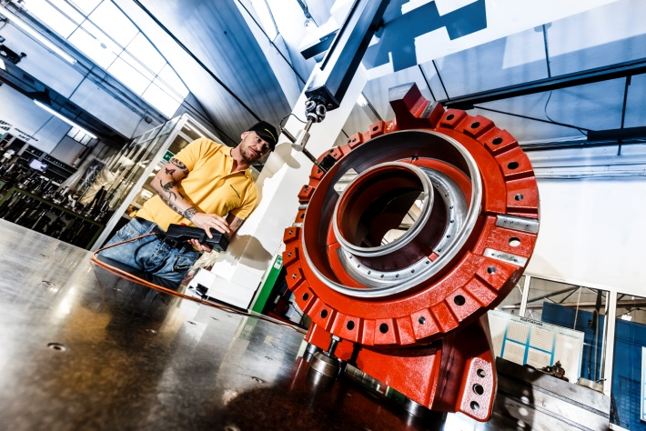
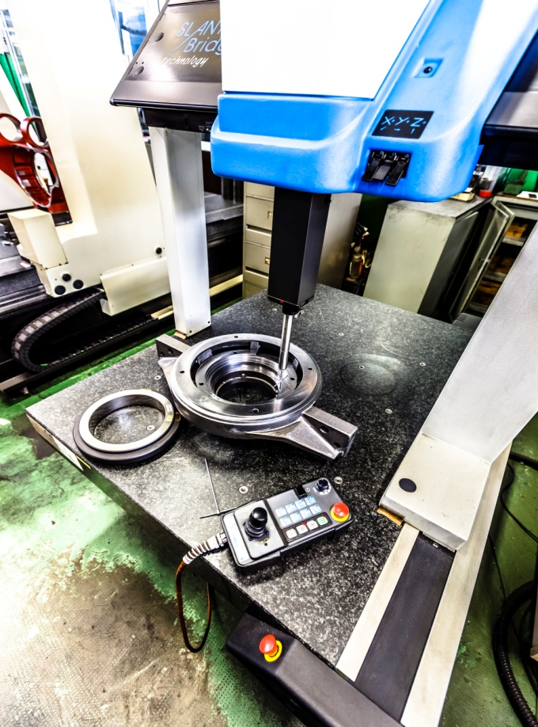
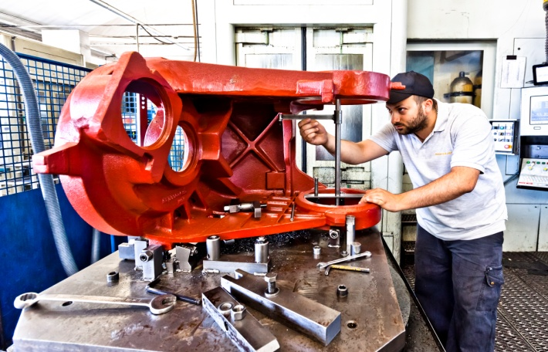
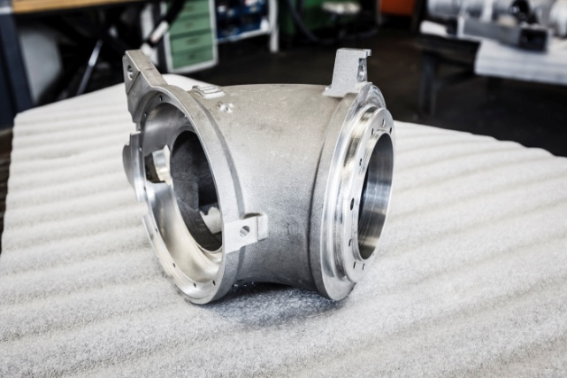

Slide 8
Markets we supply

Slide 9
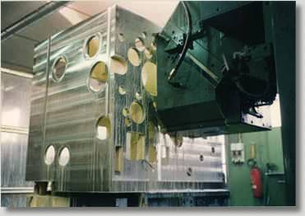
Possibility of serving Customers with Consignment Stock or following Forecasts
We act as correctors between foundries language (ton/day) and Customer needs(pcs/week)
Continuous investments in technological innovation (IT services, tools, tooling machines retrofitting)
We are participated by an international group of packaging sector

Slide 10
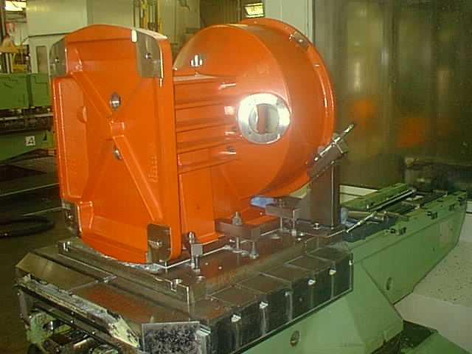
Delivery on time
99% DOT following agreement with main Customers
Every Monday a meeting with:
- Customers Resp.
- Production Resp.
- Purchase Resp.
- Logistic Resp.
- General Manager
3 times per week direct contact with foundries and suppliers

Slide 11

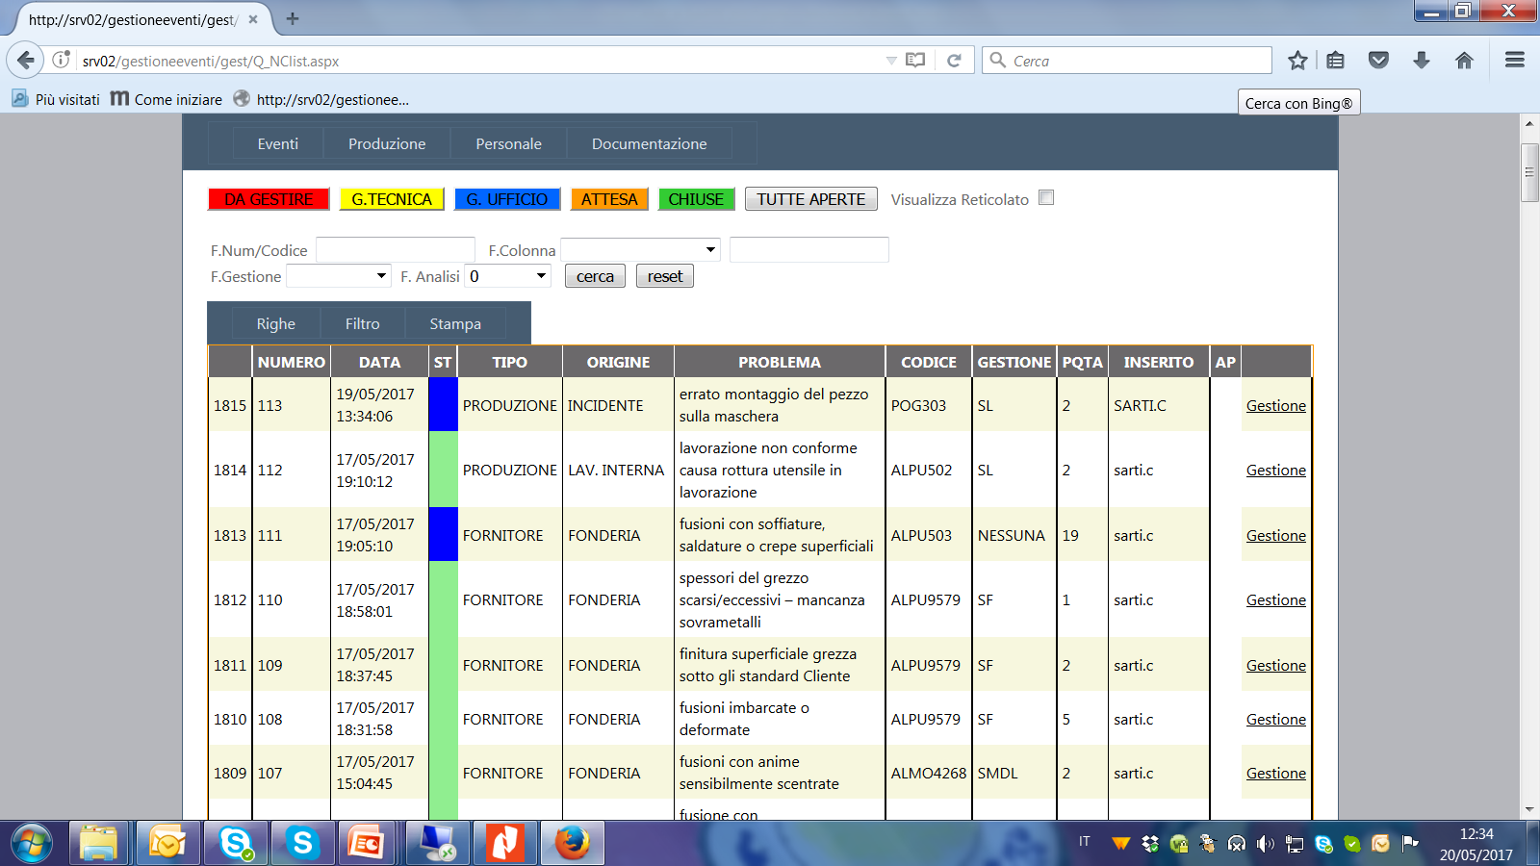
Quality
Iso 9001 certified since 2005
Event management system, from incoming material control to internal incidents, to the possible customer claim and consequent corrective actions

Slide 12

Quality
ISO 9001: 2015 : in 2017 we succesfully obtained update to 2015 norms
An internal system underlines eventual not conformities of previous productions next to tooling machines
Checking responsibles: 1 inspections per day for every tooling machine/code
Continuos exchange of information with foundries in order they check parts and avoid scraps:

Slide 13
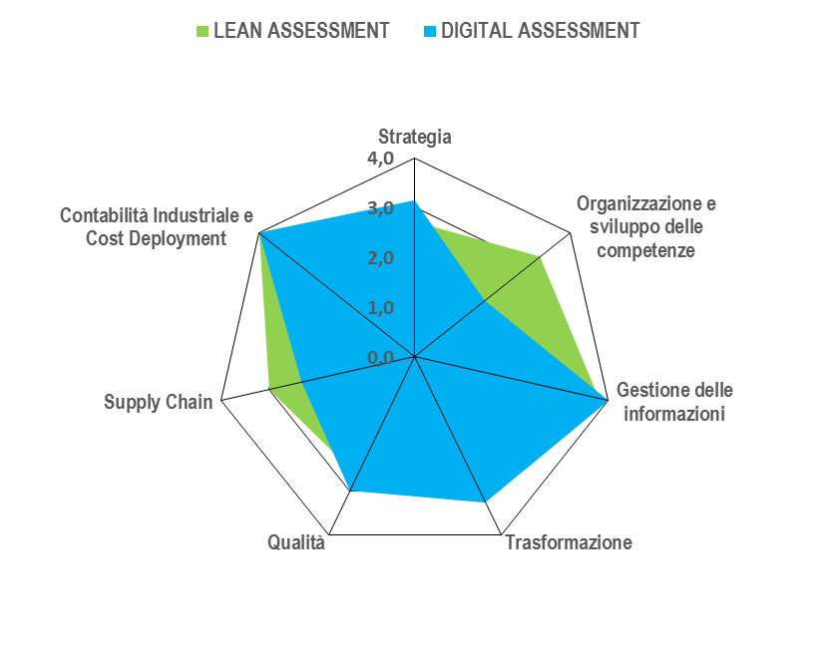
Digitalizations of Processes and Production Control
(Stated during a recent Industry 4.0 assessment)

Slide 14
THANK YOU FOR YOUR ATTENTION

