Slide 1




P R E S E N T A T I O N

Slide 2
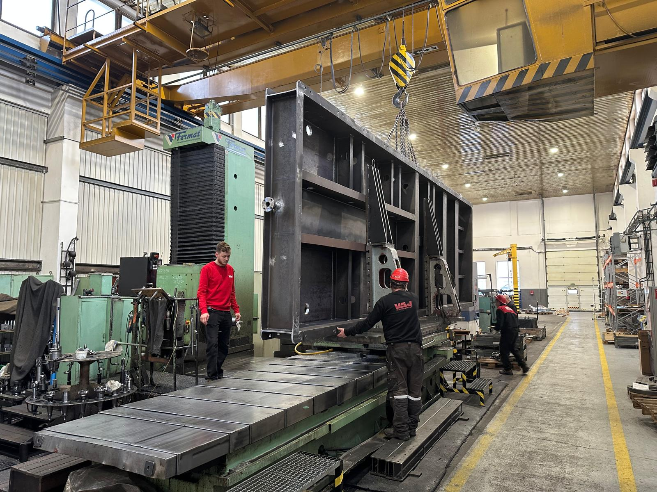
P R E S E N T A T I O N
OUR COMPETENCY
Since 2004, the philosophy of VSJ-MACHINERY has been based on high-quality products, the development of new technologies and high reliability. From sales to design and production, logistics and commissioning, our qualified employees meet the high demands of our customers, this gives VSJ-MACHINERY a high position in innovative solutions. We have sufficient production capacity and we are able to offer both serial, small-batch or piece production. Our company is located in the industrial zone in Planá nad Lužnicí at the D3 motorway exit (EXIT 84).

Slide 3
P R E S E N T A T I O N
OUR PRODUCTION PROGRAM
CNC Milling
CNC Turning
CNC Drilling
MIG/MAG, TIG Welding
CNC-Flame Cutting
Annealing, Blasting, Painting and other Surface treatments
Production of single-purpose equipment
Production and handling of parts up to 10 tons
Conveyor machines for material transport
Processing equipment for industry and recycling
Production and assembly of spare parts and jigs
Increasing the service life of machine components
Relocation of machinery and equipment
Assembly work

Slide 4
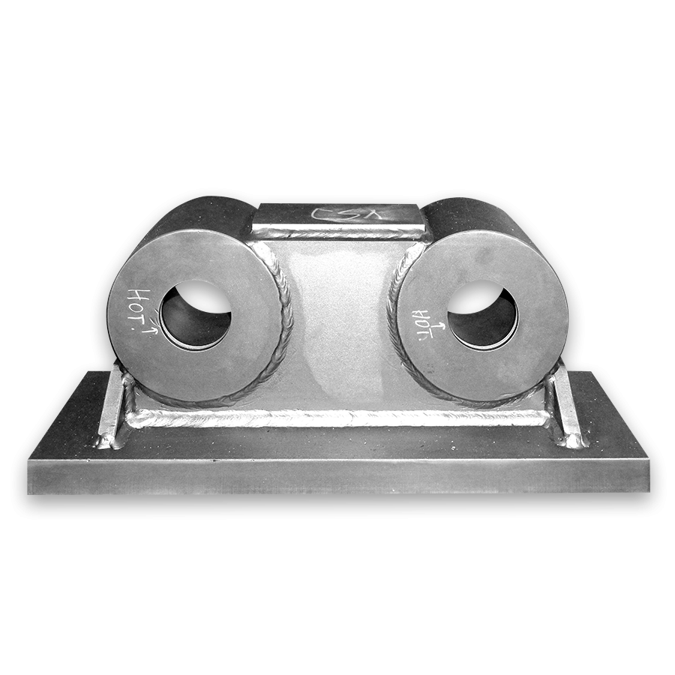
P R E S E N T A T I O N
MACHINERY– CNC MILLING
Vertical Milling Center AWE A+1600
Control System: FANUC - Series 18i - MB
Vertical Milling Center FERMAT VMF 1000 CNC
Control System: FANUC - Series Oi - MC
Load | Rotation Speed | Dimensions
20 kW | 6.000 rev/min. | 1.600 x 800 x 800
Load | Rotation Speed | Dimensions
- | 10.000 rev/min. | 1000 x 500 x 570
Vertical Milling Center HYUNDAI VX 500
Control System: FANUC - Series 21i - MB
Vertical Milling Center YCM XV 560 A
Control System: FANUC - MXP - 100FA
Load | Rotation Speed | Dimensions
15 kW | 8.000 rev/min. | 1.060 x 510 x 635
Load | Rotation Speed | Dimensions
11 kW | 10.000 rev/min. | 560 x 410 x 450
Horizontal Drilling Machine WHN 13 B CNC
---
Horizontal Drilling Center MORI SEIKY SH 633
Control System MORI FANUC - MSG 502
Load | Rotation Speed | Dimensions | Indexing
38 kW | 2.800 rev/min. | 3.500 x 1.900 x 1.700 | osy – B
Load | Rotation Speed | Dimensions | Indexing
30/25 kW | 10.000 rev/min. | 840 x 760 x 840 | Axis – B
Knee-type Milling machineFGS 40
External dimensions of the workbench
1.600 x 400

Slide 5
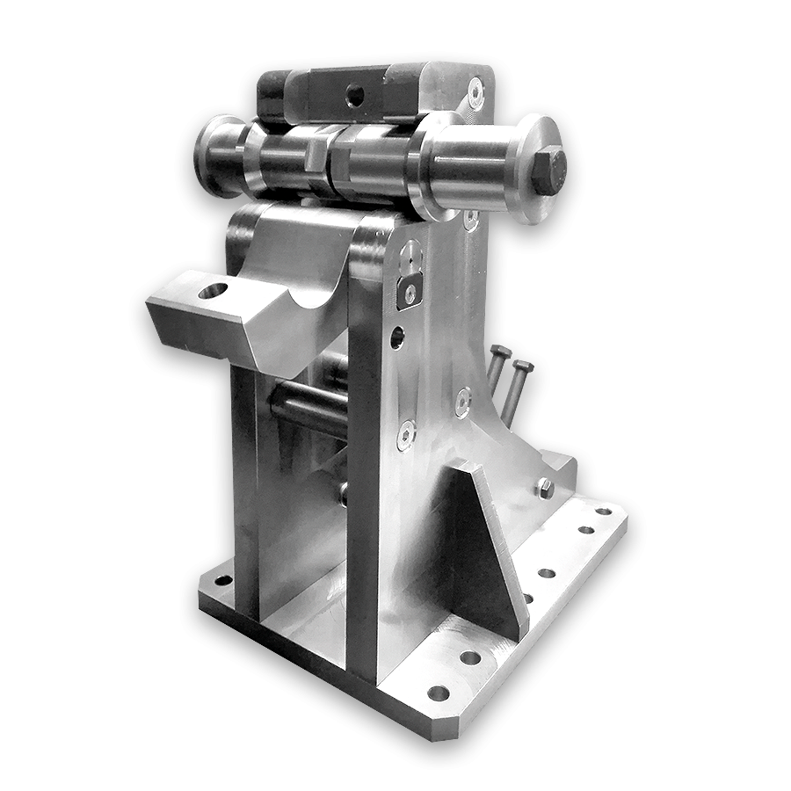
P R E S E N T A T I O N
CNC MACHINERY - TURNING
CNC Lathe PUMA 240 M
Control System: FANUC – series Oi-MK
Lathe SPT 32 NC
---
Rotation speed | max. Lathe length | max. diameter above bench
4.500 | 530 | 550
12 x Driven tool
Load | Rotation speed | Max. turning length | Max. diameter above bench
30 kW | 2.240 rev/min. | 1.500 | 490
Measuring Equipment Mitutoyo LINEAR HEIGHT 600EG
Universal Centre Lates
Max. measuring dimensions | Calibration
1.200 x 800 x 150 | 0,001/0,0001 mm up to 1000 mm
Type | Max. length | Diameter above bench | Diameter above support
SUI 40 | 2.000 | 400 | 220
SUI 63 | 3.500 | 630 | 360

Slide 6
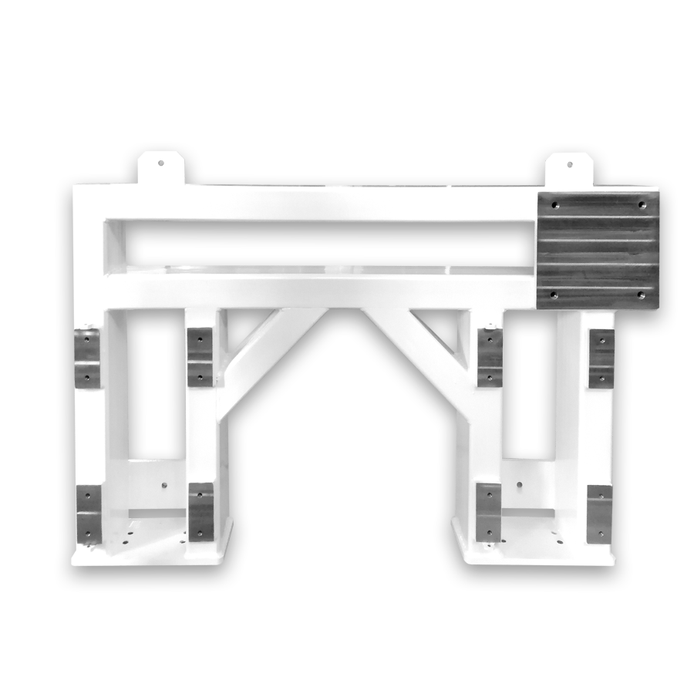
P R E S E N T A T I O N
WELDING
We guarantee professional welding either on the basis of your drawings
or processed by our designers.
We carry out production both from our own stock or from material supplied by the Customer.
Our capacity capabilities allow us to handle weldments weighing up to 10 tons.
We offer:
CO2 welding
MAG-, TIG-, MIG-welding
The welding process is certified according to:
EN-1090-2:2018 to EXC2
EN-ISO-3834-2:2005
CUTTING
Max. cutting dimension of rectangular cross-section horizontal 90°/520x450 mm
Max. cutting dimension of rectangular cross-section upright 90°/520x450 mm
Max. cutting dimension of circular cross-section 90º /450 mm

Slide 7
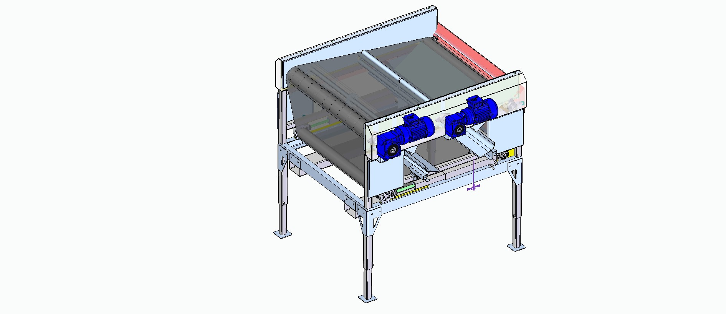
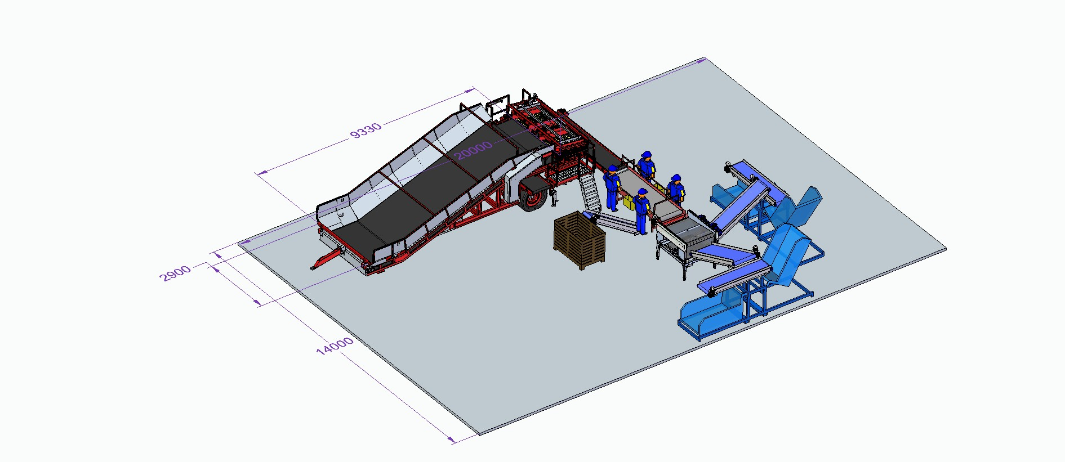
P R E S E N T A T I O N
CAD/CAM DESIGN
Part of our Team are professional designers that prepares layout of single-purpose machines or production lines.
Single-purpose machine – sorter
Manufacturing processing line

Slide 8
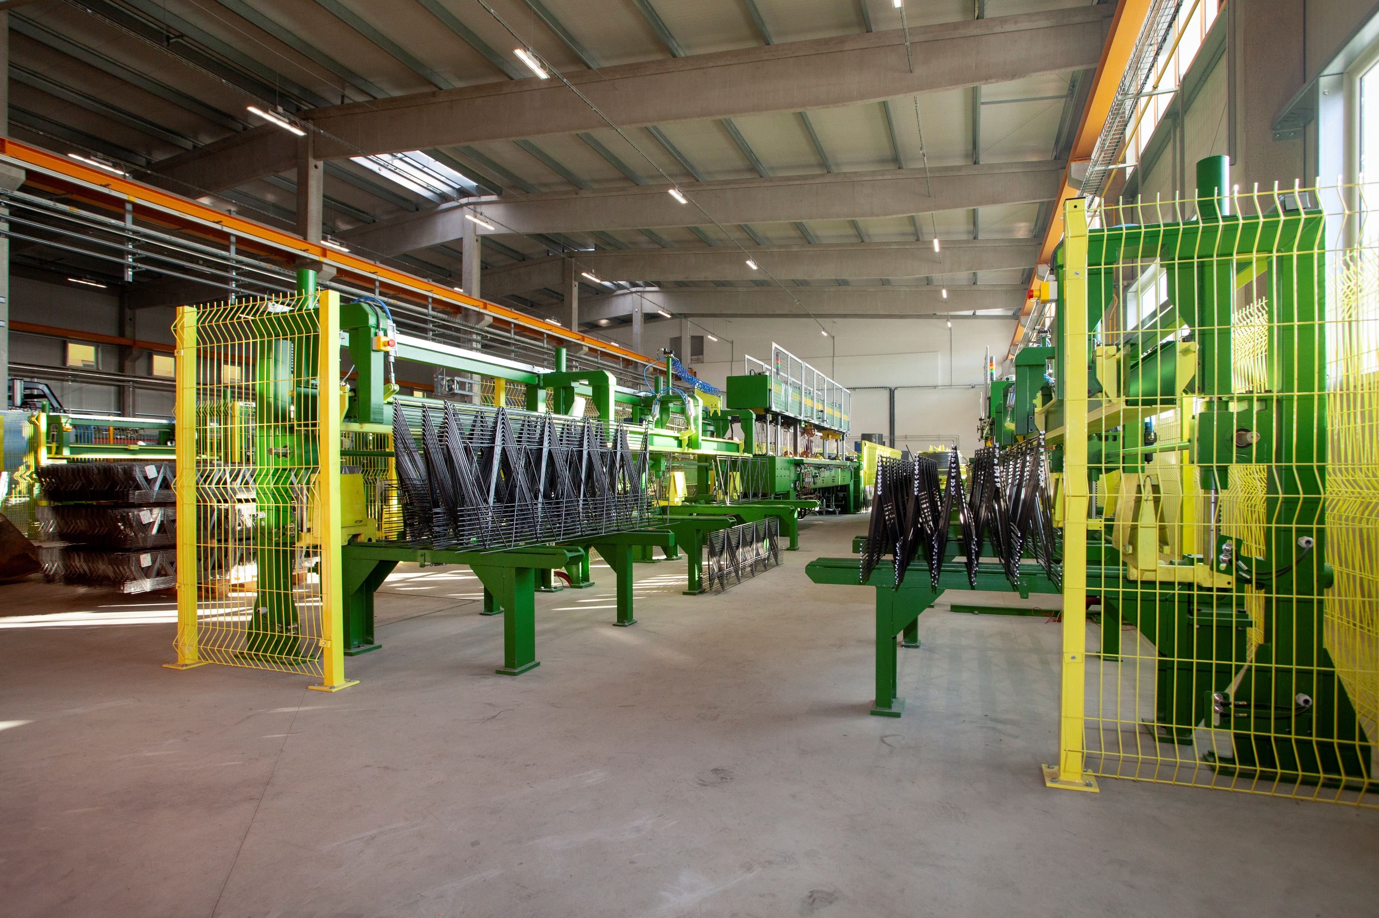
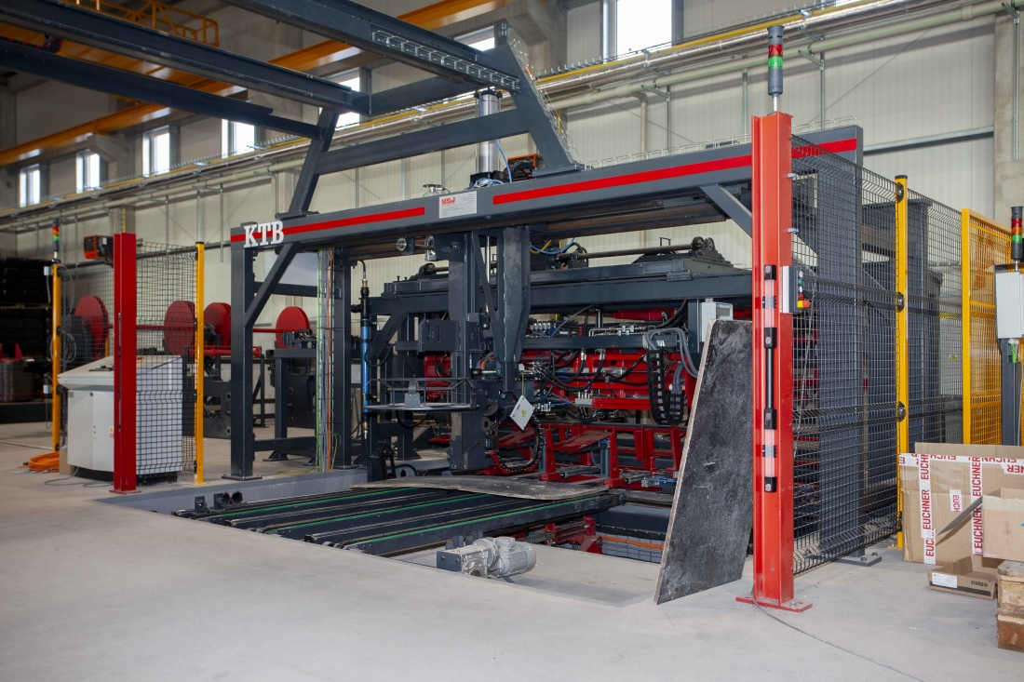
P R E S E N T A T I O N
PRODUCTION OF SINGLE-PURPOSE MACHINES
We have years of experience in the production of industrial single-purpose machines.
Our competencies range from development, planning, design, production to assembly and commissioning.
Our production of single-purpose machines focuses, for example, on equipment for transport,
processing or material recycling.

Slide 9
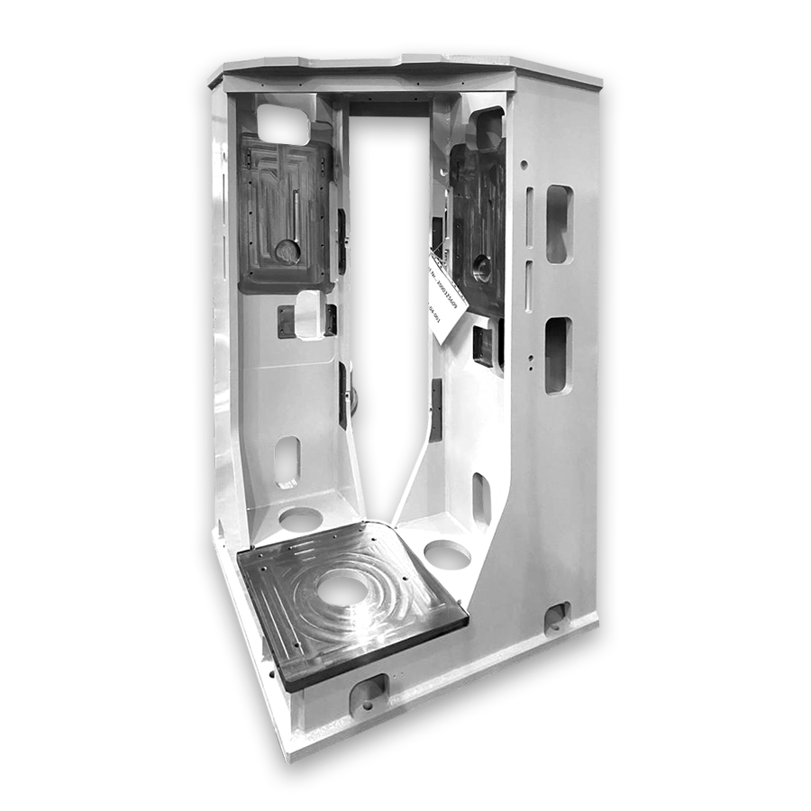
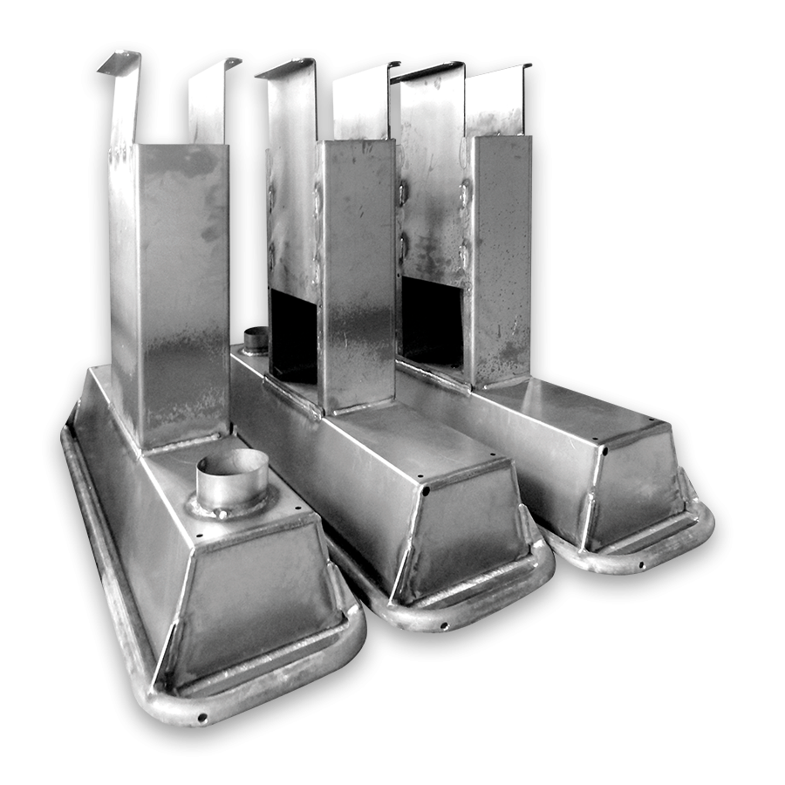
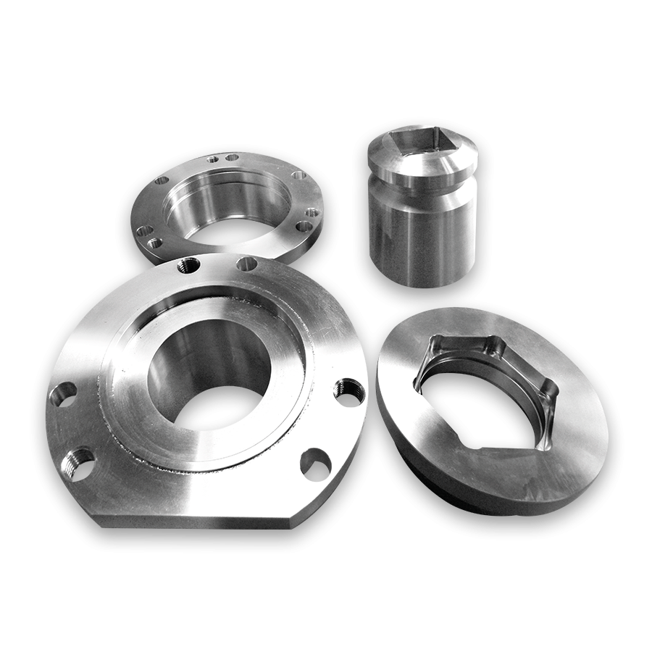
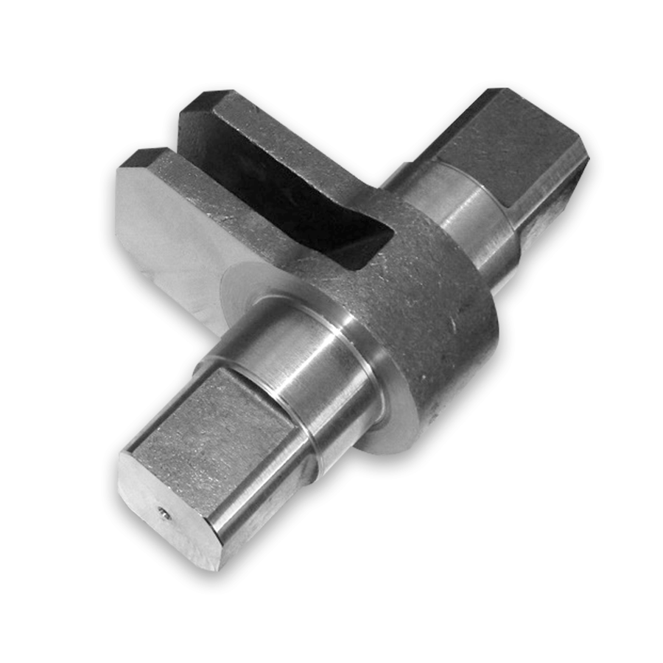
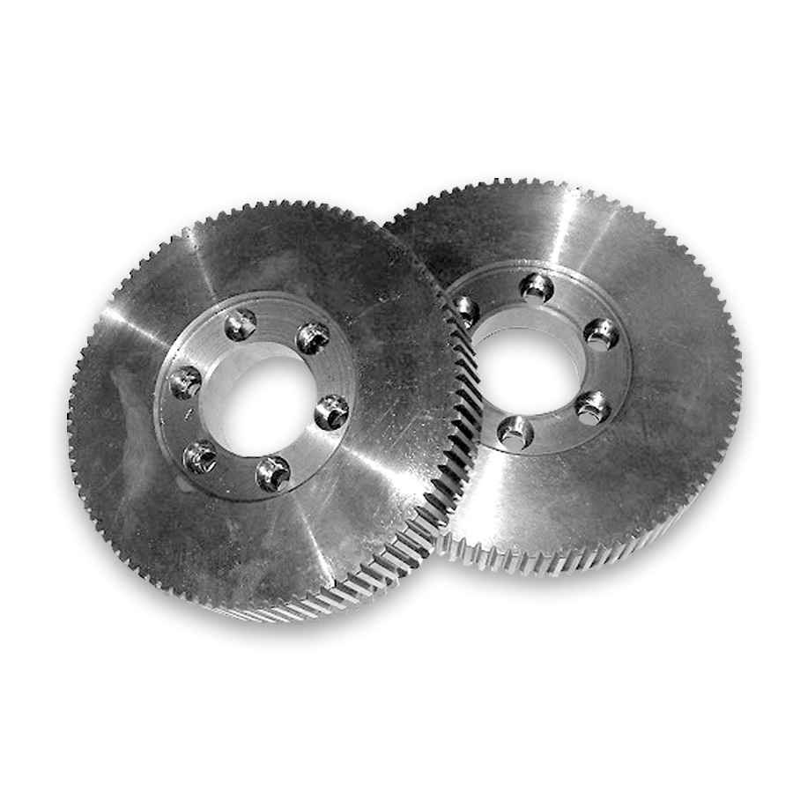
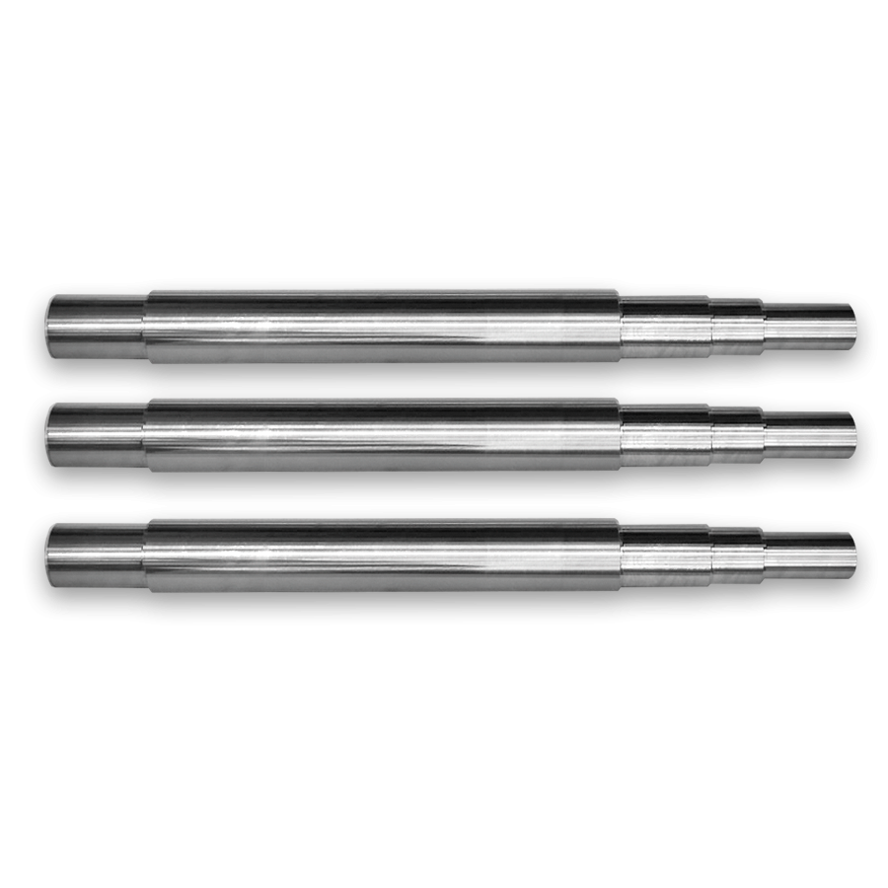
P R E S E N T A T I O N
REFERENCES OF OUR PRODUCTS AND SERVICES

Slide 10
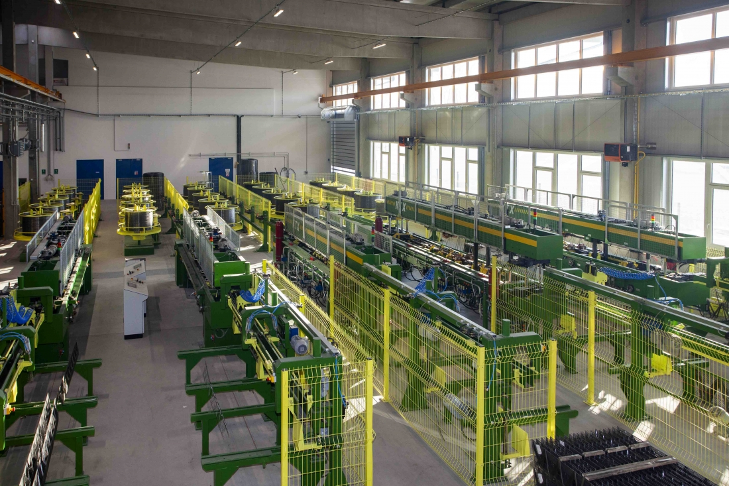
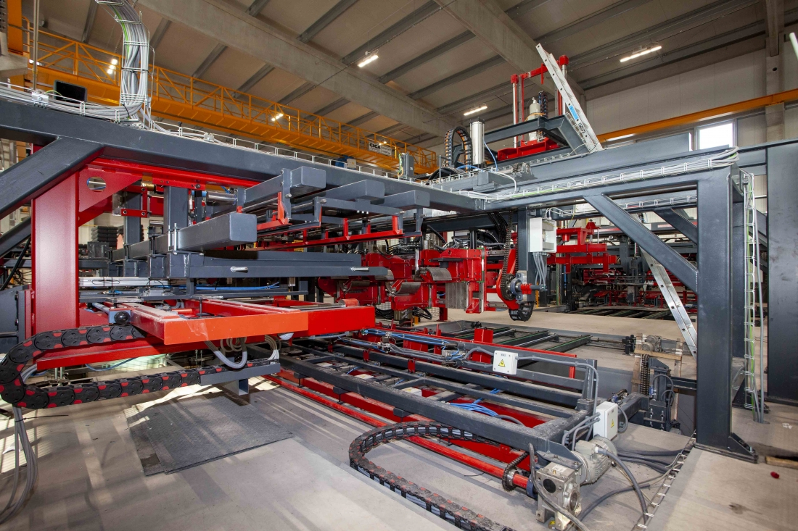
P R E S E N T A T I O N
REFERENCES OF OUR PRODUCTS AND SERVICES
Single-purpose manufacturing line
for reinforcement parts
Single-purpose machine for wire mill

Slide 11

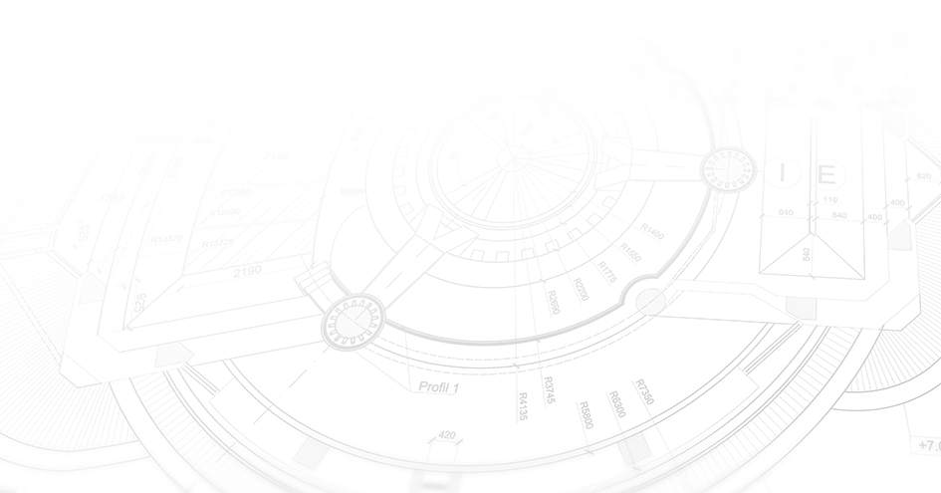
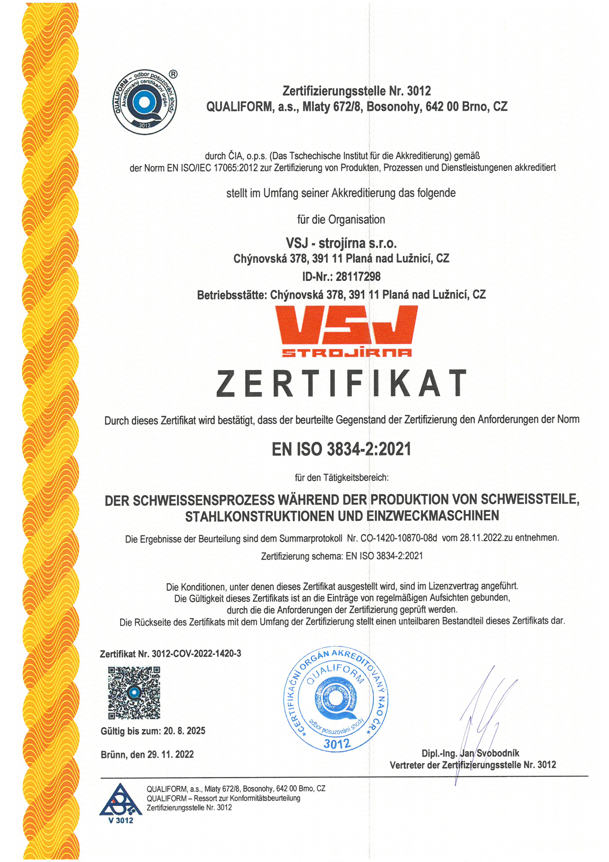
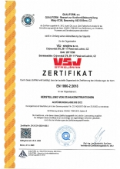
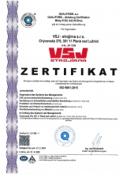

CERTIFICATES
EN ISO 3834-2:2021
EN 1090-2:2018 EXC1-2
ISO 9001:2015

Slide 12
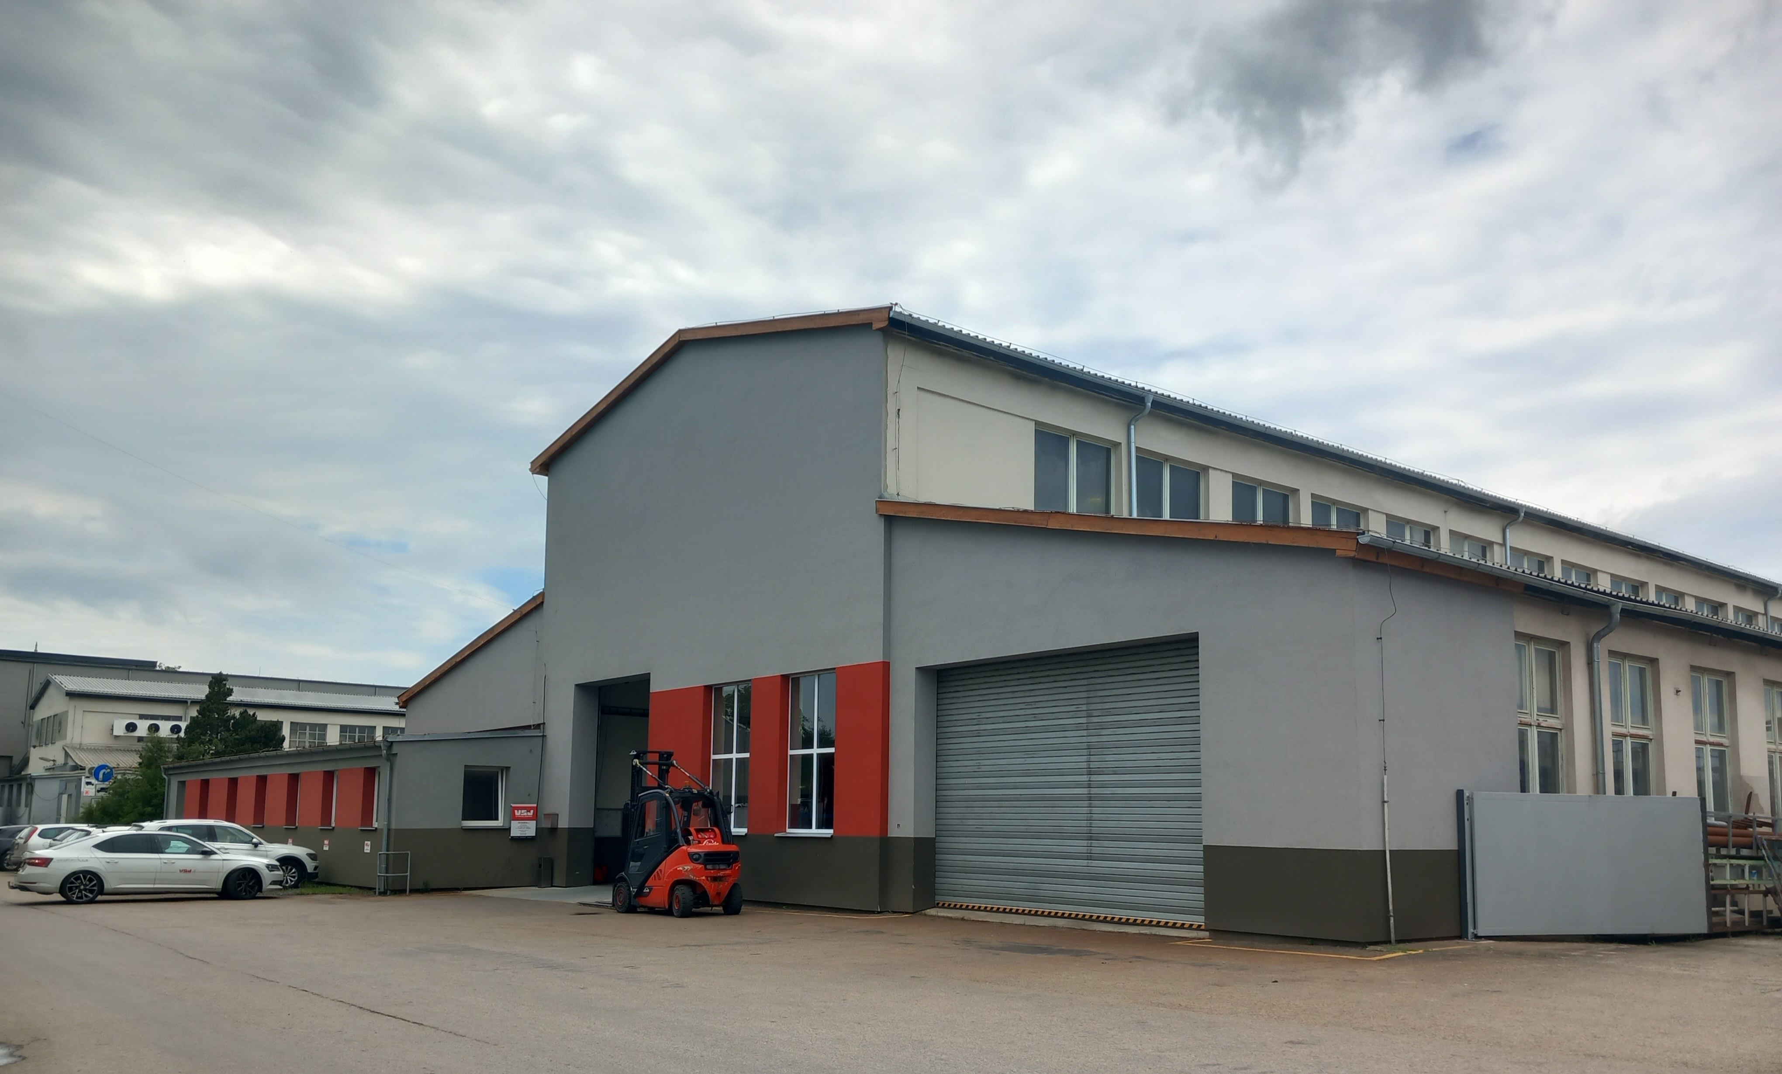
Prague
OUR CONTACTS
Nürnberg
100 km
MANAGEMENT
Vít Švehla
Managing Director svehla@vsjplana.cz
SALES AND LOGISTICS
Hynek Falta, MSc., MBA +420 799 119 741
Sales and Technical Representative falta@vsjplana.cz
(DE, EN, F, CZ, IT, RU)
Věra Tousková +420 734 542 870
Sales and Logistics touskova@vsjplana.cz
(DE, EN, CZ)
300 km
VSJ
330 km
210 km
München
140 km
Wien
Linz
VSJ-strojírna s.r.o.
Chýnovská 378
391 11 Planá nad Lužnicí
Czech Republic
ID: 28117298
vsjplana.cz

