Slide 1
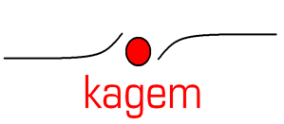
KAGEM
Reliable Partner for the industry.
Zuverlässiger Partner für die Branche.

Slide 2

WHO WE ARE

Slide 3

KAGEM Engineering Company has been offers engineering, fabrication and site installation EPC services to industrial premises, factories and industrial plants since 2005 for several industries and sectors. Since 2011, KAGEM re-start to activities focus on development and application of industrial systems and own material supply.
KAGEM offer services with its experienced experts and strong background in industrial services and Industrial EPC for existing and new clients within collaboration of corporate offices in a World.

Slide 4


TEAM PROFILE
KAGEM has the most experienced experts and consultants with PhD, Masters and Bachelor degrees;
Mechanical engineers
Environmental engineers
Energy engineers
Civil engineers
Welding engineers (IWE& EWE)
Design engineers
Site Managers
Site Supervisors

Slide 5
CORPORATE OFFICES
Our Corporate offices
TURKEY
CHINA
HONG KONG
GERMANY
UK
USA

Slide 6



CORPORATE OFFICES
TURKEY - INSPECCO INSPECTION AND CERT. INC.
CHINA - INSPECCO CHINA LTD. CO.
HONG KONG - TRENCO INTERNATIONAL LTD. CO.

Slide 7



CORPORATE OFFICES
GERMANY – INSPECCO ZERT. INSP. GMBH
UK - TRENCO LTD. CO.
USA - INSPECCO LLC . - TX

Slide 8
Reliable Partner ? EPC in Industrial Market

Slide 9

EPC ?
Our
Approach

Slide 10
OUR APPROACH
KAGEM is structured in vertical markets to increase our focus on industry needs.
The Vertical Market Industrial offers innovative and tailor-made solutions for each market segment and customer.
Our global team of KAGEM and corporate office experts provides the infrastructure, tools and processes in order to bring your business to the next level with effective at site Operation and factory works

Slide 11
OUR APPROACH
Turnkey, engineering, procurement and assembly (EPC) contracting services
KAGEM Industry is committed to providing services to its customers.
Detailed Engineering - Equipment design
Field and Factory Manufacturing
Material procurement and supply (Domestic-Foreign)
Mechanical
Electricity & Instrumentation,
Insulation, paint and coating
It undertakes to undertake the whole of the required business areas including the commissioning of the system or part of the customer's preference.

Slide 12
Reliable Partner ? EPC in Industrial Market

Slide 13

RELIABLE PARTNER
Dedicated approach for all segments. These are our Industrial Sub-Verticals
Process piping & Pressure Eqp.
Automation & SCADA
Raw and Base Material
13

Slide 14

RELIABLE PARTNER
We have the solution for several Industrial segments.
Process Piping & Equipments
Automation & SCADA
Components
Systems & Automation
Appliances
Raw and Base Material
Piping & Spools
Plant
Process Equipments
Tailor Made projects
Pipe & Fittings
Valves
Non Metals & Metals
KAGEM Industrial Solutions are special services for diverse industries and we constantly invest in knowledge, technology and markets in order to remain a leading logistics service provider in Industrial markets.

Slide 15
Industrial Sector
Our
Activity

Slide 16
Main Sectors Our company’s activity
ENERGY: Our company provide many services in the fields of energy ; we highly offers heat recovery system ; Fluid bed type boiler power plant and construction, assembly, maintenance, repair and management
ENVIRONMENT: Our group invest in R&D of environmental technologies. We provide turnkey engineering, procurement, construction, maintenance, repair and operation services in fields like RDF systems ; Air Treatments ( VOC – Flue Gases ) ; Odor Removal Systems
INDUSTRIAL SYSTEMS: These sectors are mostly dedicated construction activities and
industrial purposes equipments ; storage and cryogenic tanks and piping systems and
start up operations etc.

Slide 17






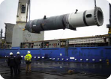


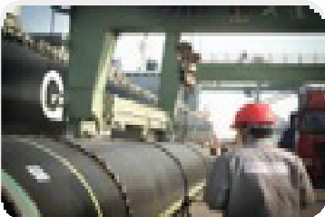
Main Sectors Our company’s activity
SUPPLY MATERIAL
PIPE
VALVE & FİTTİNGS
PLANTS
4 IN 10
EQUIPMENTS
ENERGY
CFB (FLUID BED )
HYDROMECHANIC
JEOTERMAL
INDUSTRIAL
EPC or EP +C
FIRE PROTECTION SYSTEMS
AUTOMATION & INSTRUMENTATION
TECHNOLOGICAL PRODUCTS
ENVIRONMENTAL
FGD ( FLUE GAS )
SLUDGE DRYING
WASTE SYSTEMS ( RDF)
17

Slide 18
Our Services
Industrial Sourcing
Projects & Design
Factory Works
Site Supervision
Site Operation & Start -Up
KAGEM is your turn key solution partner
Turn –Key Operations
Notes:
no slide master

Slide 19
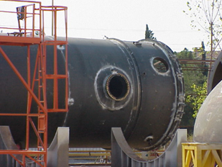
INDUSTRIAL FACILITIES
Wide Range of Sectors
KAGEM Industry; It serves large industrial sectors such as power plants, refineries, petrol and gas storage and process plants, mining plants, petrochemical and chemical plants, air separation plants, acid process plants, starch and glucose plants, and iron and steel plants.

Slide 20
Comprehensive Contracting Services
KAGEM Industry; specializes in equipment, tanks, steel, piping, electrical and instrumentation installation in industrial facilities.
Turnkey Engineering
Build
Equipment Supply
Technical Purchasing
It can provide complete contracting services by combining field installation services.

Slide 21
Fire Protection Systems
KAGEM's mission is with design; national and international standards
(NFPA - UL - FM) continues its field and project activities. Among the proposed services;
Fire Detection Systems
Aqueous Fire Safety Systems
Gas Fire Security Systems
To be done again; renewal of the existing; maintenance and inspection tests are also included.

Slide 22
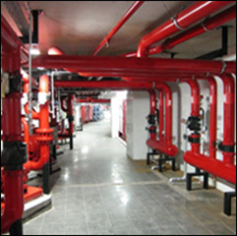
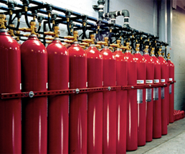
Fire Protection Systems - II
KAGEM, service sector; hotel industry; shopping malls; may include combined services such as industry, energy, factories.
The sensitivity and technical inclination of qualified local and technical teams and international standards are the two most important factors appreciated by KAGEM's customers.

Slide 23
Equipment and Instrumentation Assemblies
Field assembly of process equipment; steam and gas turbines, steam boilers, heat recovery steam generators, waste heat recovery units, auxiliary boilers, compressors, turbines, generators, pumps, tanks, pressure and atmospheric containers, drums, towers, chimneys, heat exchangers, modular units, installation and erection of cooling towers, all electrical equipment and systems and similar equipment.

Slide 24
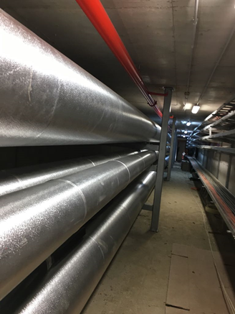
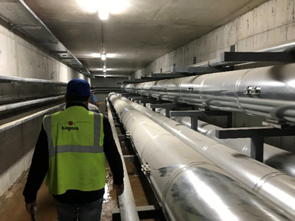
Field Tanks and Piping Manufacture and installation of lines in field tanks and process piping, auxiliary facilities piping, power plants piping systems, field piping.
Steel Structure Assemblies
Manufacturing of process units, pipe carrier structures, pipe and equipment supports and field assemblies.

Slide 25

RELIABLE PARTNER
Your benefit at a Glance
Extensive industry knowledge and market intelligence within the Industrial arena
Production and Engineering background of best practices
Scalable solutions across all Industrial segments and supply chain stages, tailored to your individual needs
Innovative approaches and concepts that help you to increase productivity and/or service quality
Integrated approach with global standards and competencies across all modes (EN –ASME – AD MERKBLATT etc.)

Slide 26
Service Provider EPC in Industrial Market

Slide 27
OUR CERTIFICATES

Slide 28
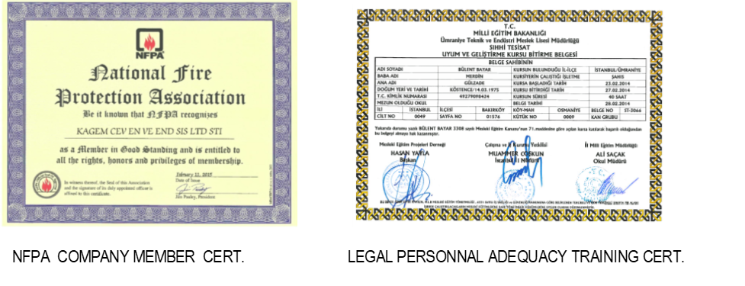

Slide 29




ENGINEERING
EN
ASME
EPA
ASTM
EURO CODES

Slide 30
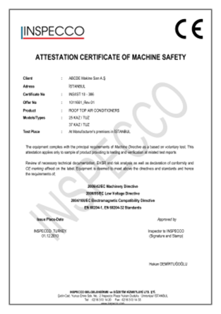

The equipment included in our production has a CE certificate in accordance with the new regulations. According to customer requests, Dizayn approval activities are performed according to national and international standards, if necessary.

Slide 31
QUALITY AND PERSONNEL COMPETENCIES
The competencies of the personnel within our structure are qualified from accredited institutions in accordance with the legislation.
EN 9606 -1 WELDING STAFF CERTIFICATION
EN 15609 -1 WPS - WELDING PROCEDURES
EN 15614 -1 WPQR - APPROVED WELDING QUALIFICATIONS
MEB VOCATIONAL QUALIFICATION DOCUMENTS
ISG OCCUPATIONAL SAFETY EXPERT (A-B-C)
EWE WELDING ENGINEER
NDT INSPECTION PERSONNEL (VT- UT-MT-PT Level II)

Slide 32
COMPLETED PROJECTS PHOTOS

Slide 33
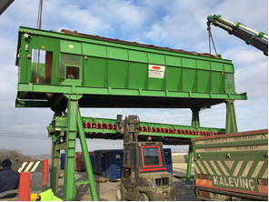
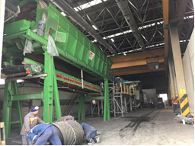

1.RDF SOLID WASTE RENEVATION - MONTAGE & & COMM.

Slide 34
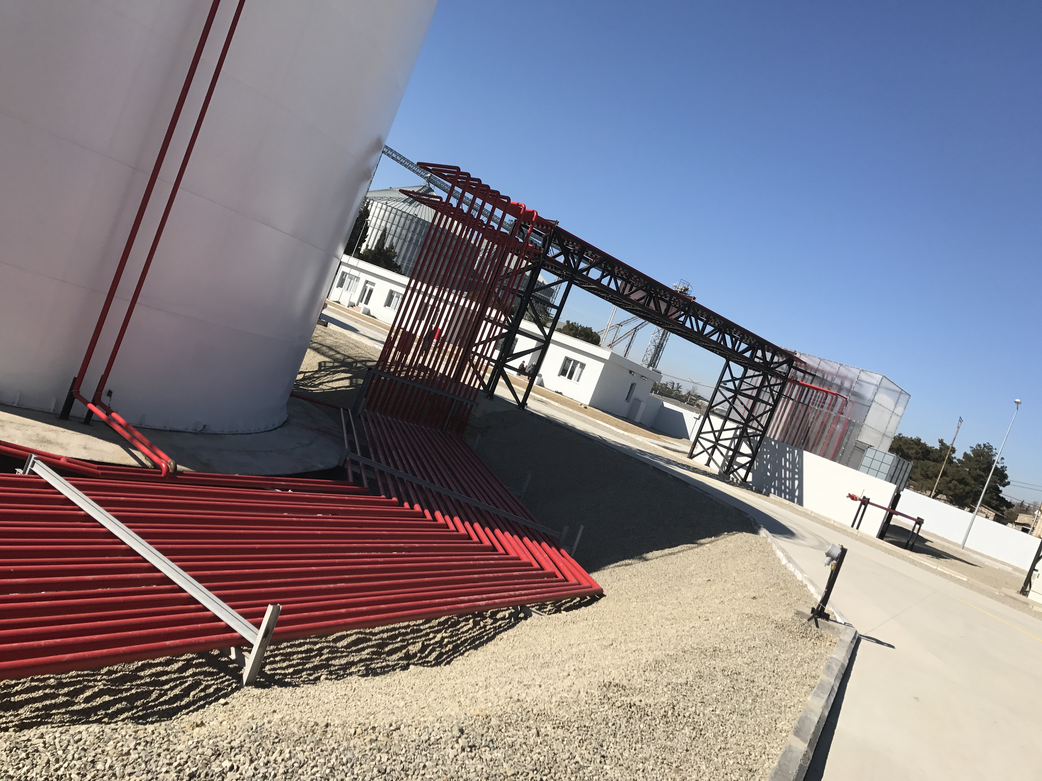
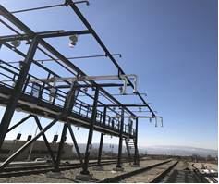
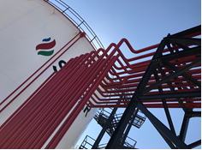

2.PROCESS PIPING

Slide 35
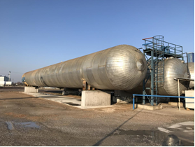
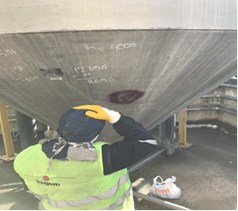

3.CRYOGENIC GAS TANK INSTALLION AND PIPING

Slide 36
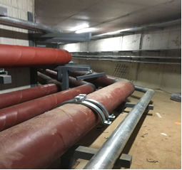
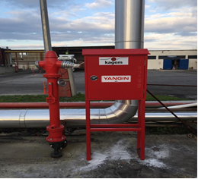

4. FIRE FIGHTING SYSTEM PIPING AND INSTRUMENTS

Slide 37
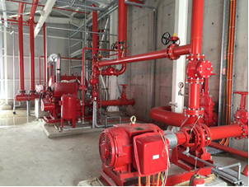
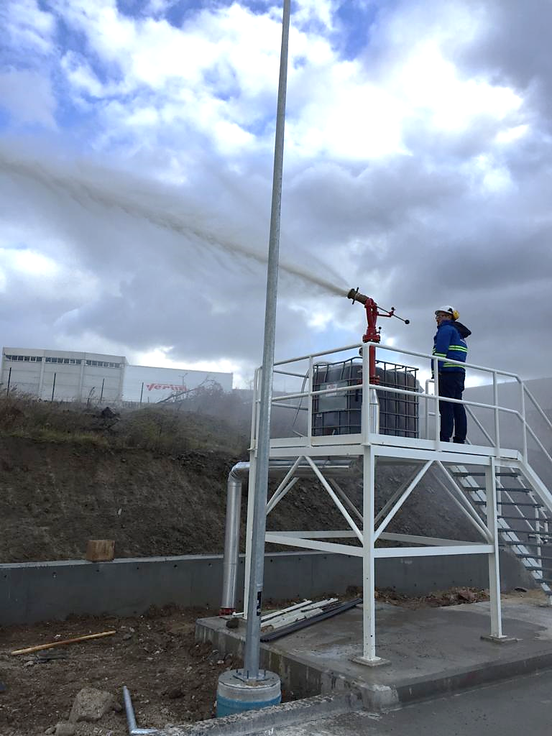

5.FIRE FIGHTING SYSTEM PIPING AND INSTRUMENTS-II

Slide 38
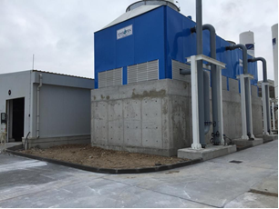
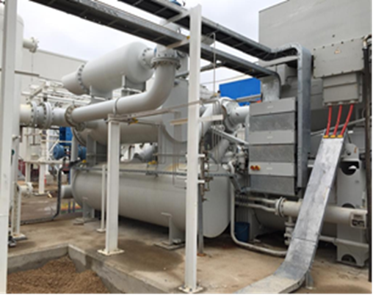


Slide 39
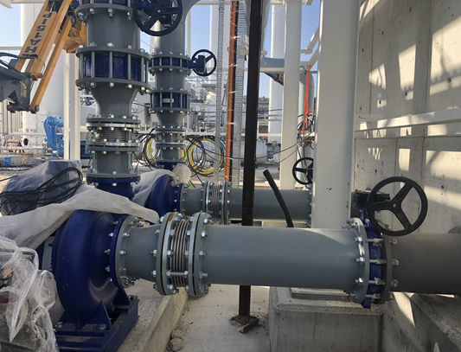
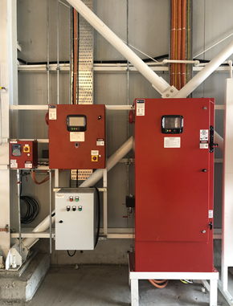
Cooling Water Circuit Field Application
Fire Pump Panels (UL / FM Certified)

Slide 40
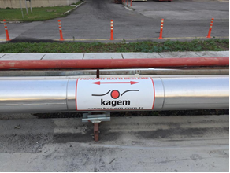
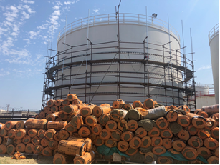

6.FIRE FIGHTING SYSTEM PIPING & INSTRUMENTS -III

Slide 41
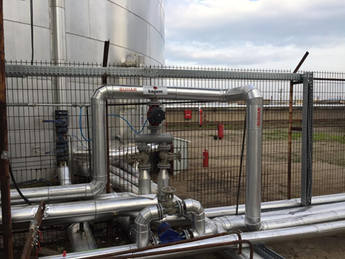
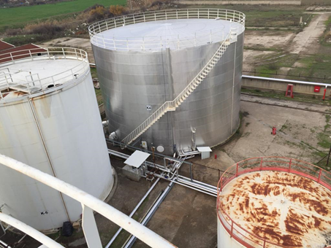
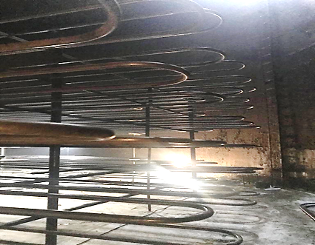
Insulation and Piping
Tank and Insulation
Serpentine Manufacturing

Slide 42
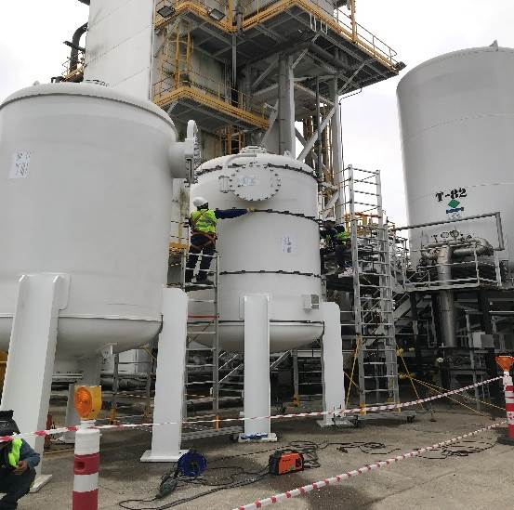
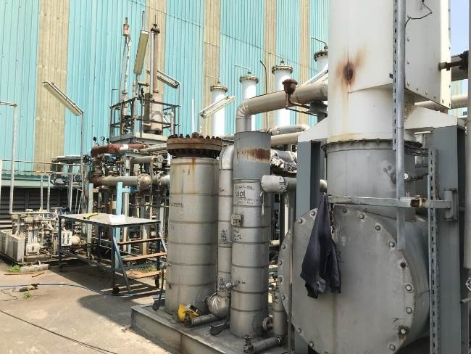

REFERANCE AT E+PC
AIR SEPERATION UNIT
HYDROGEN PLANT

Slide 43
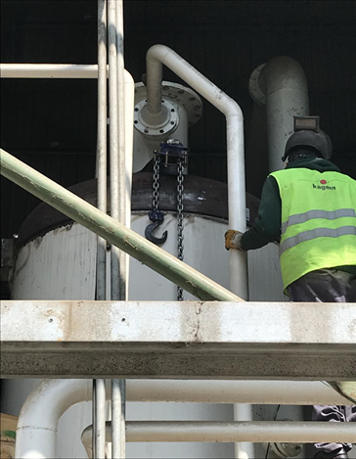
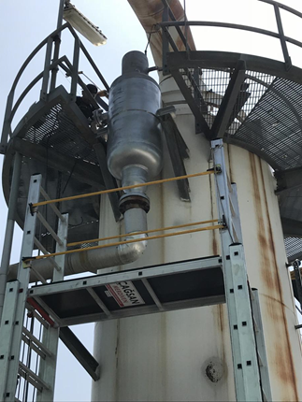
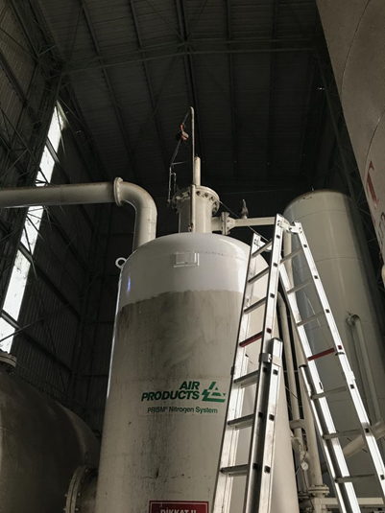
Cap Exchange
Instrumantation
Nitrogen Tank Revision

Slide 44
REFERANCES

Slide 45












REFERANCE AT SEVERAL SECTORS
LINDE TÜRKİYE
LINDE –USA

Slide 46

















REFERANCE AT SEVERAL SECTORS

Slide 47





REFERANCE AT ENVIRONMENTAL SYSTEM

Slide 48

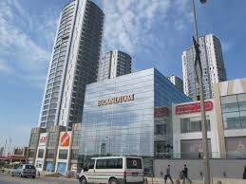
KAGEM OFFICAL ADRESS: Head Office :
BRANDIUM AVYM R-5 Blok D:27
ATAŞEHİR - İstanbul-TURKEY
Tel : +90 216 314 15 04
Fax :+90 216 314 15 06 mail : info@kagem.com.tr
www.kagem.com.tr
48

Slide 49
KAGEM LIASON ADRESS:
Liason Office : KAGEM UND KARA
Herr Ufuk KARA (Diploma Eng.)Vermittlungs- und
Beratungsbüro für Maschinenbau, technischen
Einkauf Nikolastrasse 20D-84034 Landshut
Telefon: +49 (0) 871 / 43 01 99 12
Telefax: +49 (0) 871 / 43 01 99 14
Mobil: +49 (0) 179 / 51 99 943
Web: www.kagem.com.tr
mail : info@kagem.com.tr
www.kagem.com.tr
49

