Slide 1


COMPANY PRESENTATION

Slide 2
Content
Company Overview
Machinery
Products & Technical Skills
Contact Information

Slide 3
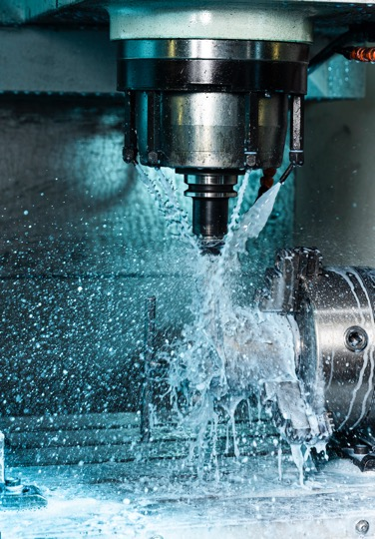
Profile
Our company is established in 2007
Factory Area: 700 m²
# of Employees: 15 (4 white collars & 11 blue collars)
8 Machines with different specifications, turning & milling machines with automatic bar feeder
30% of total turnover is coming from exports to EU (mainly Germany)
Total Turnover: 650K.€
Manufacturing all kinds of steel, stainless steel, plastics, brass, aluminium, metal bars, pipes, rods and tubes

Slide 4
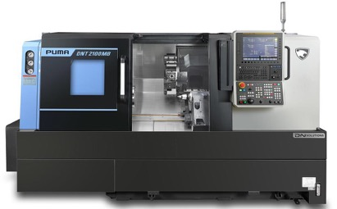
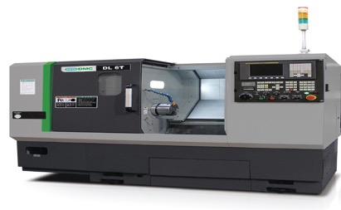
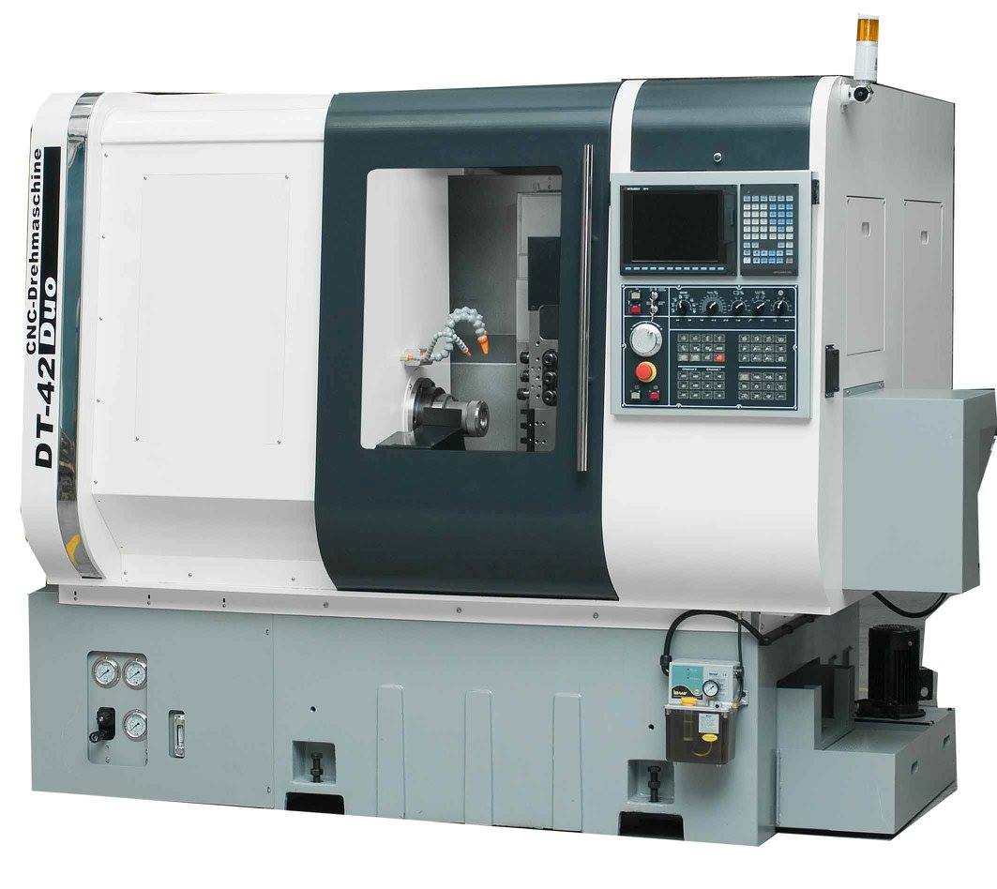
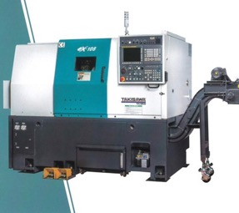
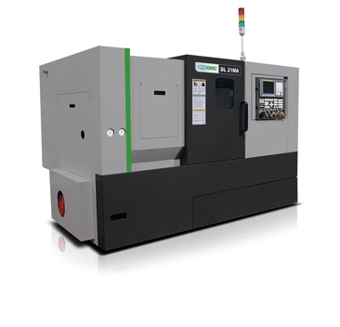
Machinery
DOOSAN 2100B
DMC DL 6T
NAITO MD42
TAKISAWA EX 108
DMC DL 21MA

Slide 5
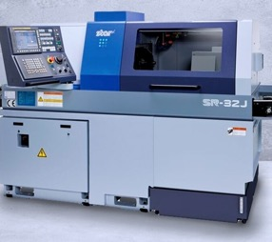
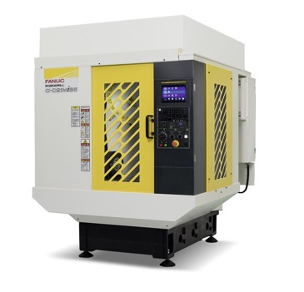
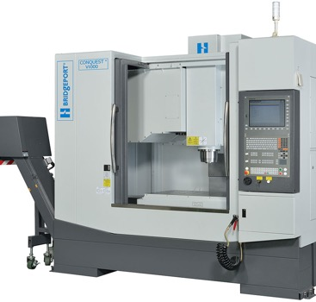
Machinery
STAR SR 32-J FANUC ROBODRILL D21MIB5 BRIDGEPORT CONQUEST V1000

Slide 6
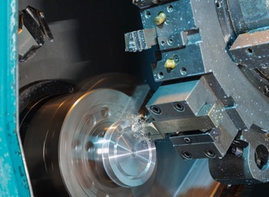
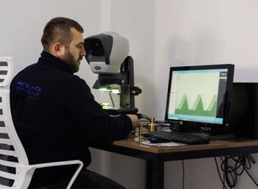
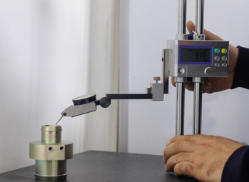
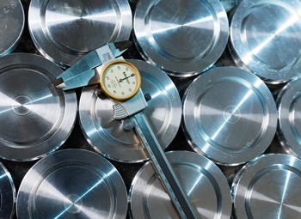
Quality
Optical Measurement Device
Mitutoyo Surface Roughness
Micrometers
Hole Comparators
Callipers
Check gauges
Upcoming investment: 3D CMM

Slide 7
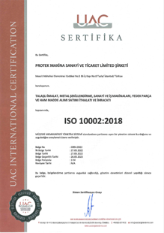
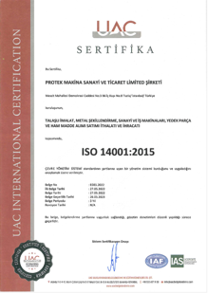
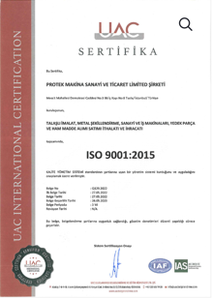
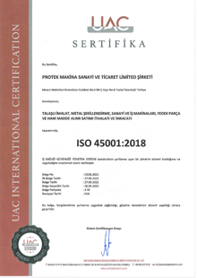
Certificates

Slide 8
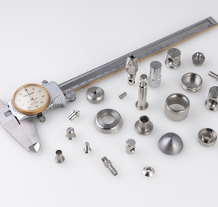
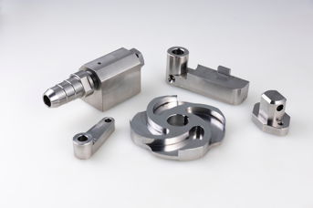
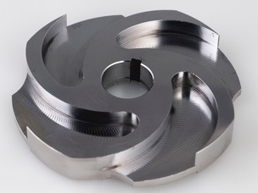
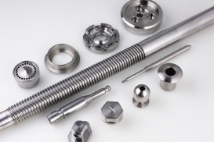
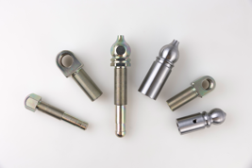
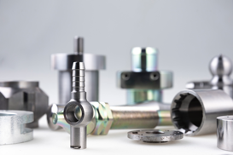
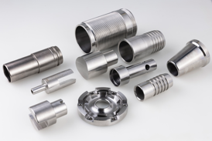
Steel & Stainless Steel

Slide 9
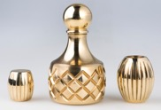
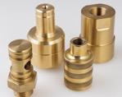
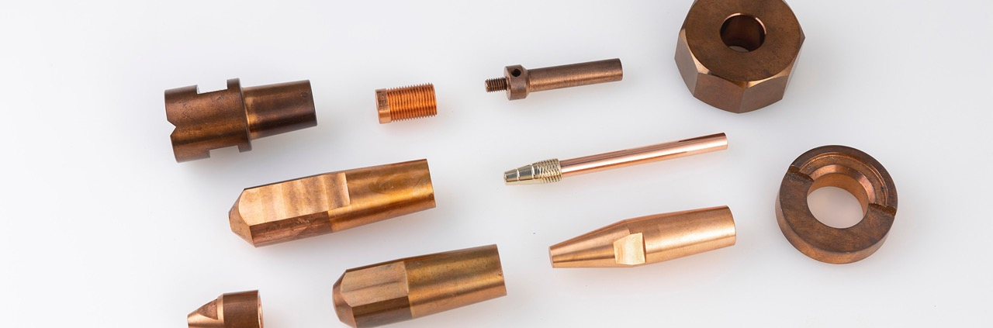
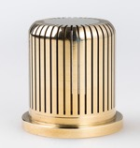
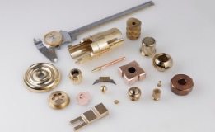
Copper Alloys (Brass & Bronze)

Slide 10
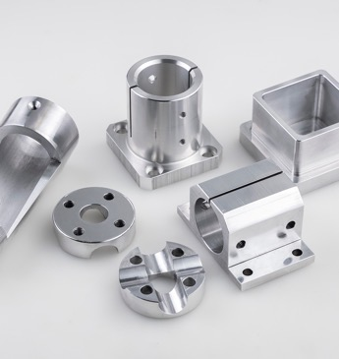
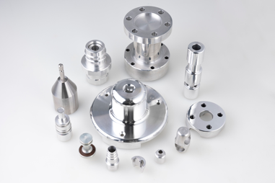
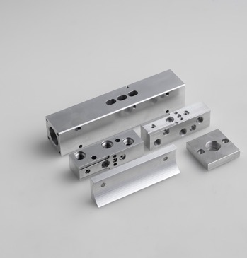
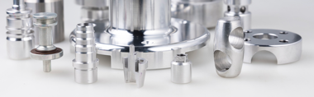
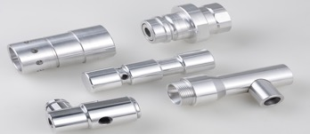
Aluminum

Slide 11
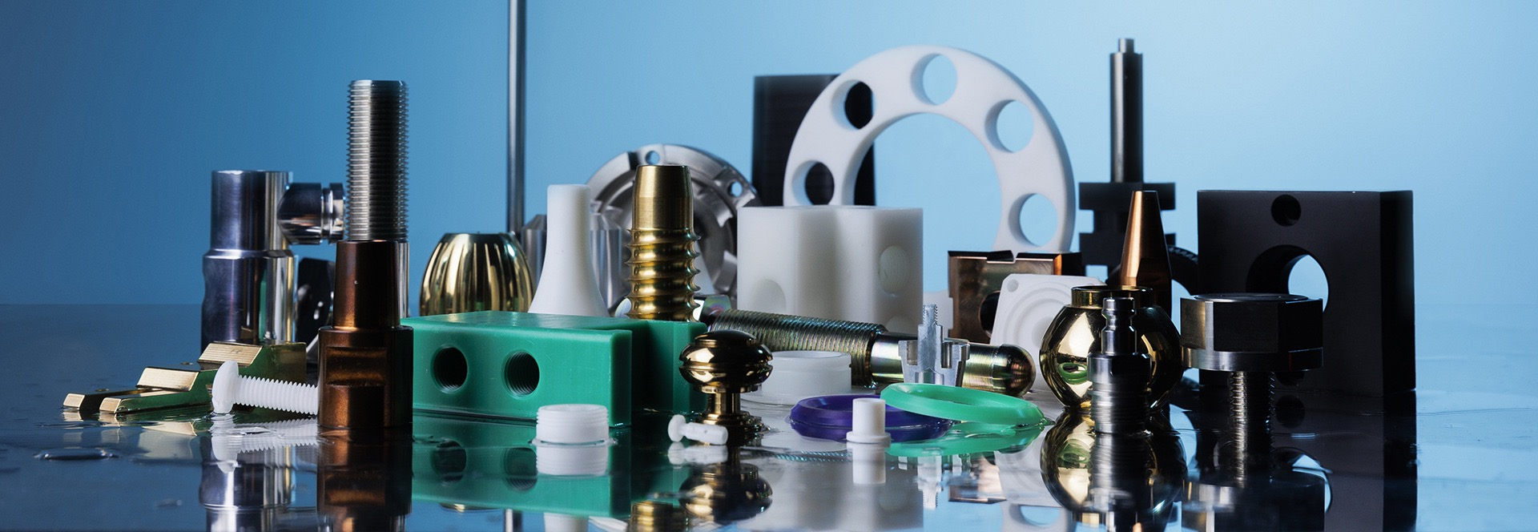
Engineering Plastics

Slide 12
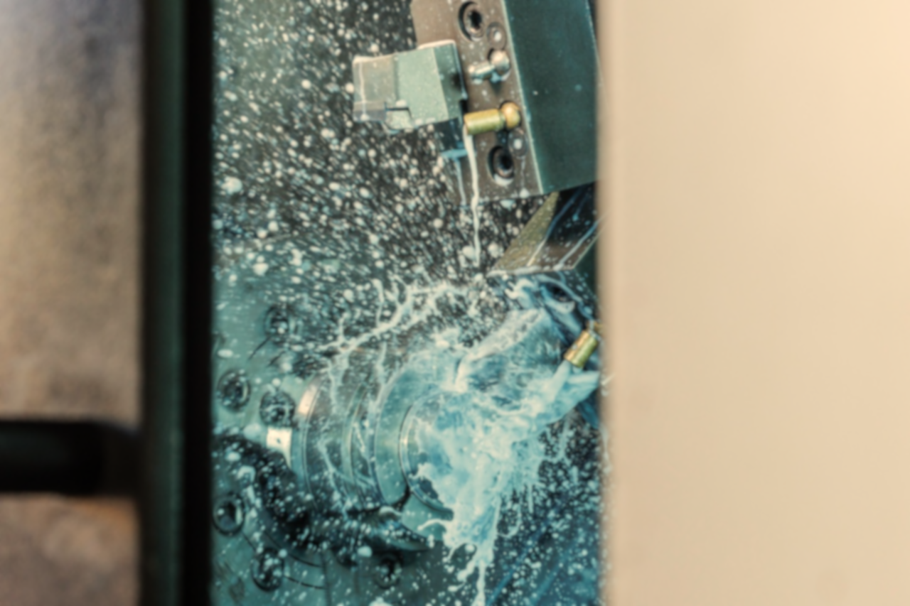
S | W | O | T
STRENGTHS | WEAKNESSES | OPPORTUNITIES | THREATS
Mainly our company owner and General Manager Mr. Okan Bahceci, mechanical engineer from Kocaeli University in Turkey, Master Degree in Massachusetts – US, Worcester Polytechnic Institute, Job experience in a Japan Automotive Company in Turkey for 3 years, Strong capability of design and production, Finally, launched his own business in 2007. | In terms of quality inspection equipment, our upcoming investment will be a 3D CMM machine which is currently missing, We aim to increase our export share in total revenue which is lower than targeted, We are planning to move a larger facility which will enable us to make new machinery investment. | Since we have newly exhibited in Hannover Messe 2023, we are at the starting phase of our export adventure, Having said that our quotations will be much more aggressive and competitive, Specialized communication and flexible approach with newcomers. | Our free capacity is about 30% and if any bulk order come with very high quantity, it will take time to handle.

Slide 13

Contact
Mescit Mh. Demokrasi Cd.
Birmes San. Sit. B6 Blok No.8-9-10
34956 Tuzla – İSTANBUL
Tel: +90 (216) 394 02 36
Fax: +90 (216) 394 93 28
www.protekmakina.com.tr
Thanks for your patience and attention

