Slide 1

inovaPlus
General Presentation
Notes:
1

Slide 2
Contents
01_ general information
02_ inovaPlus’s services
03_ examples of projects
04_ main strengths and advantages
05_ refences

Slide 3
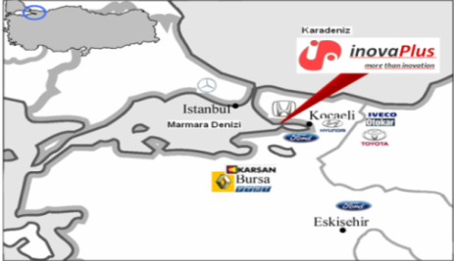
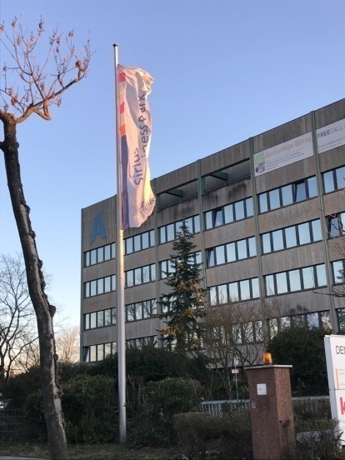
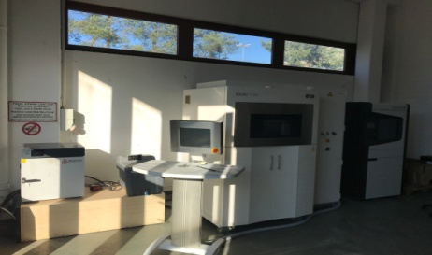
General information
inovaPlus is an engineering partner to the
automotive , aviation ,defence and R&D industry providing complete solutions for product development projects
Our assets:
A team of skilled and experienced engineers and technical experts specializing in project management , profession of CAD/CAE tools also know-how of engineering plastics, compozite materials, prototype making techniques and moulding feasibility.
CAE Cfd,Thermal,Structural Analysis
Experience in Design & Eng . projects
Complete solutions for R&D Activity sector
Reverse Eng. & GD&T inspection Assets
Rapid Prototype Techniques
As İnovaPlus Engineering Ltd. ,we have two facilities;
Tubitak Martek Technology Zone in 41480, Gebze - Kocaeli / Turkey
Sirius Facility Gmbh 63073 Offenbach am Main –Frankfurt / Germany

Slide 4
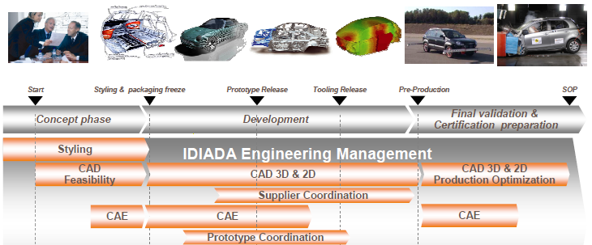
Services (Product Development System)
Concept Design
&
Benchmarking
Styling
&
Ergonomics
Product Engineering Design
Product Engineering Simulation
Model
&
Prototype
Tests
&
Validation
Releasing 3D
2D Drawings
Production
Support
inovaPlus Engineering Management

Slide 5
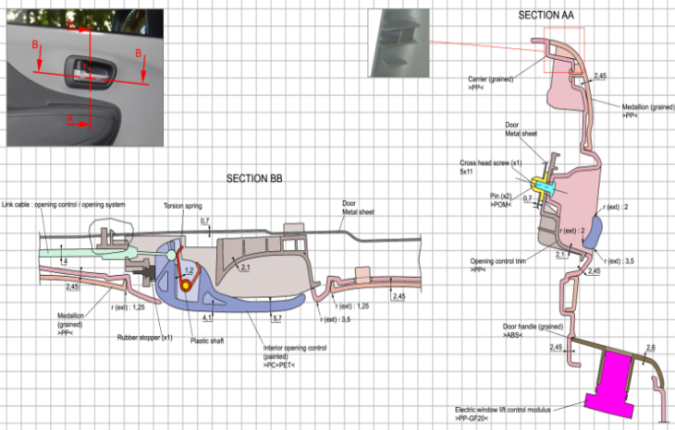
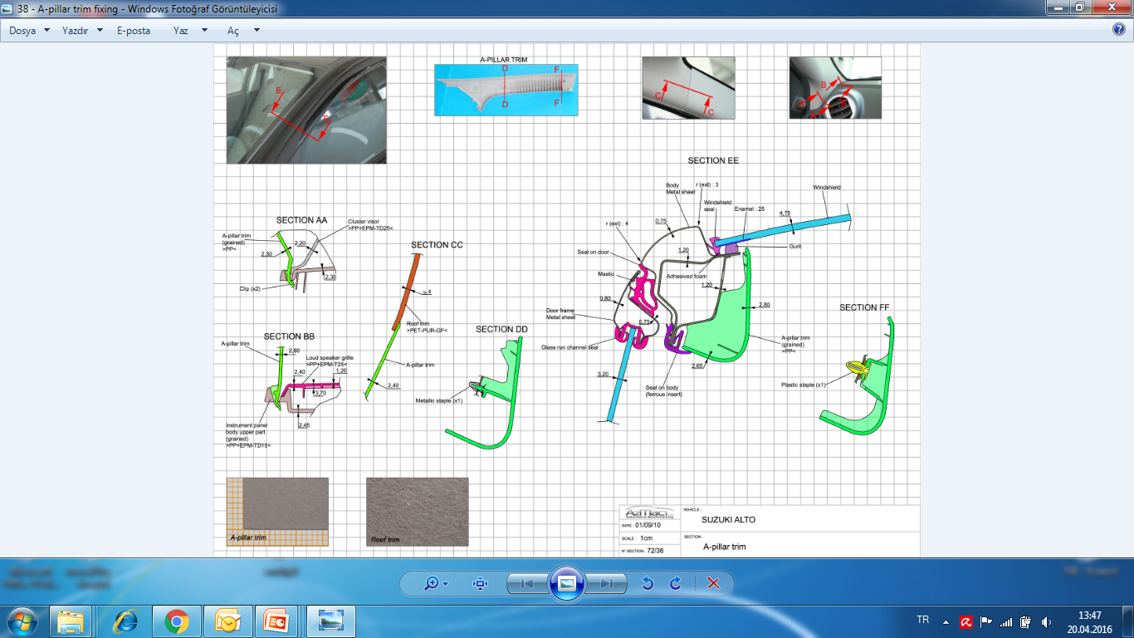
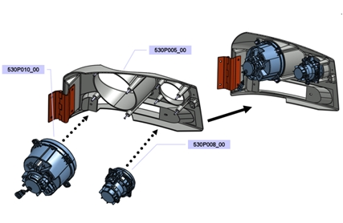
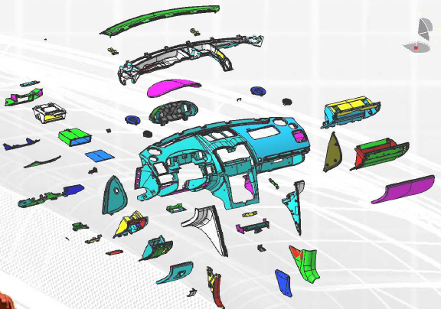
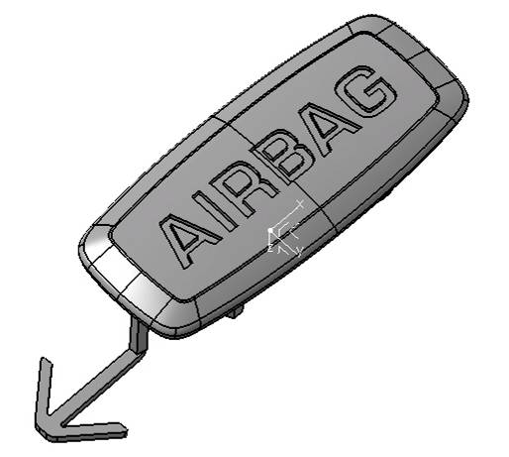
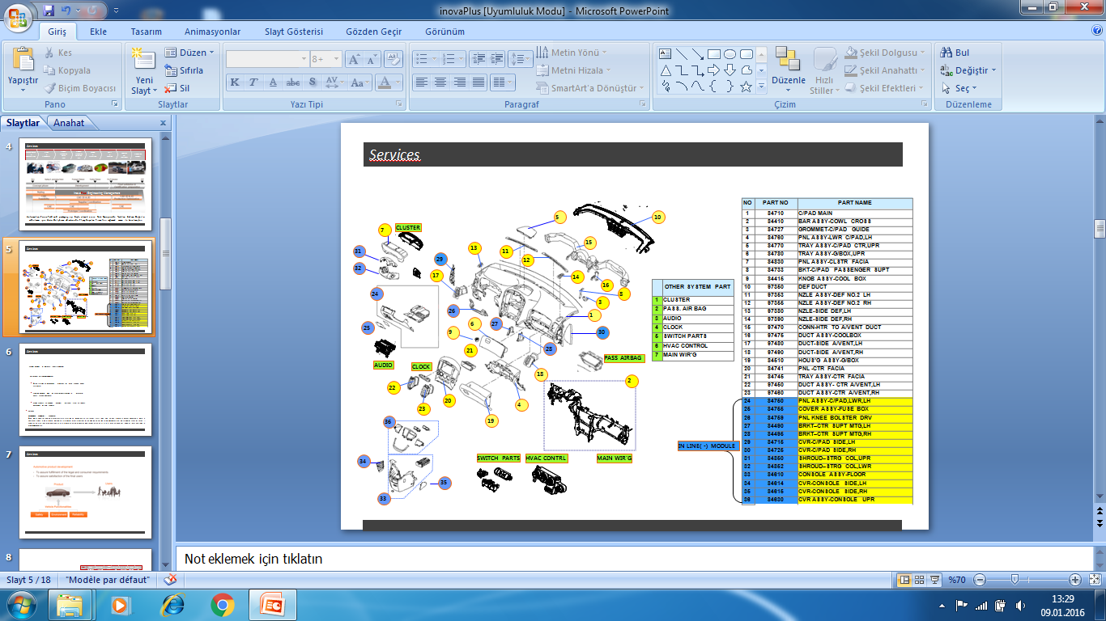
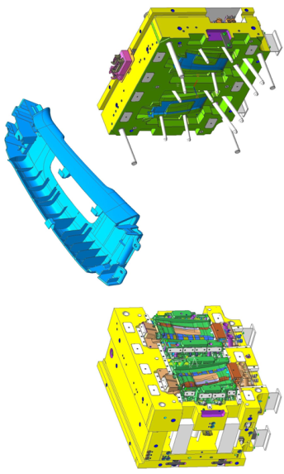
Services (Engineering Approach)
De-Compensation (Gap&Flushes)
Chritical Section Study
Mounting Setup
Material Chose (PP,PA,PC,ABS,PU,SMC,CFRP…etc)
Moulding Feasibility
Detailed BOM list

Slide 6
CAE and CFD Analysis Engineering
Our Analysis Skills
CFD Analysis
Vehicle Aerodynamic Optimization and Under Hood Thermal Performance Improvement
Vehicle Air Conditioning and Thermal Comfort Optimization
Vehicle Defroster Box Improvement
Vehicle Windshield De-Icing Performance Improvement
Vehicle Fuel Tank Filling and Sloshing Improvement
Engine Air Intake and Exhaust Systems Optimization
Engine Intake and Exhaust Manifolds Optimization
Engine Cooling Systems Improvement
Engine Thermal (Metal Temperatures) System Improvement
Engine Combustion Performans Improvement
Engine Lubrication System Improvement
Engine Gear Oil Pump Evaluation
Centrifuge Pump Improvement
Electronic Device Cooling Optimization
Marine Vehicles Design Improvement
Structural Analysis
Linear and Non-Linear Finite Element Analysis
FE Model Development
Material Failure Characterization for FEA
Verification of FE Models
Validations of Models Thru Correlated Test Results
Classical Methods and Hand Calculation
Static and Dynamic Strength
Methods Development
Fatigue And Damage Tolerance

Slide 7
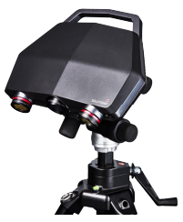
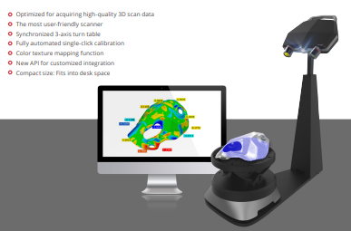
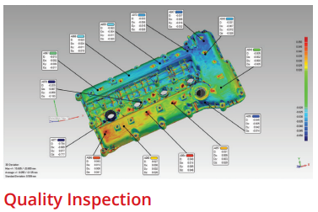
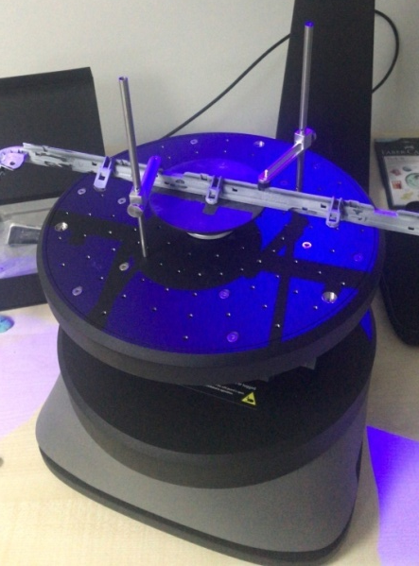
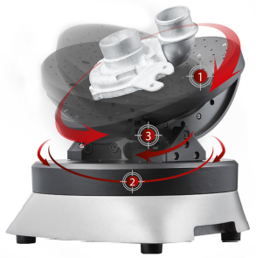
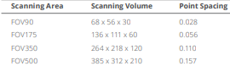
Reverse Engineering and GD&T Inspection Services
We have Solutionx C500 3D Scanner ;
Reverse Engineering Services
GD&T Inspection services
90 – 500mm sizes 4 pieces focus
Tripod for bigger parts up to 2M parts.
Automatic calibration
3 and 5 axis tables for 10kg to 100kg.

Slide 8
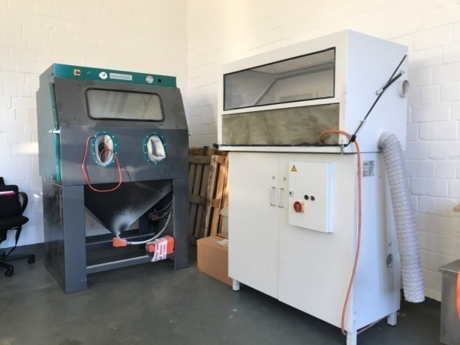
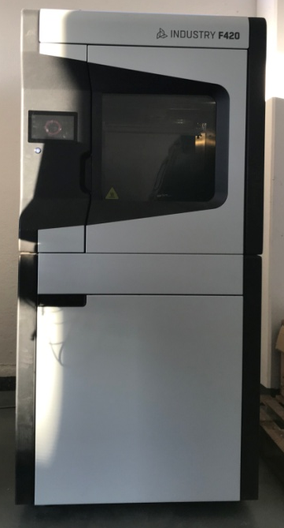
Model and Rapid Prototype Services
In Contemproary Design and Engineering approaches, the need to produce a visual and functional similarity of the final product with rapid prototyping has become inevitable.
With this rapid prototype model produced, the test process can be carried out, demostrative parts can be produced enough to be shown at the fairs, and the senior management and customers are met.
We have great experience rapid prototype techniques and have open our prototype production facility on February 2022, at Frankfurt / Germany.
*Have EOS P385 SLS Machine , production size 340x340x620mm, SLS technique for PA powder .
*Have 3DGence FDM Machine ,production size 380x380x420mm, FDM technique for ABS,PC,PA,PA CF, PEEK,PEKK,ULTEM…etc.
*We have also know-how SLA,silicon molding and CNC production techniques and support our customer all these techniques.

Slide 9
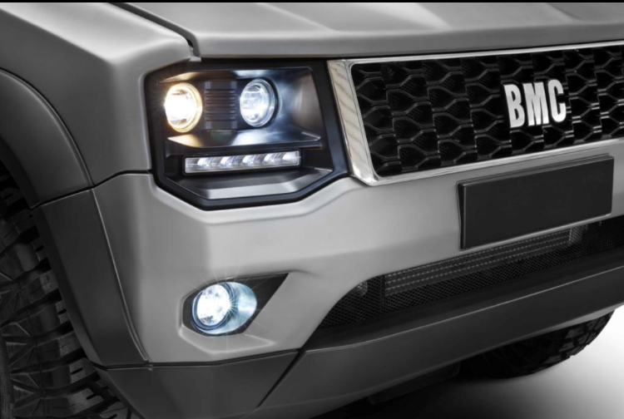
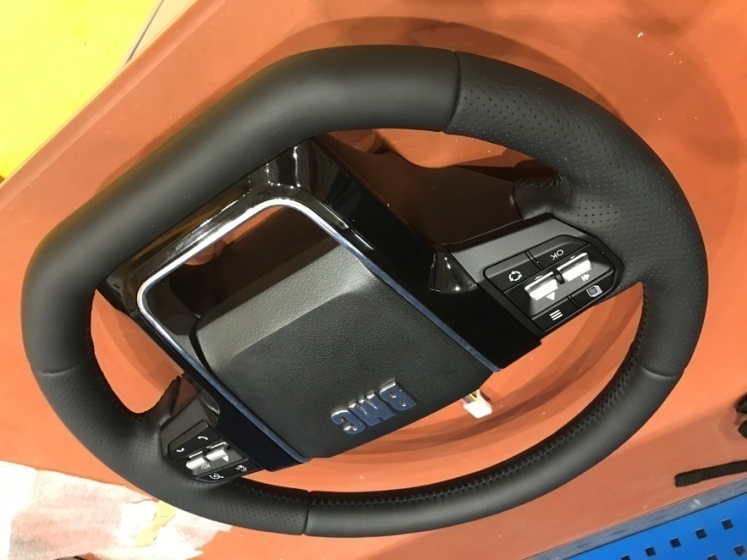
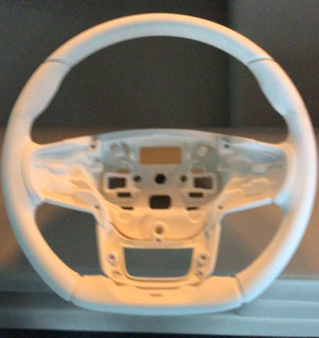
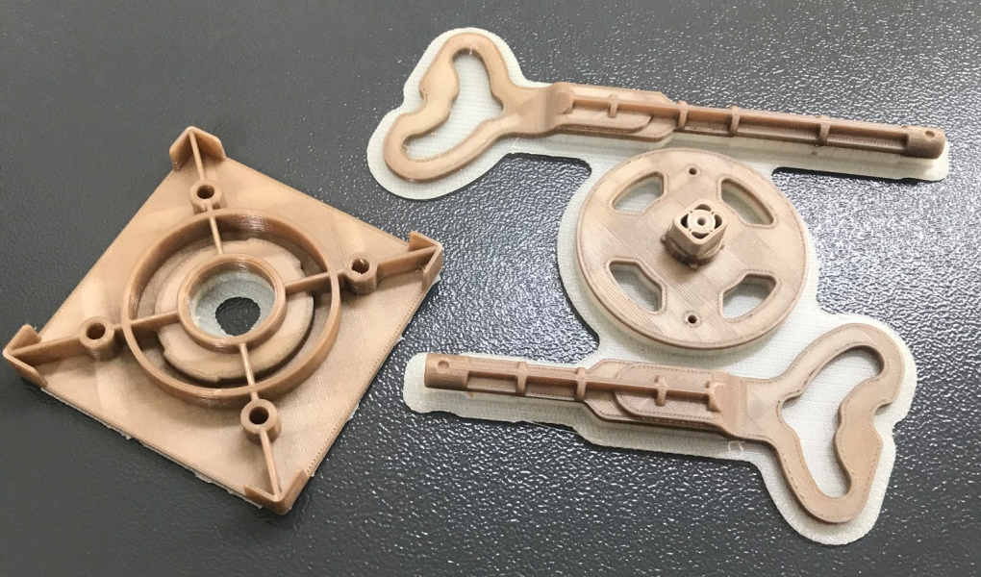
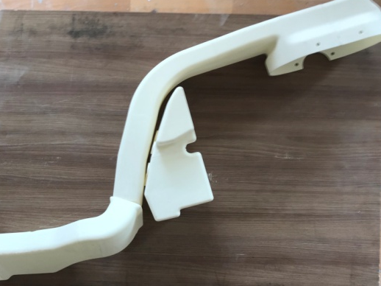
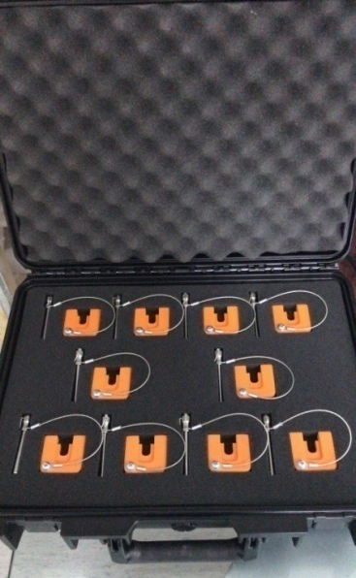
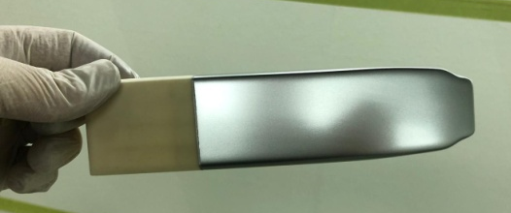
Model and Rapid Prototype Samples
Silicon Molding ;
-Front Grill
-Lamp Covers
-Handles …etc.
PA Powder SW
System Production
ABS Parts
PEEK Parts
PA with Painted
System Production

Slide 10
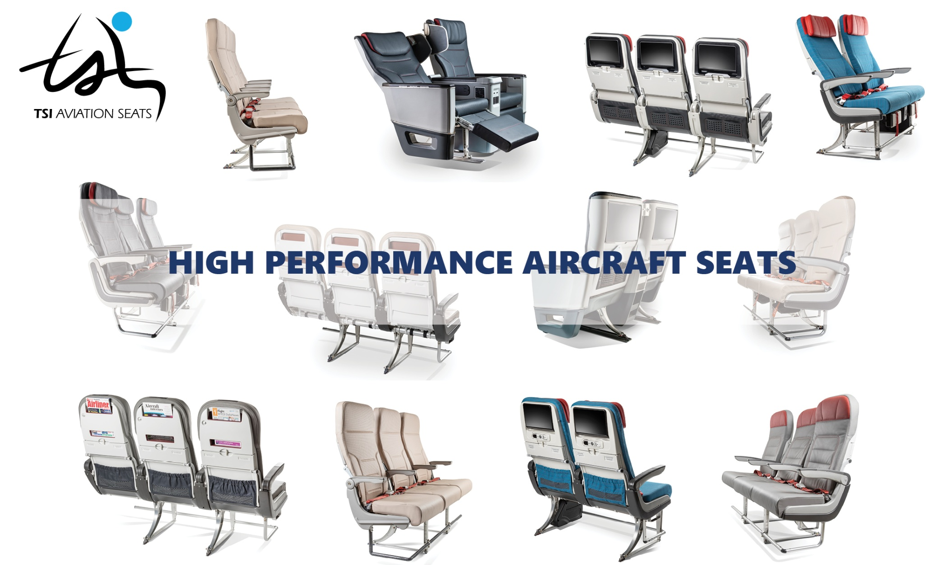
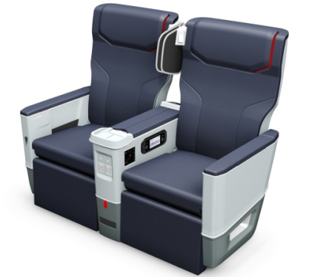
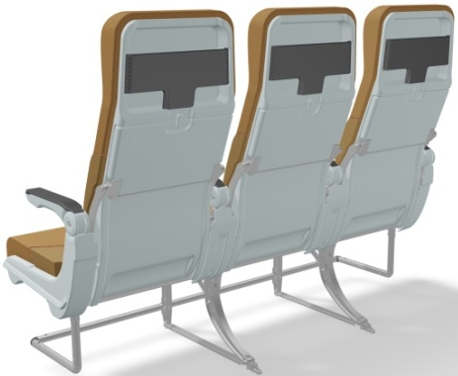
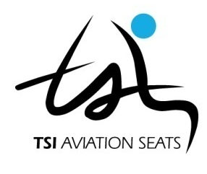
Aviation Seating Group Design,Engineering&Prototype

Slide 11
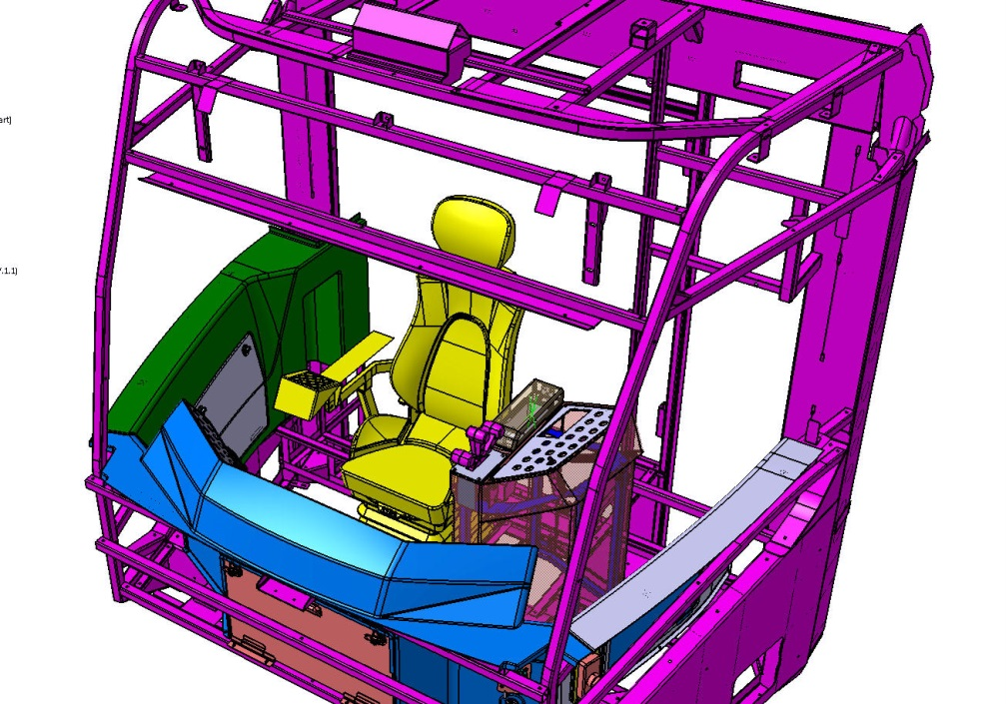
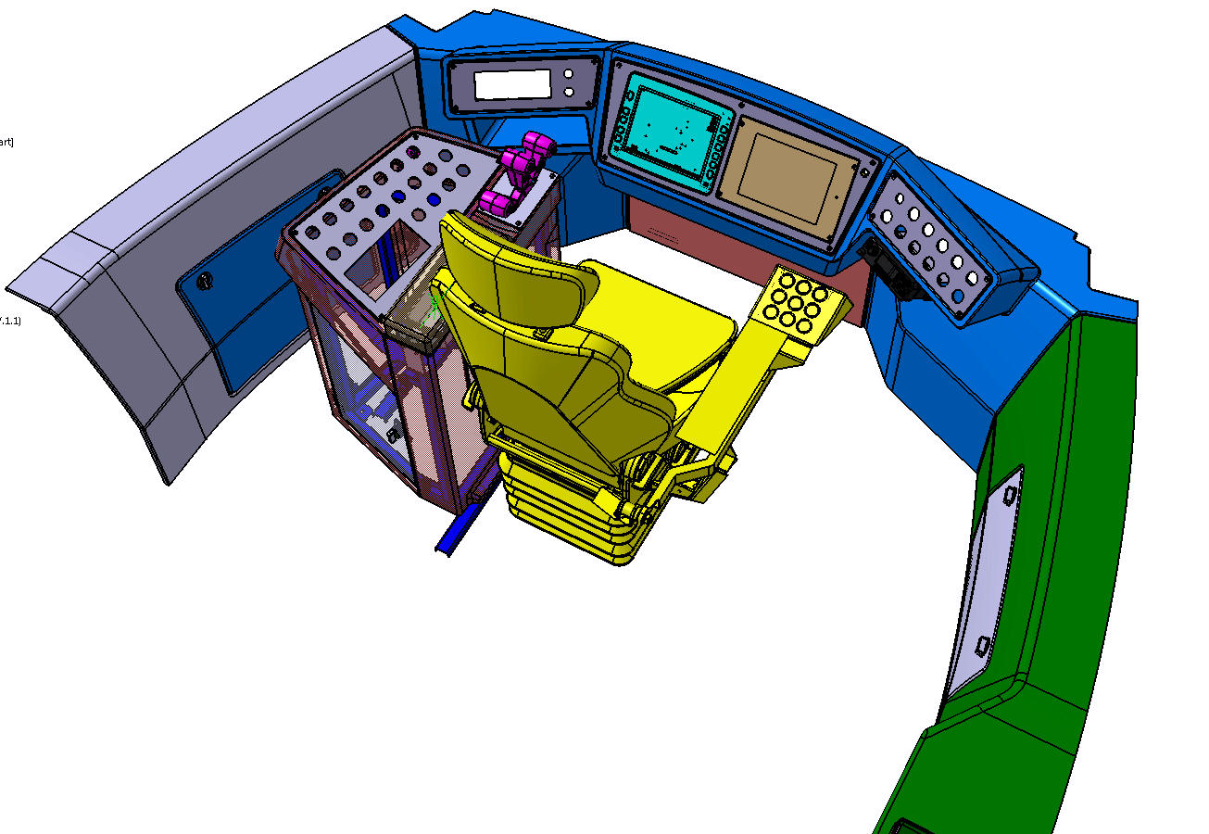
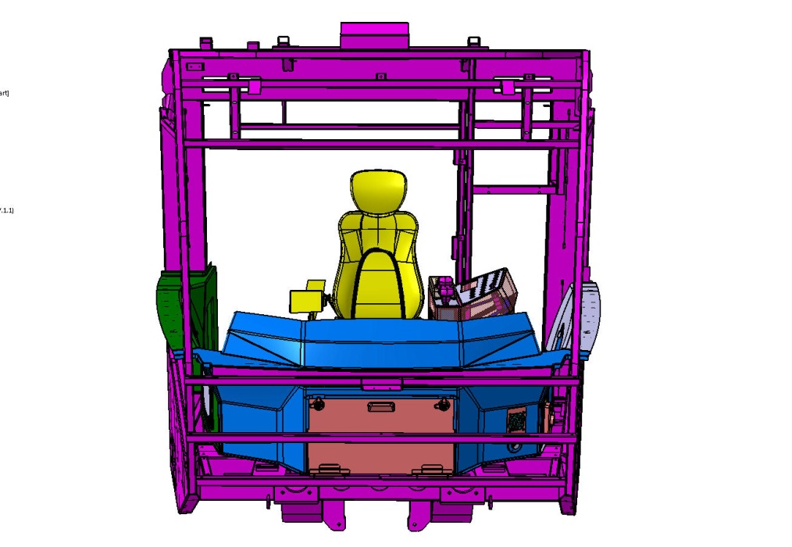
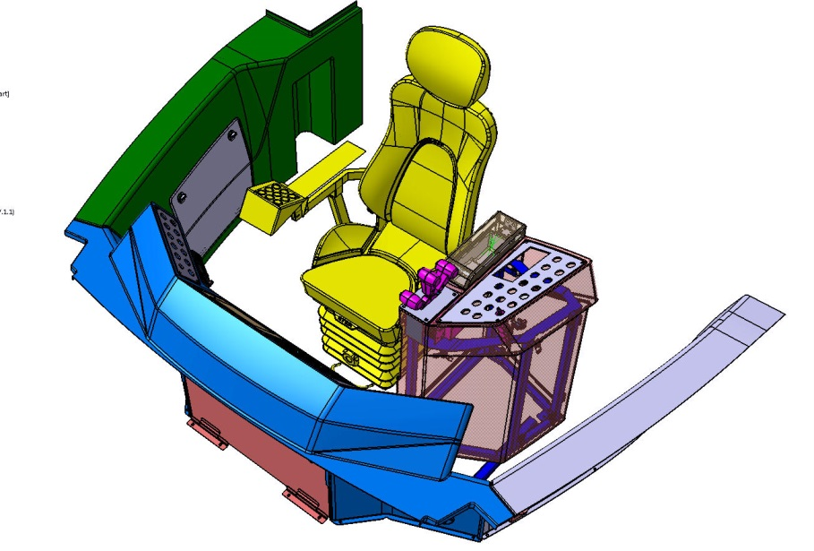
Public Transportation Projects

Slide 12
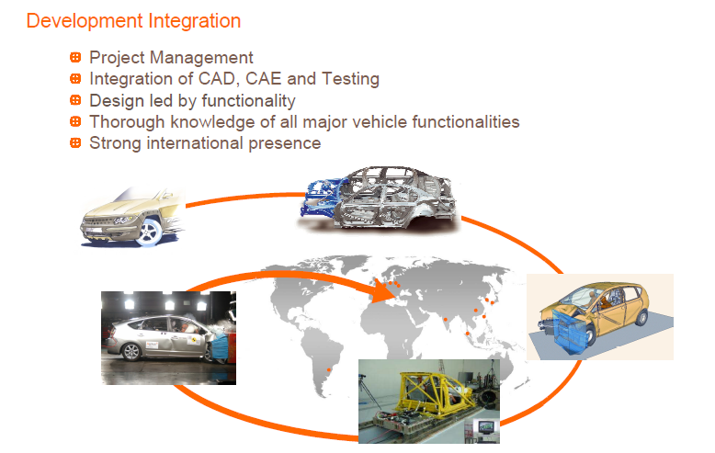
Main strengths and advantages
Development integration ;
12 Dedicated Technical Persons.
Integration of Cad,Cae ,RE and Prototype
Design led by functionality
Strong presence

Slide 13










References

