Slide 1
HCV TECHNOLOGY
All the images and information are also available on the website of the town hall where we rented the space : https://www.cerctm.ro/ro/servicii/prototipare-serie-mica

Slide 2
What we can do
We want to demonstrate our skills in the CNC field of over 2000 different parts programming and production in 3 or 5 axes as well as on the lathe. We work with different materials: Aluminum, Steel, Stainless Steel, Titanium, Plastic and composite materials.
We also have experience in the field of designing and making 3D and 2D models.

Slide 3
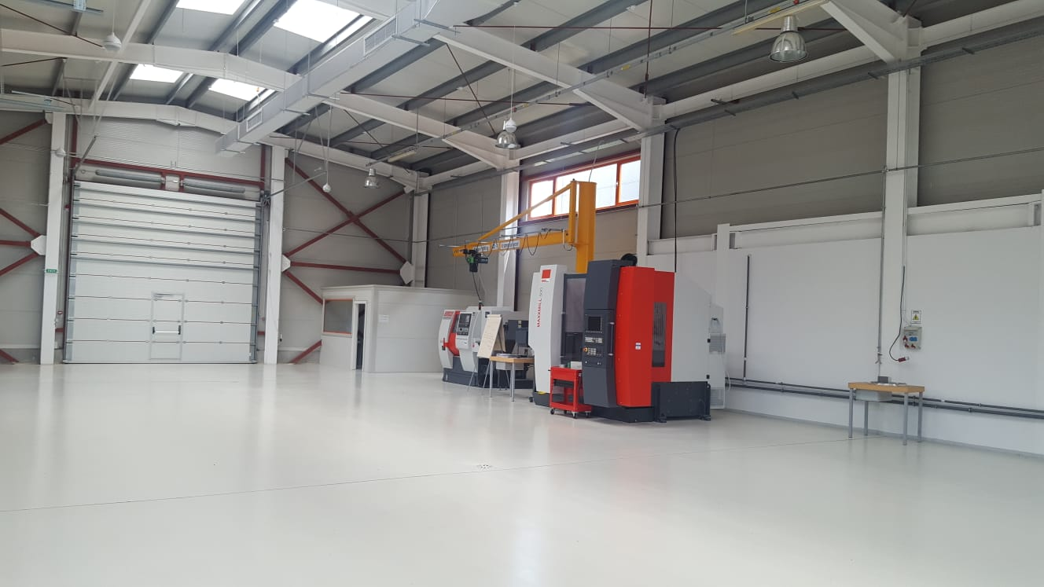
Our production space

Slide 4
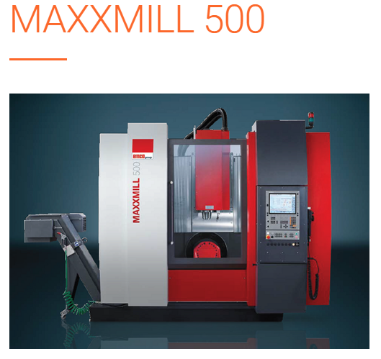
Our machines
Work area
5 axes milling center
Travel in
X/Y/Z:650/550/500 mm
Max. table load:
250 kg

Slide 5
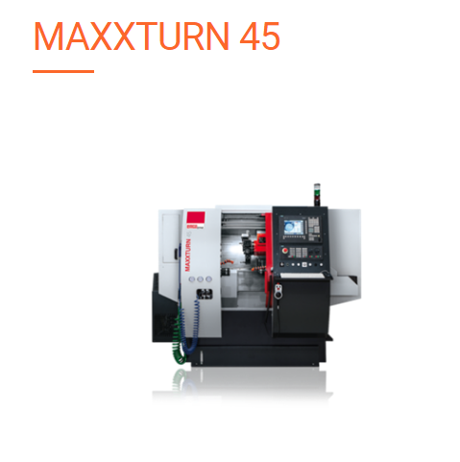
Work area
Travel in X/Y/Z:160 /70 /510 mm
Bar diameter: 45 mm
Max. turning diameter:300 mm
Swing over bed: 430 mm
Spindle distance: 720 mm
Driven tools for milling and drilling operations
Y axis directly implemented in the machine construction

Slide 6
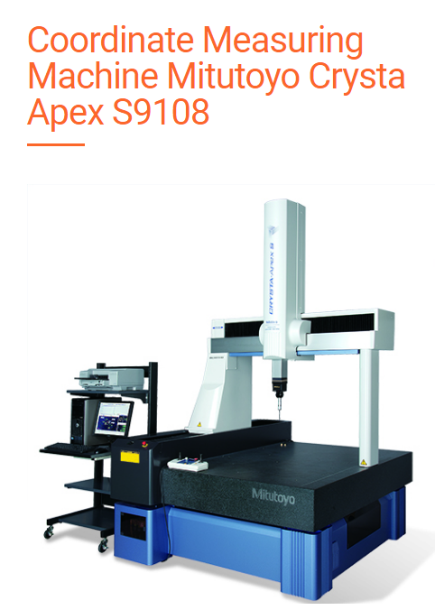
Work Table Material Granite
X-axis 35.4" (900mm)
Y-axis 39.4" (1000mm)
Z-axis 31.5" (800mm)
Resolution 0.000004" (0.0001mm)
Guide Method Air bearing on each axis

Slide 7
Our partners
We also have partners in this field who help us with thermal and coating treatments. The company has ISO 9001:2008, ISO 14001:2004 and BS OHSAS 18001:2007 certification.
But also on the cutting and bending side The company has
SR EN ISO 9001: 2008 Quality Management Systems and SR EN ISO 14001: 2004 CNC
BENDING MACHINE
The equipment - CNC bending press has 160 tons force, the maximum length is 3 meters.

Slide 8
LASER CUTTING
The worktable is 3 x 1,5 meters and the power is 2 kW.
This machine can cut material with thickness from 0.2 mm to 15 mm - steel, 5 mm - stainless steel, 4 mm - aluminum, 4 mm - brass, 4 mm - copper.
WATER JET CUTTING
We can cut materials up to 100 mm thickness.
The working table of one of the CNC machines is 3,4 x 2 m and it has 50 CP. m

Slide 9
Thank you very much !

