Slide 1
TWOMILLER S.R.L.
Field of activity: General mechanical operations

Slide 2
General information
Name: TWOMILLER S.R.L.
Phone: Mehez Andrei +40741661039
Rusu Vlad +40754672762
CIF: RO46368370
CAEN code: 2562

Slide 3
Main object
TWOMILLER SRL’s main point of activity is based on mechanical manufacturing.
Mainly we focus on aluminum and plastics, with future plans to process steel, stainless steel and other materials.
Our current work capacity is one milling machine with plans to acquire more.

Slide 4
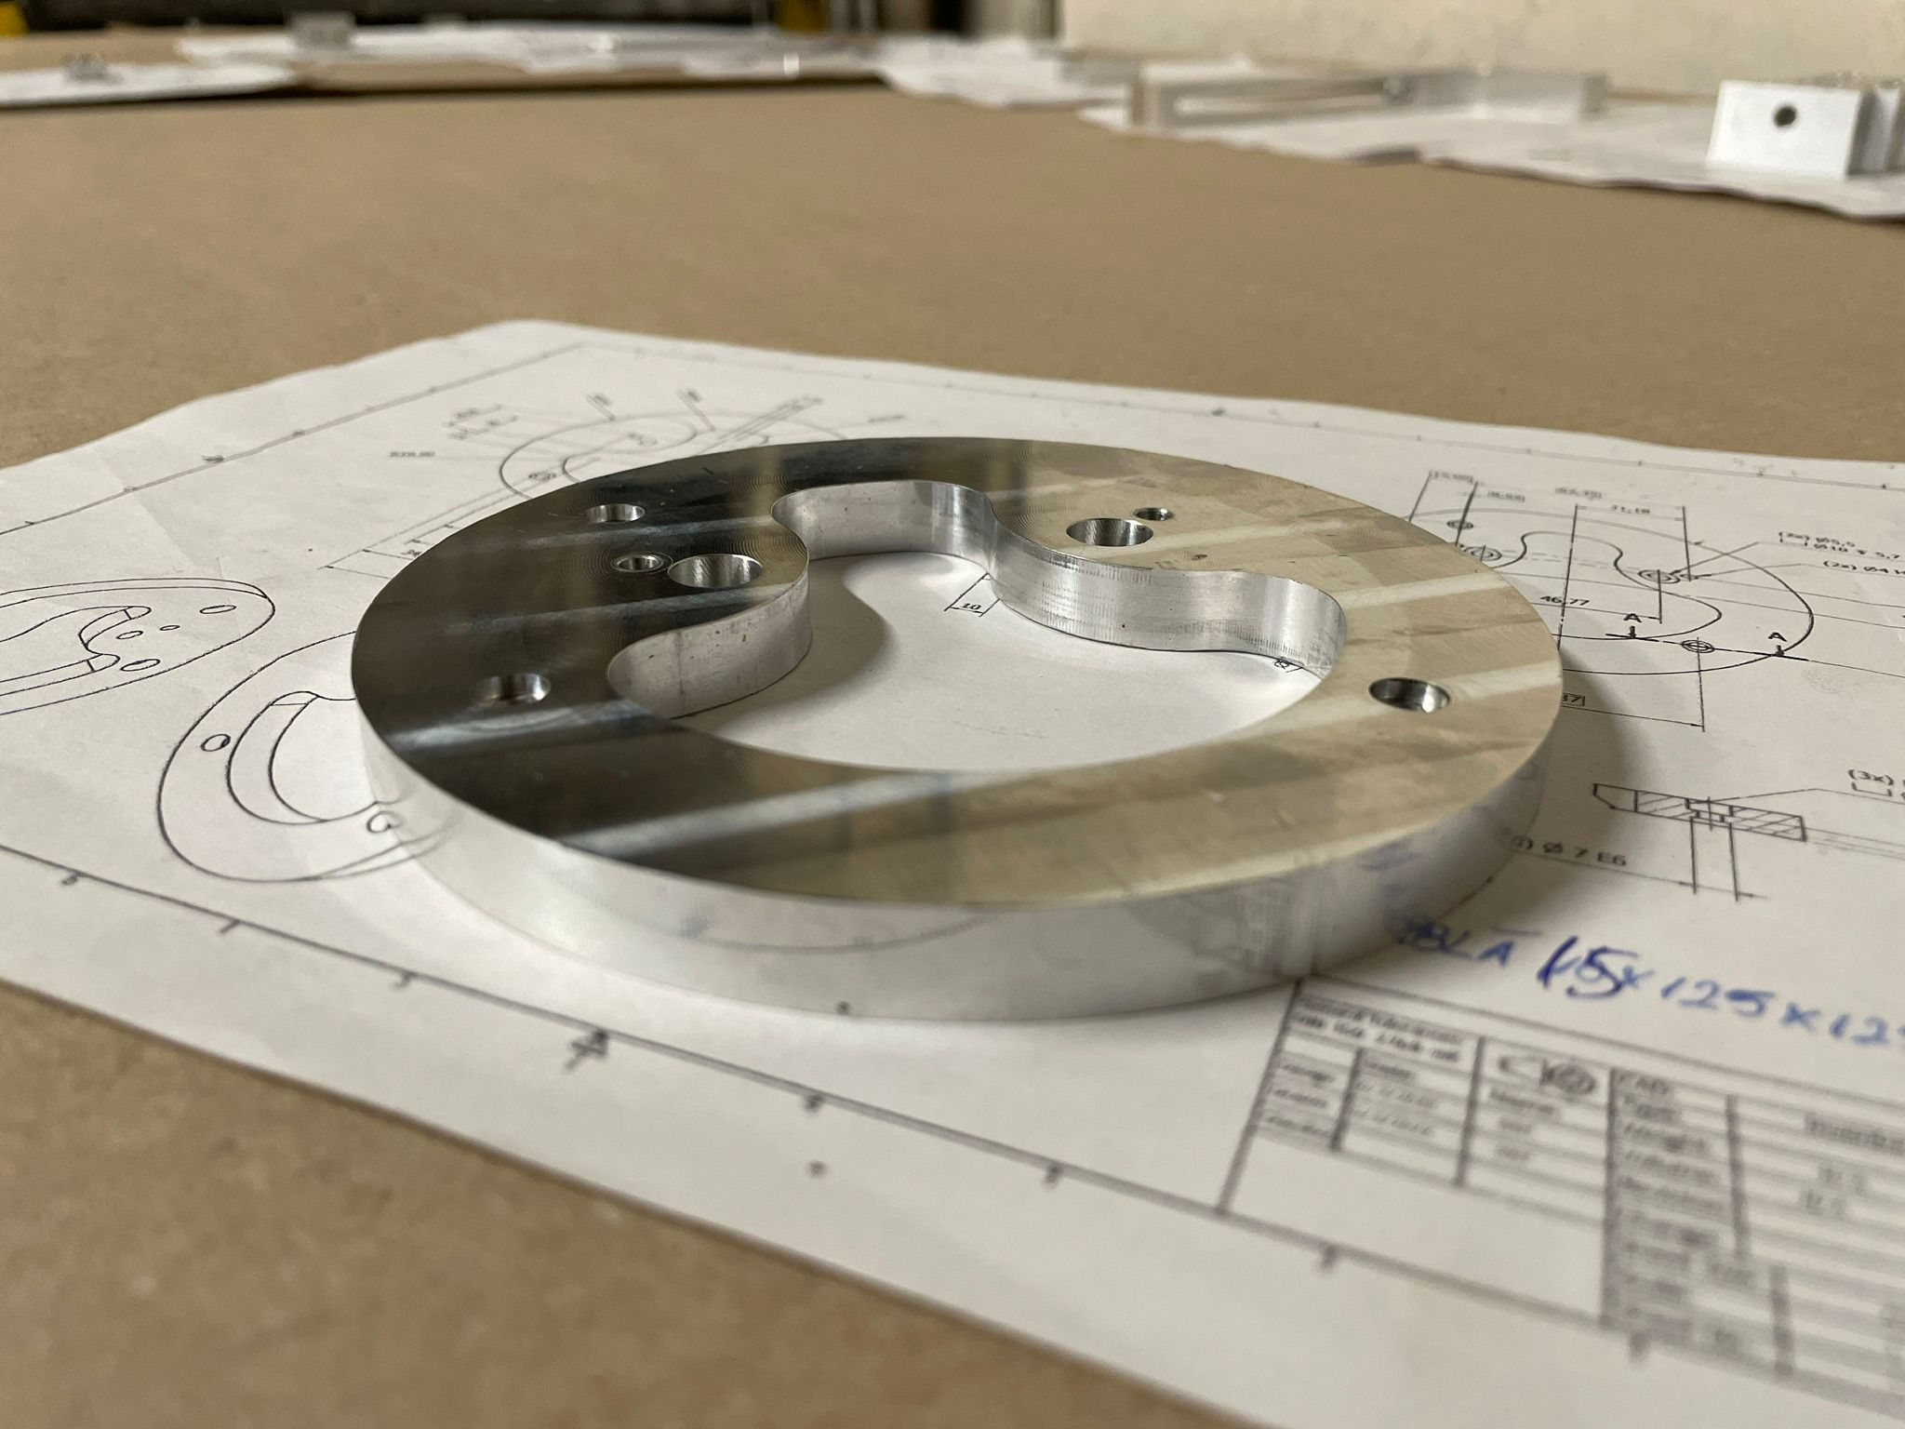
Here it is a short portfolio of our previous work
In the example on the right, we have a part with a circular shape, with ISO Fine tolerances(±0.05mm) and Roughness of 1.6μm.

Slide 5
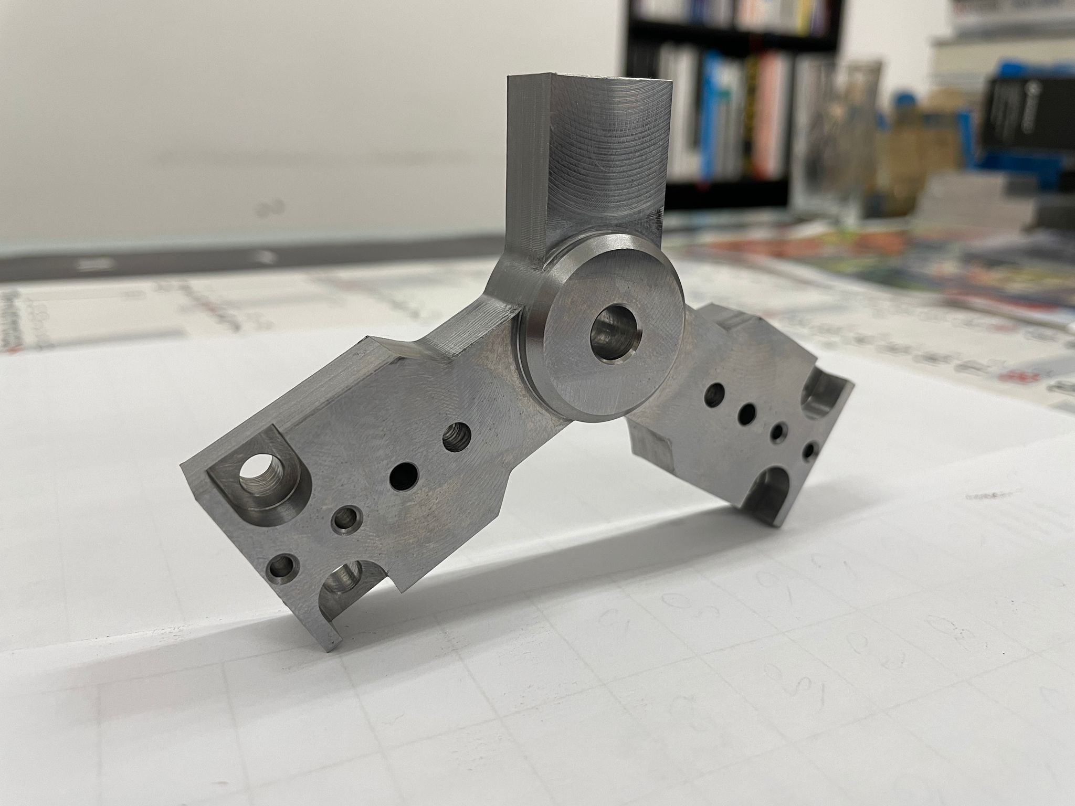
In the following picture you can observe a part with small radii and precision holes, fully executed on a 3-axis milling machine.

Slide 6
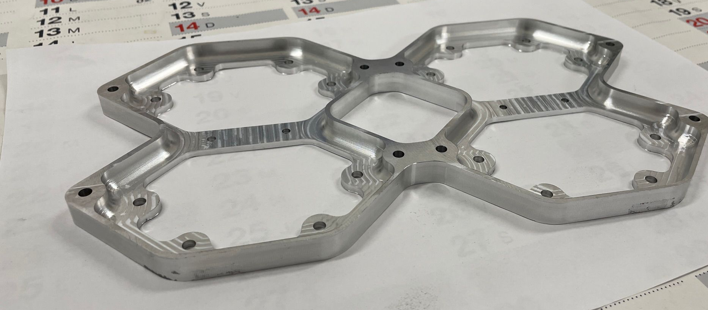
In the example above you can witness an aluminum part that has as special characteristics reduced wall thickness(2mm), fragile structure (that is hard to maintain fixed in a vise) and inner radii machined by HSM (High-Speed Machining).

Slide 7
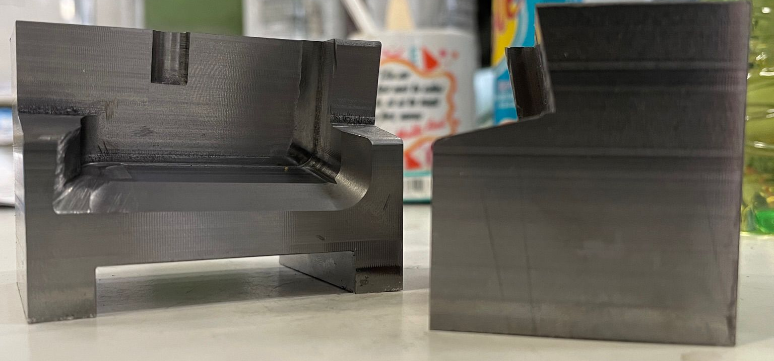
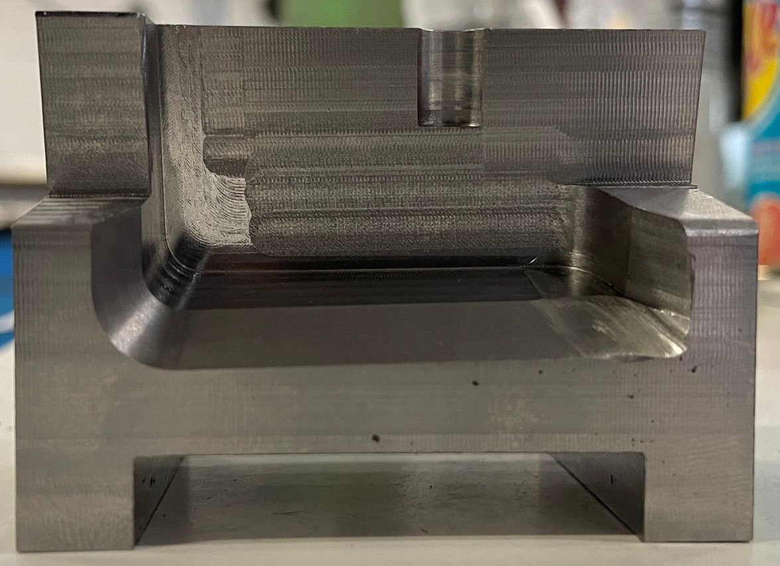
In the pictures on the right side we have parts with an inner angle of 45.9 degrees and various machined surfaces at different angles, including small inner radii, executed on a 3-axis CNC.

Slide 8
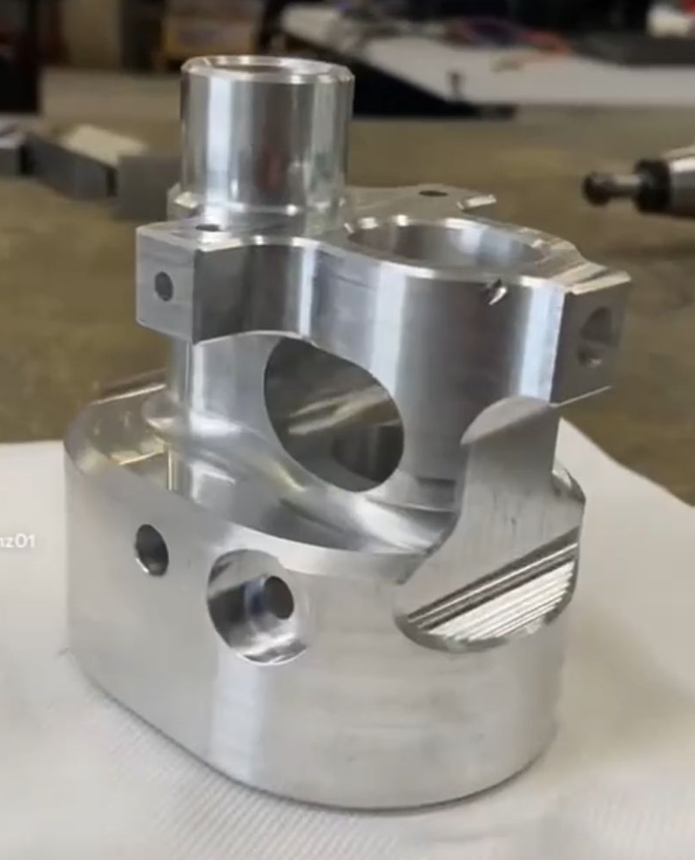
This part was realised considering complex geometry and difficult positioning in vise.
Both internal and external elevations are tolerated H7 and the roughness is 1.6 μm.

Slide 9
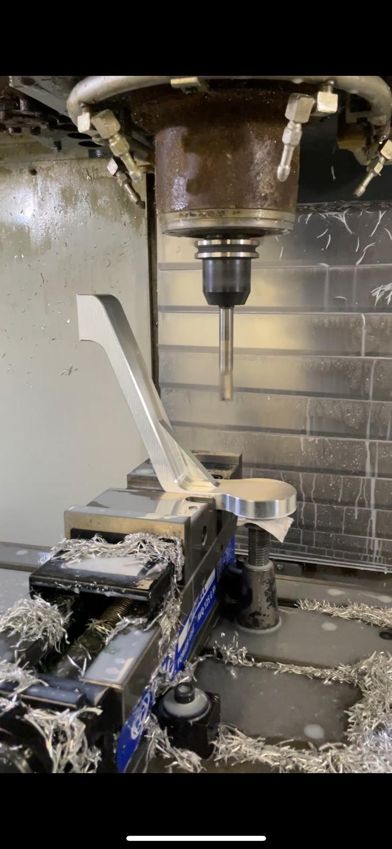
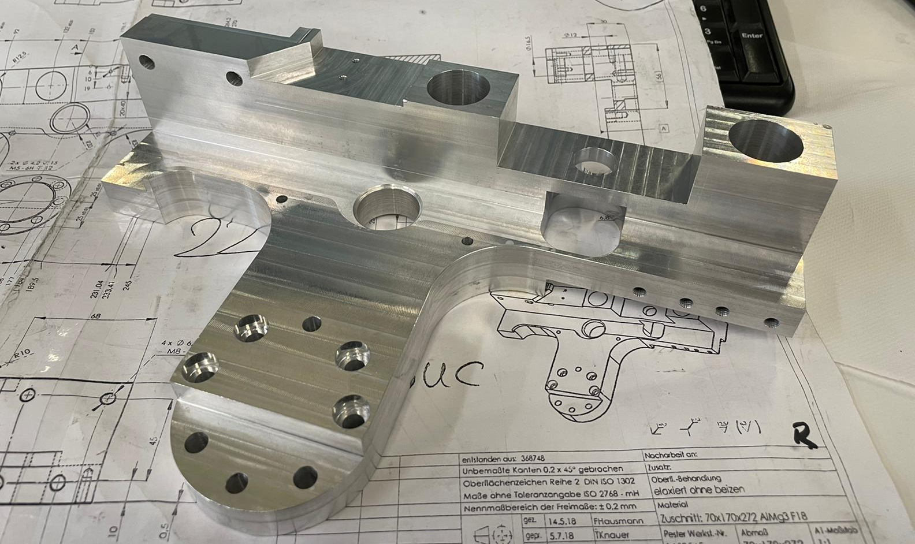
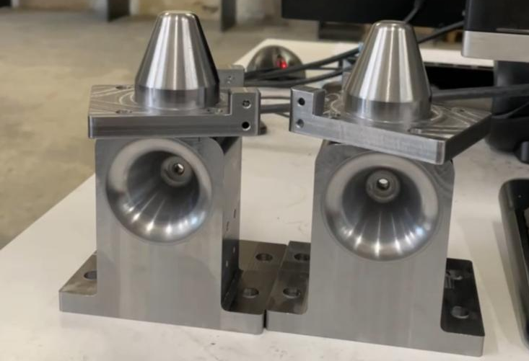

Slide 10
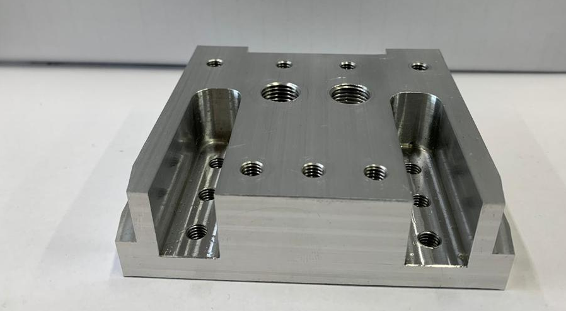
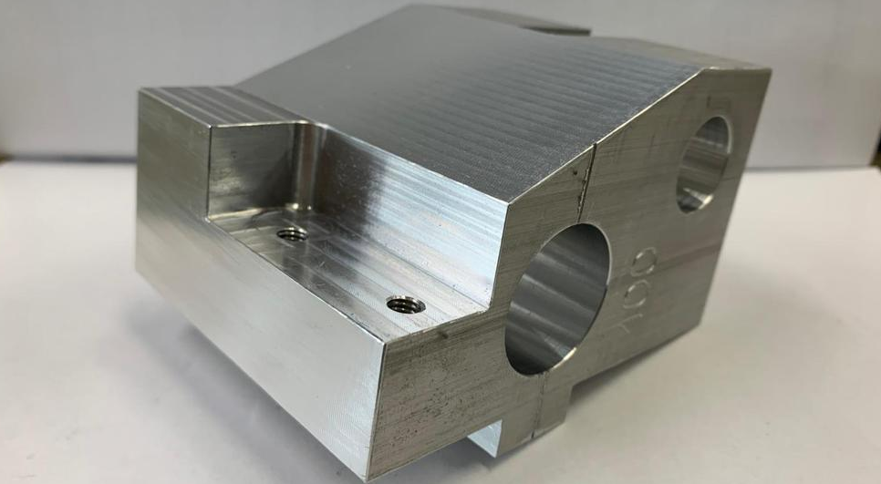
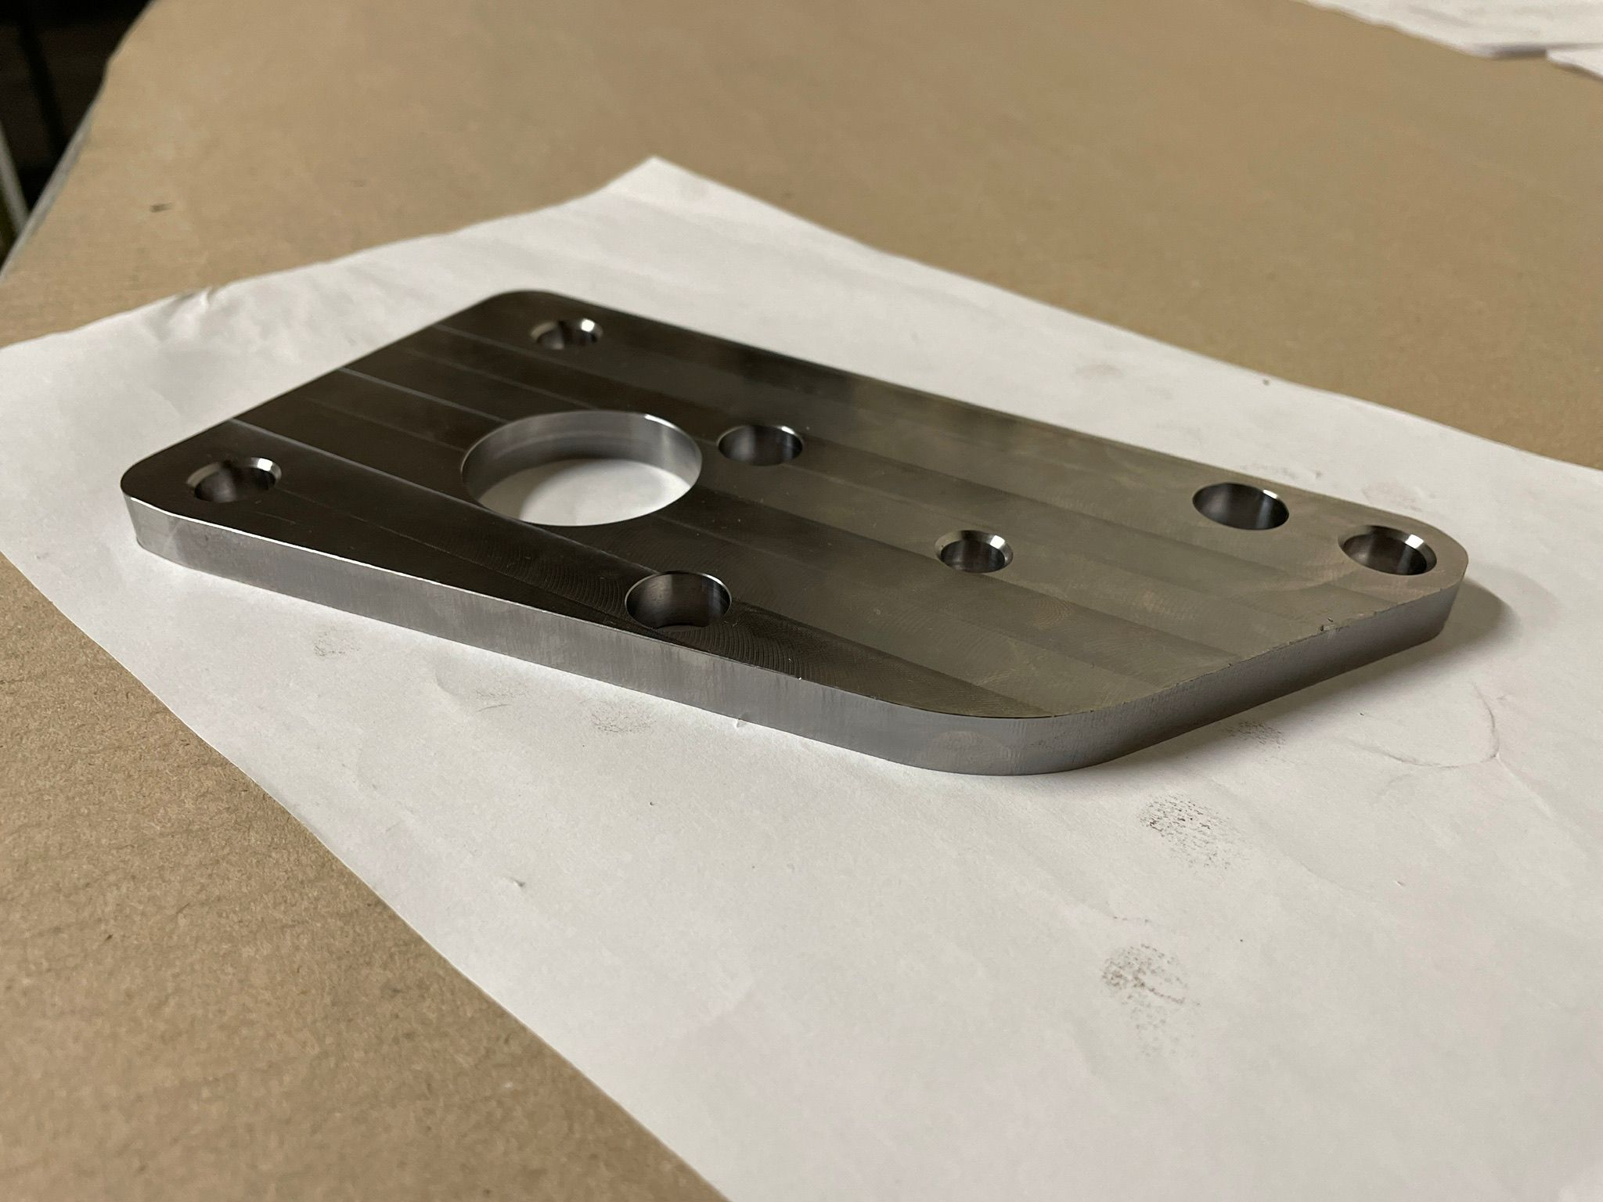

Slide 11
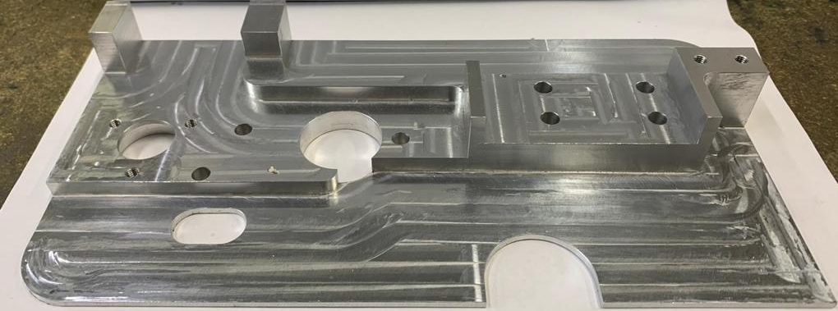
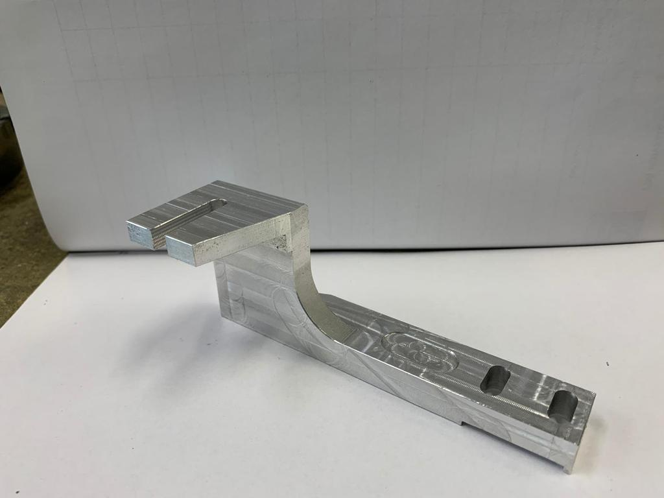
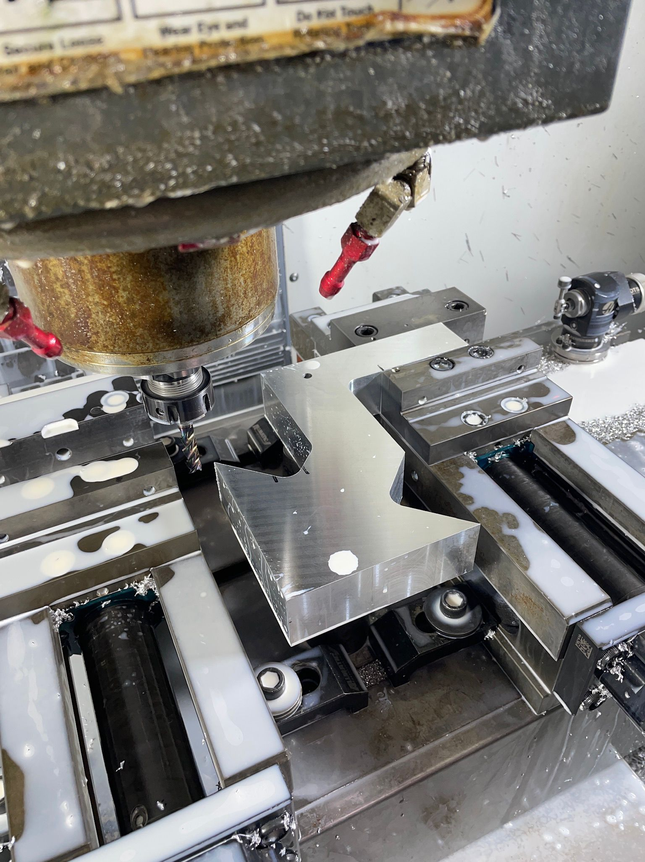
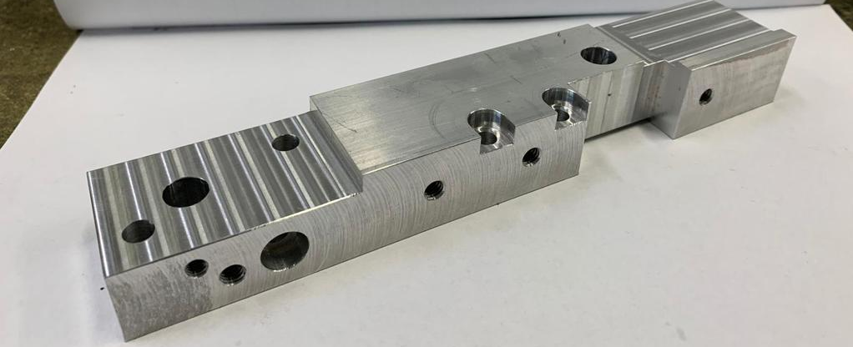

Slide 12
Our vision for the future
First of all we have a plan of development which includes one more milling machine in the very short future.
We also have in plan to extend our productivity in activities such as rectification, anodising and sanding.
Secondly we intend to increase the area of materials used in making parts.

Slide 13
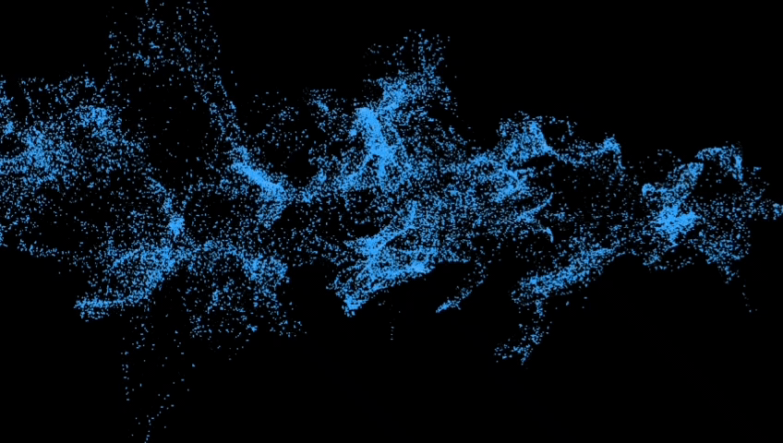
Best regards,
TWOMILLER

