Slide 1

.
.

Slide 2
MAIN CUSTOMERS
POLAND
RAFAMET S.A.
MICHELIN Olsztyn
KIRCHHOFF Poland
FAT HACO Wrocław
AFM - DEFUM S.A. Andrychów
GERMANY
MAG IAS GmbH, Eislingen/Fils
FOOKE GmbH, Borken
BIMATEC SORALUCE, Limburg
FFG Werke GmbH, Chemnitz
SHW Werkzeugmaschinen, Aalen
Reform Maschinenfabrik, Fulda
ELHA Maschinenbau Hövelhof
CZECH REPUBLIC
TOS Varnsdorf
SMT Pilzno
TOS Kurim
TSS Trebechovice
ITALY
JOBS Piacenza
TENOVA Castellanza
NORWAY
BRUNVOLL VOLDA Volda
HUNGARY
MAG IAS GmbH Kecskemet
SPAIN
JUARISTI Azkoitia
SORALUCE Osintxu Auzoa

Slide 3
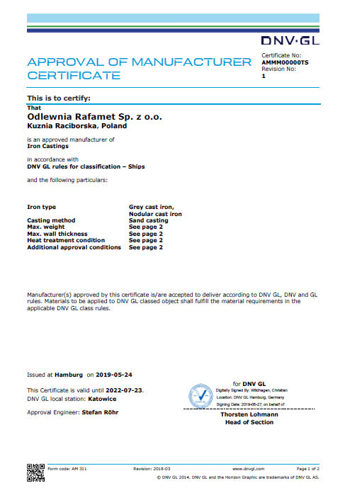
QUALITY POLICY
Quality Policy of our company is to produce high quality iron castings and the provision of services in accordance with the requirements and to the full satisfaction of our customers.
To implement quality policy objectives were developed and implemented by Quality Management System to comply with the requirements of ISO 9001:2015 and ISO14001:2015, which are overseen and controlled by Quality Supervisor and systematically improved by all employees.
The first certificate was obtained in 2010.
Certified range: production and sales of iron castings and providing of connected services.
Since 2016 Rafamet Foundry is approved manufacturer to deliver according to DNV GL, DNV and GL rules.
Materials to be applied to DNV GL classed object shall fulfill the material requirements in the applicable DNV GL class rules.

Slide 4
SALES STRUCTURE – COUNTRIES 2022

Slide 5
PRODUCTION PROFIL
Cast iron: | Ductile iron: | Alloy cast iron
EN-GJL 200; EN-GJL 250; EN-GJL 300; EN-GJL 350; | EN-GJS 400-12; EN-GJS 400-15; EN-GJS 400-18; EN-GJS 500-7; EN-GJS 600-3; EN-GJS 700-2; | Ni-hard; Ni-resist;
NORM
EN 1561 | EN 1563
Net weight: 200 - 40 000 kg; | Net weight: 200 - 30 000 kg; | Net weight: 100 - 20 000 kg;

Slide 6
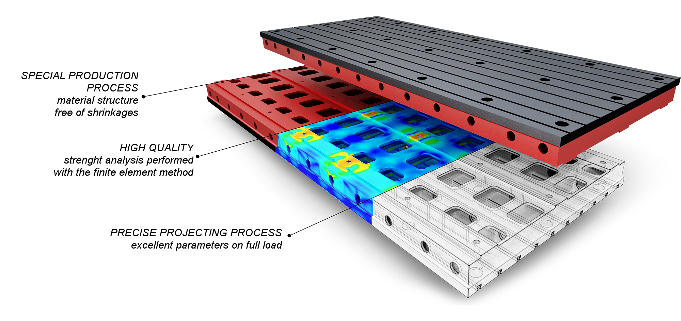
TECHNOLOGICAL PROCESS
ENGENEERING

Slide 7
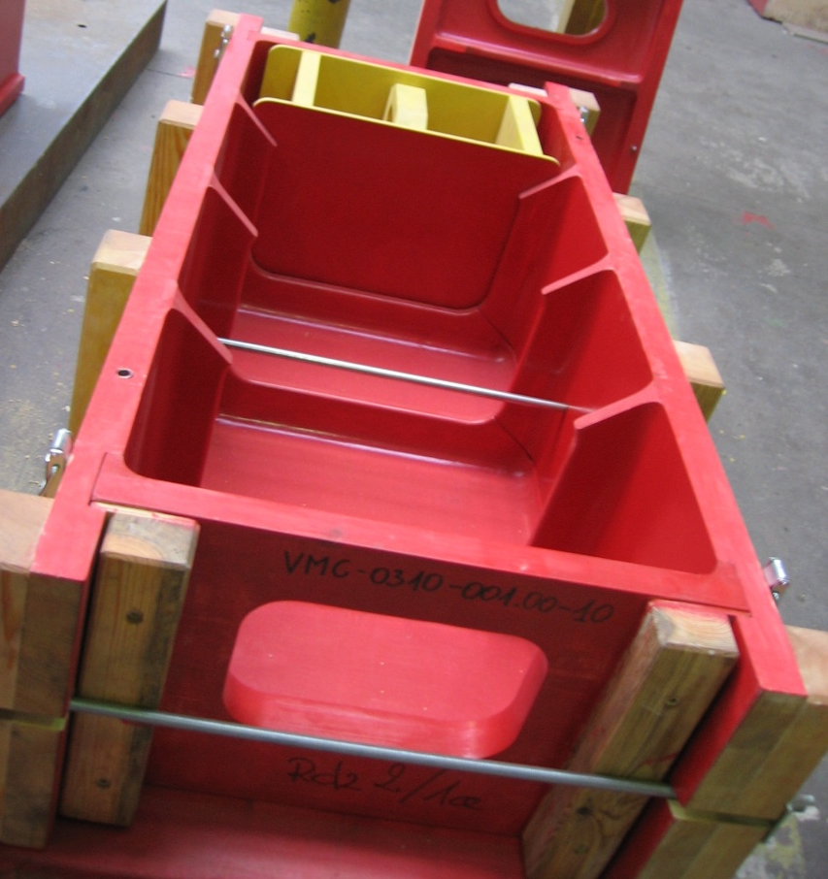
TECHNOLOGICAL PROCESS
PATTERN SHOP
Specialized in big-size patterns
Patterns made from wood according to H1 or H2 class (DIN-PN-EN 12890)
Adaptation of customer patterns
Pattern storage space – over 5000 m²

Slide 8
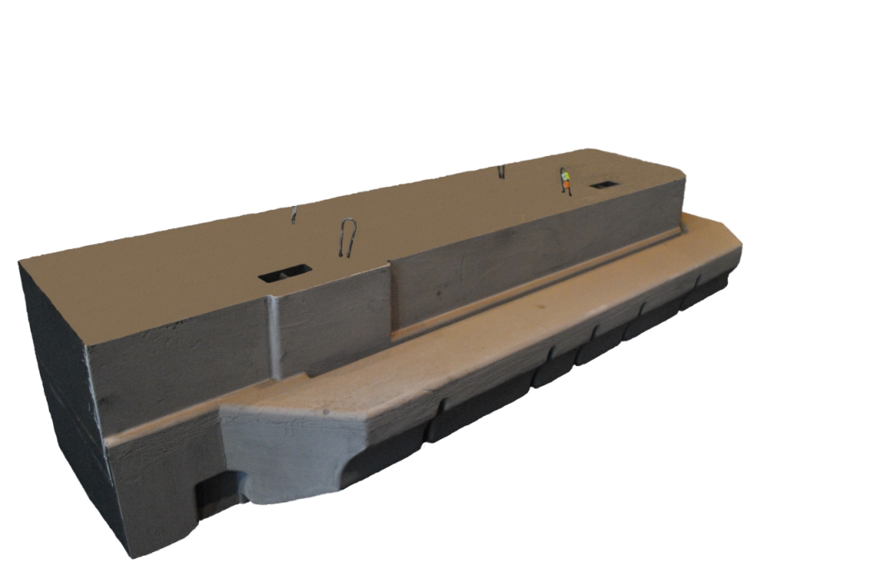
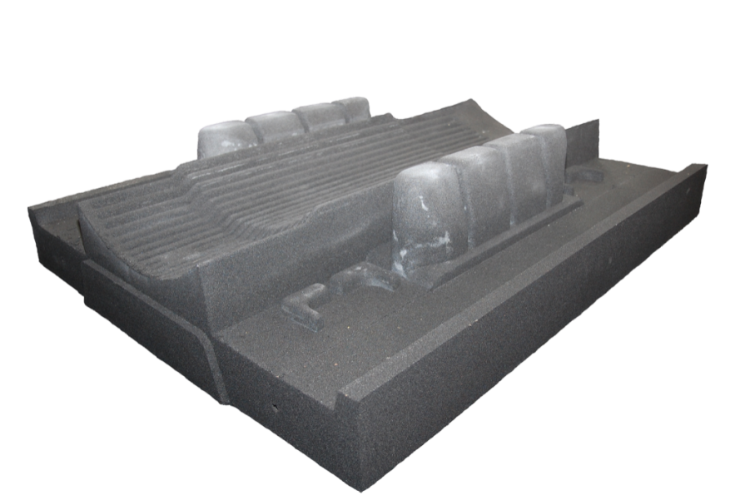
TECHNOLOGICAL PROCESS
CORE SHOP
3 WDS Wohr mixers – 20 t./h
FAT mixer – 35 t./h
Pneumatic sand transport system with graphic interface.
6 prepared recipes for different sort of moulding sand
Moulding sand with furan resin
Zyrconium-based coat for cores and moulds

Slide 9
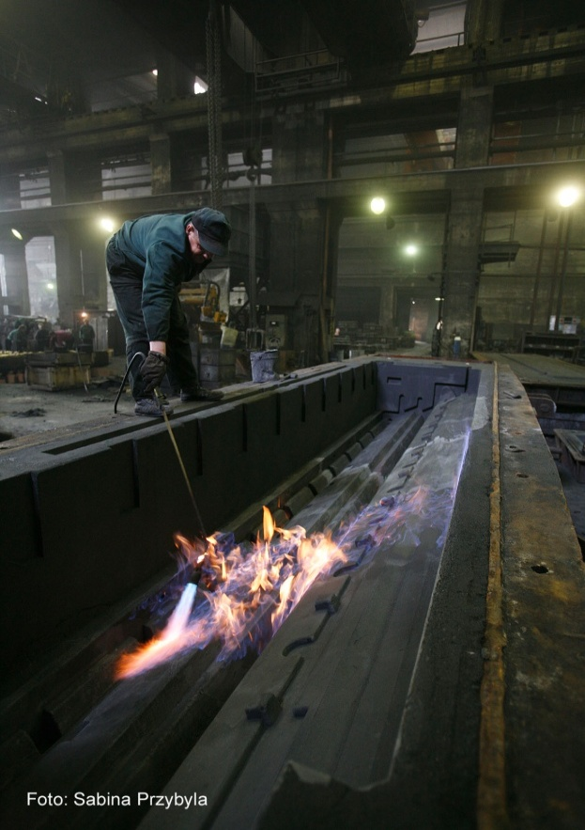
TECHNOLOGICAL PROCESS
MOULDING SHOP
>400 moulding boxes size up to:
8000 x 1700
and 4500 x 4500 mm.
5 moulding pits size up to:
20000 x 4000 x 2000
and 14000 x 5500 x 2500
Sand reclaiming station – 8 t/h
Fresh sand addition – less than 10%

Slide 10
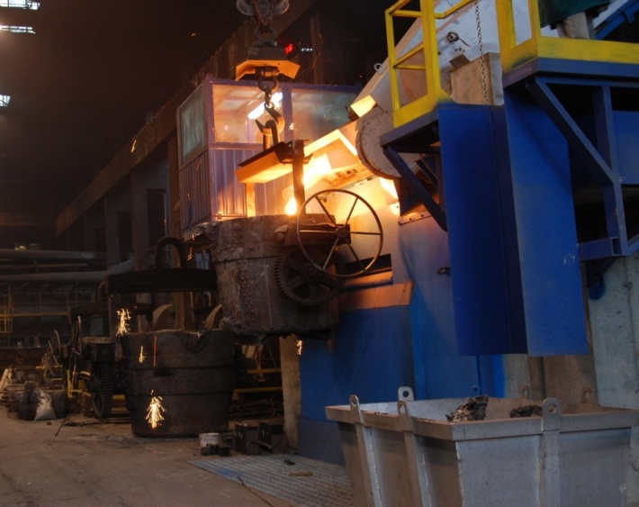
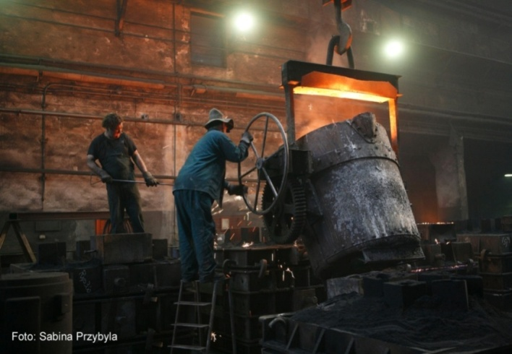
TECHNOLOGICAL PROCESS
IRON MELTING
Induction furnaces OTTO JUNKER, capacity 12 t and 6 t.
Spheroidization - Progelta Cored Wire Treatment station
Tilting ladles – capacity 5, 7, 10,15 and 20t
ITACA MeltDeck Cast Iron Thermal Analysis

Slide 11
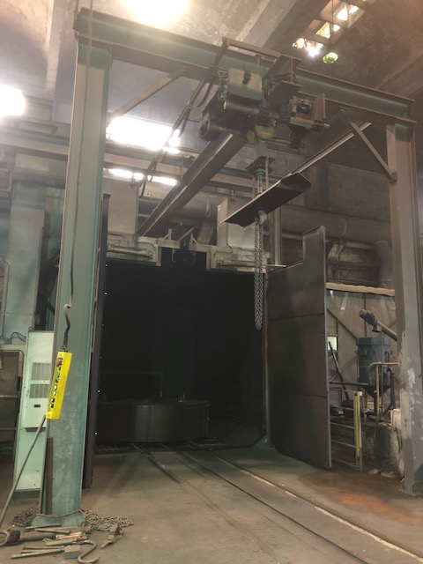
TECHNOLOGICAL PROCESS
CASTING CLEANING
Shaking chamber 5 x 5m with dust exhaust system
Water cleaning station – 160 bar pressure
STEM Shotblasting Machine H35x35
Special chamber for manual shotblasting 6 x 4 x 2 m
Final cleaning by manual operated grinding tools

Slide 12
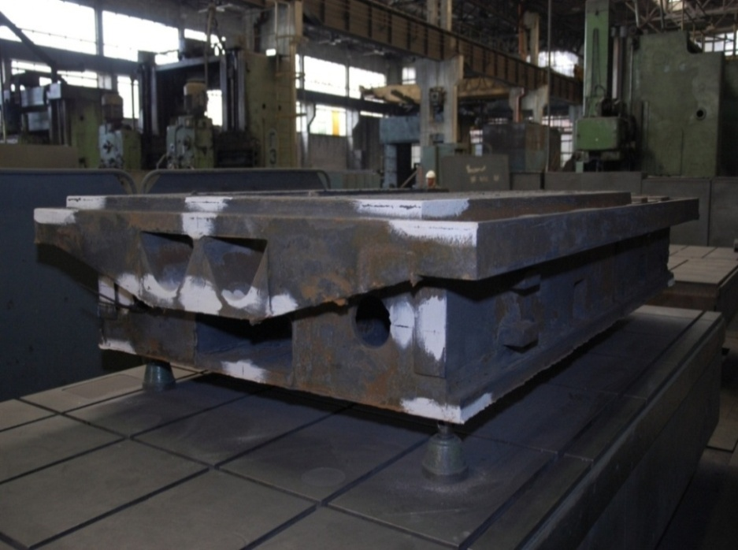
TECHNOLOGICAL PROCESS
QUALITY CONTROL OF CASTINGS
Quality control of all production processes:
Patterns
Cores and moulds
Sand and moulding mass parameters
Raw materials quality
Liquid metal and melting process parameters
Chemical composition
Dimension protocols
Mechanical propoerities
Non-destructive testing

Slide 13
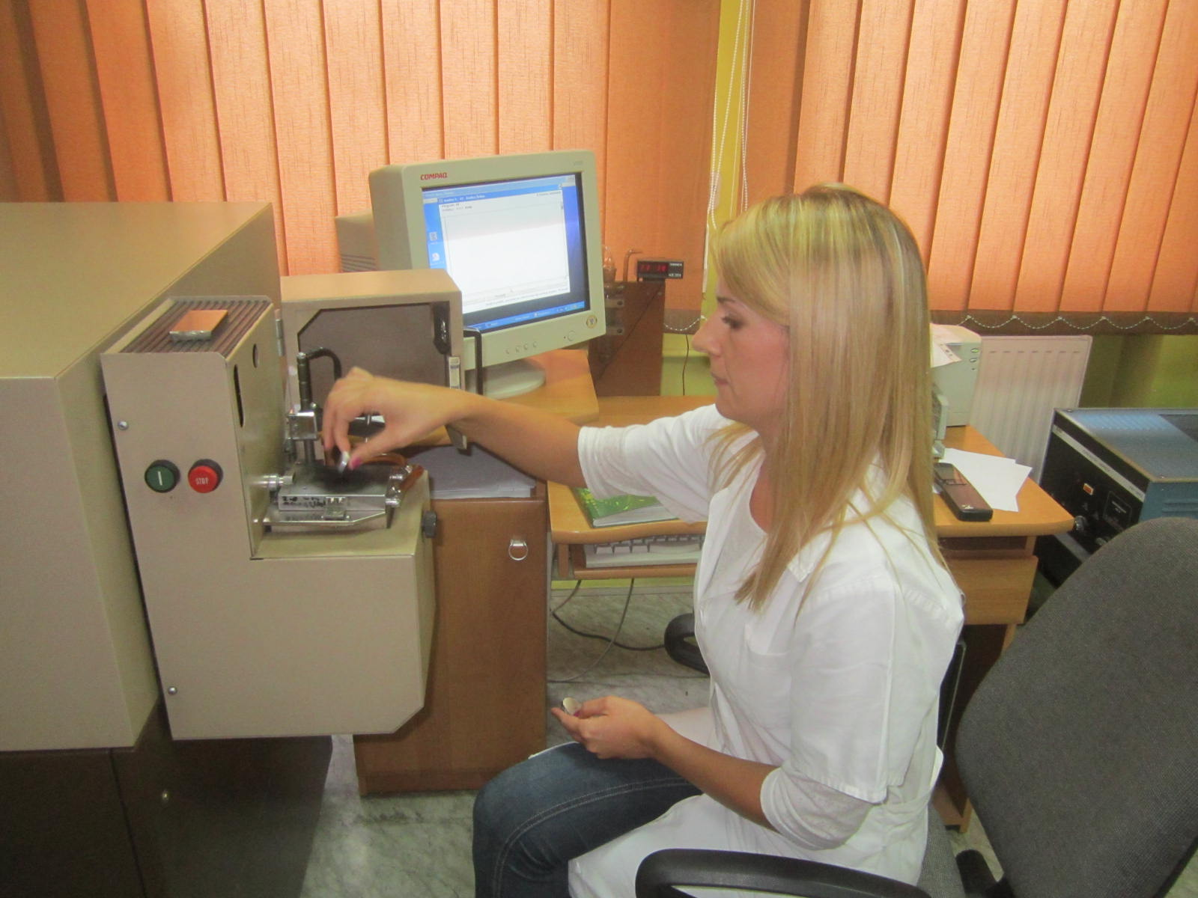
TECHNOLOGICAL PROCESS
LABORATORY
spectral analysis
metallographic tests
Charpy impact tests
Brinell hardness tests
strength tests
ultrasonic testing

Slide 14
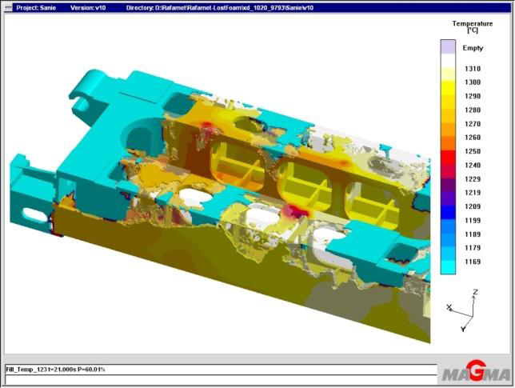
EPS INFORMATION
Rafamet Foundry uses lost foam process as a innovative alternative addition to conventional technology.
The lost foam casting is a full mold casting process - models made from EPS (expanded polystyrene) are embedded in molding box filed with sand. Liquid metal introduced into it replaces the plastics and fills out the cavities of the mold. The Lost Foam method is an economic manufacturing technology for complex components, because the polystyrene model can reproduce the undercuts, angular channels and contour-optimised cavities. This technique in many cases is cheaper than other casting methods in that a foam pattern can be fabricated much more easily.
EPS casting pouring process simulation calculated in MAGMA system

Slide 15
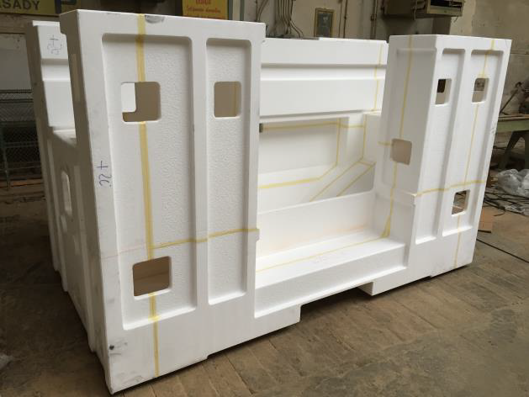
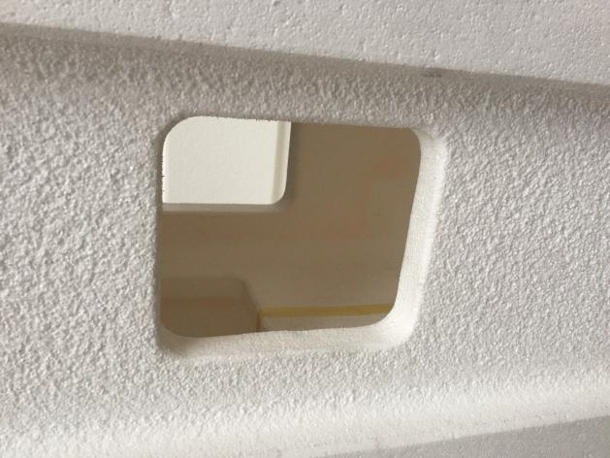
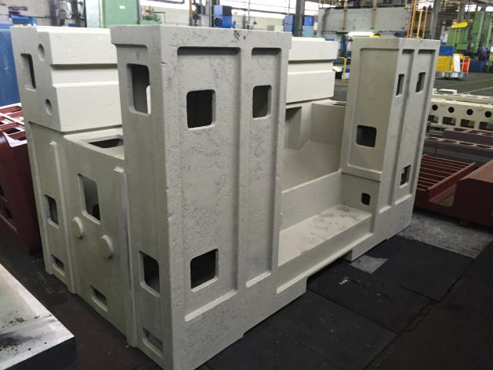
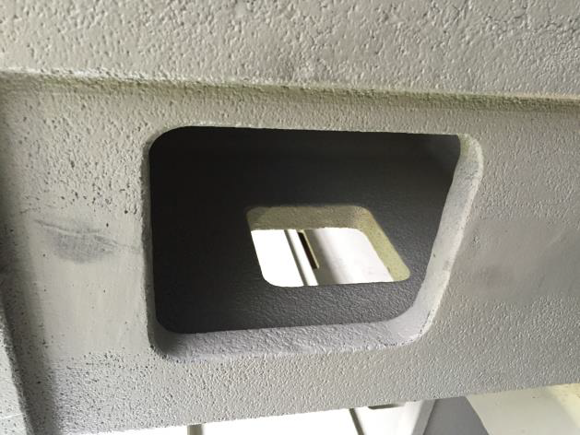
EPS INFORMATION
Sample images of EPS pattern, surface and final casting – 9000 kg, EN-GJL-300.

Slide 16
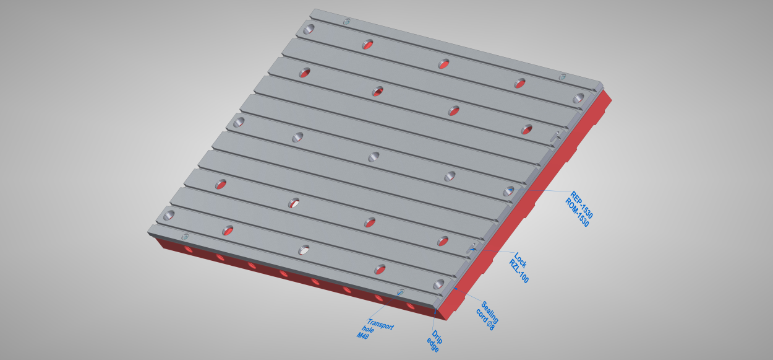
MOUNTING PLATES

Slide 17
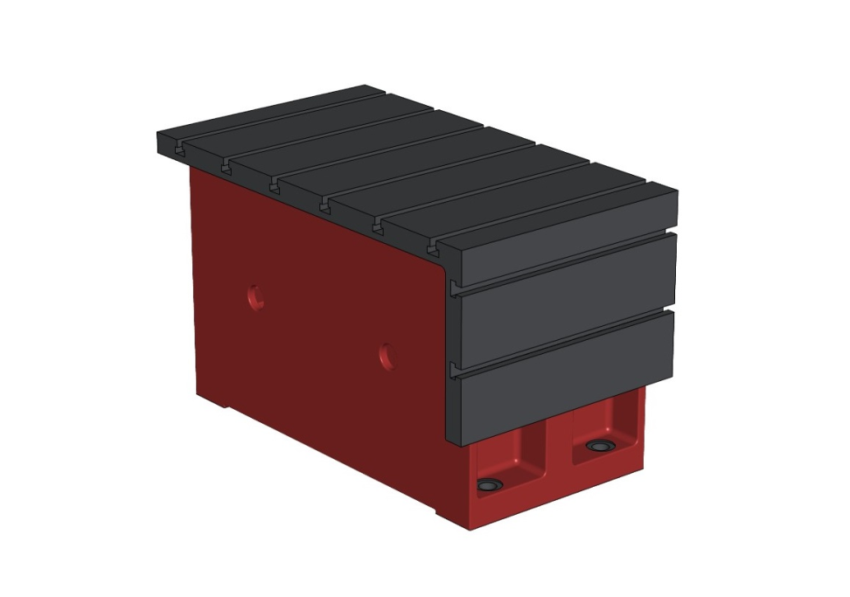
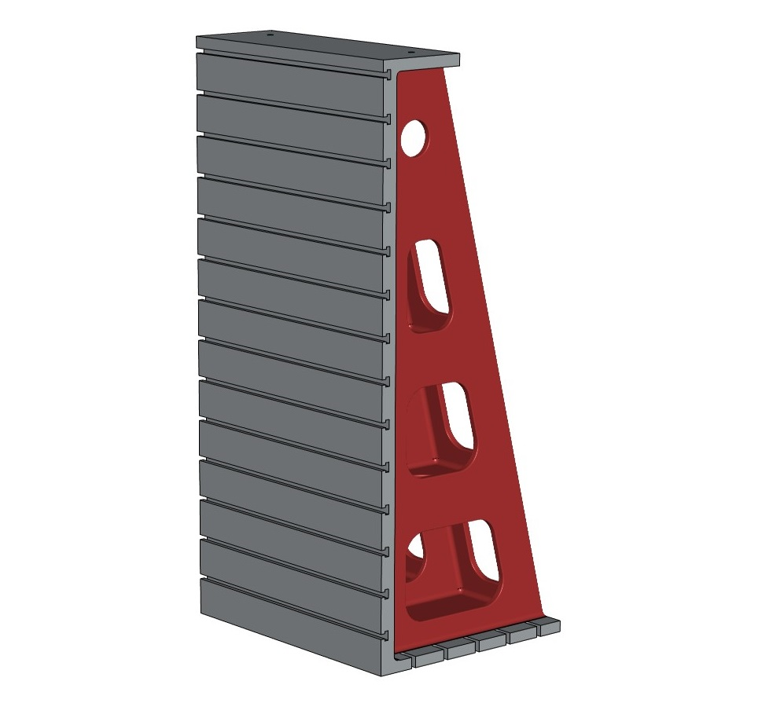
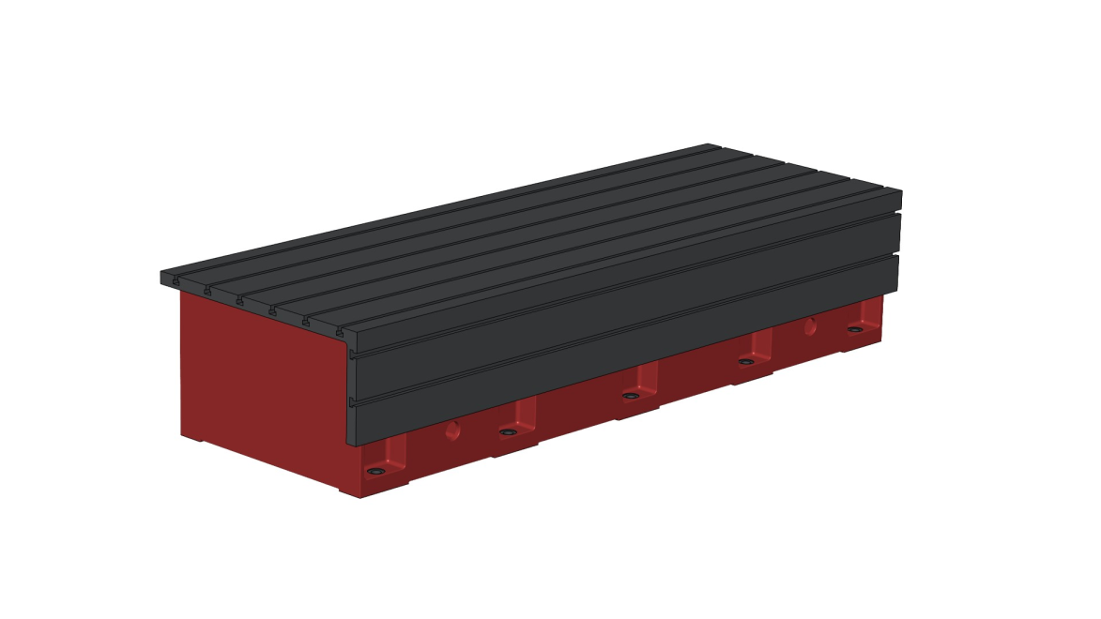
ANGLE PLATES, CUBES
The largest of angle plate has been produced basing on polystyrene pattern.
Dimensions of this angle plate: 2500x2000x3000mm, weight: 14.950 kg

Slide 18
MOUNTING PLATES
Specification of mounting plates in standard execution
Length – up to 9000 mm
Width: 1750, 2000, 2500 or 3000 mm
Height: 250, 300 or 350 mm
Working loading :
8.000 kg/m² (for plate with height of 250 mm)
20.000 kg/m² (for plate with height of 300 mm)
35.000 kg/m² (for plate with height of 350 mm)
Surface accuracy acc. to DIN 876/II or DIN 876/III
T-slots acc. to DIN 650, distance each 250 mm or (175 mm available if requested)
4 x M48 holes for manipulation purposes (for 1 pc of plate)
4 pcs of eye bolt (per set)
Covers for manipulation holes
Covers and o-rings
Oil-tight execution
Painting acc. to customer requirements
Additional elements/execution:
Sealing rope and locks for connected plates
Holes on plate edges and connection places
Drip edge
Levelling elements AE55 type

Slide 19
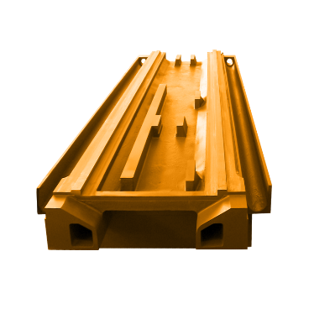
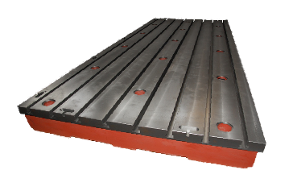
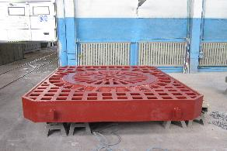
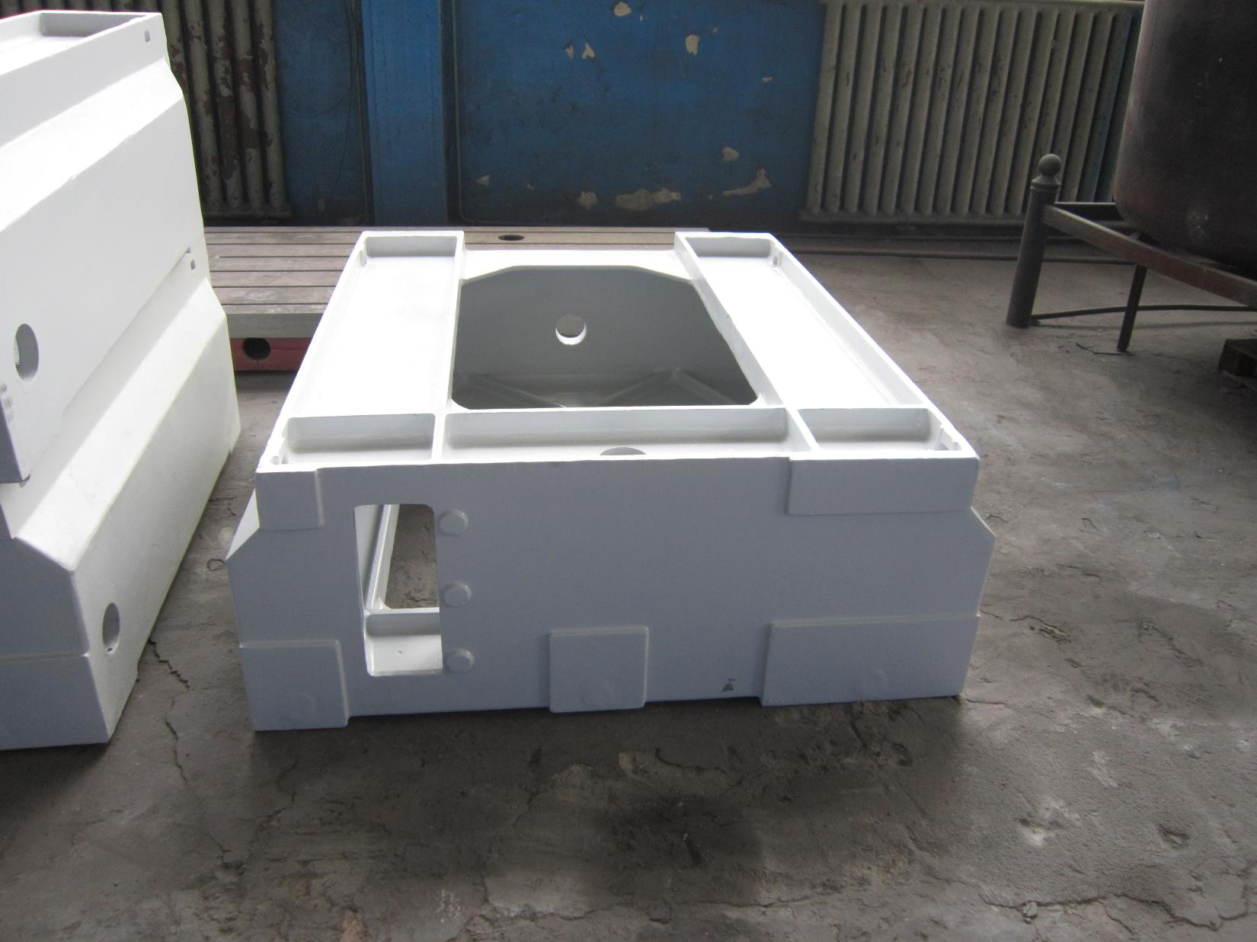
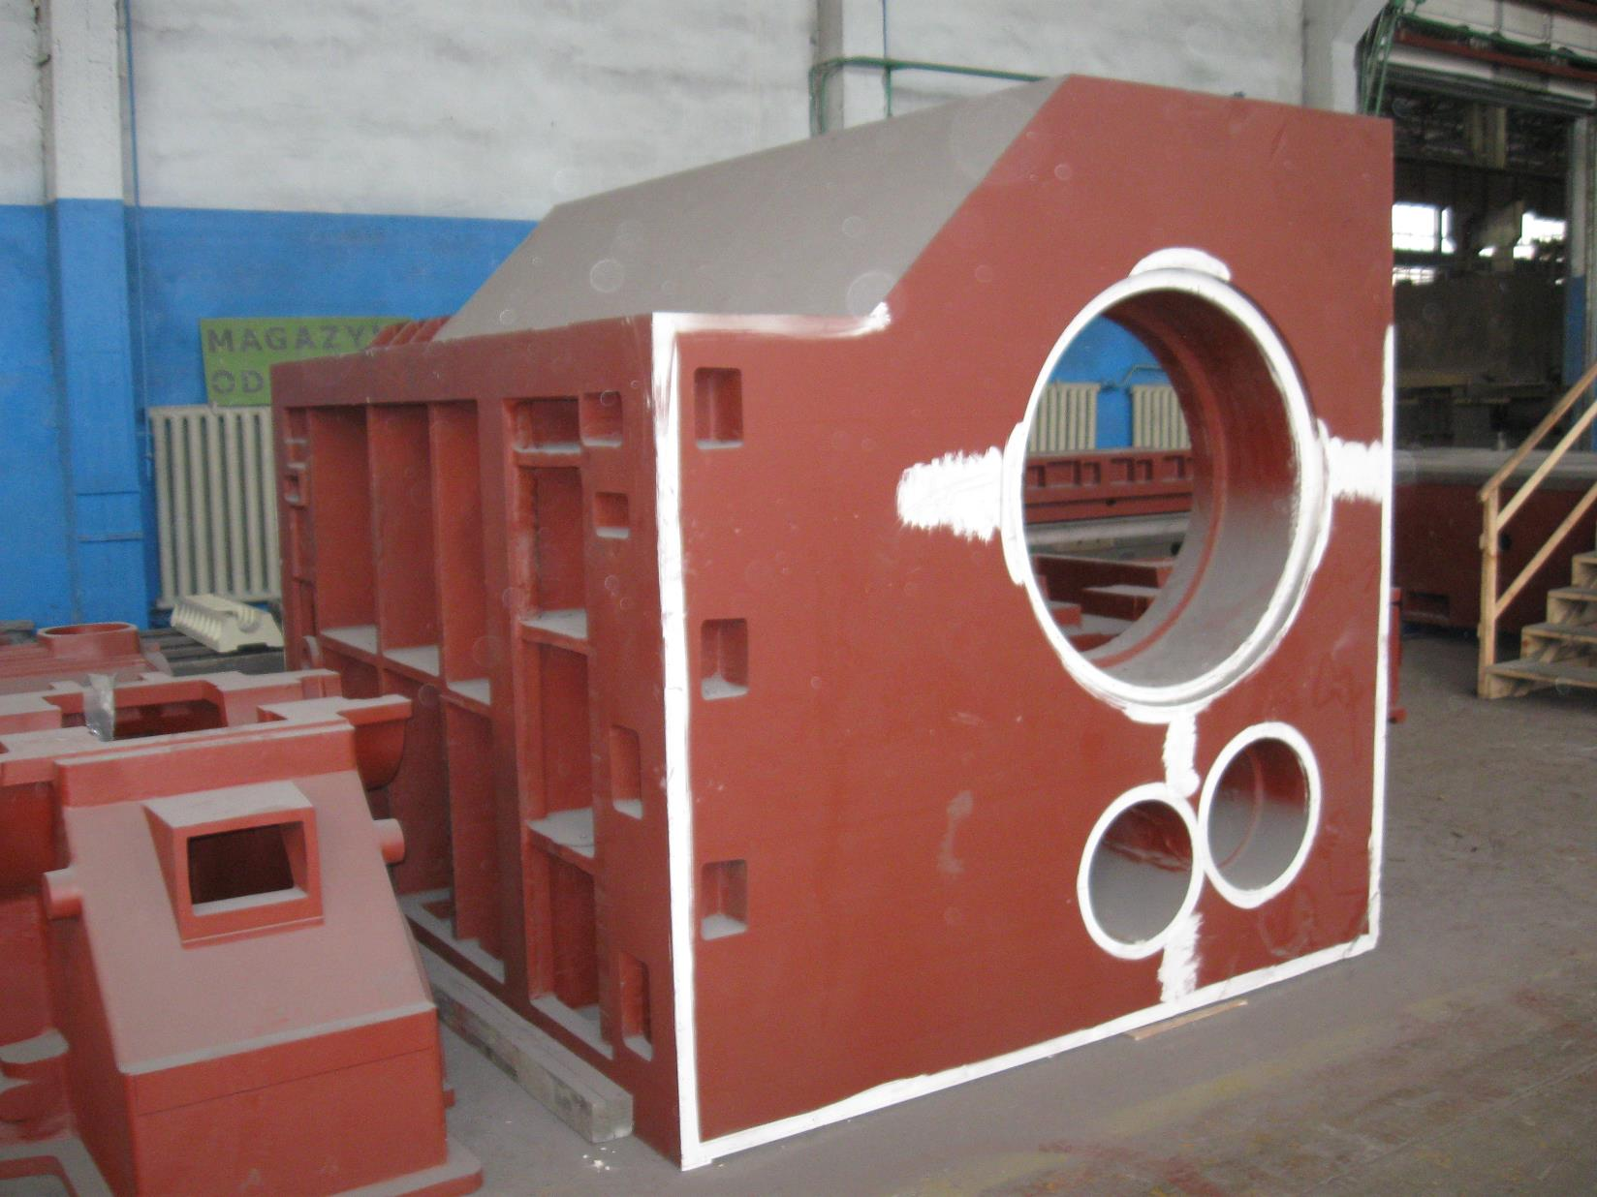
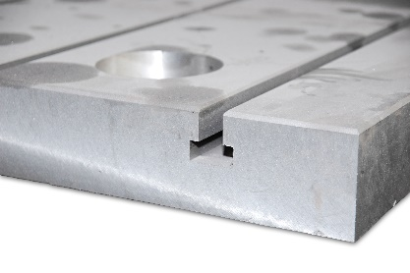
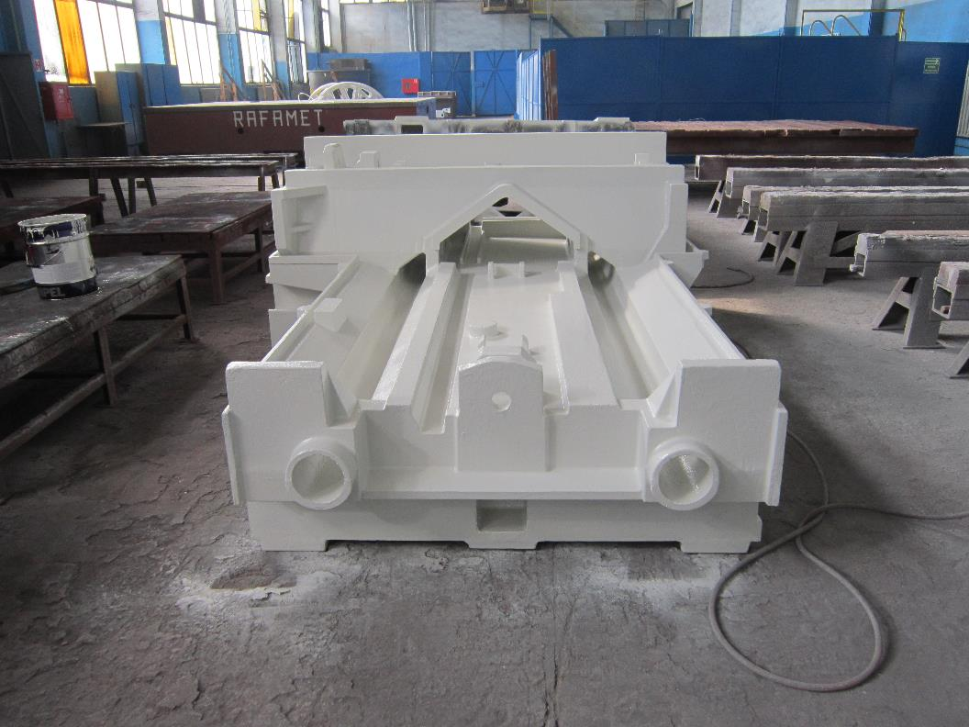
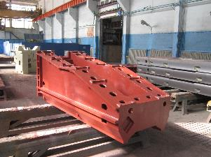
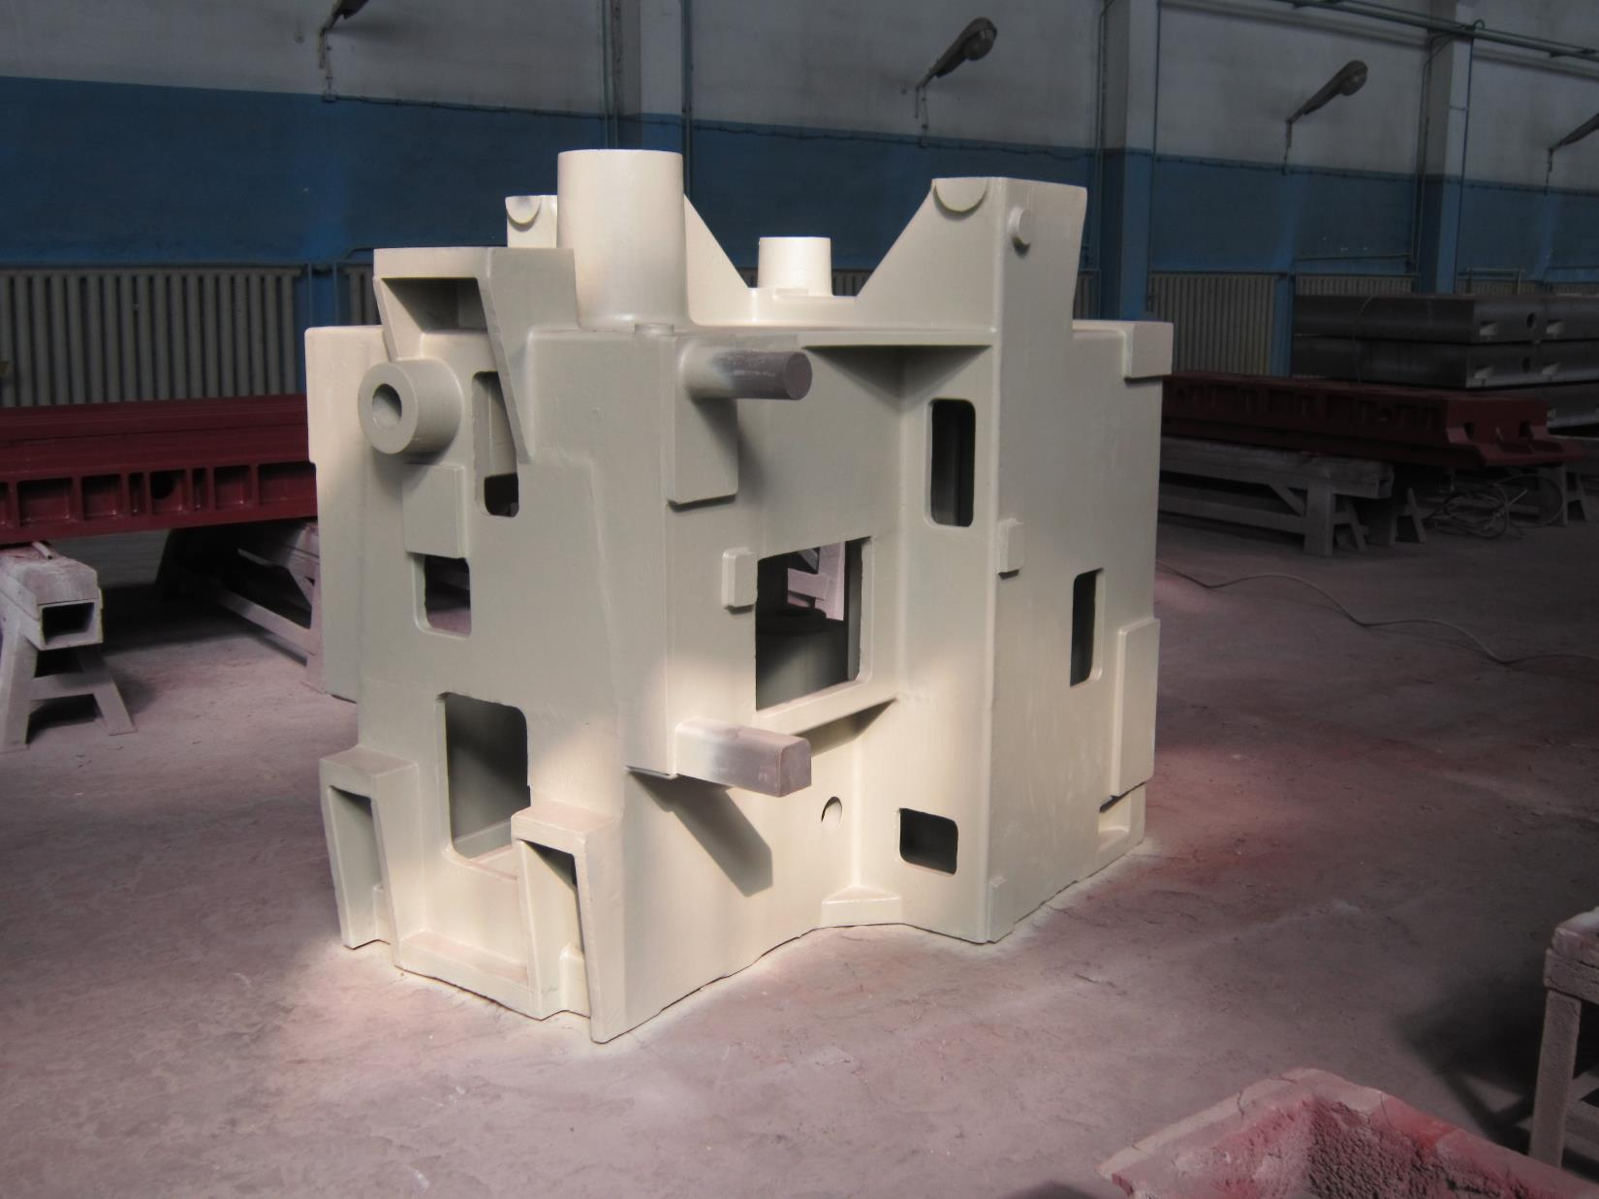
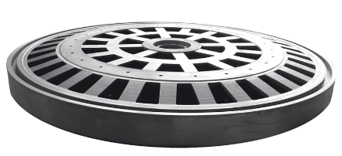
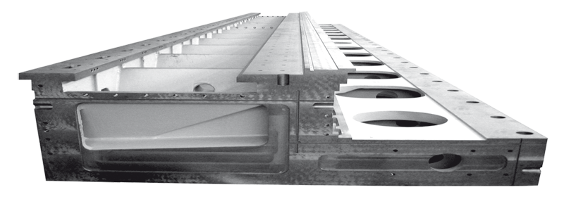
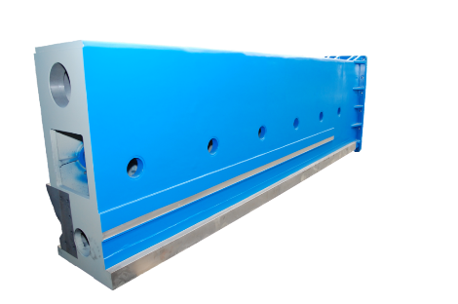
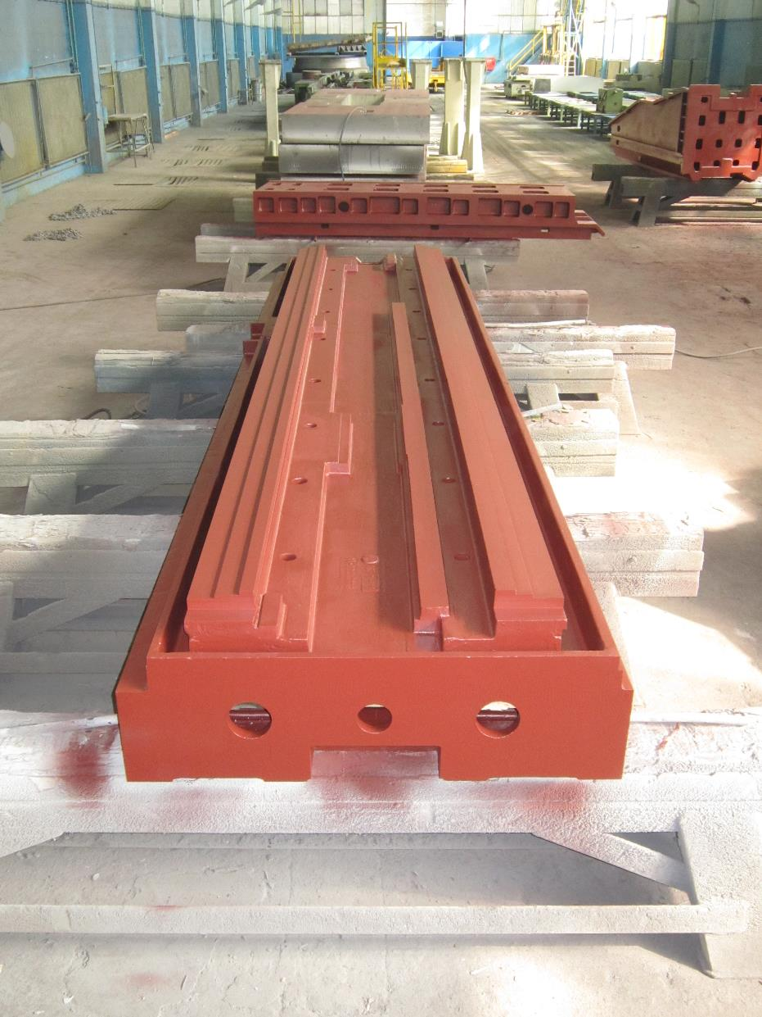
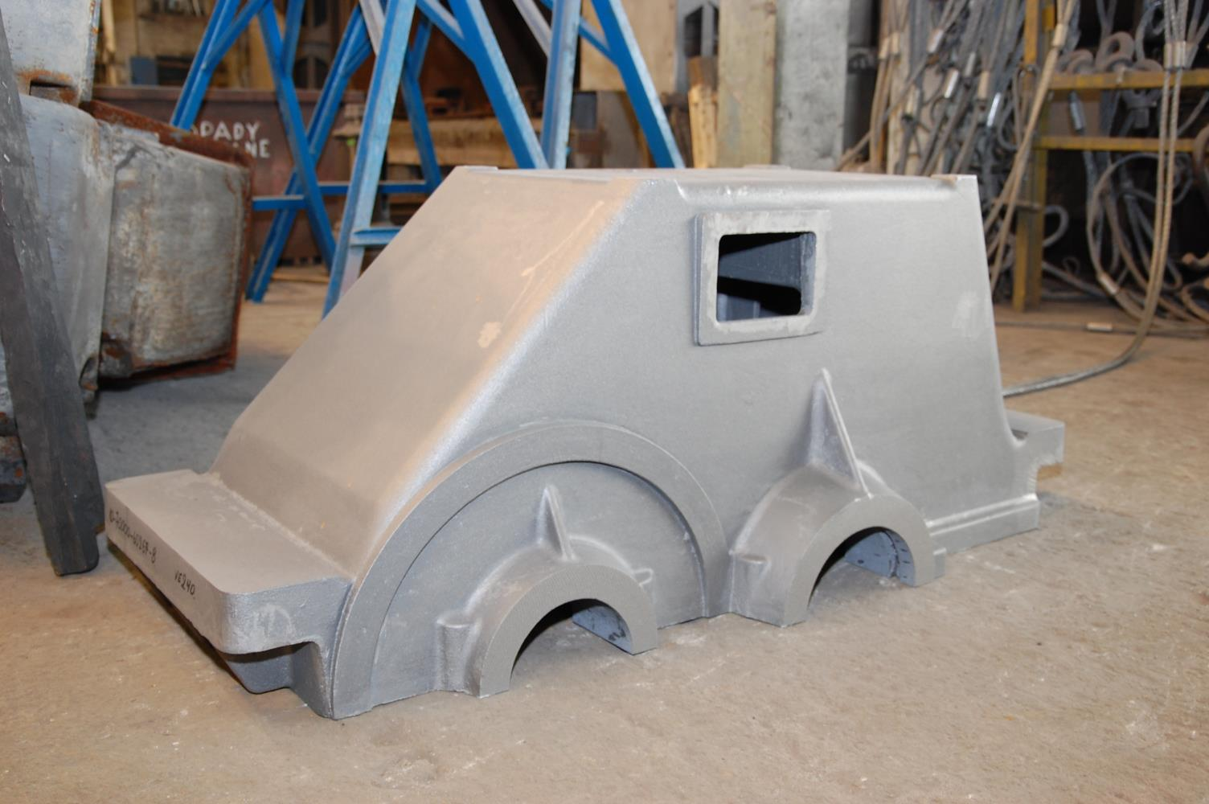
PRODUCTION PROFILE
Mounting plates | Beds | Tables | Columns | Other castings

Slide 20

ODLEWNIA RAFAMET Sp. z o.o. ul. Staszica 1, 47-420 Kuźnia Raciborska, tel: +48 32/721 3353 e-mail: marketing@odlewnia-rafamet.pl, www.odlewnia-rafamet.pl
www.plytymontazowe.pl

