Slide 1
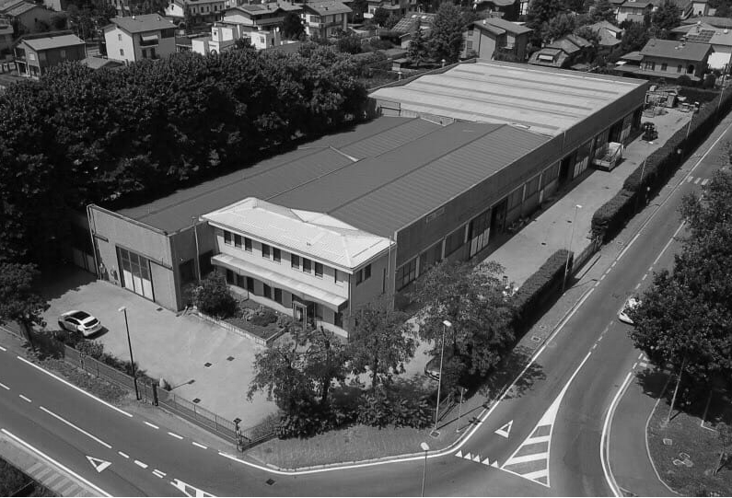

Diapositiva 1
Tresoldi & Casiraghi Srl
Presentation

Slide 2



Our Strengths
Technology and Innovation
All the generations that have followed one another in T&C, up to the present day, have had in common the tenacity, the correctness and the desire to improve.
Still today the development of new technologies and the propensity to invest in machinery and above all in personnel are the main engine that allows T&C to continue to be a reference in the world of mechanical carpentry
Quality
ISO 9001/2015, certification of welds, patent welders are the prestigious awards obtained over the years by T&C to guarantee the quality of its products and attention to the customer.

Slide 3

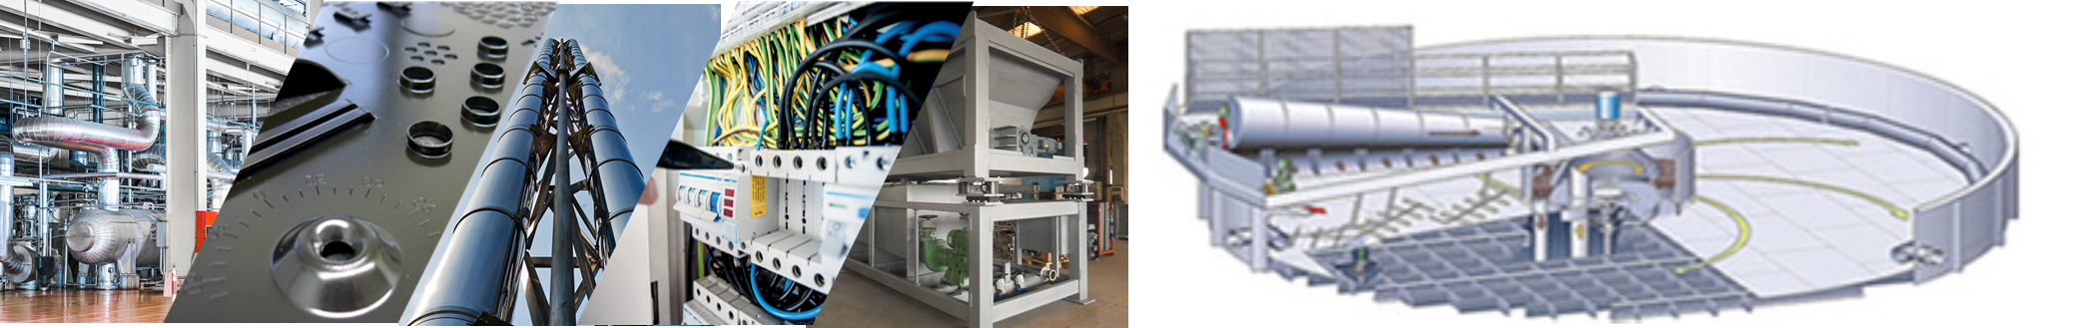
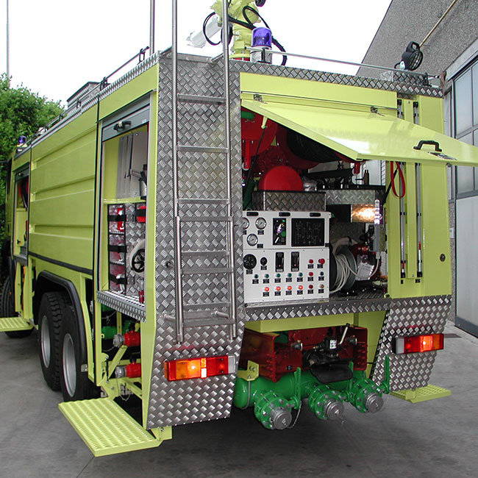
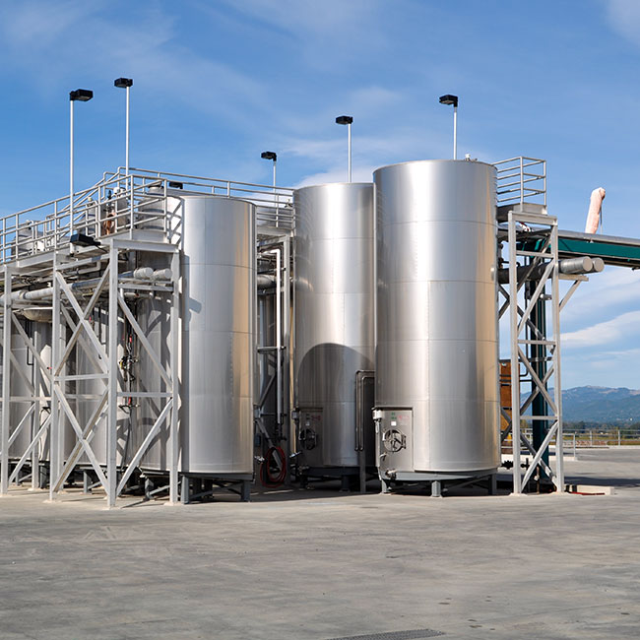
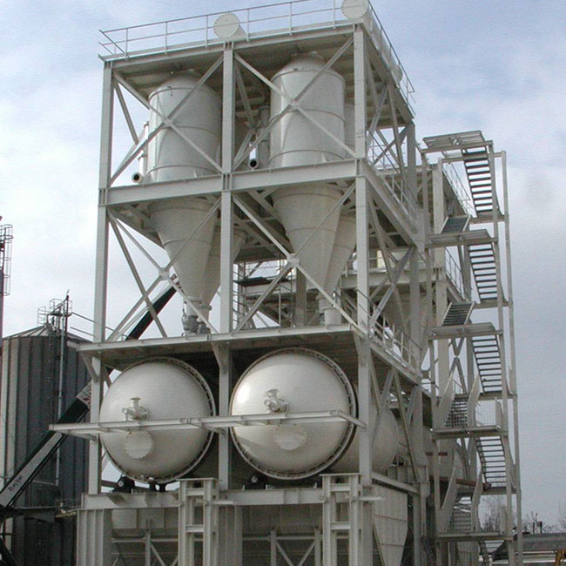
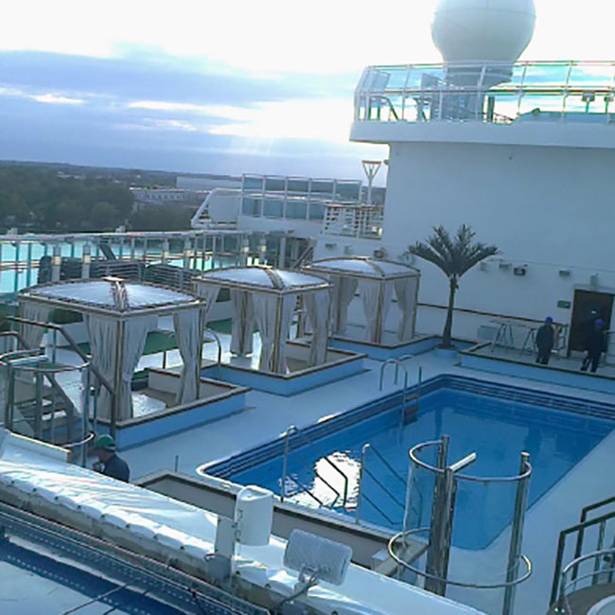
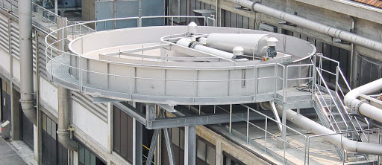
Sectors and Products
Skid High pressure
Special vehicles
Metal carpentry
Naval sector
Equipment

Slide 4
Diapositiva 1
The company
Producing quality is more than a mission for Tresoldi & Casiraghi has always been a real passion.
Since 1962, the year the company was born, this passion has materialized in the production of carpentry which, over time, has become recognized in the Italian and international market. A way of working that marked the transition from the artisan to the industrial and technological dimension to guarantee competitiveness and offer only the best, at always competitive prices.
A progress made not only of numbers but also of safety of internal processes and respect for the external environment. A success built thanks to the daily commitment of a group of people capable of looking at the challenges of the future with the same unchanged enthusiasm of the first day.
The company employs personnel specialized in welding, bending, punching, and assembly.
The welds are performed by qualified personnel in possession of the qualification licenses:
TIG - MIG - MAG - ELECTRODE.
We are also able to issue mechanical test certificates and non-destructive test certificates.

