Slide 1

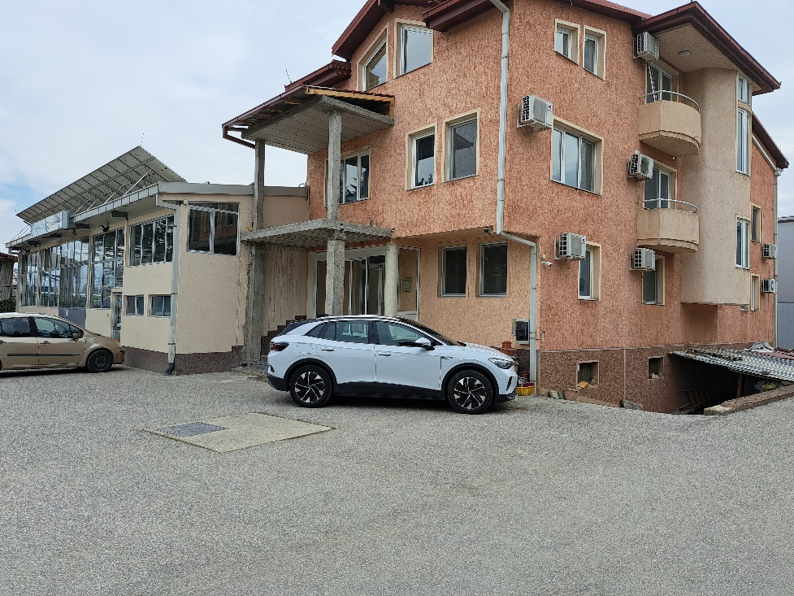
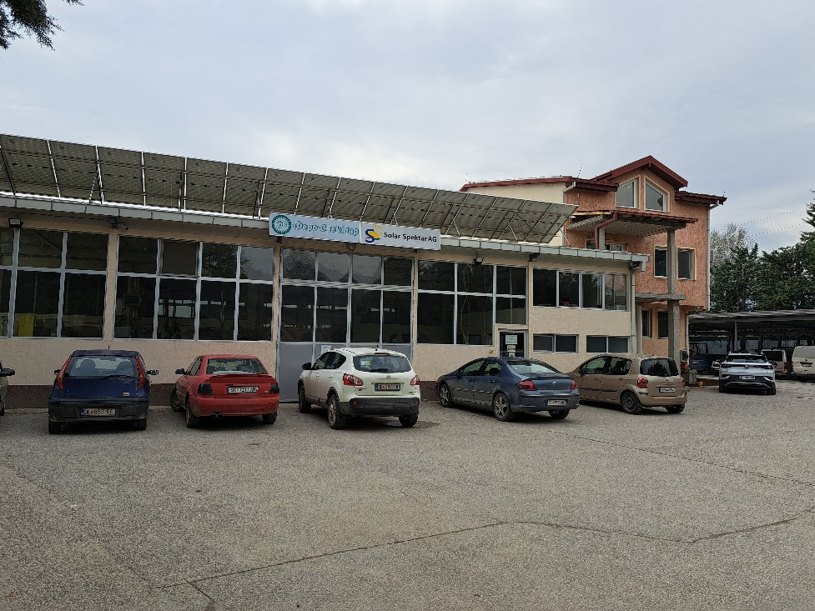

FERO SPEKTAR
www.ferospektar.com.mk

Slide 2
About the company
Fero Spektar Dooel Skopje is a production and service oriented Company in private ownership. The company is completely custom oriented.
The company was founded in 1991 with the main goal providing services in the field of machinery industry. With the development of Fero Spektar, the spectrum of services enlarged, thereby increasing the number of employees, in total 21, 9 engineers (7 mechanical and 2 electrical). In 1997 the company relocated in the new industrial zone in Pintija, Skopje. Fero Spektar’s facility covers an area of 3,600 m² where compactly integrated are the production center and the premises.
Today the core business of Fero Spektar Dooel Skopje is production and processing of all types of spare parts, as well as constructions of different industrial tools.
It is a serious company that successfully operates on the market more than 30 years, always keeping in foreground the service quality and satisfaction of its customers.

Slide 3
OUR HISTORY
NEW LOCATIONS
AWARDS
EXPANDING
Relocated in the new industrial zone in Pintija
Enlarging the number of customers
Second location
1991
1997
2003
2010
2018
2023
FOUNDED
GROWING
SUSTAINABLE ENERGY
Main goal is providing services in the field of machine industry
Enlarging the spectrum of services and number of employers
Implementing PV solar energy

Slide 4
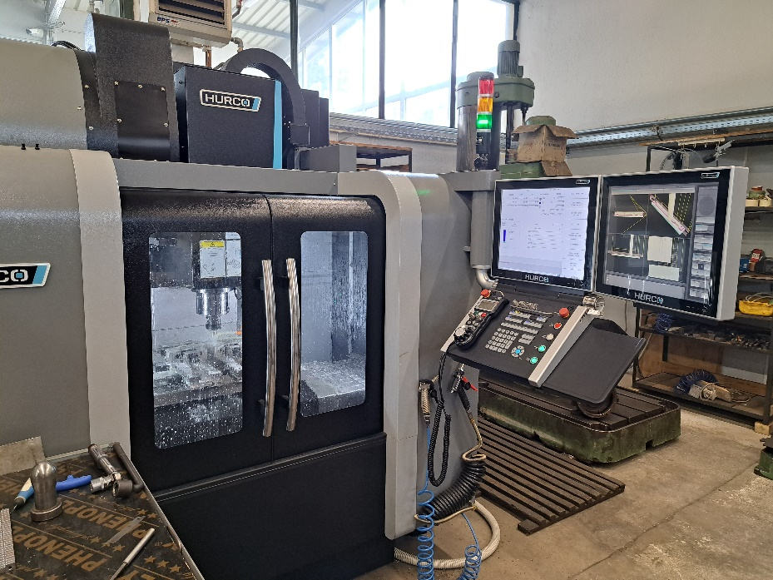
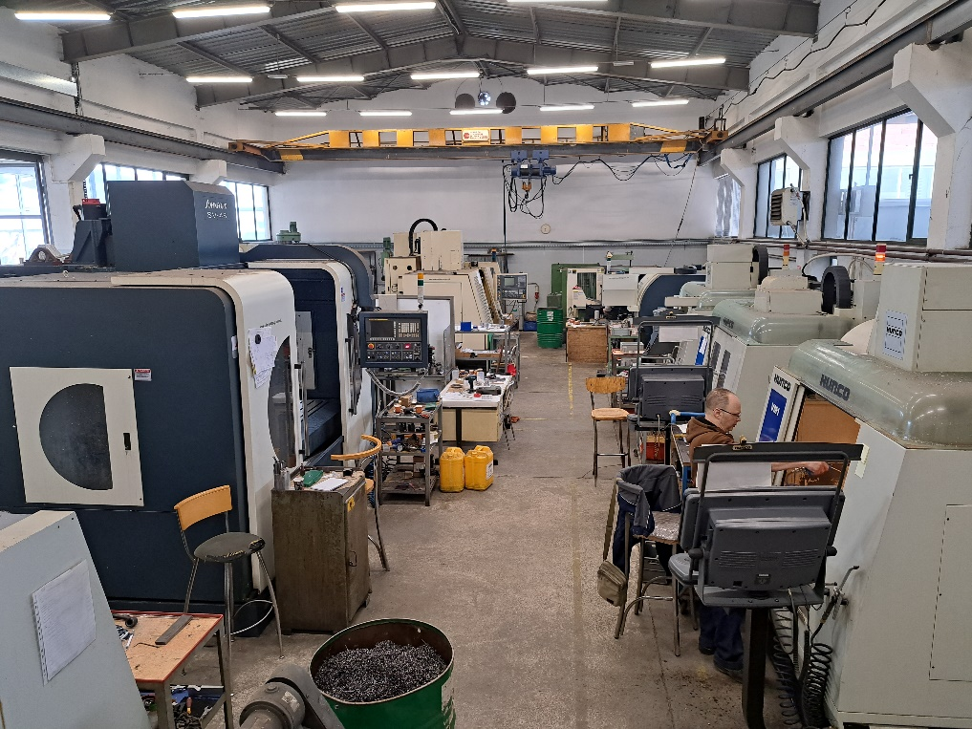
Machine park
Cnc Leadwell vertical center
Cnc Johnford vertical center
CNC Hurco VM1 vertical center (Amount: 3)
CNC Hurco VM1 10i vertical center
CNC Hurco VMx24 vertical center
CNC OKUMA V50 vertical center
Cnc Lathe Leadwell LTC-20P-TM
Cnc Lathe Johnford SL-30
Cnc Lathe Index GU 2000
CMM(Coordinate Measuring Machine) DEA Global - Hexagon
CNC EDM Wire FANUC Tape cut W2 (Amount:2)
Lathe universal
Milling machine universal
Radial drill - Φ50x1350
Stos Machine - (200 mm)
Fellows serration - (module 8) Φ800x100
Pfauter
External and internal round grinding machine - Φ600x1100
Flat Grinding machine
Tempering furnaces and cementation
Knuth horizontal bandsaw Φ250
Rel and mig/mag welding instrument

Slide 5
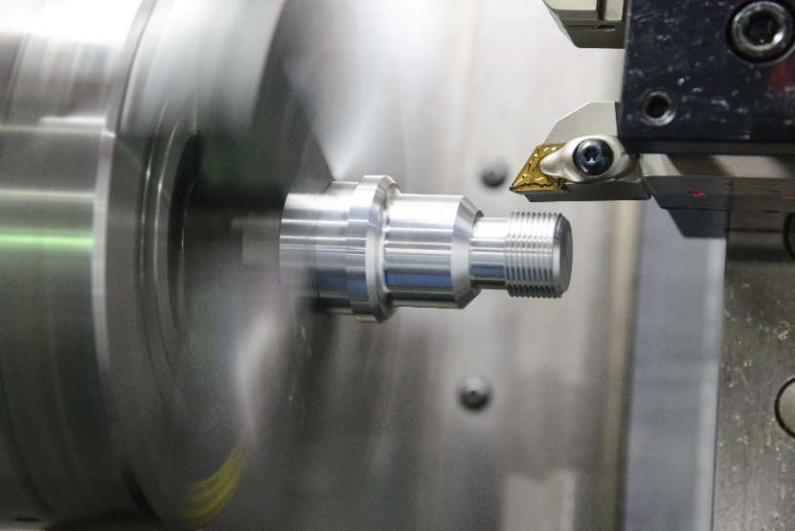
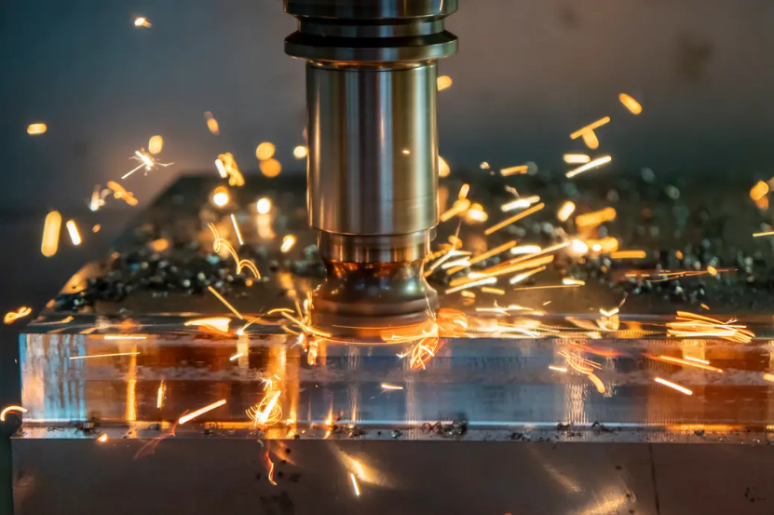
Services
Milling
Drilling
Turning
Mechanical processing with cutting on metal and non metal on numerical controlled (CNC) and conventional machines for small and medium serial production
Mechanical processing of cast steel, cast iron and aluminum alloys as well as cast from steel and brass, all for medium serial production
Mechanical processing of plastic materials, POM (polyoxymethilene), Polyamid and other plastic materials requested by the end customer
Servicing and repair of machine tools
Possibility of single installation of machine tools
Align
Quenching and cementation
External and internal grinding
Sharpening tools
Waves and compaction bearings press
Welding
Locksmith processing

Slide 6
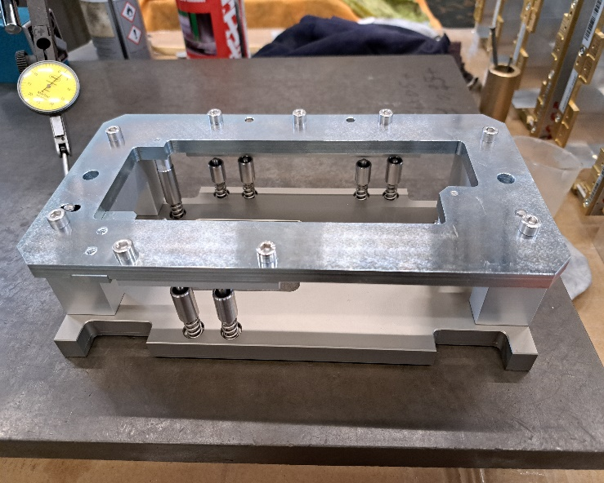
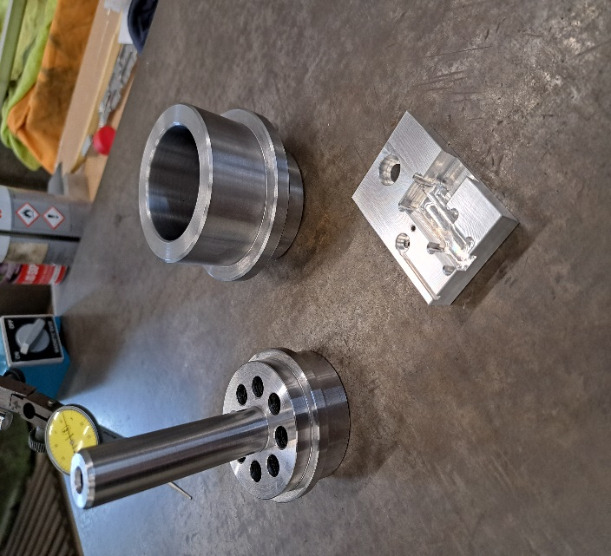
Production
Shaft
Axes
Gears
Connections
Castings, for a given drawing
All types of sliding bearings of special bronze processed with special technology
Production of tools
Production of parts for metallurgy, construction and agricultural industry
Other spare parts as special bolts, nuts, etc.

Slide 7







Reference of major clients
Johnson Matthey – Macedonia
Kemet Electronics – Macedonia
Mikrosam Prilep - Macedonia
Dura Automotive - Macedonia
Makstil AD – Macedonia
Liberty AD- Macedonia
Ograzden Strumica – Macedonia
Granit AD – Macedonia
Beton AD Stip – Macedonia
Feni Industry Kavadarci – Macedonia

Slide 8
FUTURE PLANS
Implementing robotics and automatization systems
Modernize of
Machine park
Expanding
our services and
products globally
Implementation of CMM and Quality control system

Slide 9





ADVANTAGES
Quick response
Customer loyalty
Quality
Customization
Employee motivation and retention

Slide 10
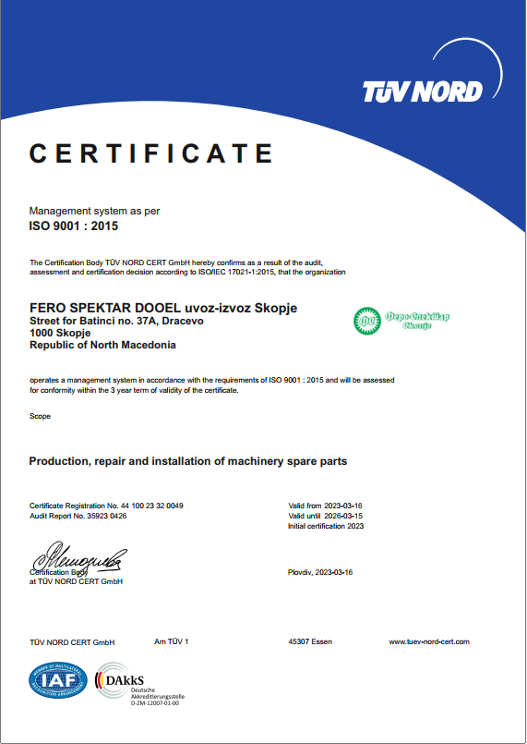

CERTIFICATES

Slide 11
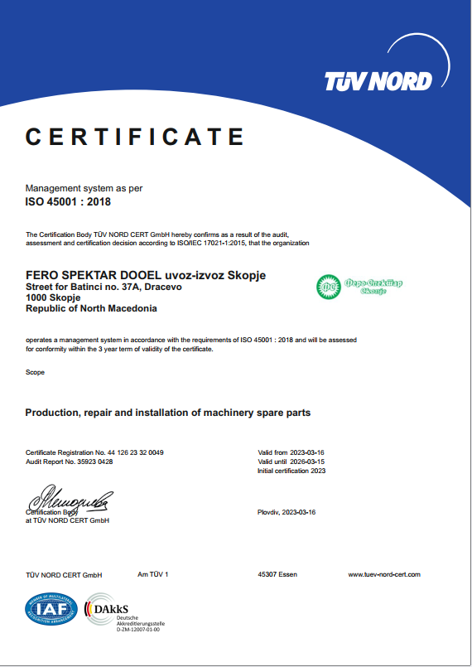
CERTIFICATES

Slide 12
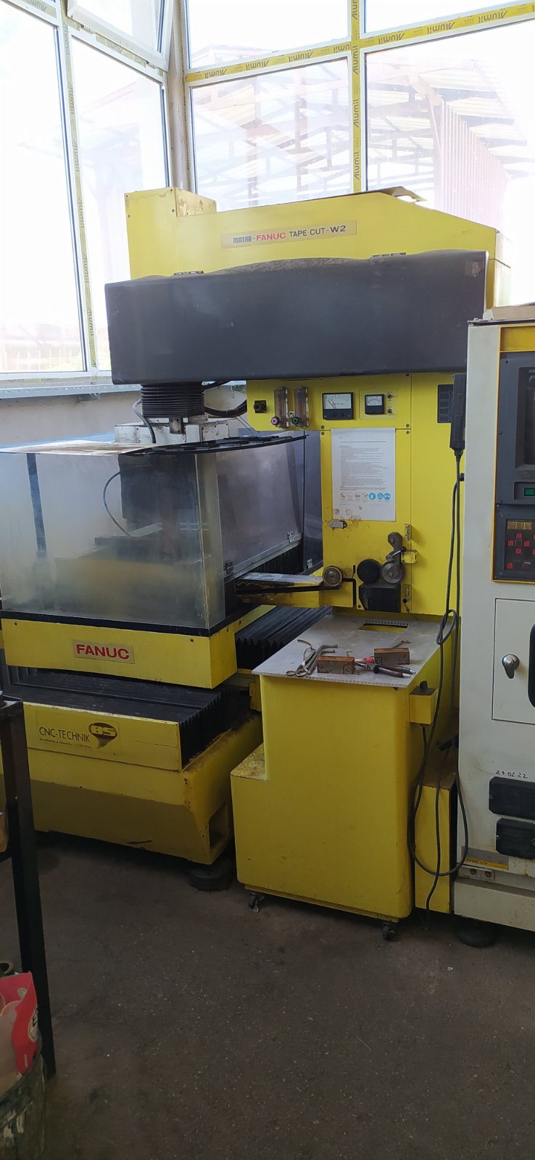
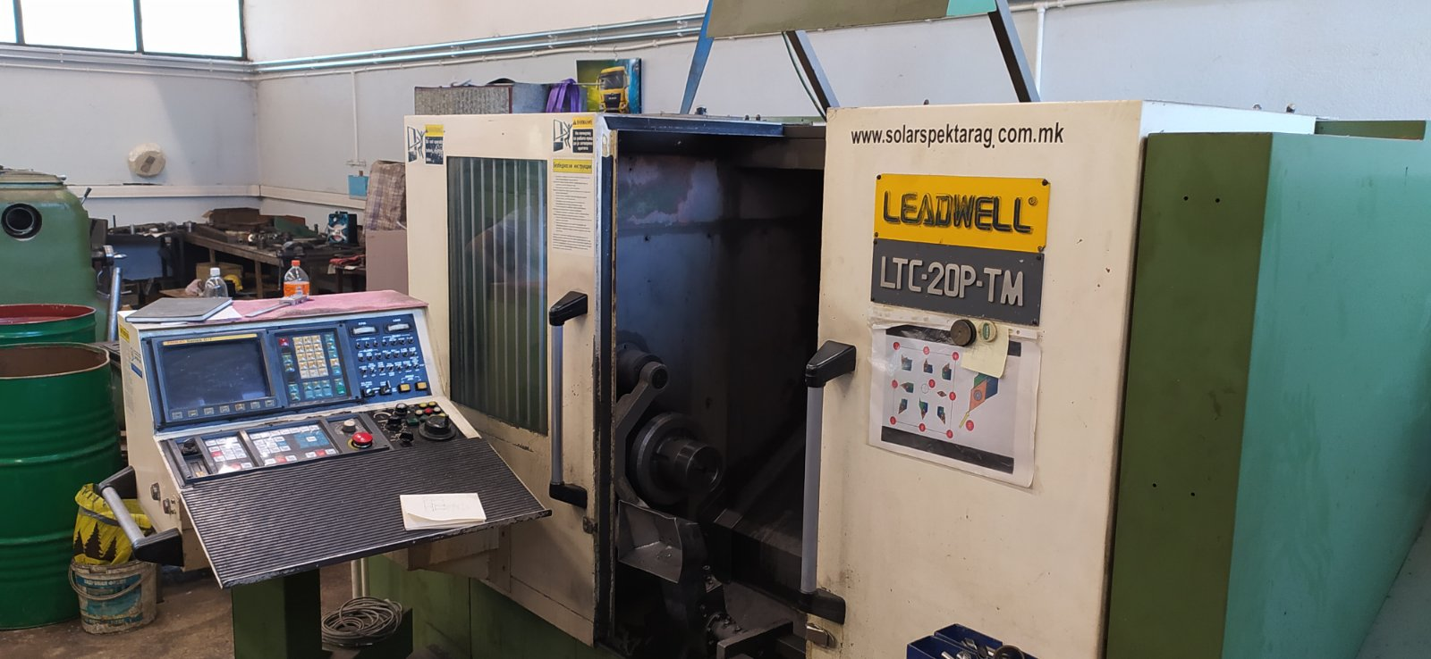
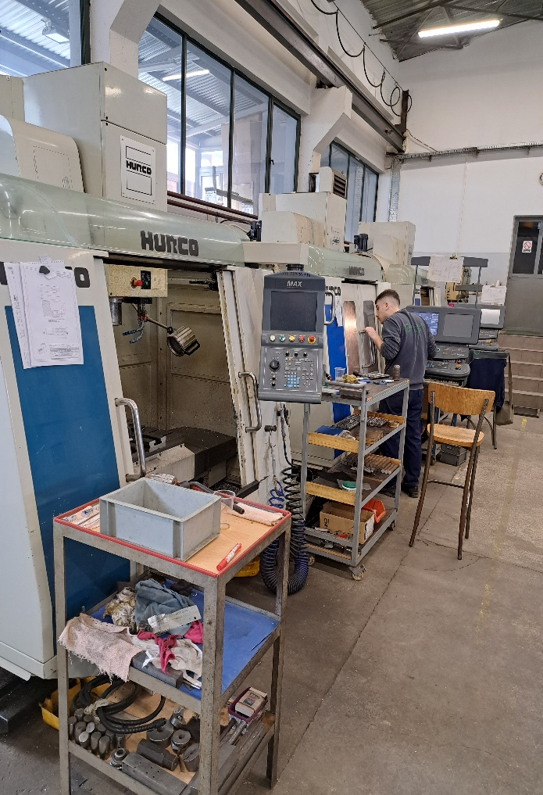
Gallery

Slide 13
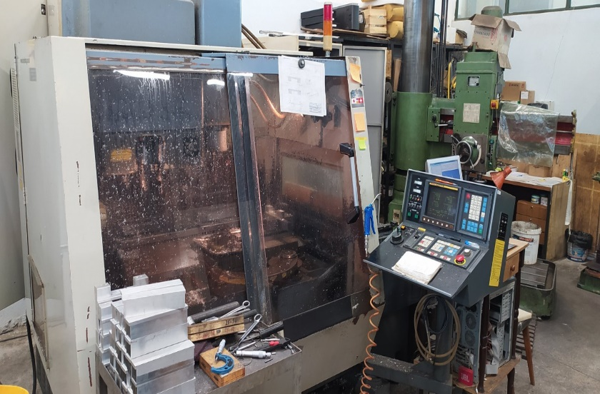
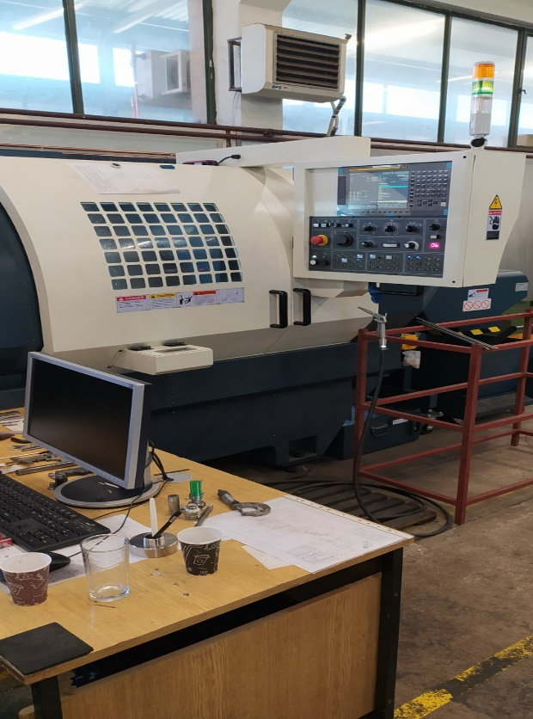
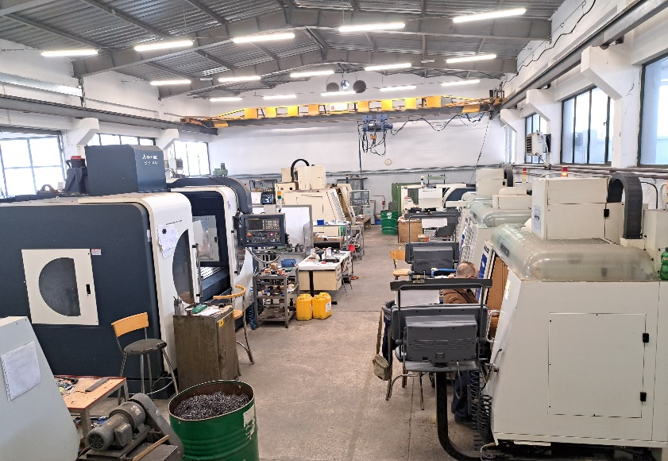
Gallery

Slide 14
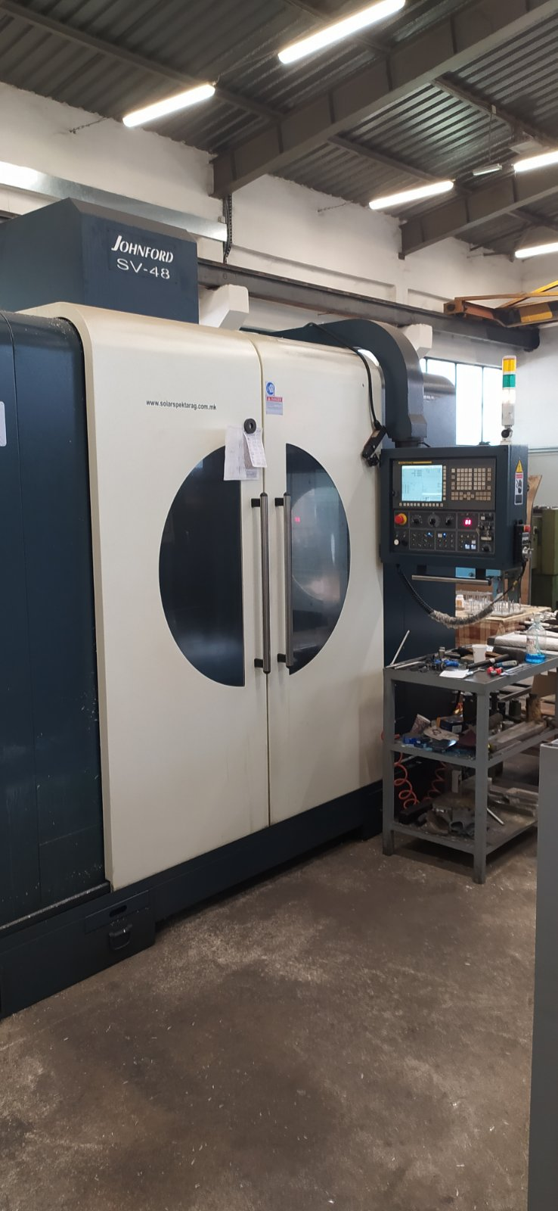
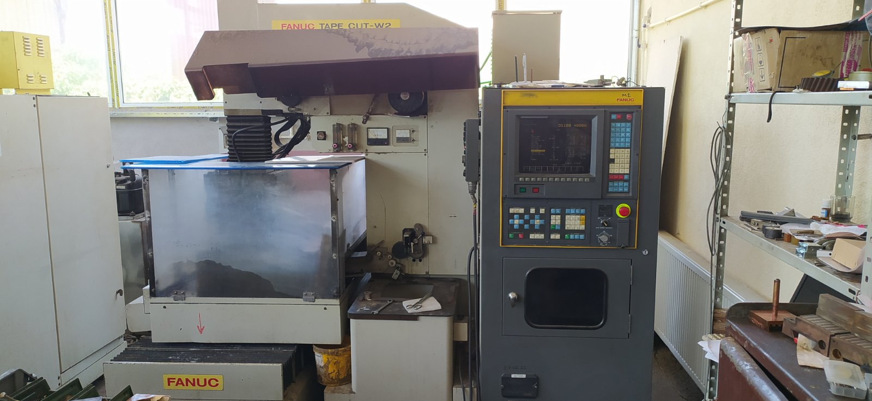
Gallery

Slide 15

Goran Kocevski
Product manager
FERO SPEKTAR
Road to Batinci 37A
1000, Skopje
Mobile: +38975407537
e-mail: ferospektar@yahoo.com

