Slide 1

As MoldMaster Makine, we are proud to have been supporting our solution partners since our establishment in 2017. We strive to understand your needs accurately and provide the exact service you require in the shortest possible time. With our accumulated knowledge and experience, we currently serve many sectors, primarily automotive, defense, and heavy industry, in areas such as machine park installation, plant design, maintenance, and spare parts manufacturing.

Slide 2
Mold Master is an engineering firm specializing in machine design, prototype development, plant design, and turnkey system solutions. It provides end-to-end engineering support to its clients by actively participating in every stage of the product lifecycle, including design, analysis, production, and commissioning. With its experienced engineering team, analytical perspective, and commitment to high quality standards, Mold Master aims to offer its clients a reliable and sustainable solution partnership.
Our top priority is to earn the trust of our business partners and always be there for them.

Slide 3
Our services
Machine Manufacturing
Machining
Welding
Special Fixtures and Tools
Moulding Design and Manufacturing

Slide 4
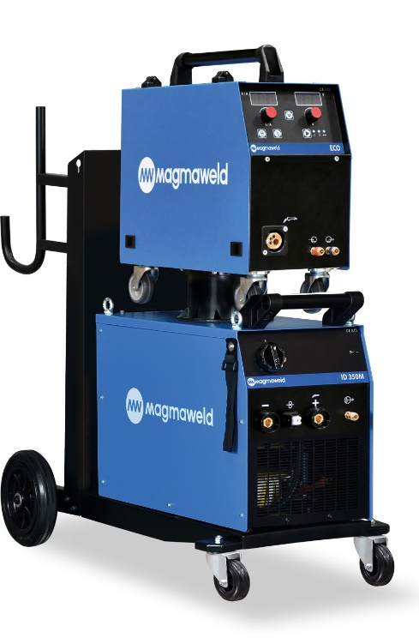
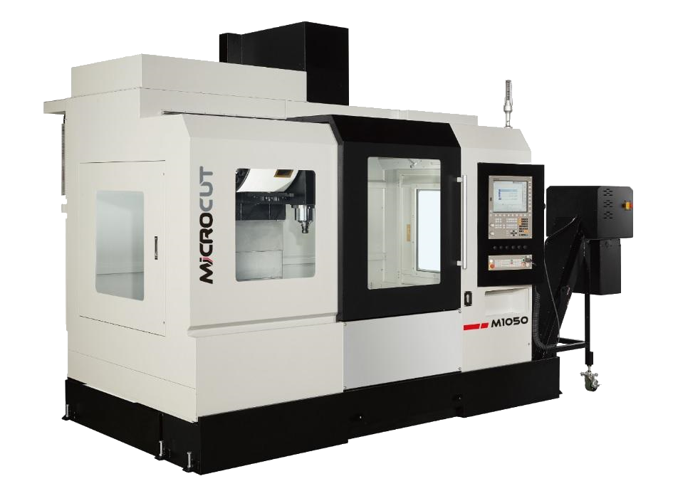
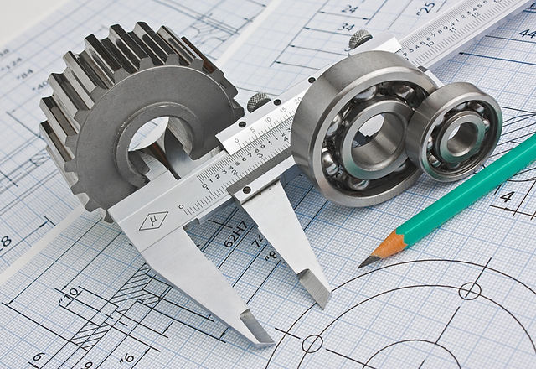
Makine Parkurumuz ve Kabiliyetlerimiz
Machining Tech.
Microcut M1050 CNC VMC
Quaser MV184C CNC VMC
Quaser MV204C CNC VMC (4 Axis)
Akira Seiki 3 Axis CNC Turning
Welding Tech.
Gas Welding Machine
Argon Welding Machine (TIG)
Electrode Welding Machine
Design, Production and Assembly
200 m² Manufacturing Area + 1000 m² Assembly Area
We provide end-to-end solutions for design, manufacturing, and assembly processes.
Yüzey İşlem ve Kumlama
1000*1000 SandBlasting Machine

Slide 5

















References

Slide 6
İletişim Bilgilerimiz
Adres : Sultan Orhan Mah. Hasköy Sanayi Sitesi 10A Blok No:10
Gebze / KOCAELİ
Web Sitesi: https://www.moldmaster.com.tr
Mail: info@moldmaster.com.tr Mail: import@moldmaster.com.tr
Tel : +90 536 811 83 99 Tel : +90 553 801 38 35
Yetkili: Nurullah Erdoğan Yetkili: Şaban Tapan

Slide 7
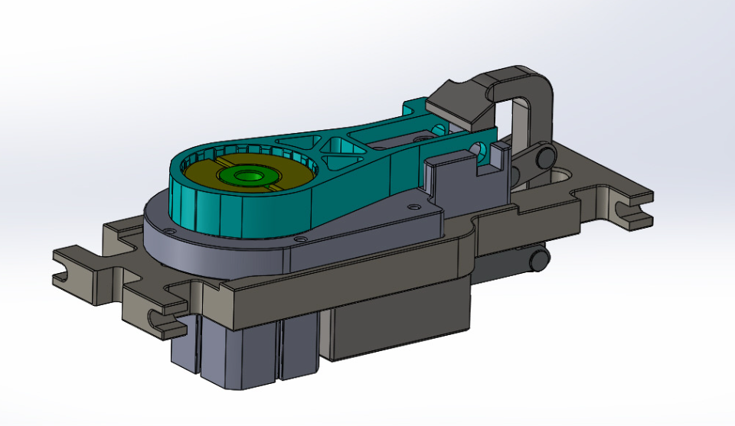
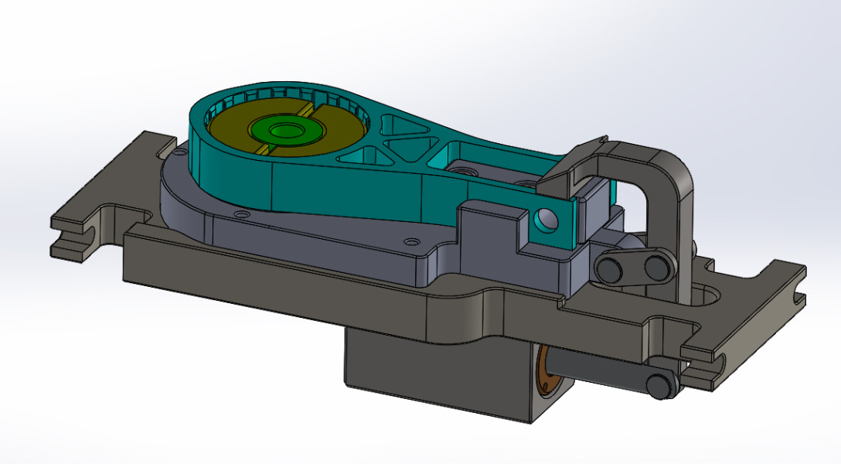
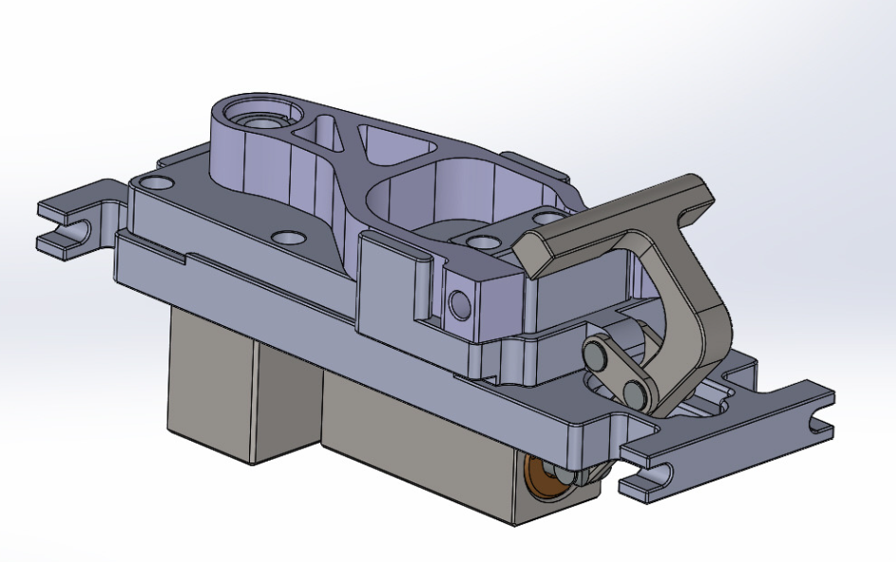
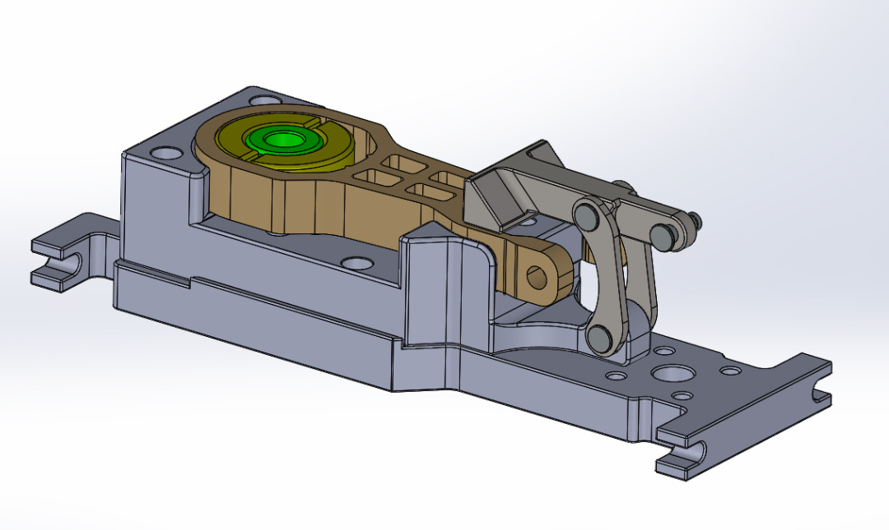
Here are some examples of our work:
Connection Fixtures

Slide 8
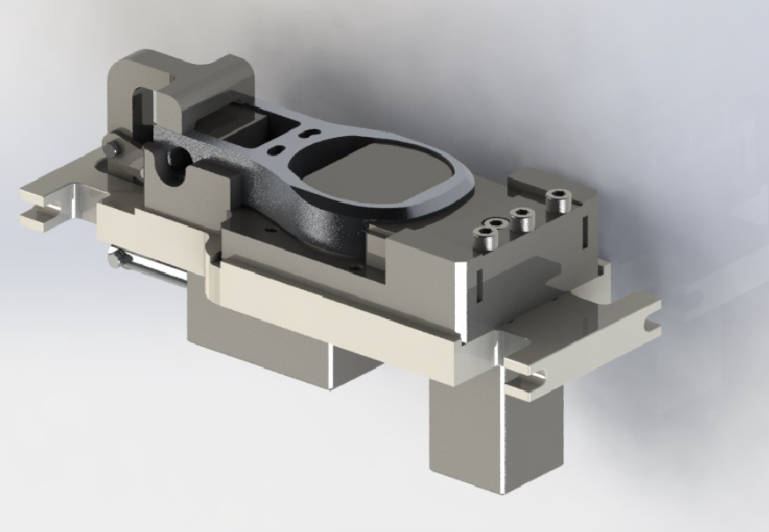
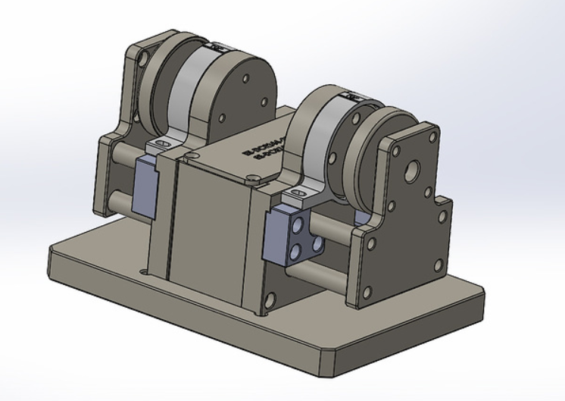
Connection Fixtures

Slide 9
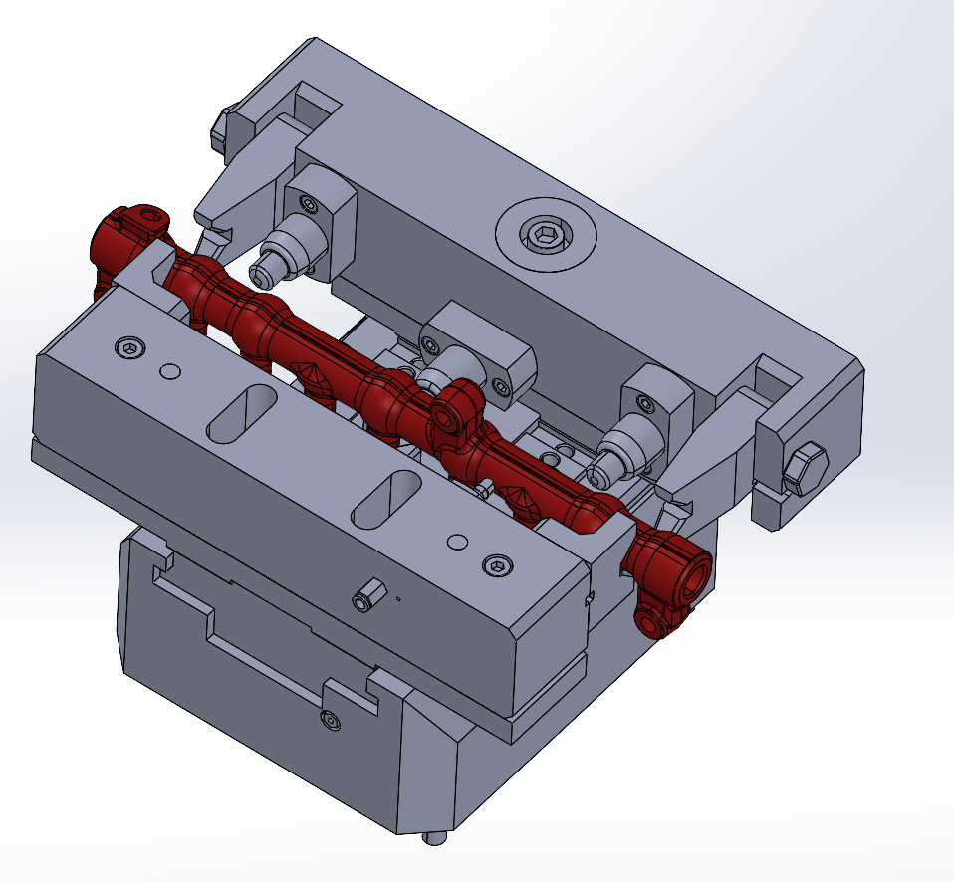
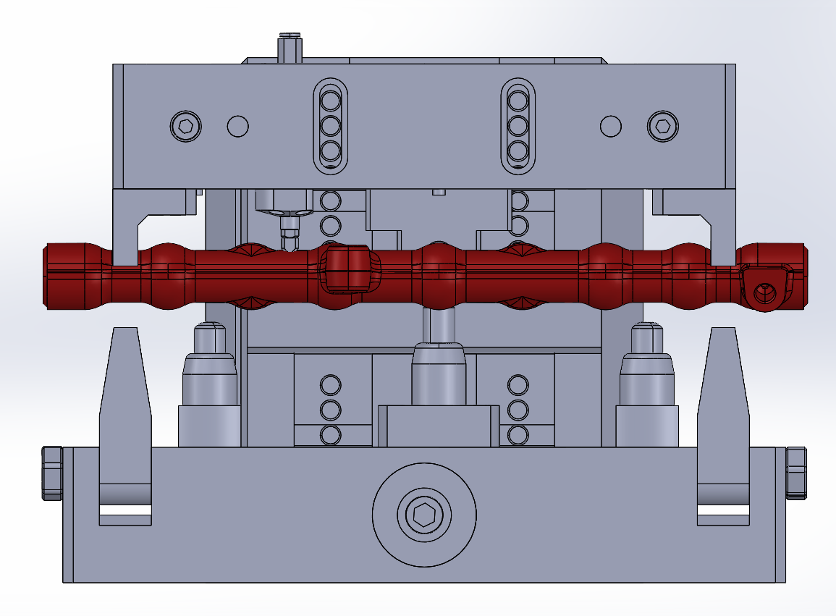
Complex Shaped Part Clamping Fixtures

Slide 10
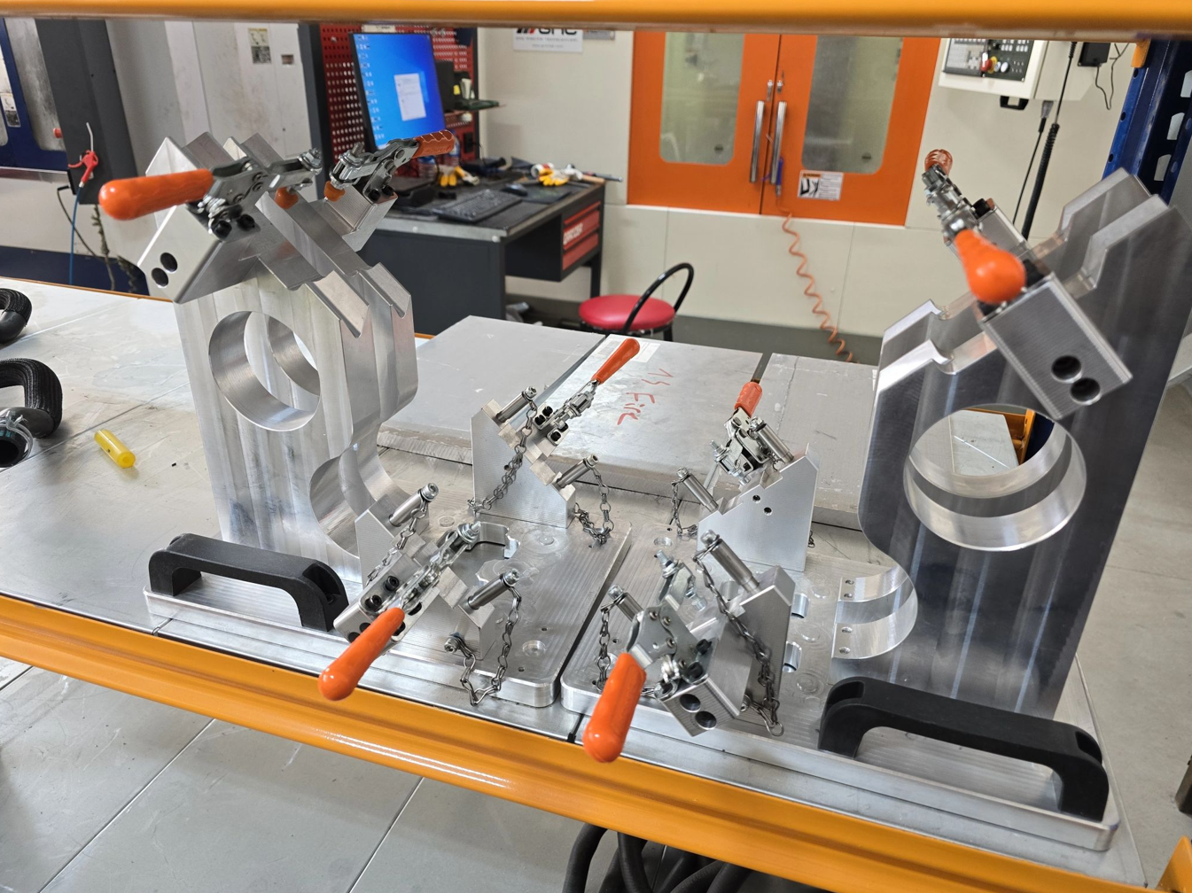
Metal Pipe Welding Fixtures

Slide 11
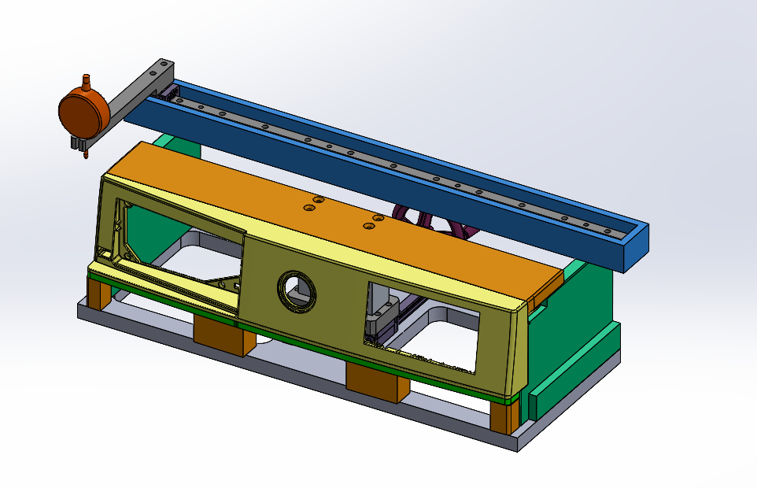
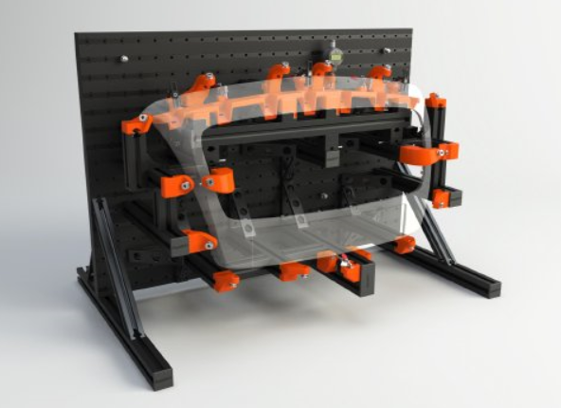
Control Fixtures

Slide 12
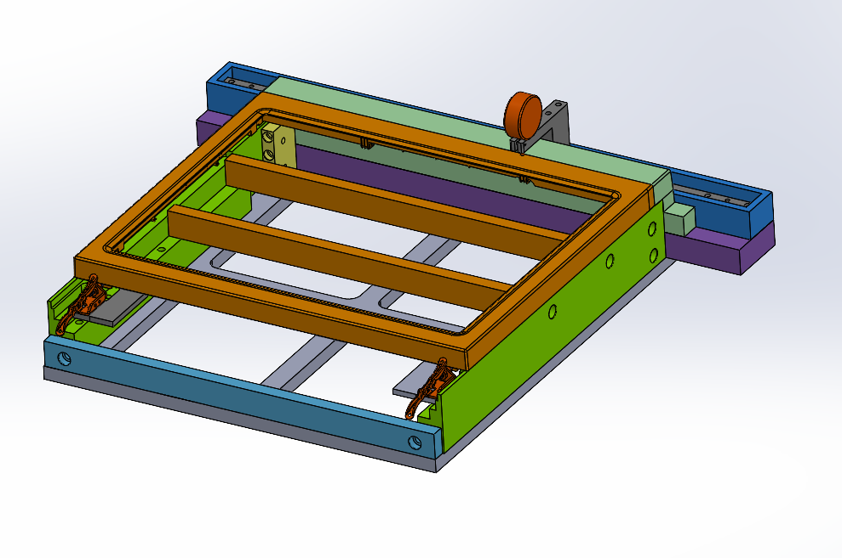
Control Fixtures

Slide 13
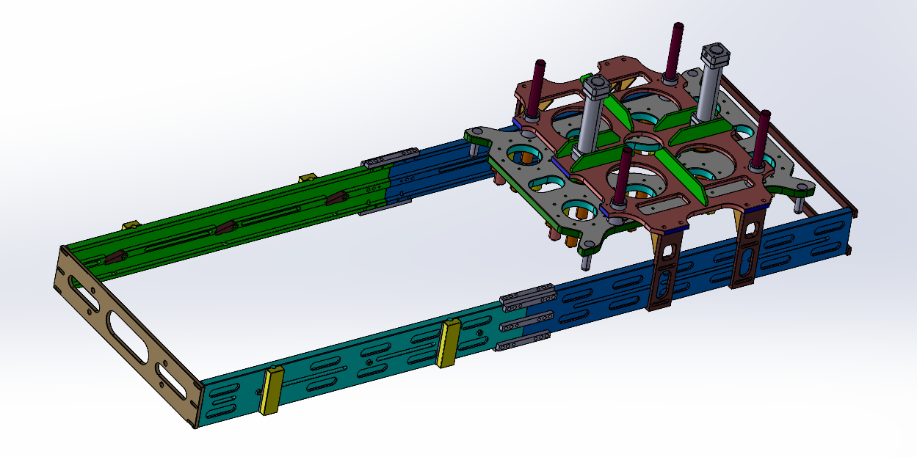
Robot Arm CNC Slide System

Slide 14
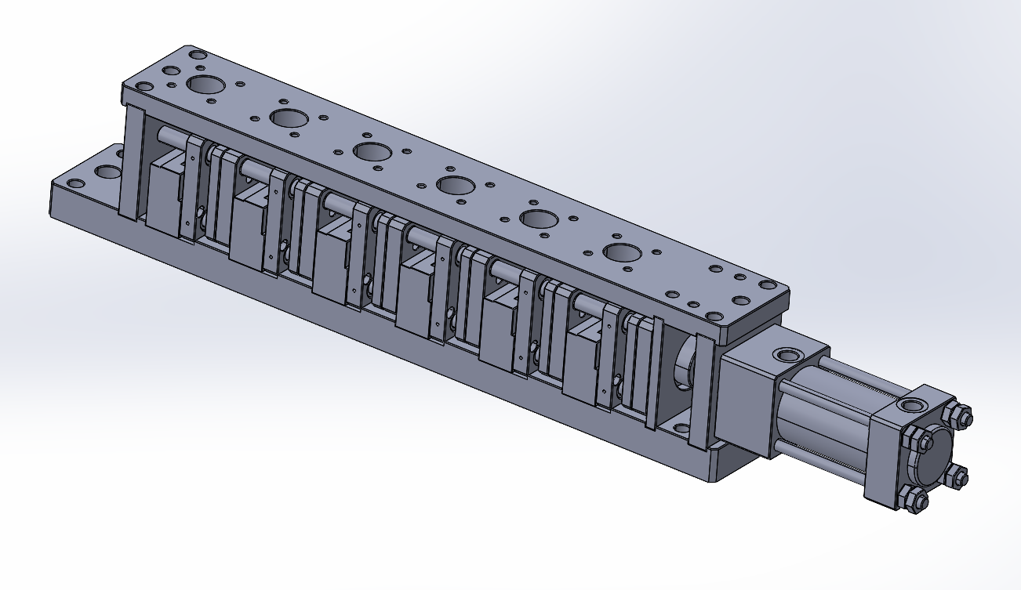
Solar Panel Cutting Die

Slide 15
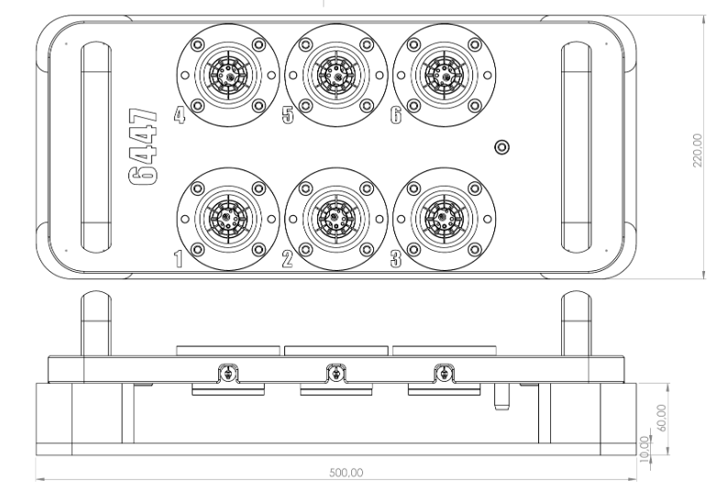
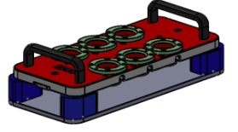
CNC Robot Welding Fixture

Slide 16
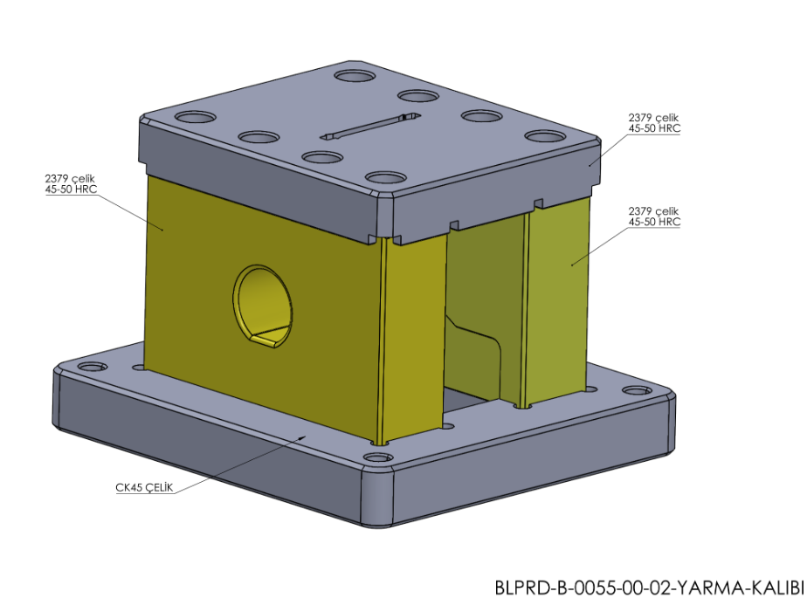
TOGG - Cutting Die

Slide 17
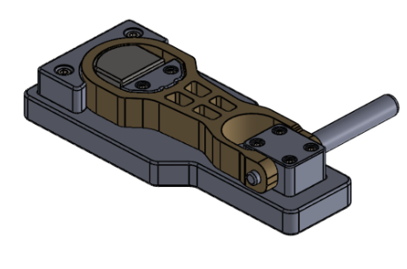
Measuring Gauges

Slide 18
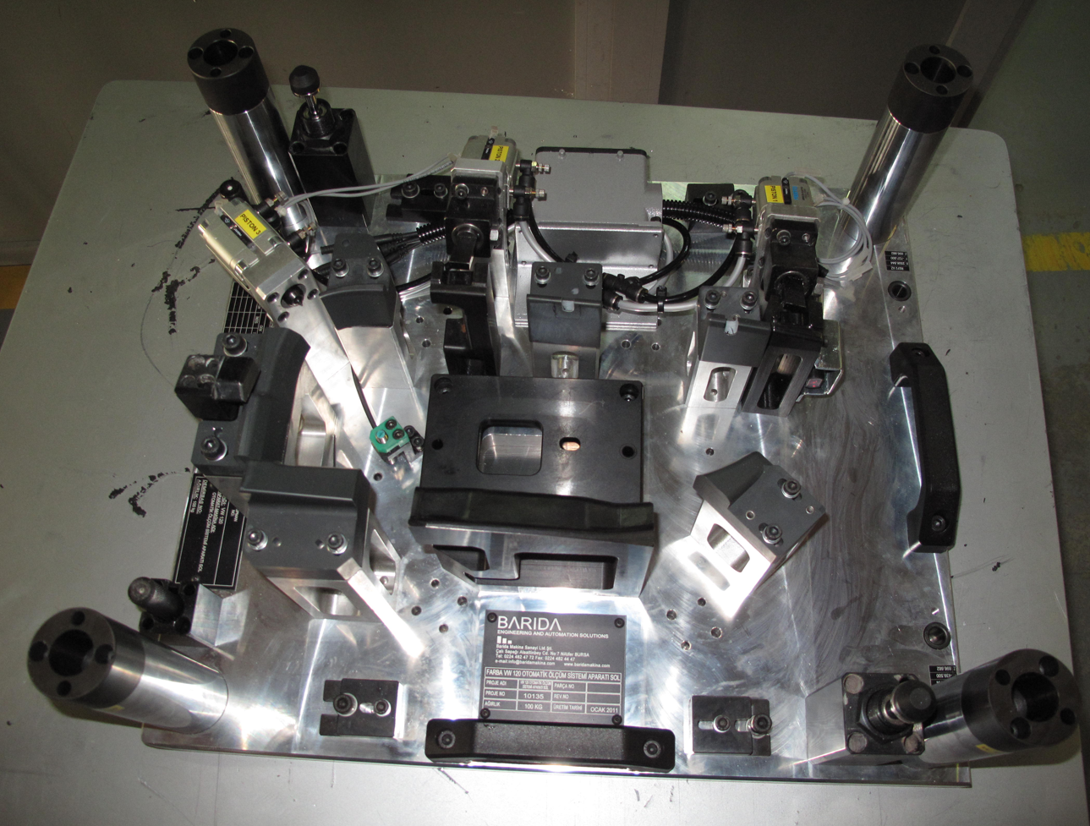
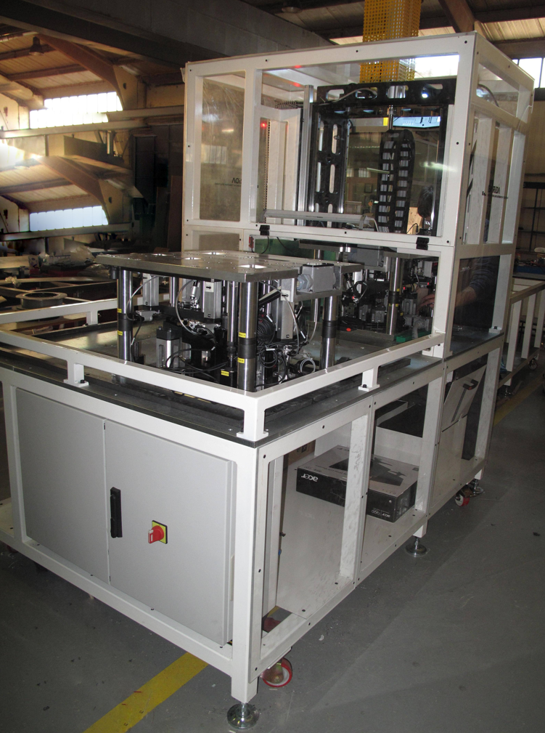
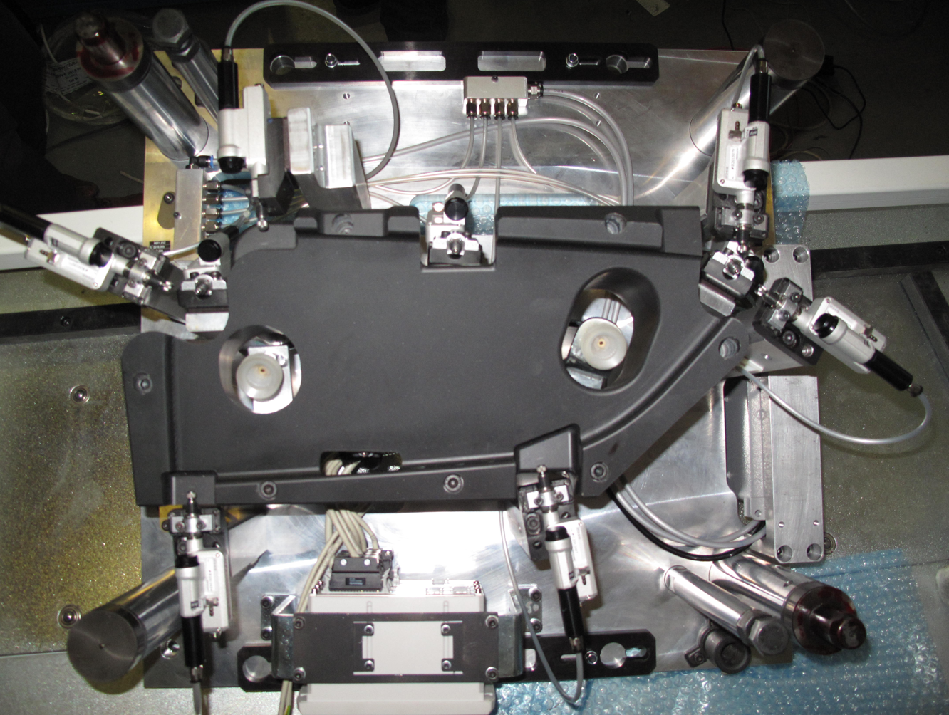
Automotive Assembly Line

Slide 19
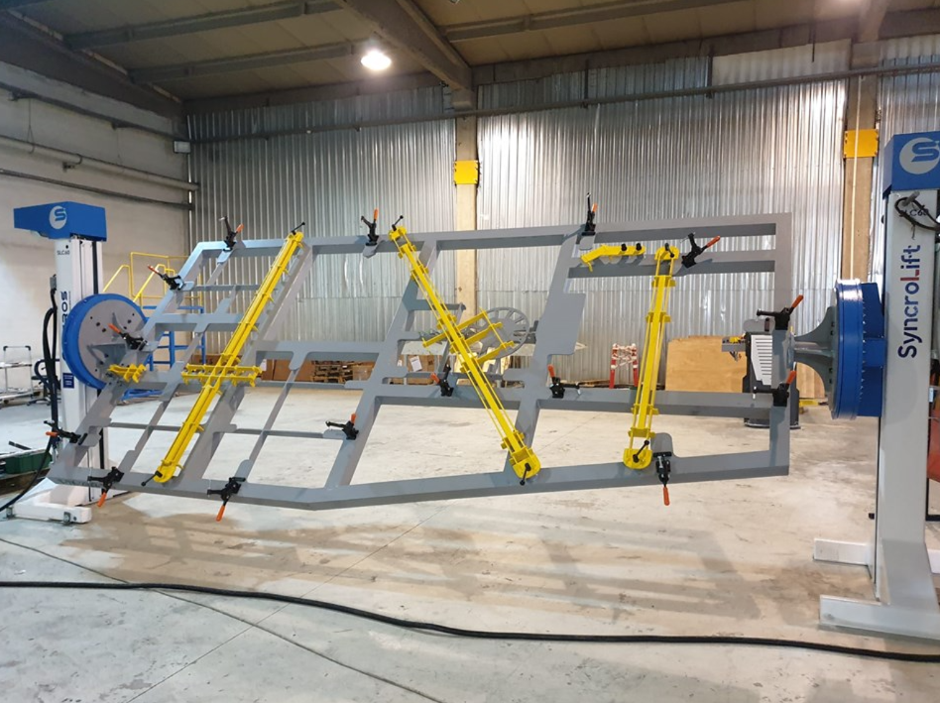
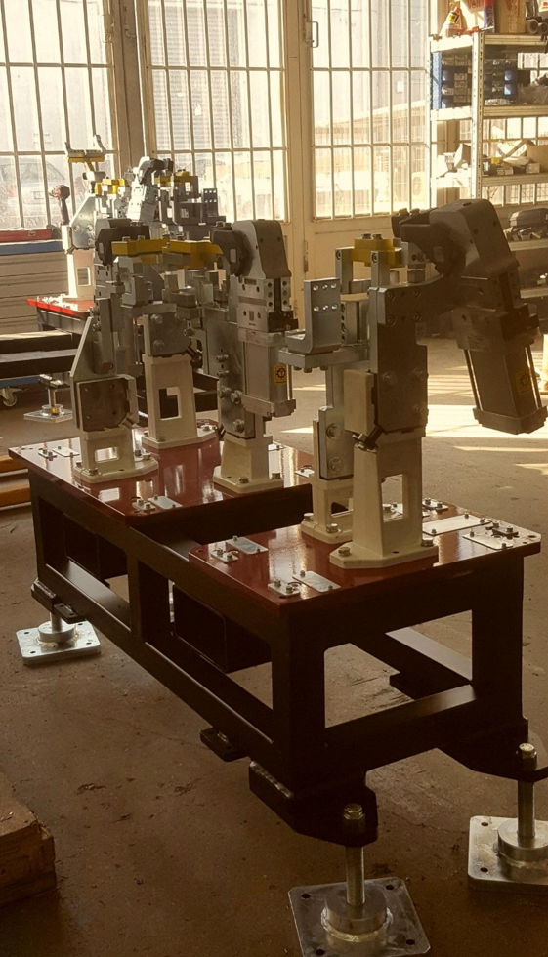
Welding Fixtures

Slide 20
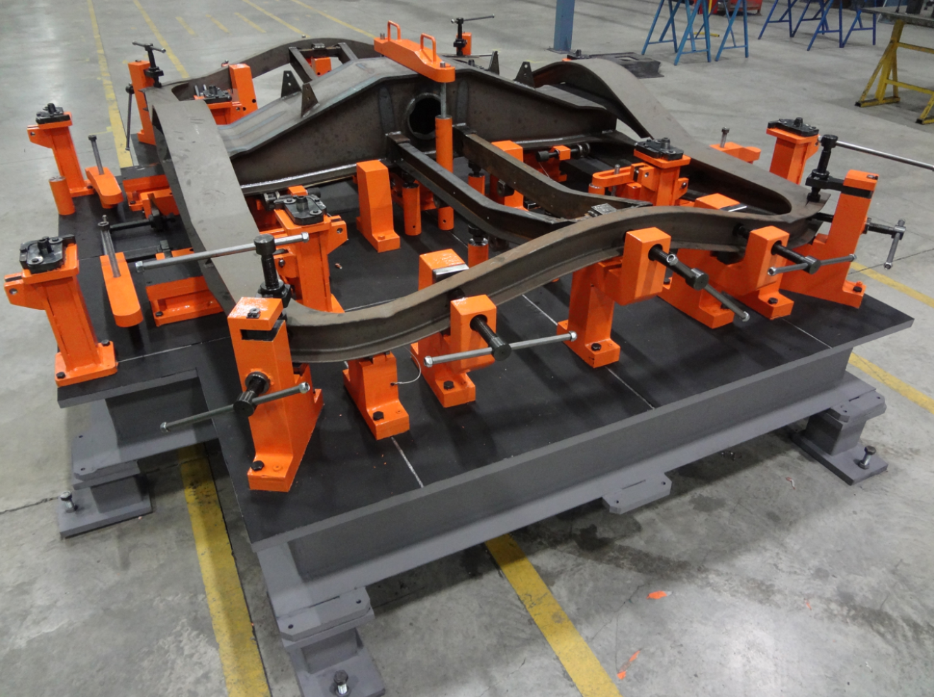
Welding Fixtures

Slide 21
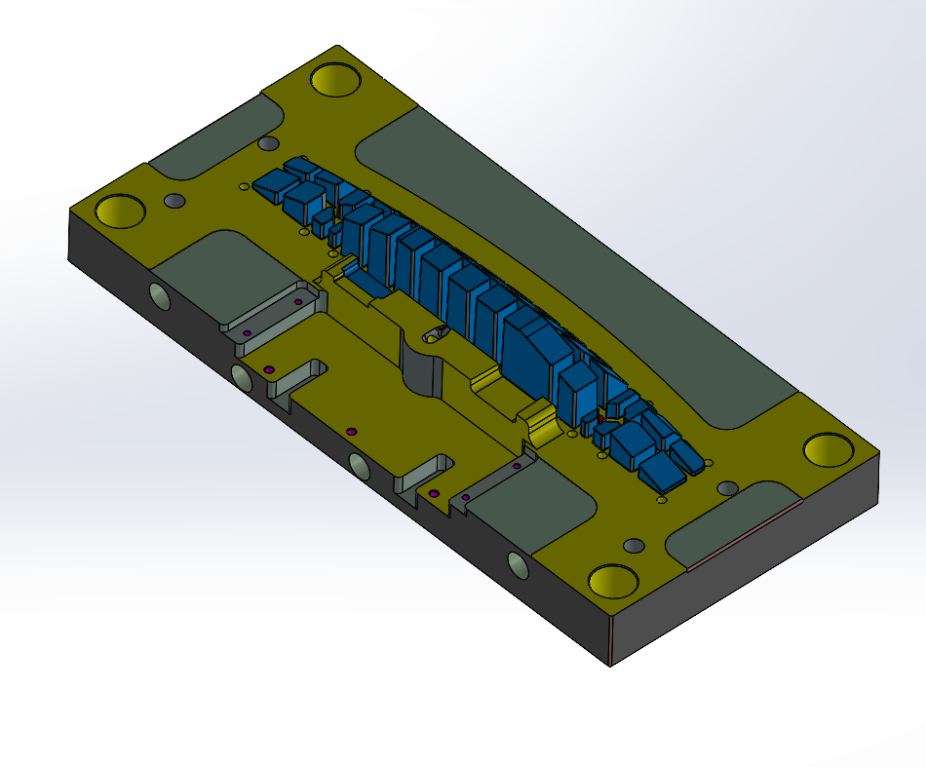
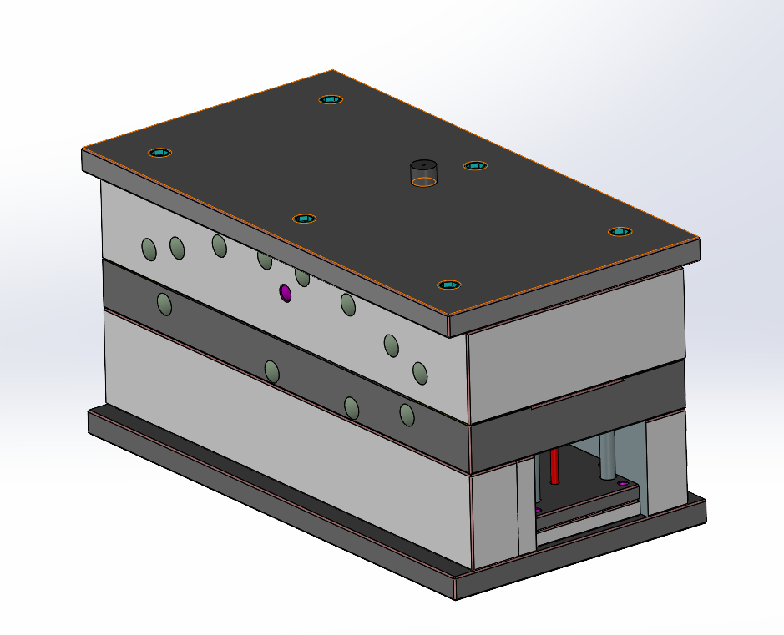
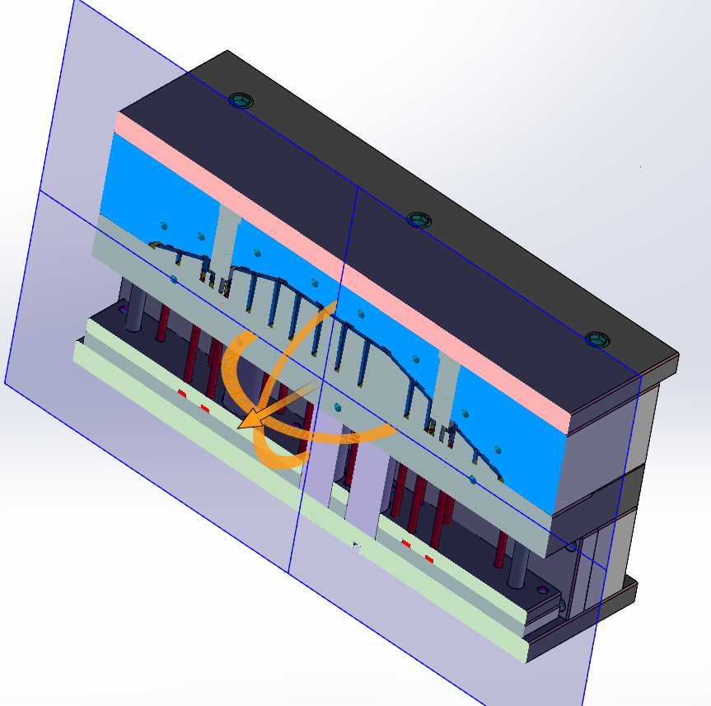
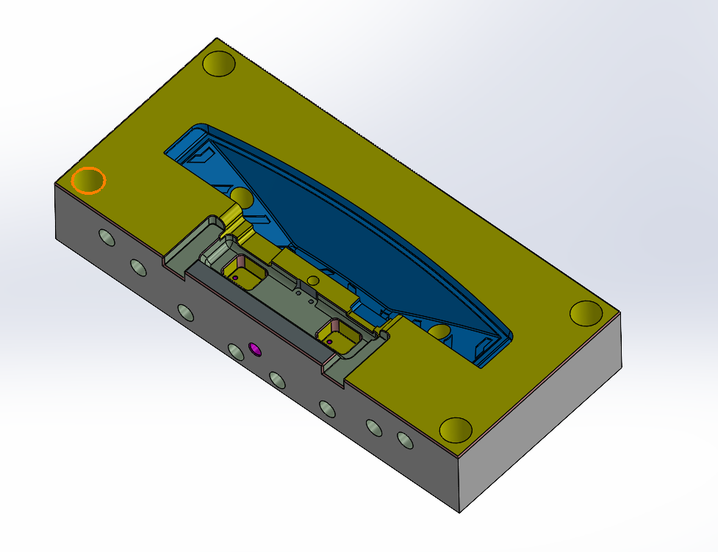
Injection Molds

Slide 22
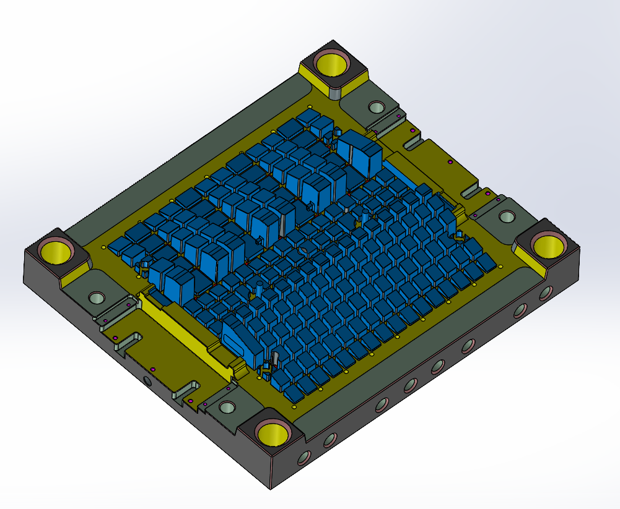
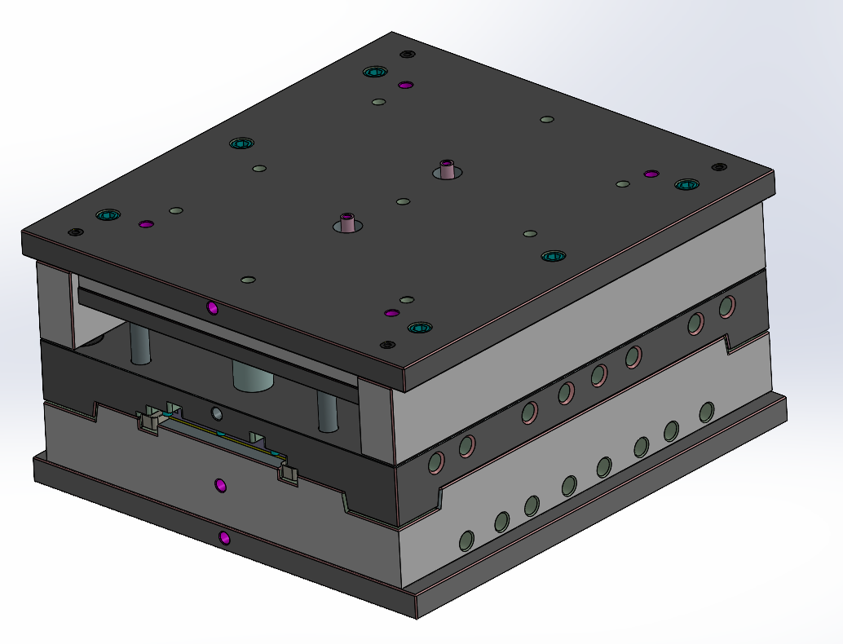
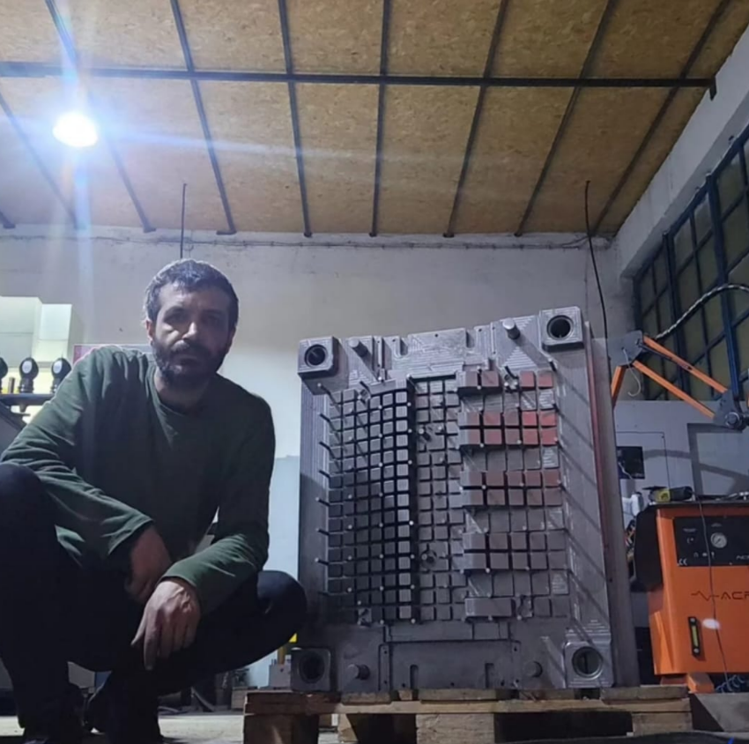
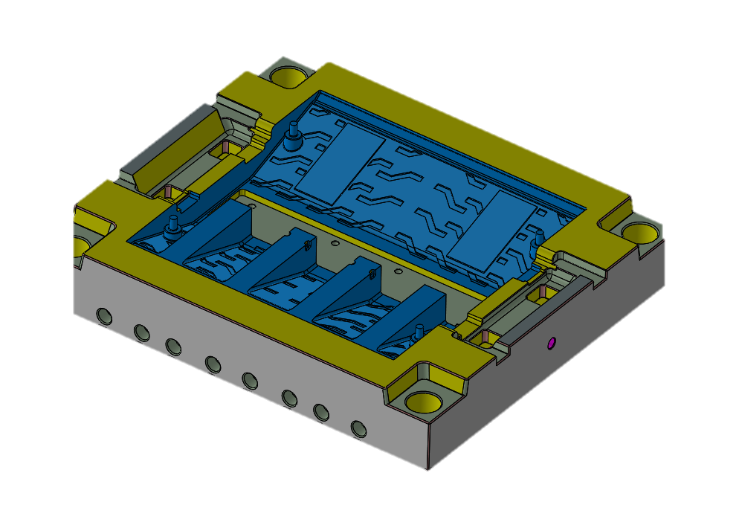
Plastic Injection Molds

Slide 23
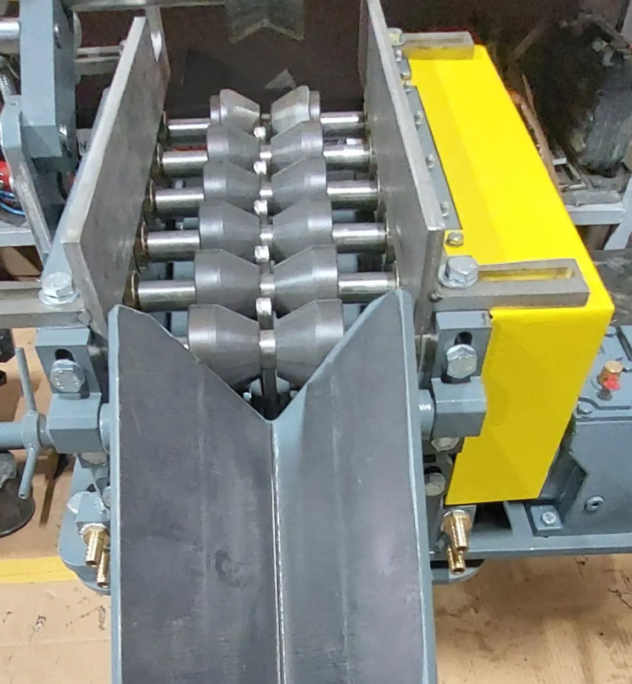
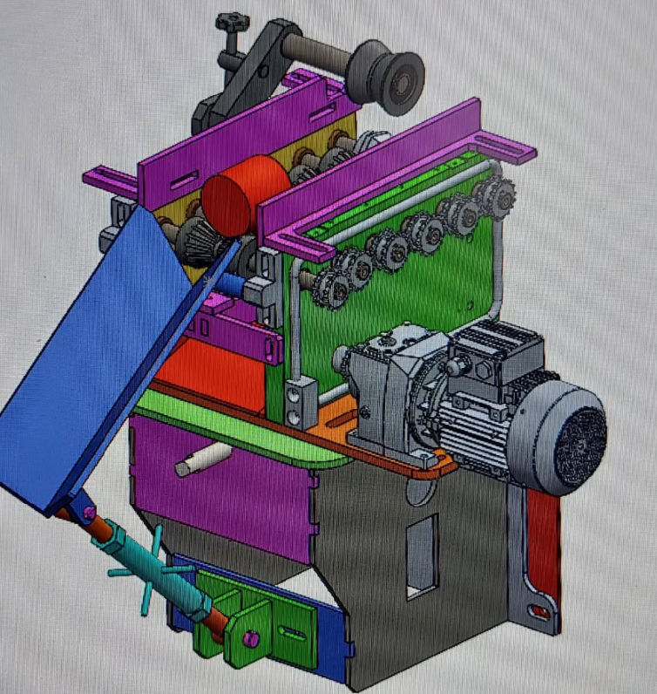
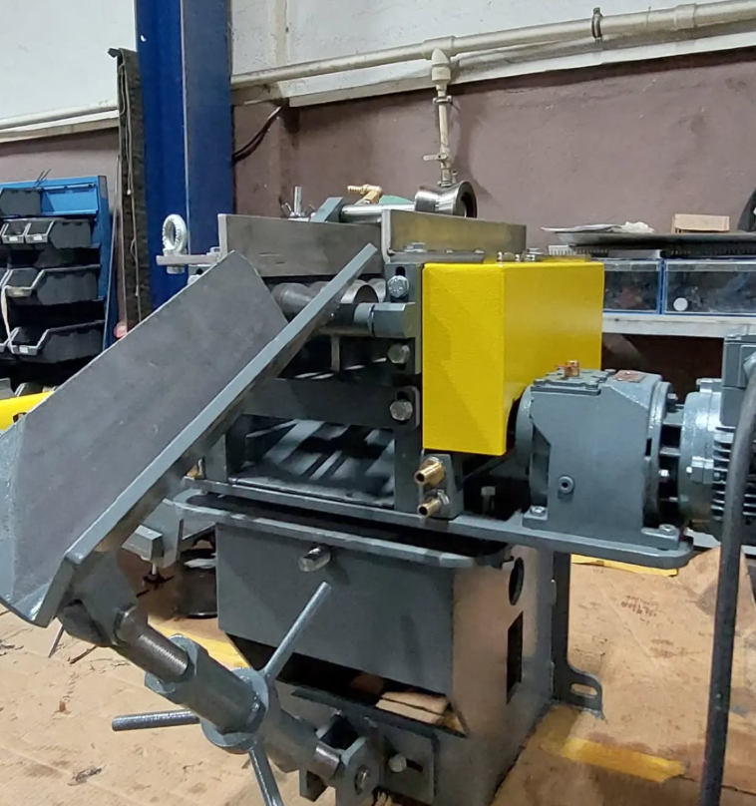
Loading and Unloading Ramp Design and Manufacturing

Slide 24
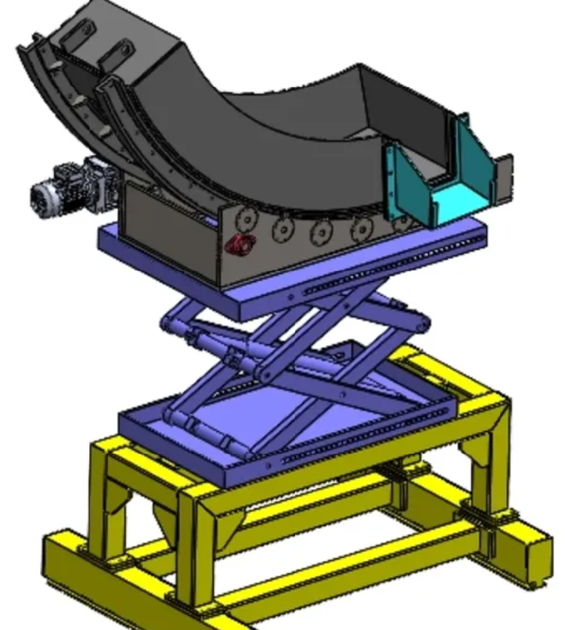
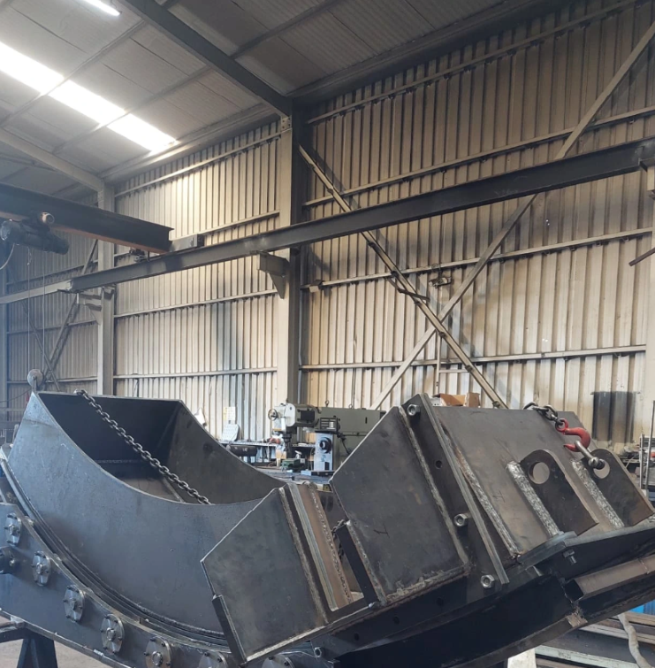
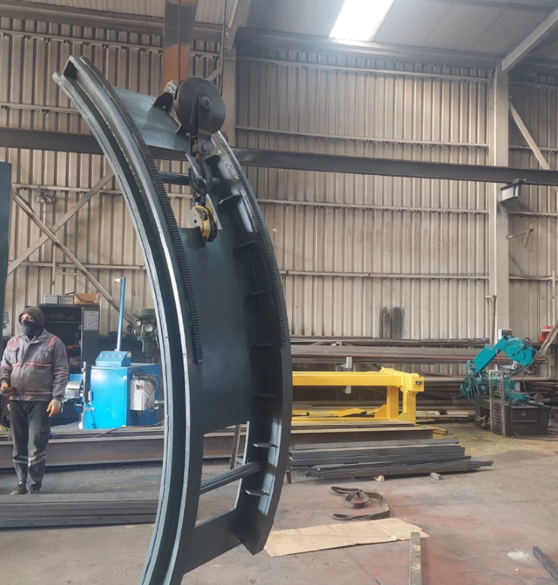
Design and Manufacturing of Movable Cast Iron Runners

Slide 25
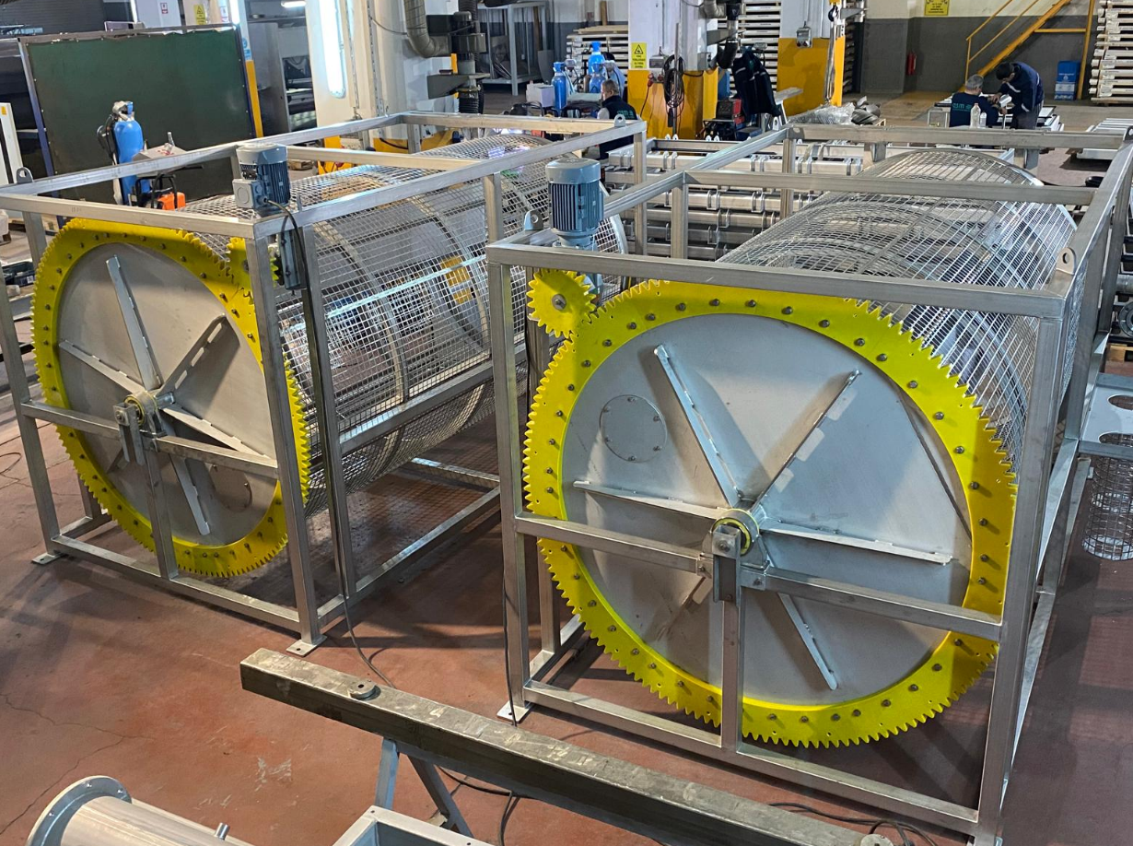
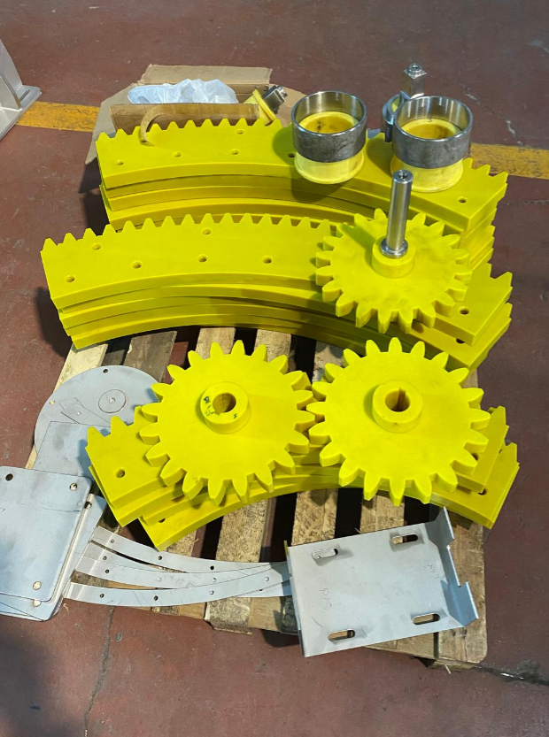
Gear Manufacturing

