Slide 1
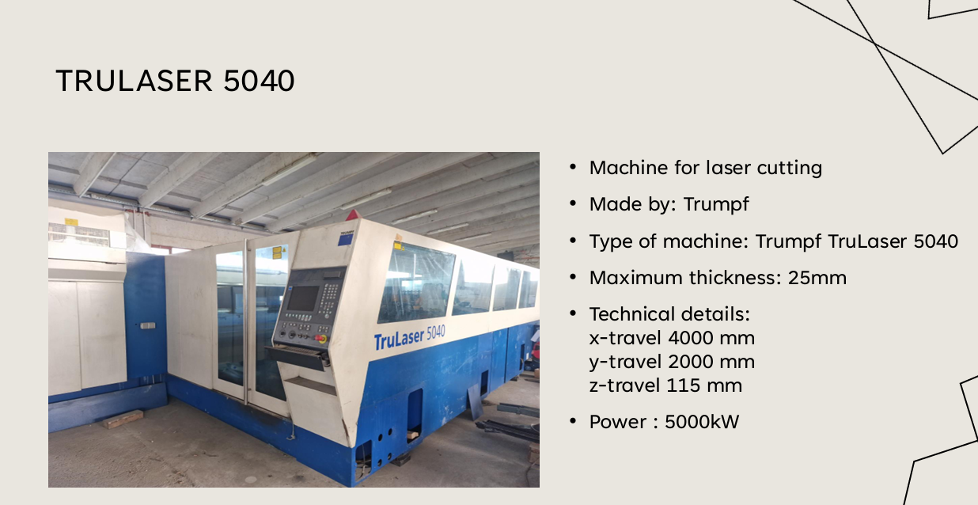
MACHINES IN OPERATION

Slide 2
DM MIG DOO
INDUSTRIJSKA ZONA JANJEVCI BR 13
31540 DONJI MIHOLJAC
OIB: 09893608099
Kontakt Dražen Majdenić
Mob 099 217 9102

Slide 3
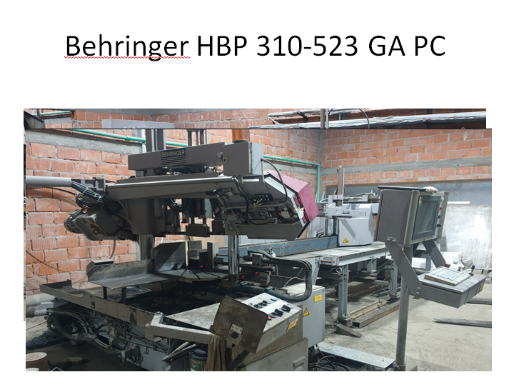

Slide 4
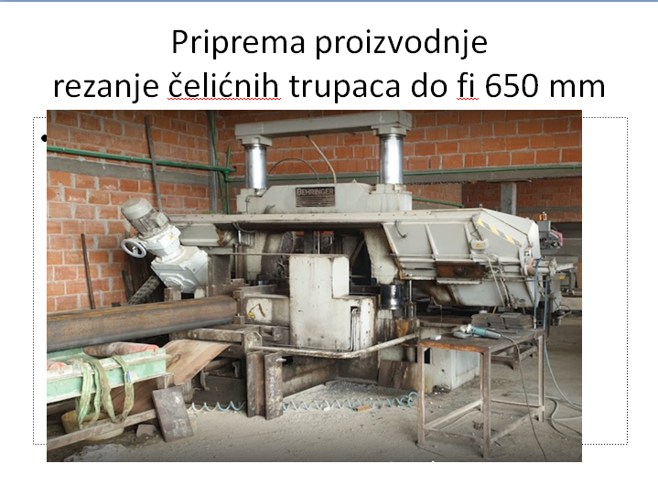

Slide 6
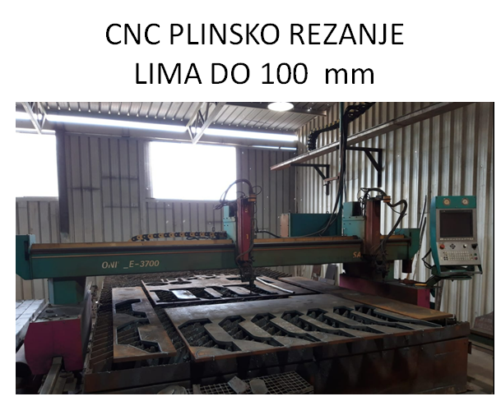
4000 x 2000

Slide 7
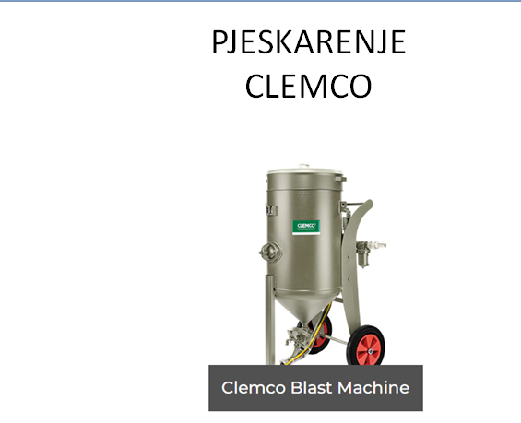

Slide 8
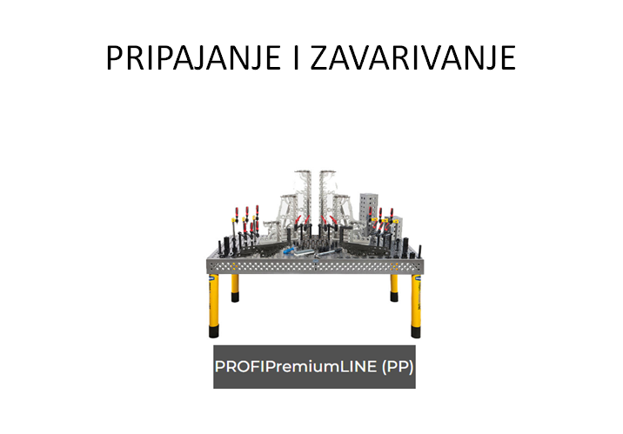

Slide 9
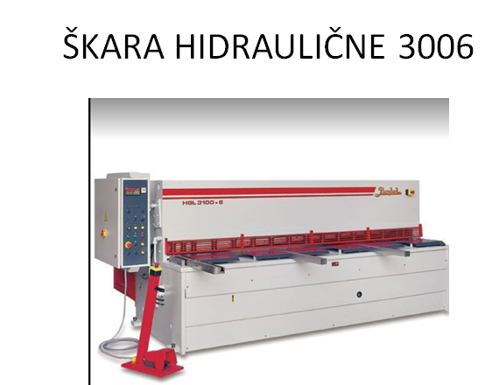

Slide 10
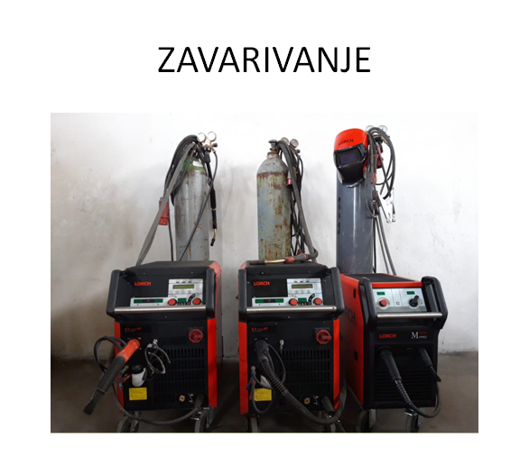
Lorch aparati S5

Slide 11
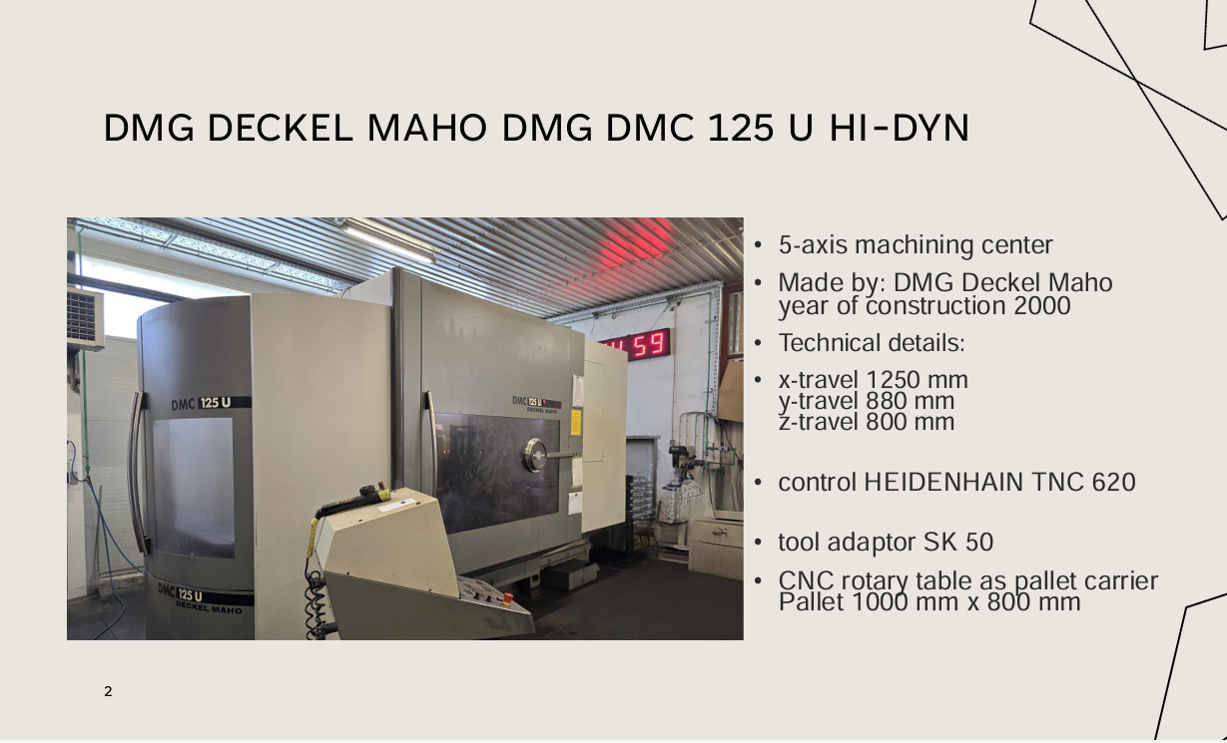

Slide 12
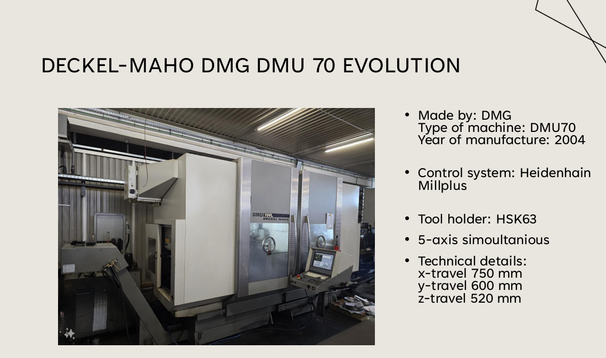

Slide 13
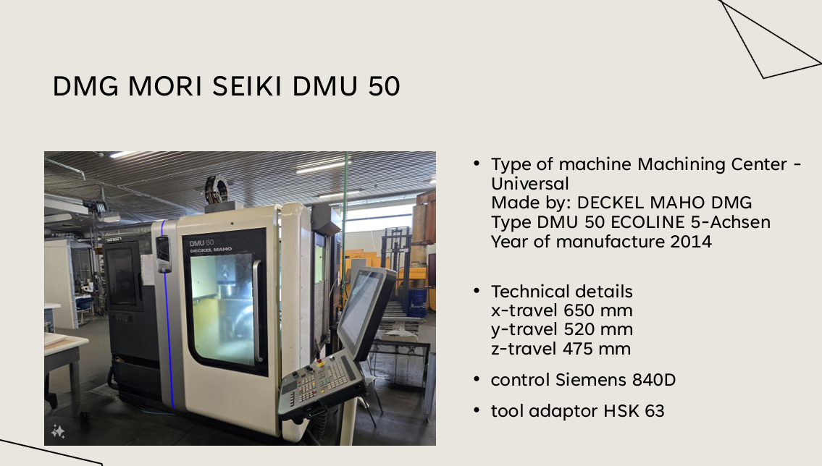

Slide 14
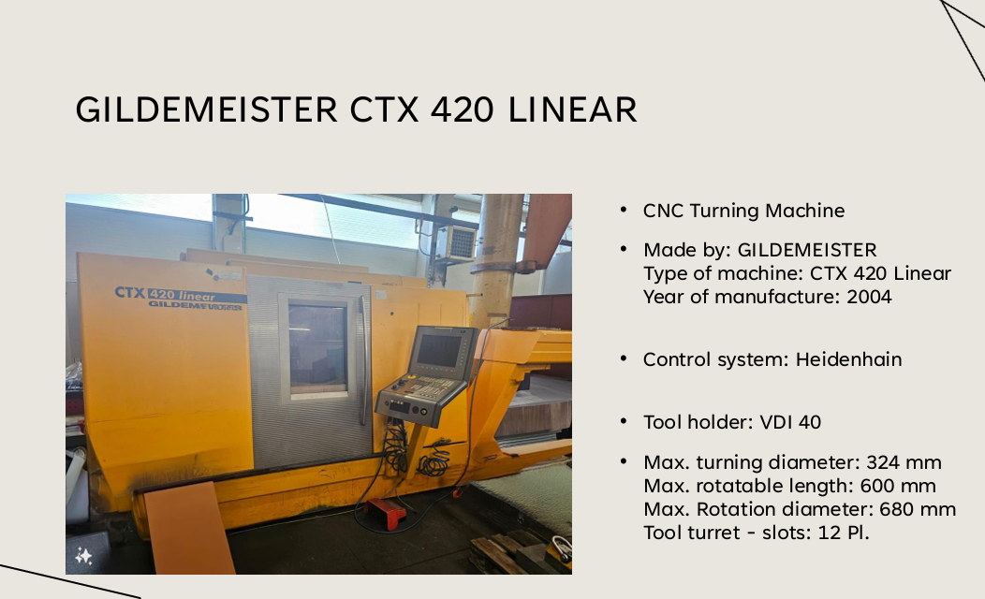

Slide 15
