Slide 1

Geschäftsführer: Jason Ni | Mathias Prosch - HRB780612 | AG Stuttgart - UST-ID: DE347663944
^{Part of LEMAN Group}

Slide 2
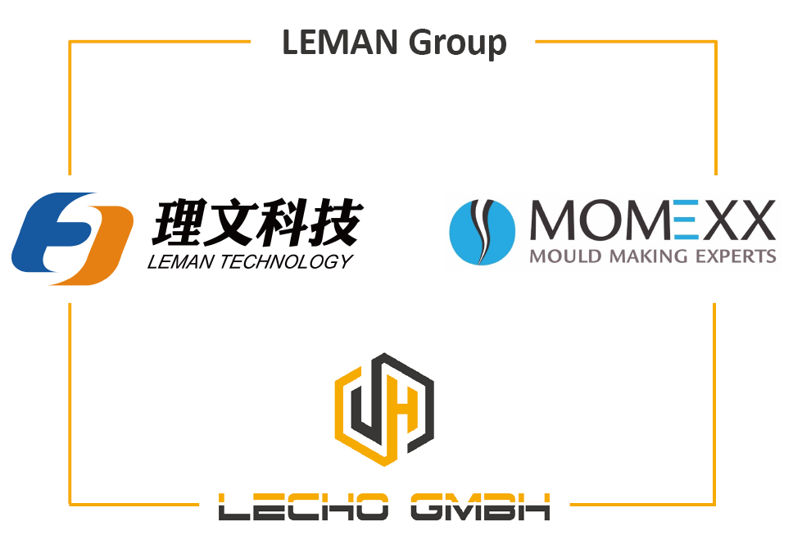

Slide 3

i
^{ABOUT LECHO}
AGENDA
^{WHAT WE DO}

Slide 4
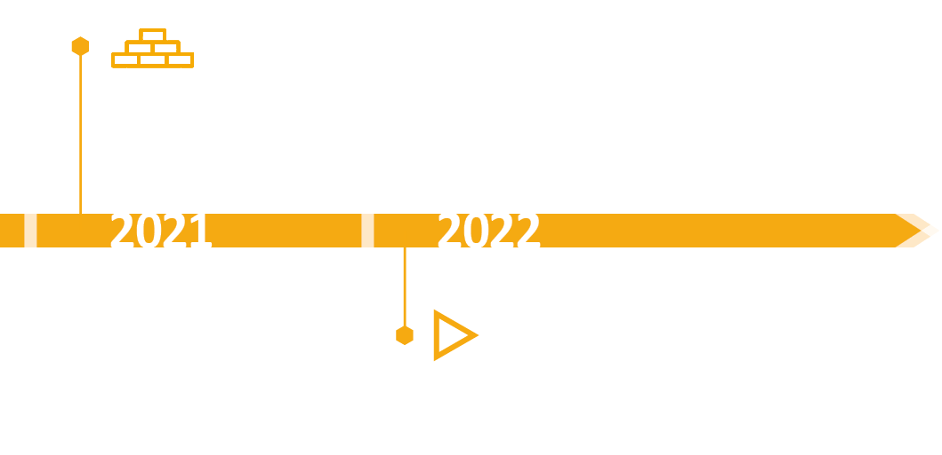
LECHO ABOUT LECHO
FOUNDED IN 2021
Several existing European Customers with a wide range of products were supplied with goods from south of Germany

Slide 5
^{WHAT WE DO}

Slide 6
LECHO ABOUT LECHO
6
^{SUPPORTING ALL}
^{INDUSTRIES LIKE}
^{AUTOMOTIVE, HEAVY DUTY TRUCKS,}
^{INDUSTRY, OEM´S}
^{FOCUS ON BUSINESS}
^{MANAGEMENT}
^{OVERSEAS FOR LEMAN TECHNOLOGY}
ACTING AS LOGISTIC OPERATOR AND
^{CONTRACTOR FOR OVERSEAS}
^{CUSTOMERS}
^{SAFETY STOCK –}
^{WAREHOUSING –}
SUPPORTING LOGISTIC SYSTEMS (JIT / JIS)
SERVICES AS PER CUSTOMER (ADDITIONAL QUALITY CONTROL / SORTING / ASSEMBLY)
SHORTER LEAD TIMES, AVAILABLE AT YOUR OFFICE TIME AND
^{ABOUND}
^{SUPPORT IN}
DOCUMENTATION AND IMPLEMENTATION OF YOUR SUPPLY CHAIN SPECIFICATIONS

Slide 7

LECHO WHAT WE DO
Implementing your requirements to manufacturer
Realizing your savings performance
Cost efficient offers with competitive pricing
Full Service from engineering to logistics
Special Shop Floor for small batch and pre-serious fabrication

Slide 8



LECHO WHAT WE DO
^{WITH LEMAN Group,}
THE LECHO GMBH CAN RELY ON A WIDE RANGE OF
FABRICATION METHODS AND PRODUCTS
^{OVER 30 YEARS EXPERIENCE}
^{IN FABRICATION AND}
BUSINESS WITH EUROPEAN, ASIAN AND CUSTOMERS FROM NORTH AND SOUTH AMERICA
^{ALL SORT OF MATERIAL AVAILABLE}
(OFFICIAL MATERIAL AND SUBSTITUTIONS)

Slide 9
LECHO WHAT WE DO
LEMAN GROUP OF
COMPANIES
^{CNC MACHINING}
^{(AUTOMOTIVE/}
^{INDUSTRIES)}
^{FORGING AND}
CASTING (SMALL AND HEAVY ITEMS)
^{BENDING AND}
^{PRESSING}
^{(TUBES AND FLAT}
^{MATERIAL)}
PLASTIC INJECTION (BIG AND SMALL ITEMS, HARD
PLASTIC AND ELASTHOMER MATERIAL)
^{ASSEMBLY}
^{PACKAGING}

Slide 10
LECHO WHAT WE DO
^{CERTIFICATION OF FABRICATION}
ISO and TS certificated or equivalent audited
^{fabrications only}
Additional control during fabrication if required
Create fabrication control plans - review for each item and / or fabrication step if required
Quality labor capacity and measuring machines
^{available}
Sales support and after sales service

Slide 11
LECHO WHAT WE DO
11
^{Logistics}
Realizing Supply Chain concepts
^{Safety stock options}
Implementing your requirements, especially challenging supply chain due diligence, at the manufacturers

Slide 12

What can we do for you?

