Slide 1
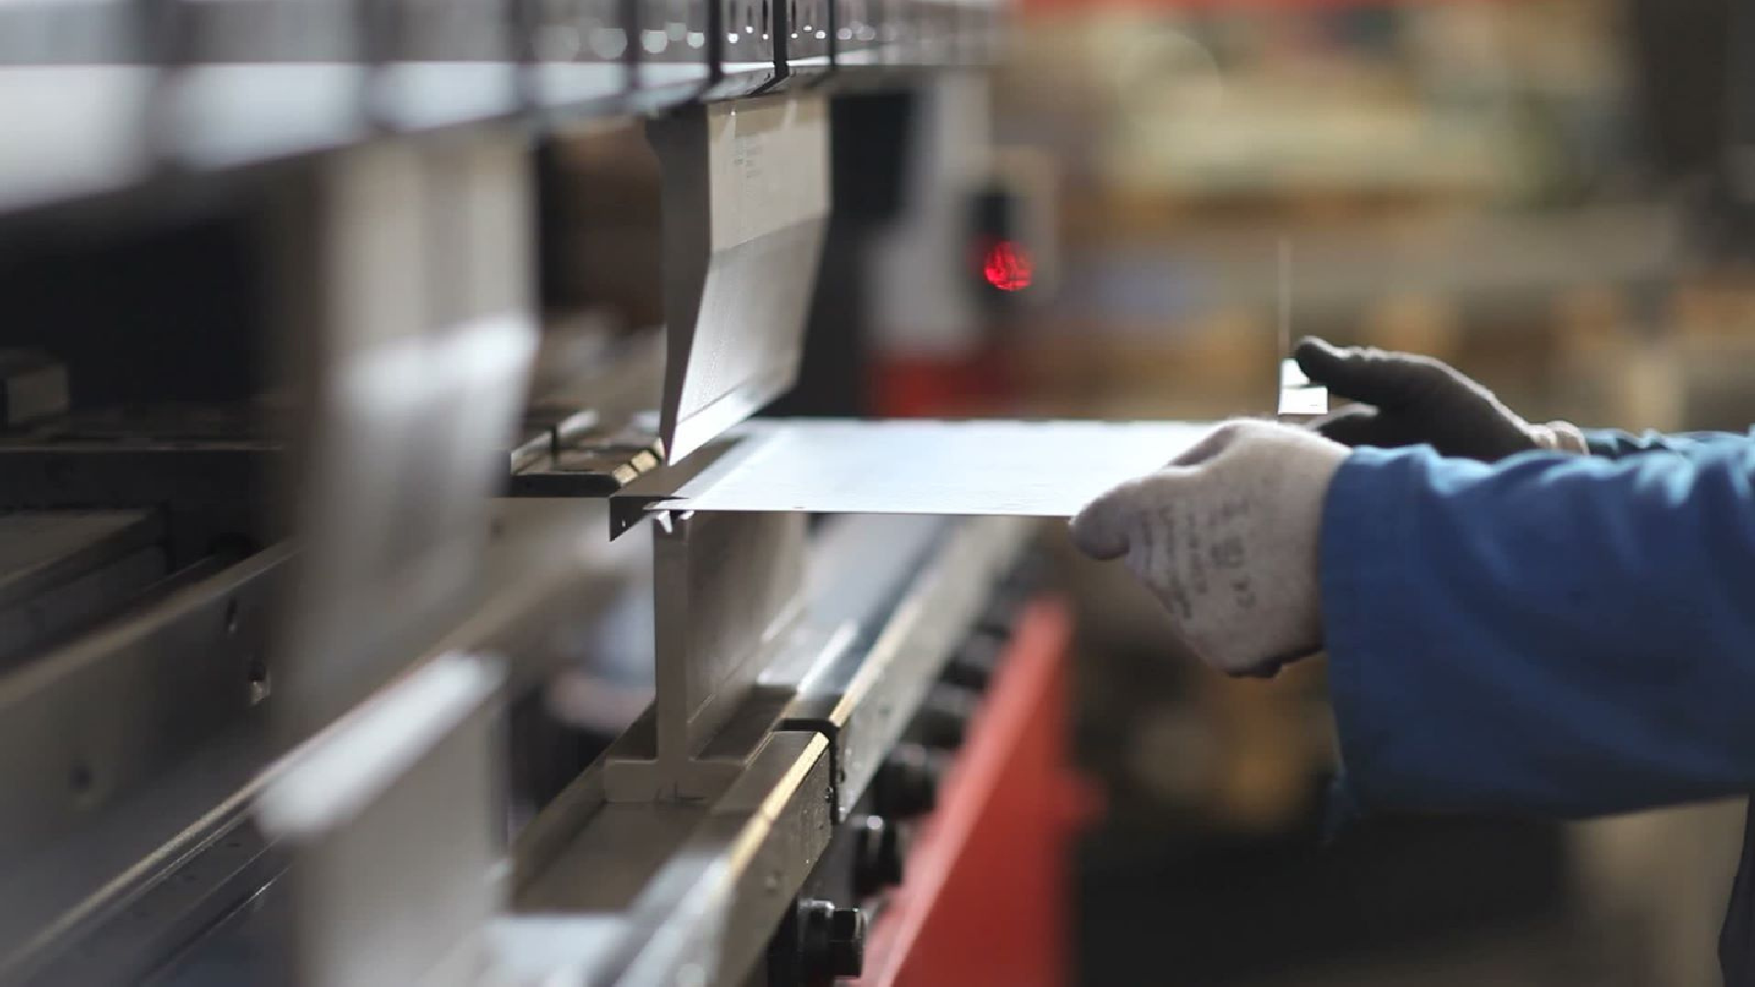






Slide 2
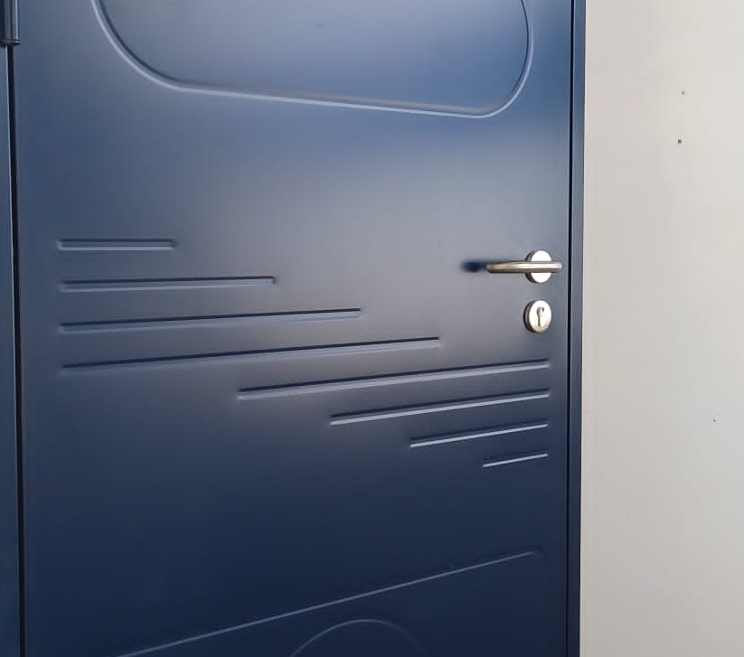
STEEL DOORS
ABOUT US
Established in 2017
Steel doors production
Metal fabrication
15 workers
1,5 M turnover
Exporting across Europe
Certified according to EN standards

Slide 3
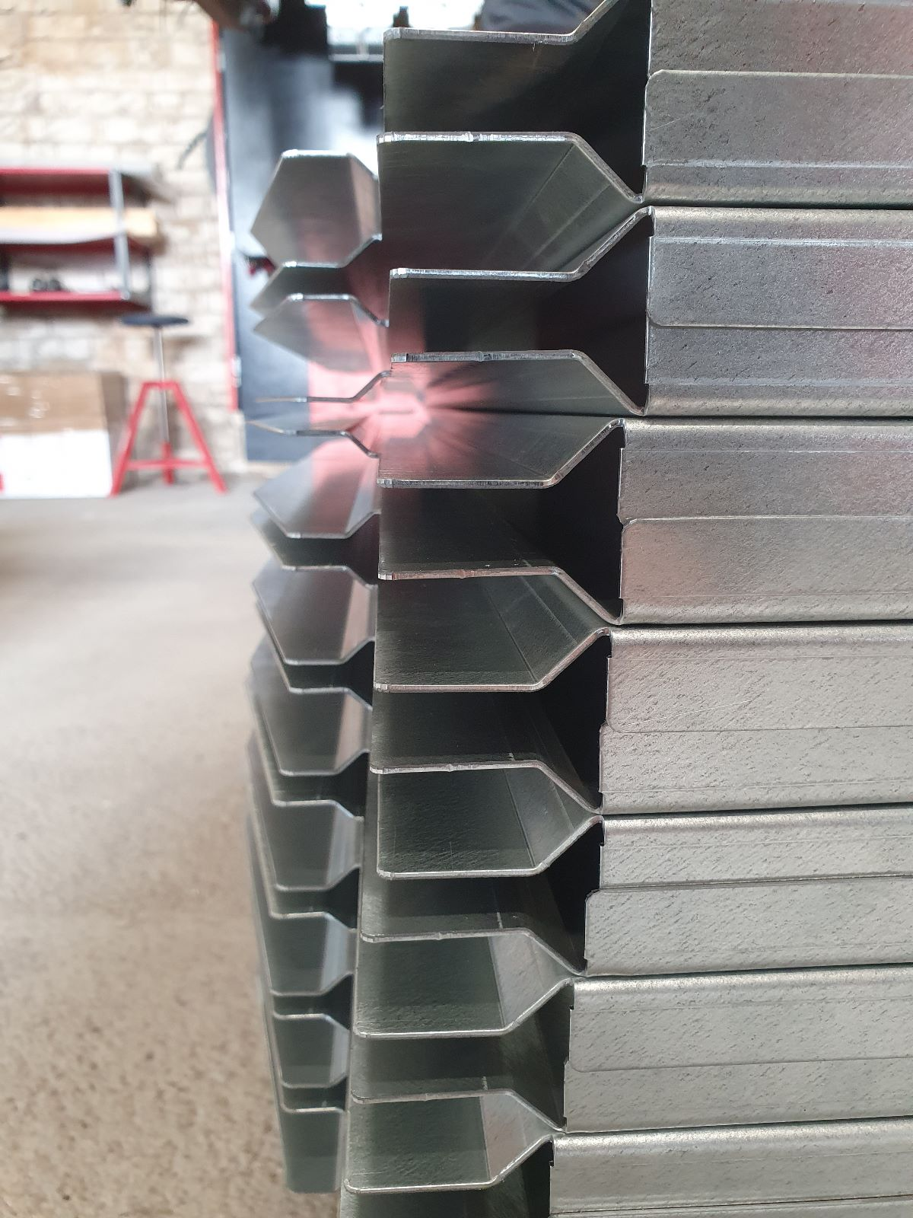
METALWORKING
STEEL DOORS
All processes are done in-house
Sound, wind, water, U-value tested
Fireproof ratings of EI30, EI60
Export across Europe
Custom made for your needs

Slide 4

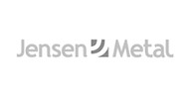


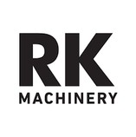



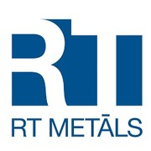


SOME OF OUR CLIENTS & INDUSTRIES
METALWORKING
Engineering
CNC sheet metal punching
CNC sheet metal bending
Shot Blasting, Powder Coating
Welding, Cutting, Assembling
Certified according to EN 1090-3
Manufacturing Construction Agriculture Engineering
Machinery

Slide 5

SOME OF OUR CLIENTS & INDUSTRIES
Manufacturing Construction Agriculture Engineering
Machinery
THANK YOU
We look forward to working with you
Padures iela 12, Aizpute
LV- 3456, Latvia
+371 29995574
info@kurz.lv
www.kurz.lv

Slide 6
THANK YOU!
We look forward to working with YOU
Padures street 12,
Aizpute
LV-3456, Latvia
+371 28805292 +371 29995574
info@kurz.lv maris@kurz.lv
www.kurz.lv

