Slide 1
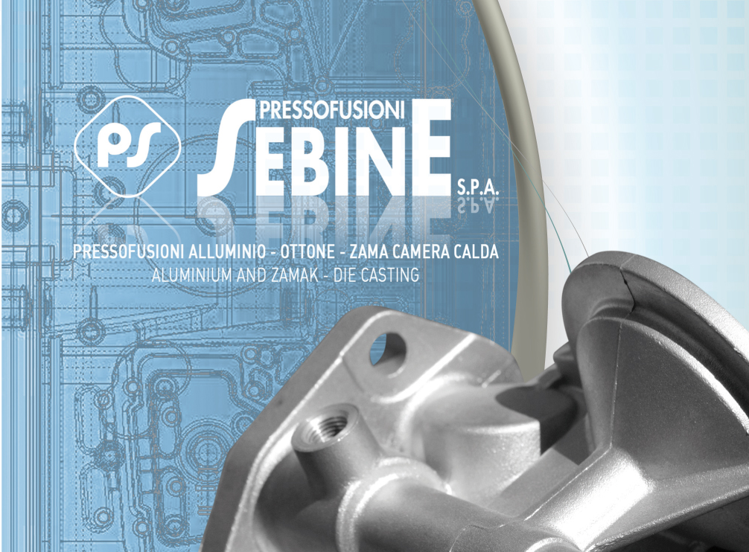

Slide 2
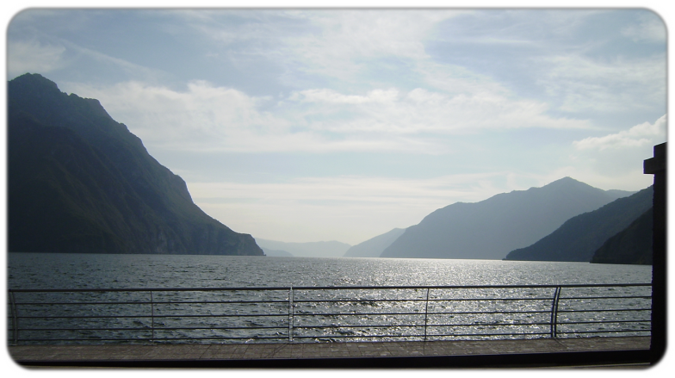
COMPANY’S PROFILE
HISTORICAL NOTICE
Pressofusioni Sebine was founded in 1966, it owes its name to the location of its first factory which has established in Pisogne, near the Sebino lake.
In 1974 the factory was moved to Artogne, in the heart of the industrial area, in order to respond to the new structural and innovative requests.
Our main production lines are: die-casting of aluminium alloy, zinc alloy and brass moulding.
The biggest part of our production is in automotive, household appliance and general mechanical industries. For this purpose the company uses various alloys.

Slide 3

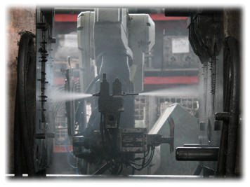
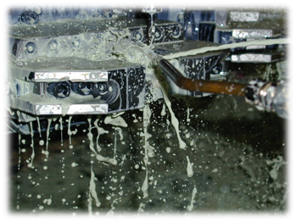
COMPANY’S PROFILE
Ettore BRESCIANI President and founder
Davide BRESCIANI Managing director
ACTIVTY: manufactures of non-ferrous metal die-casting
(aluminium – zamak – brass)
FONDERIE BRESCIANI srl
Davide BRESCIANI President
ACTIVITY: aluminum die-casting
BRESCIANI ETTORE
“Lavorazioni Meccaniche”
Individual enterprise
ACTIVITY: mechanical machining
on die-casting products

Slide 4
STAFF
QUALITY DEPARTMENT 8
TECHNICAL DEPARTMENT 4
SALES AND ADMINISTRATION 9
PRODUCTION 94
TOTAL 115
FONDERIE BRESCIANI srl
QUALITY DEPARTMENT 1
TECHNICAL DEPARTMENT 2
SALES AND ADMINISTRATION 0
PRODUCTION 24
TOTAL 27
BRESCIANI ETTORE
QUALITY DEPARTMENT 1
TECHNICAL DEPARTMENT 2
SALES AND ADMINISTRATION 1
PRODUCTION 25
TOTAL 29

Slide 5
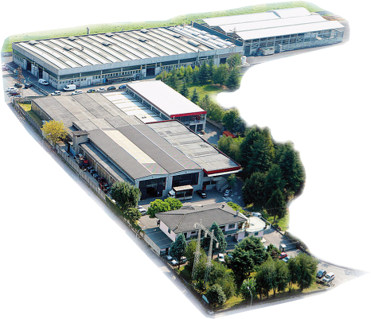
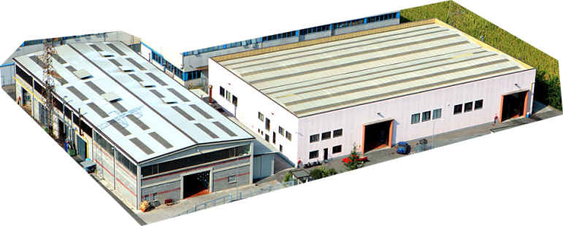
PLANTS
Plant (1) 22 Fornaci Street – built in 1974:
covered area approx 6.550 mq, total area approx 10.000 mq
Plant (2) Artigiani Street – built in 1997:
covered area approx 3.200 mq, total area approx 5.000 mq
Plant (3) 9 Artigiani Street 9 (FONDERIE BRESCIANI srl):
covered area approx 1.200 mq, total area approx 2.400 mq
Plant (4) 19, Artigiani Street built in 2000 (BRESCIANI ETTORE):
covered area approx 1.850 mq, total area approx 3.200 mq
Plant (5) built in Leopardi Street used for storehouse:
covered area approx 3.200 mq. total area approx 5.000 mq
Plant (6) in Piancamuno, built in 2002:
covered area approx 2.000 mq, total area ca 4.200 mq
Total covered area approx 18.000 mq
Total area approx 30.000 mq

Slide 6
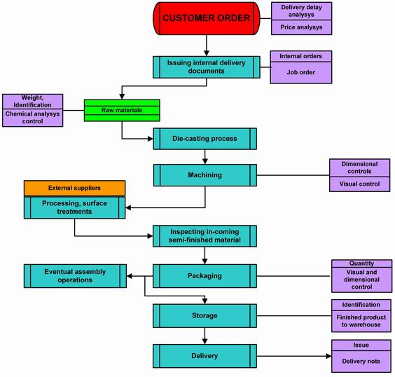
PRODUCTION CYCLE
Thanks to the vertical production system, Pressofusioni Sebine is able to perform all the processing phases in-house, beginning from the design work and die creation, all the way to piece conformity control.
In 1998, the company obtained ISO 9002 certification from DET NORSKE VERITAS, passing on to ISO 9001:2000 in March 2003 – certificate 03810-98-AQ-MIL-SINCERT. In 2011 Sebine obtained certification of norms ISO TS 16949:2009 by DET NORSKE VERITAS (102940-2011-AQ-ITA-IATF). In 2015 Sebine is on the road to obtain certification ISO 14001.
An attentive policy aimed at continuous improvement has permitted the rationalisation of the production processes, new product development and broadening the product line.
The main objectives reached are:
- The broadening of the products immediately available from the warehouse
- The possibility of delivering small lots
- A new DIE-CASTING Department with 4 presses ranging from 380 to 850 Tons.
- Increased production capacity for number of pieces and average pressed part weight
- Enlargement of the finished product warehouse and tooling deposit areas
- Improved specific control and testing equipment

Slide 7
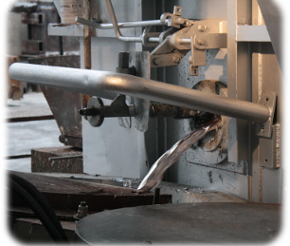
MAIN MATERIAL USED (kg.)

Slide 8
ACTIVITY FIELD
YEAR 2016

Slide 9
TURNOVER
Year 2000 | € 23.258.207 |  | Year 2009 | € 29.653.085
Year 2001 | € 22.850.513 |  | Year 2010 | € 36.628.939
Year 2002 | € 26.086.883 |  | Year 2011 | € 38.063.567
Year 2003 | € 27.616.600 |  | Year 2012 | € 39.778.819
Year 2004 | € 29.841.158 |  | Year 2013 | € 44.299.427
Year 2005 | € 31.264.236 |  | Year 2014 | € 48.116.005
Year 2006 | € 36.520.082 |  | Year 2015 | € 48.483.463
Year 2007 | € 40.211.096 |  | Year 2016 | € 51.882.875
Year 2008 | € 42.663.074 |  | Year 2017 forecast | € 53.000.000

Slide 10
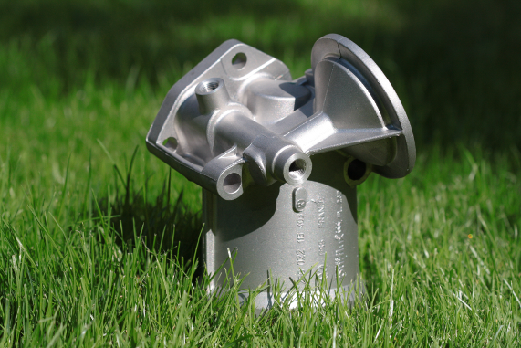
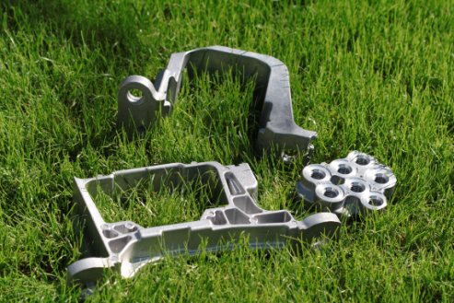
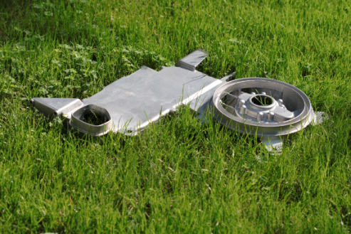
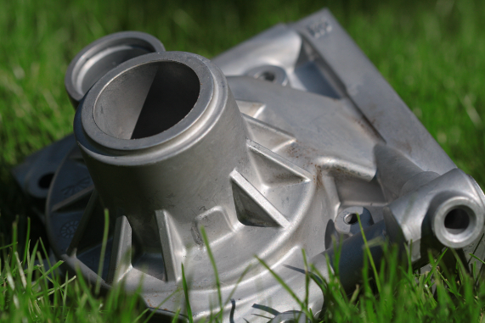
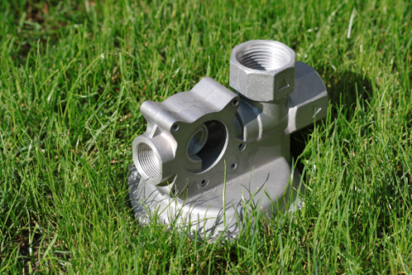
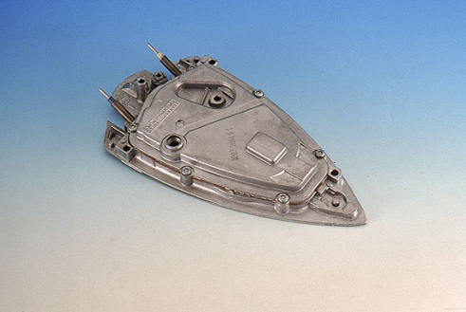
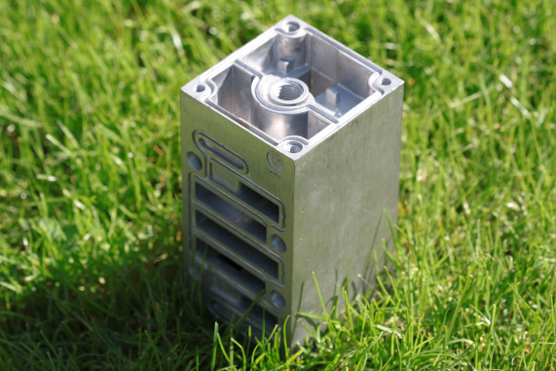
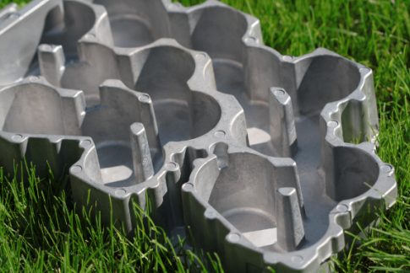
PRODUCTION
Products images and chessels

Slide 11
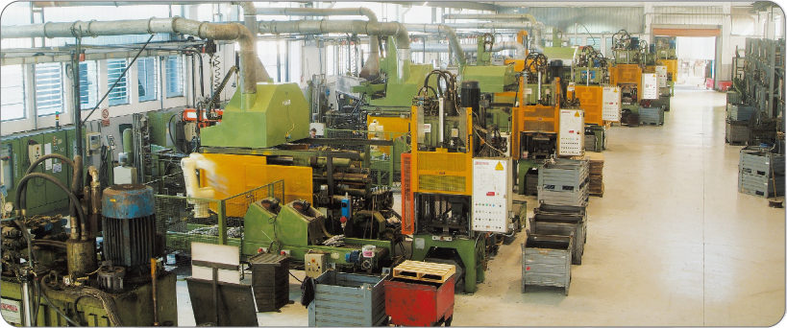
PRODUCTION EQUIPMENTS
Production equipments of various sizes allow for a big production capacity and high flexibility as required by the customers.
All the production equipments are highly automated and they use very advanced technology for the handling of the production.
3 aluminium die-casting plant 180 T/320 T
11 aluminium die-casting plant 400 T/550 T
1 aluminium die-casting plant 630T
4 aluminium die-casting plant 700T/ 750T
1 aluminium die-casting plant 950 T
4 zama die-casting plant 150Ton a 320Ton
22 trimming machines to remove risers
and to clean the castings
2 1200 kg/h melting furnace
1 500 kg/h melting furnace
2 2000 kg/h melting furnace
Workshop and maintenance Department
GILARDONI radioscopy room
SPECTROLAB laboratory

Slide 12
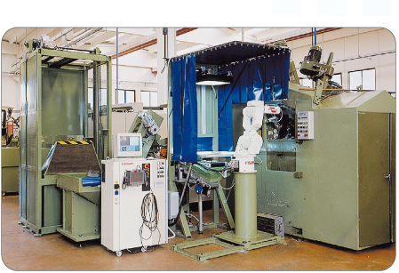
PRODUCTION EQUIPMENTS
PRESSOFUSIONI SEBINE can supply the finished or semi-finished items thanks to its own machining department.
12 transfer machines for die casting machining
7 high speed center CNC for workpieces
Cleaning Dept. with no. 2 sieves, no. 1 belt sandblasting machine and no. 1 tunnel sandblasting machine
Pressure tightness test machines for gas fitting testing

Slide 13
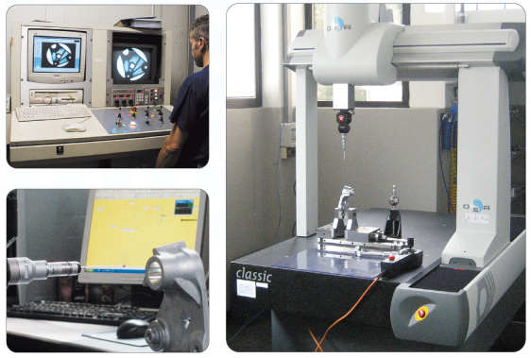
PRODUCTION EQUIPMENTS
Tridimensional module die design + die casting simulator
1 Metrological Room with 2 tridimensional control machines
Tridimensional scanner
1 Circle measuring machine
1 Profilometer: surface metrology measuring tool
Quality department special equipment

Slide 14
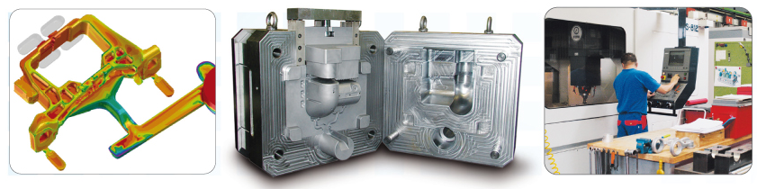
TOOLS WORKSHOP
The tools workshop is equipped with die casting flow simulator in order to optimize the design and the lifetime of the tolls.
The Technical Department can design and make the production tools.

Slide 15
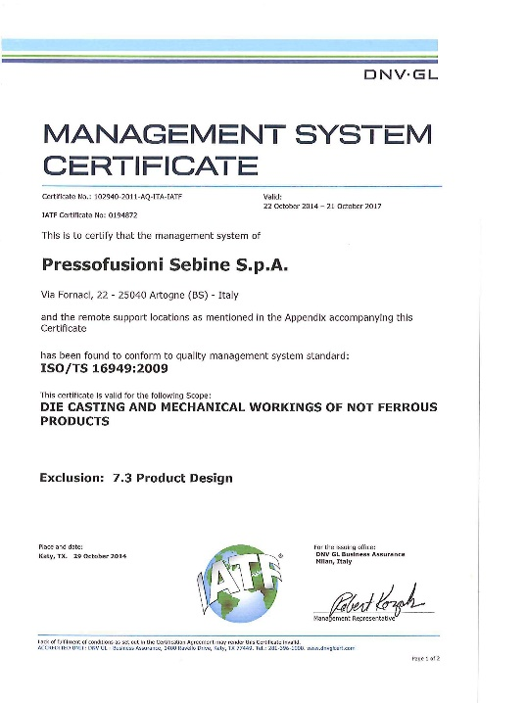
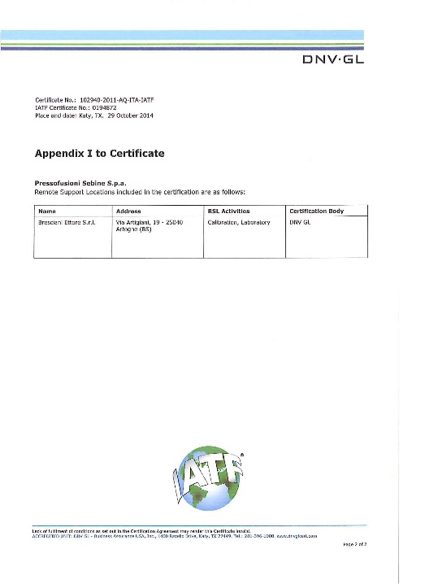
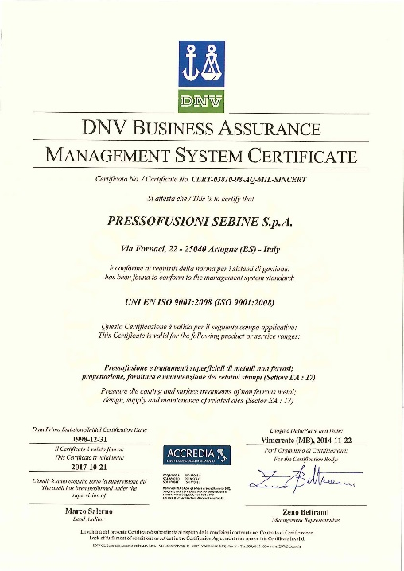
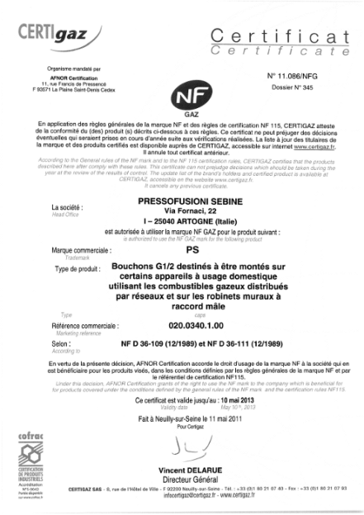
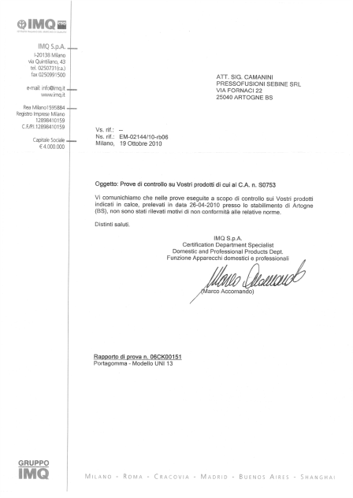
CERTIFICATIONS
In 1998 PRESSOFUSIONI SEBINE obtained the ISO 9002 certification from the DET NORSKE VERITAS authorities with the switchover to the ISO 9001:2000 in March 2003. In 2011 Sebine obtained certification of norms ISO TS 16949:2009 by DET NORSKE VERITAS (1029440-2011-AQ-ITA-IATF).
The company has been authorized to use the NF and IMQ marks for the gas sector since many years.

Slide 16
CONTACT PERSONS
Phone +39 0364 598878
Fax +39 0364 598892
Web site www.sebine.it
Davide BRESCIANI General manager
Mail: davide.bresciani@sebine.it
Renato SPANDRE Production manager
Mail: renato.spandre@sebine.it
Dario GERVASONI Manager export
Mail: dario.gervasoni@sebine.it
Andrea COTTI COMETTI Commercial manager
Mail: andrea.cotticometti@sebine.it
Sandro CAMANINI Quality manager
Mail: sandro.camanini@sebine.it
Luca TEMPINI Logistic manager export
Mail: luca.tempini@sebine.it

Slide 17
