Slide 1
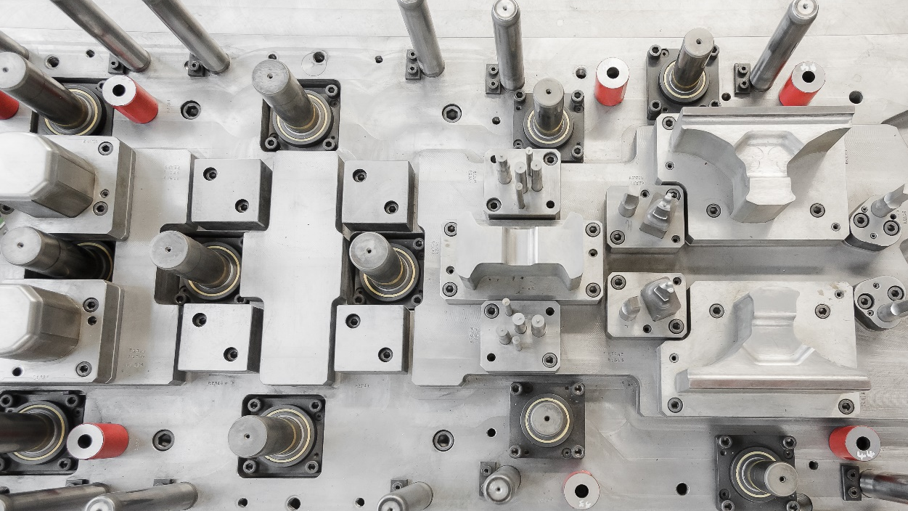

MUSA PITESTI ‘96
Presentation
JULY
2026

Slide 2
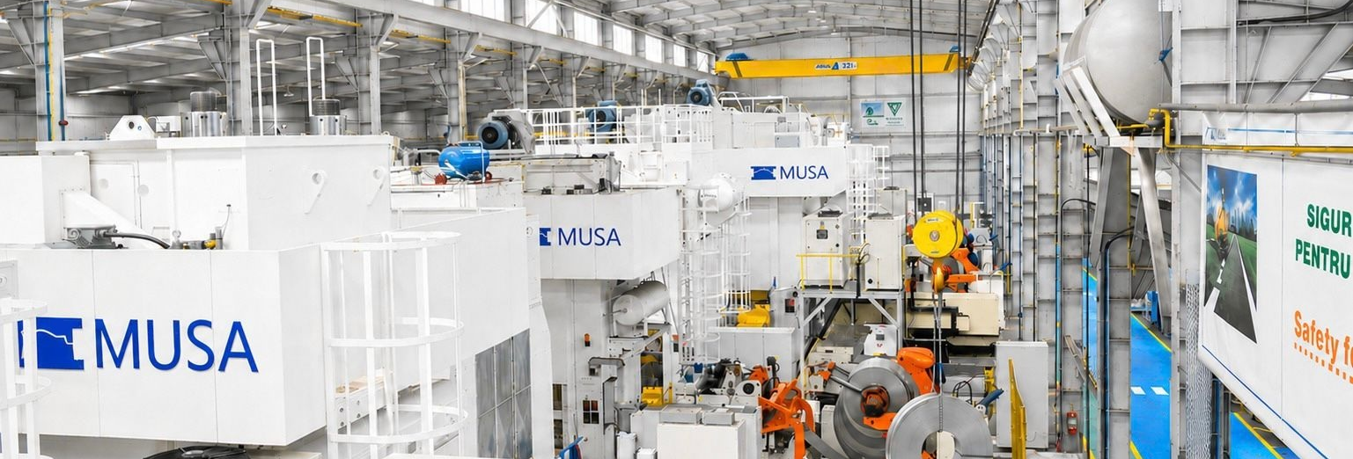
100% ROMANIAN PRIVATE COMPANY
Our name
1996
2011
2016
2023
M ATRIŢE (DIES)
U TILAJE (EQUIPMENT)
S UBANSAMBLE (SUBASSEMBLY)
A UTO
S.C. MUSA PITESTI 96 S.R.L. was founded by Mr. Aldea Nicolae, based in Pitești. The main field of activity was the manufacture of dies and molds.
The Pitești office has expanded its activity through the production of pressed parts for the automotive industry and other industries.
A second factory was opened in Coseri to increase the production capacity of pressed parts.
A second hall was inaugurated in Coseri for welding processes for metal parts.
MUSA
PITESTI 96’
2

Slide 3






CAPABILITIES & SERVICES
PRODUCTION OF PARTS
PRODUCTION OF DIES AND MOLDS
Pressed Parts Production
large and small series
press capability up to 1000 tf
sheet thicknesses ranging from 0.65 mm to 4 mm
Design & Engineering
3D design for dies, molds, welding fixtures, prototypes, and control gauges
press simulation & forming analysis
MUSA PITESTI ‘96
Welding & Assembly
robot welding (MIG-MAG , spot welding)
manual welding
assembly for complex components
CNC Machining & EDM
milling, turning, drilling, grinding, EDM, laser cutting
repair and maintenance of dies
machining of precision parts
Logistics & Packaging
worldwide delivery
over 2.800.000 parts shipped annually
Tool Manufacturing
progressive dies
manual dies
control gauges
welding fixtures
MUSA
PITESTI 96’
3

Slide 4





CAPABILITIES & SERVICES
AVAILABLE CAPACITY 2026
AVAILABILITY RATE (%)
AVAILABLE HOURS
35.000
hours available
32.000
hours available
6.000
hours available
6.000
hours available
45.000
hours available
45.000
hours available
MUSA
PITESTI 96’
4

Slide 5
























CLIENTS
KEY PARTNERS & GLOBAL REFERENCES
Over 30 years of experience in stamping, WELDING, toolinG, AND PROTOTYPE manufacturing solutions
Our main clients are Renault and Dacia, with whom we have developed long-term strategic collaborations.
MUSA
PITESTI 96’
5

Slide 6
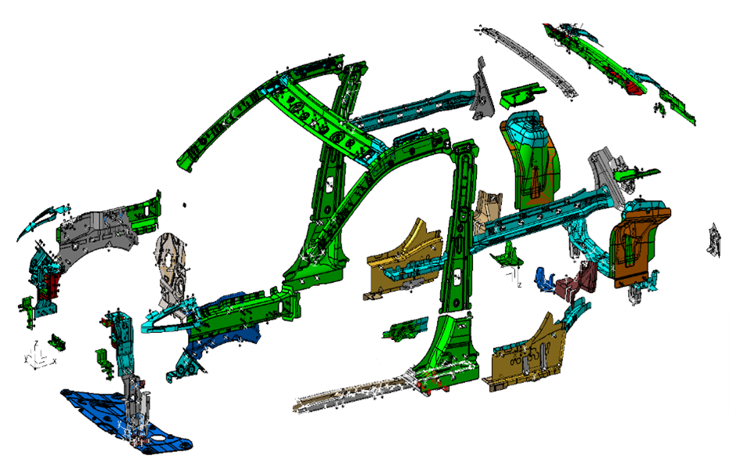
CLIENTS
118 NOMINALIZED REFERENCES
We supply stamped and welded body-in-white components covering structural, reinforcement and assembly parts.
MUSA
PITESTI 96’
6

Slide 7
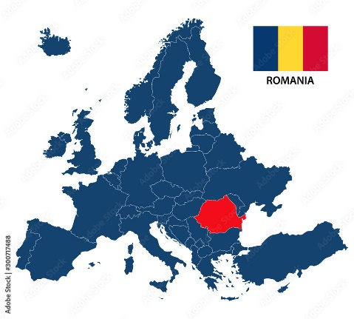
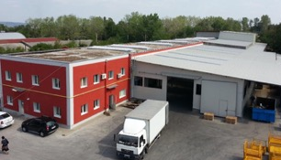
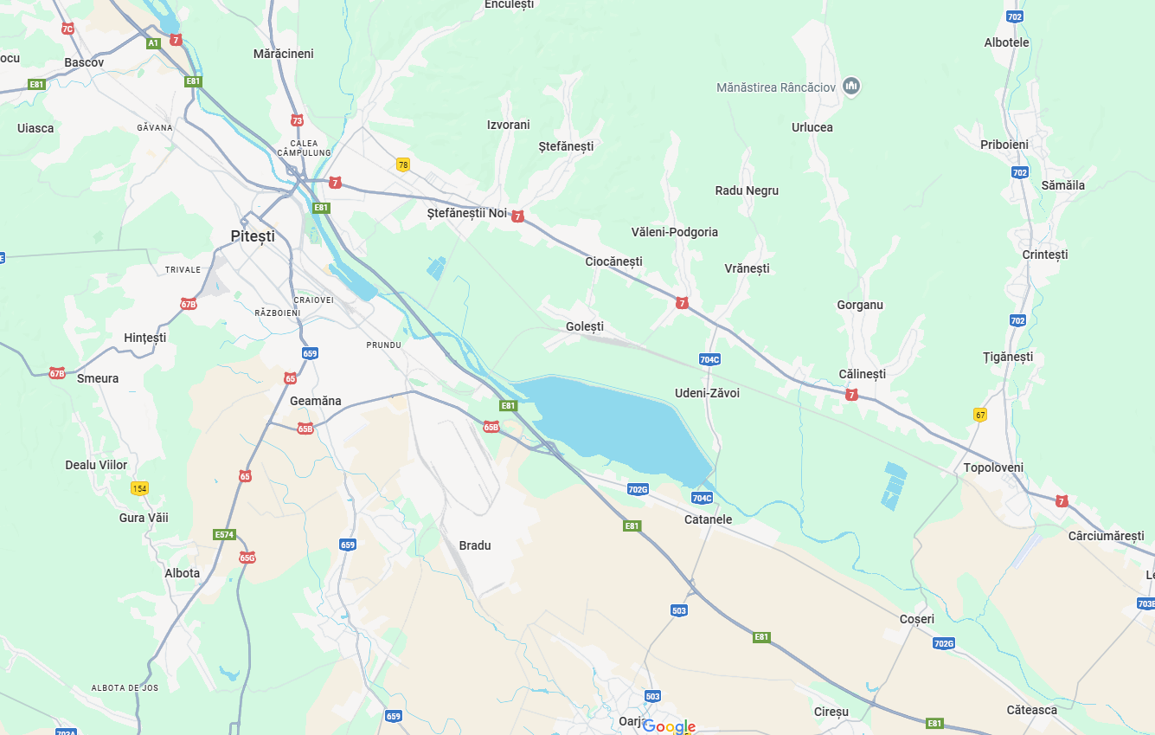
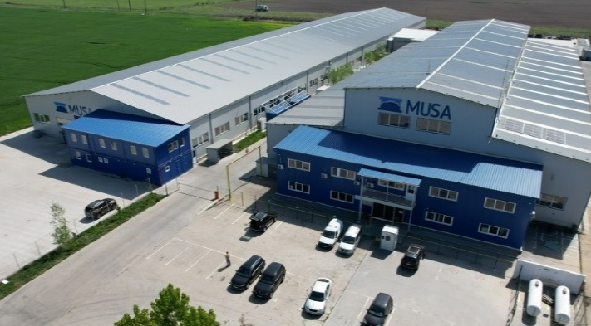
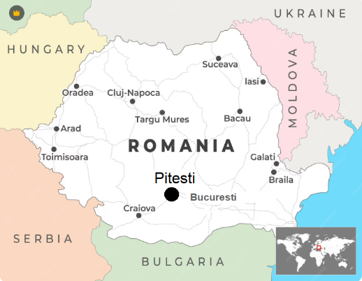
OUR PLANTs
MUSA-Pitesti
MUSA-Coseri
3.650 Square meters of land
2.523 Square meters of buildings
We produce:
Tools
Prototype parts
Press parts
36.500 Square meters of land
13.366 Square meters of buildings
We produce:
Press parts
Welding parts
MUSA
PITESTI 96’
7

Slide 8
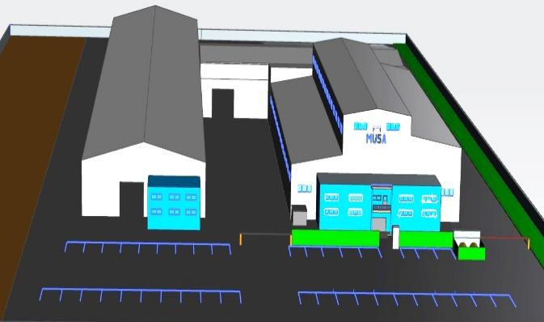
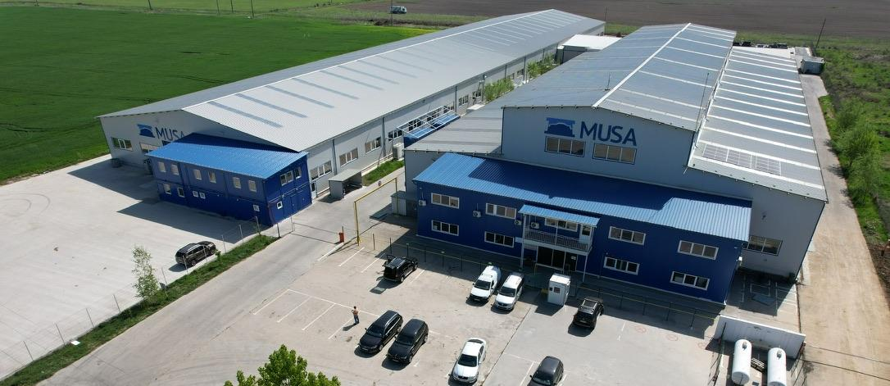
COMPANY EXPANSION
NEW LAND ACQUISITION
2
12500 m
New land - 12.500 square meters for new projects
MUSA is open to expanding its activities into new domains. With an available investment budget between EUR 1,3 million and EUR 10 million, the company has the flexibility to adapt its capabilities, processes, and production lines according to the requirements of a new client.
12.500
MUSA
PITESTI 96’
8
Notes:
POZA DIN DREAPTA MARITA – CHENAR SI SAGEATA PENTRU EVIDENTIEREA TERENULUI)

Slide 9



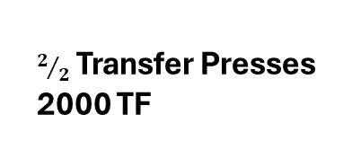
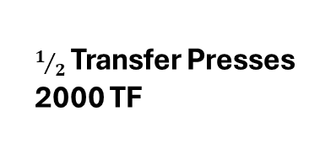

COMPANY EXPANSION
3 -year investment plan
INVESTMENTS
2027
INVESTMENTS
2028
INVESTMENTS
2029
New hall 4000${ m}^{2}$
$2/2$ Transfer Presses 2000 TF
TISAX Certificate
$1/2$ Transfer Presses 2000 TF
Roll forming
(implementation in progress)
MUSA
PITESTI 96’
9

Slide 10
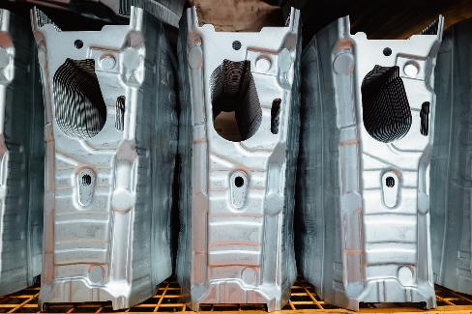
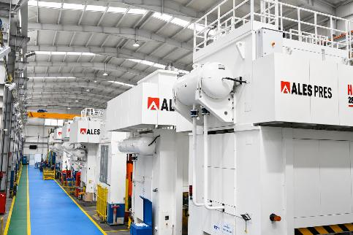
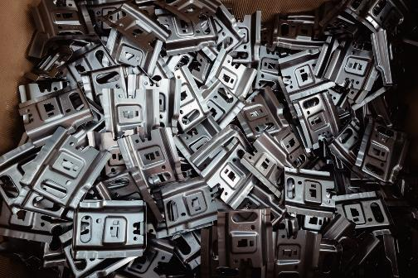
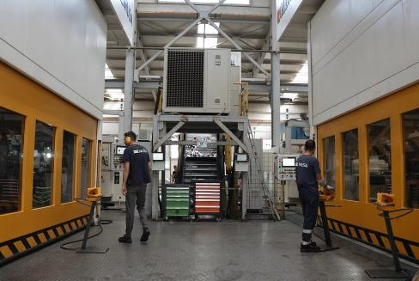
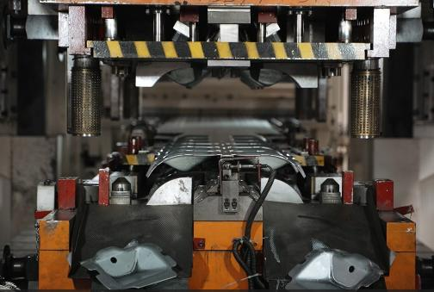

PRODUCTION OF PARTS
PRESS SHOP
MUSA PITESTI ‘96
Our press shop is equipped with 34 presses ranging from 63TF to 1000TF, enabling us to cover a wide variety of stamping processes- from small precision parts to large structural components. With progressive and tandem tools, we ensure flexible, reliable and high-capacity production.
Click here to explore MUSA - Coseri
MUSA
PITESTI 96’
10

Slide 11
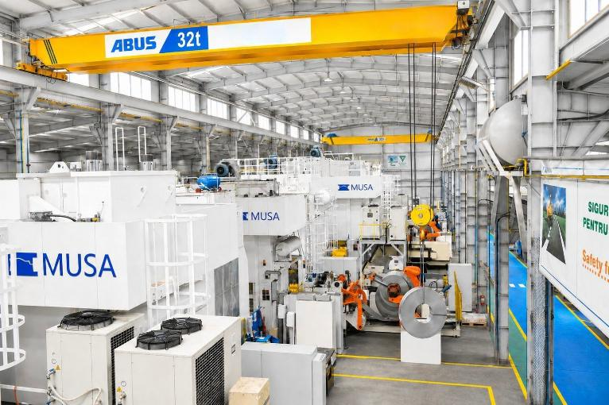
PRODUCTION OF PARTS
PRESS SHOP
COSERI PLANT
PITESTI PLANT
25 Presses – Coseri
9 Presses – Pitesti
Press Force | Qty. | Manual | Automatic
1000 TF | 3 | x | x
630 TF | 2 | x | x
600 TF | 3 | x | x
500 TF | 3 | x | x
400 TF | 1 | x | x
315 TF | 3 | x | x
250 TF | 2 | x
200 TF | 3 | x | x
180 TF | 1 | x | x
160 TF | 2 | x | x
130 TF | 1 | x
100 TF | 1 | x
Press Force | Qty. | Manual | Automatic
500 TF | 2 | x | x
400 TF | 1 | x
250 TF | 1 | x | x
200 TF | 1 | x
160 TF | 1 | x
125 TF | 1 | x
100 TF | 1 | x
63 TF | 1 | x
PRODUCTION AREA
MUSA
PITESTI 96’
11

Slide 12
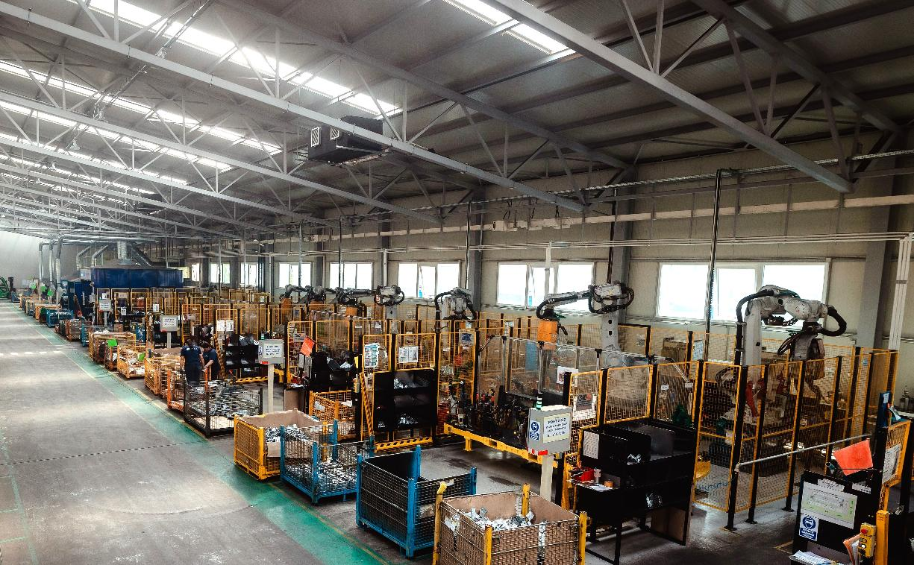
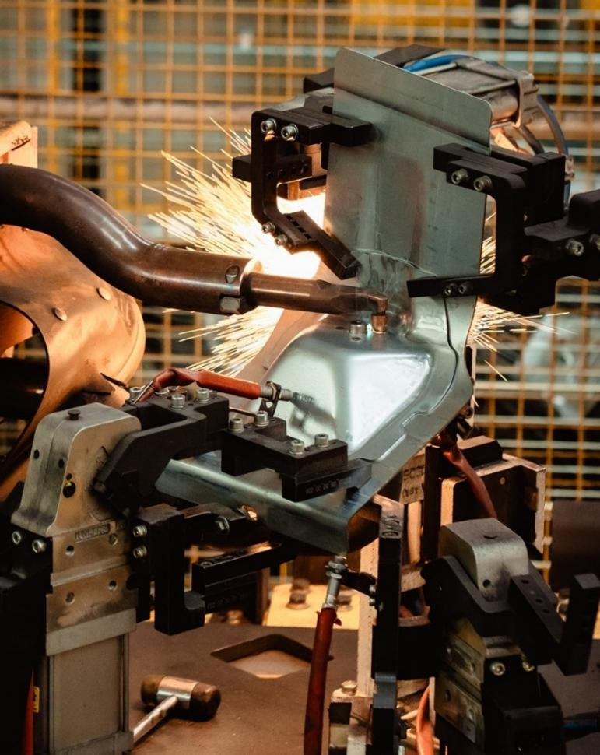
PRODUCTION OF PARTS
WELDING & assembly
AUTOMOTIVE AND NON-AUTOMOTIVE CLIENTS
Our welding department includes over 50 welding & assembly workstations.
Complete welding and assembly capabilities, including Spot Welding, MIG-MAG Welding, Stud Welding and Assembly & Fastening operations.
21 Spot Welding Cells
21 TECNA Stations
4 MIG/MAG Cells
2 Manual Welding Guns
4 Assembly & Fastening Systems
MUSA
PITESTI 96’
12

Slide 13
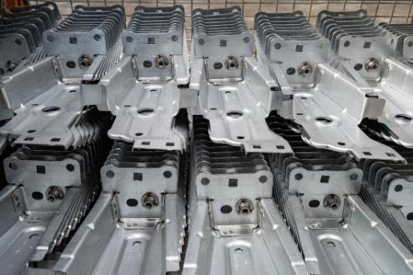
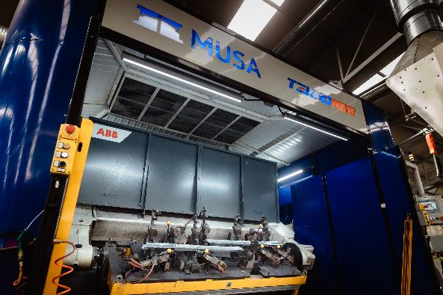
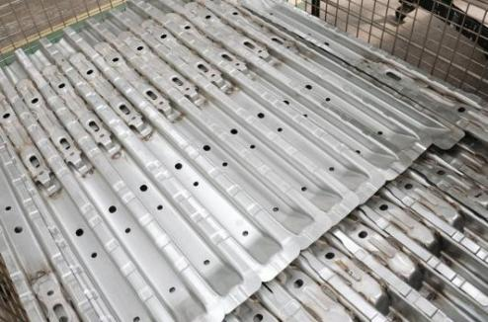
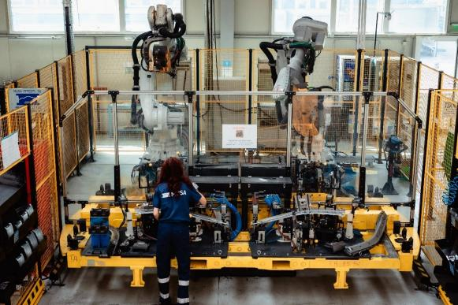
PRODUCTION OF PARTS
WELDING & assembly
MIG/MAG Welding
4 Robotic Welding Cells
3 ABB IRB 1600
1 ABB IRB 1600 ID
SPOT Welding
21 Robotic Welding Cells
20 ABB
21 Manual TECNA Stations
2 Manual Welding Guns
ASSEMBLY & FASTENING
1 Riveting Machine (Agme RA-12)
1 Riveting Gun (Rivkle NEO P107)
1 Pneumatic Rivet Nut Gun (P2007)
1 Stud Welding Machine (Tucker TGX-M)
1 FANUC
Payload up to 5 kg
Reach up to 1.8 m
Table size 1100 x 270 mm – 2 position indexing table
IRB 6600/6640/6700/6720
Payload up to 200 kg
Reach up to 2.8 m
Table sizes from 550 x 250 mm up to 3800 x 850 mm
Up to 4 tables per cell
R-2000iC/210F
Payload up to 250 kg
Reach up to 3.1 m
Table size 800 x 400 mm – 2 position indexing table
Payload up to 5 kg
Reach up to 1.45 m
Table size 2400 x 850 mm – 2 position indexing table
400 V Power Supply
Welding Force up to 735 daN
Table size 240 x 250 mm
V19311000F / V123303000F
Welding Current up to 280 A
MUSA
PITESTI 96’
13

Slide 14

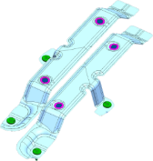
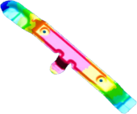
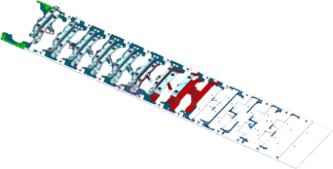
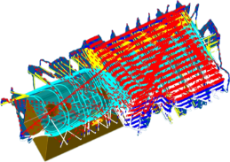

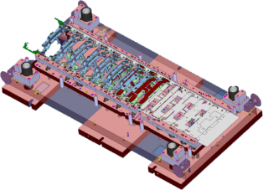
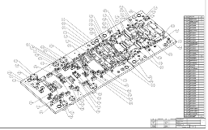
PRODUCTION OF DIES AND MOLDS
DESIGN
The design department has a capacity of 1000 hours/month, creating 3D models, simulations and technical documentation.
We design:
manual and progressive dies;
welding and assembly fixtures;
control gauges;
prototype parts.
Client requirements
Part
Simulation
Method plan
Manufacturing
Using powerful CAD-CAM software such as Siemens NX, CATIA, AutoCAD, and PAM-STAMP, we develop efficient and tailored engineering solutions.
Our stamped components are produced in sheet thicknesses ranging from 0.65 mm to 4 mm — all engineered for precision, reliability, and production efficiency.
Die design
Die documentation
Click here to explore MUSA - Pitesti
MUSA
PITESTI 96’
14

Slide 15
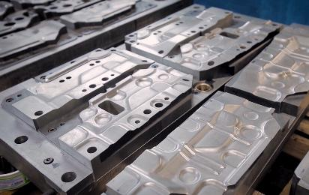
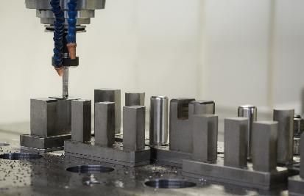
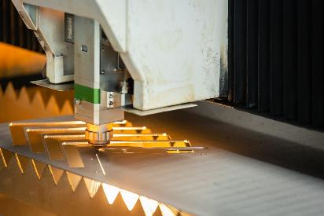
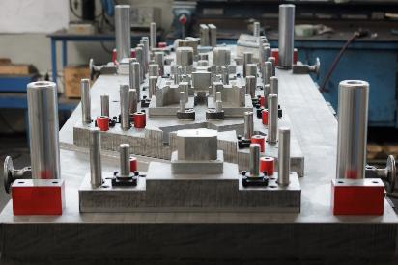
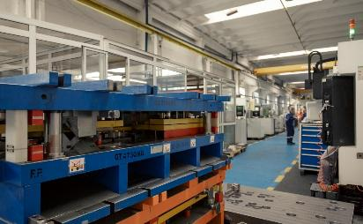
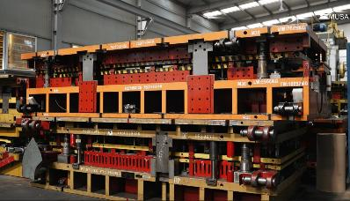
PRODUCTION OF DIES AND MOLDS
MANUFACTURING
CAPACITY
3500h/month
(with increase posibility)
EQUIPMENT | DIMENSIONS (mm)
Fiber laser cutting machine Bielda b3015 | 3000x1500
Milling centre Hartford SW323 | 3000x2300x760
Milling centre Hartford SW216 | 2000x1600x700
Milling centre Hartford PRO1000 | 1000x600x500
Milling centre Fadal WMC15RT 914 | 508x406x508
Milling centre Hartford Pro-800 | 800x400x700
Plan grinding machine Erfect PFG DL 3060AH | 600x300
Plan grinding machine Erfect PFG D 4080AH | 800x400
Round grinding machine RU500 | Ext.350x1500/Int.300x200
Wire EDM Charmille Robofil 290 | 400x250x250
Wire EDM Charmille Robofil 310 | 400x250x400
Wire EDM Charmille Robofil 100 | 200x150x70
Electrical erosion with massive electrode Agie | 400x400
Rapid holes erosion machine | ⏀0,2mm until ⏀3mm
Metal band saw OPTIMUM S275G | -
Radial drilling machine | -
Strung SN 400 | 400x1500
Strung CORMAK CD6241 | 800x1500
Milling centre Hartford PRO1000 | 1000x600x500
Centru de frezare Fadal 3016L | 762x406x508
MUSA
PITESTI 96’
15

Slide 16
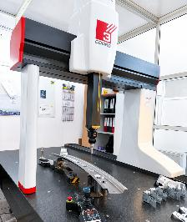
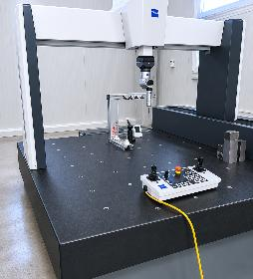
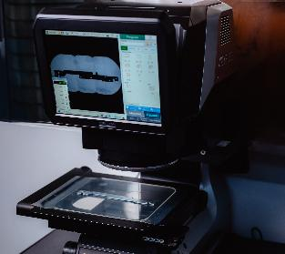
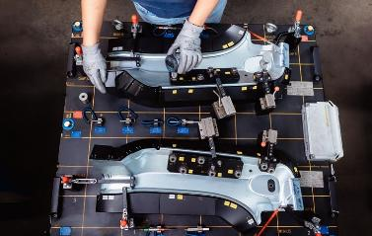
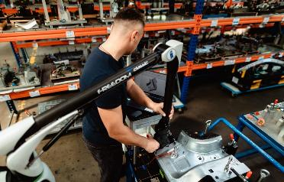
Quality
We ensure product quality through rigorous dimensional inspections using:
3D Hera Nowos Coord 3 1800x900x700 - coordinate measuring machines (CMM)
Zeiss Contura G3 1000 x1200x600- coordinate measuring machines (CMM) software Calypso
Keyence IM 7010 200x200 - Optical measurement projectors
Control gauges
LK Freedom Arm - software Polyworks
These systems allow us to validate bough prototype and series parts, meeting tight tolerances and international quality standards.
MUSA
PITESTI 96’
16

Slide 17
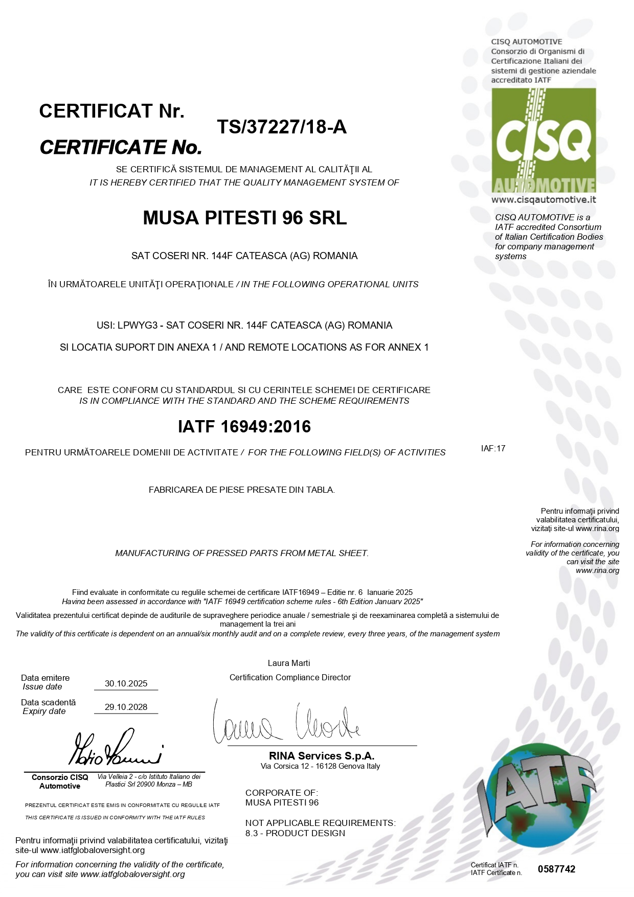
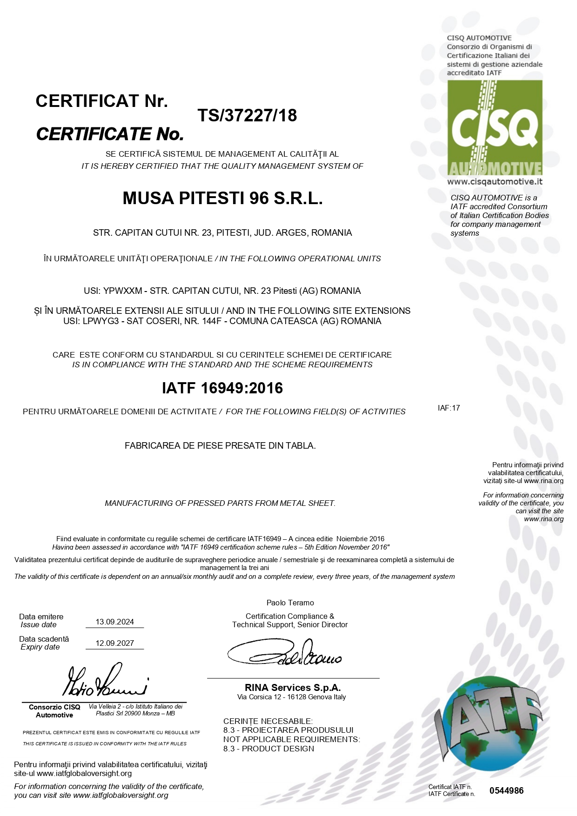
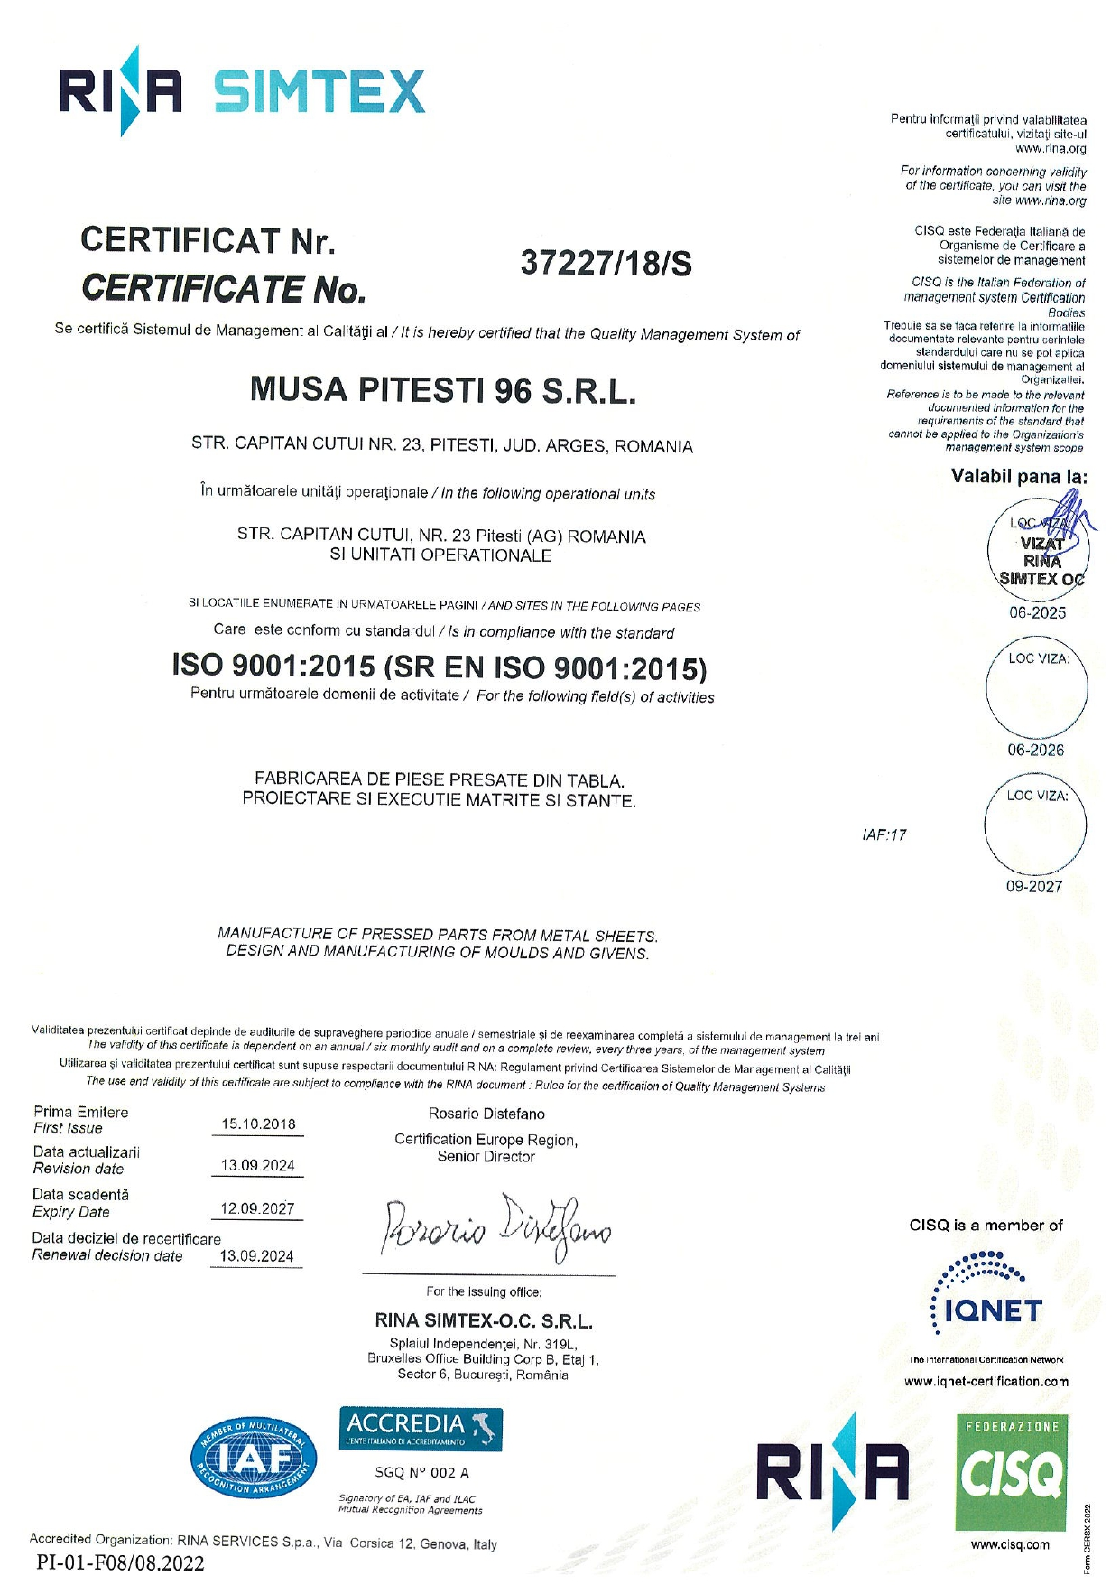
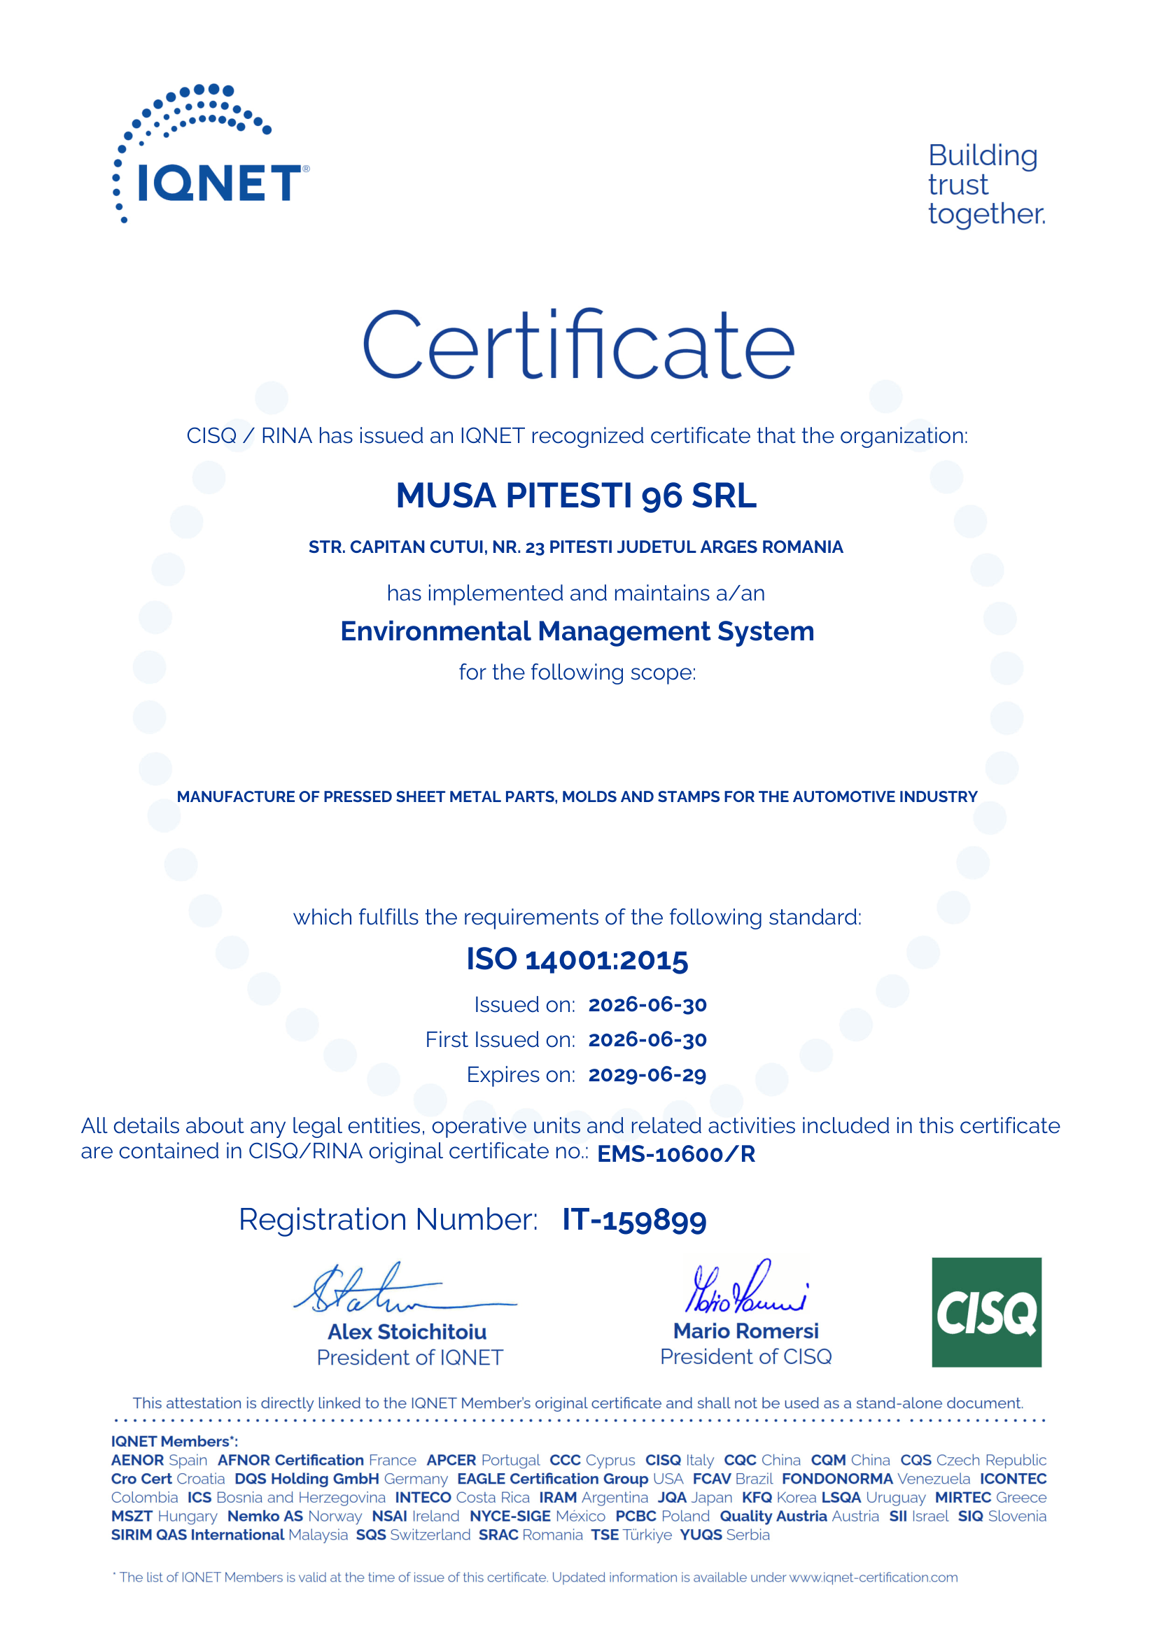
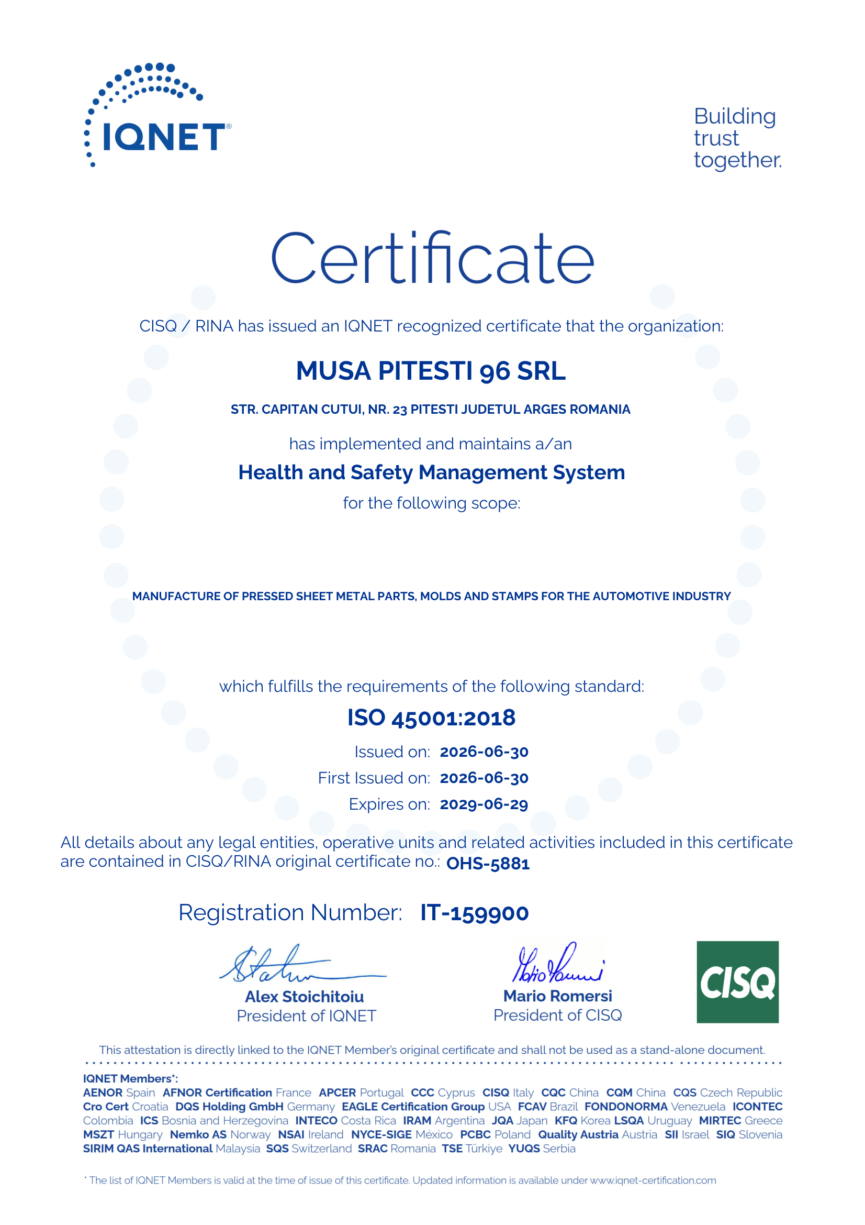
CERTIFICATIONS
IATF 16949
Automotive Quality Management System
COSERI PLANT
IATF 16949
Automotive Quality Management System
PITESTI PLANT
ISO 9001
Quality Management System
ISO 14001
Environmental Management System
ISO 45001
Health and Safety
Management System
MUSA
PITESTI 96’
17

Slide 18
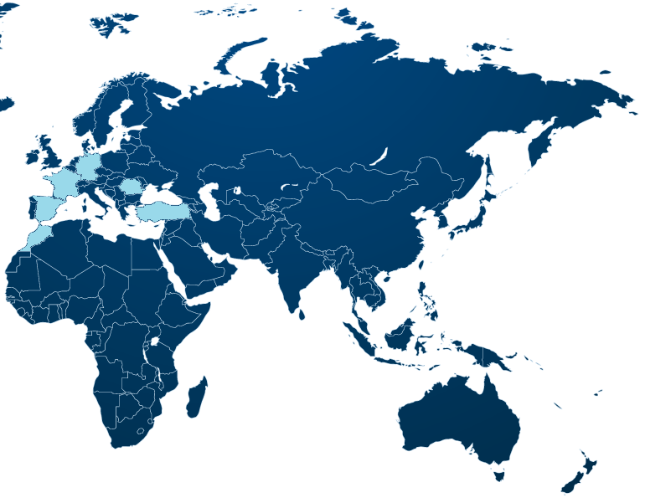
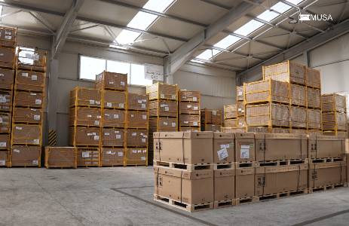
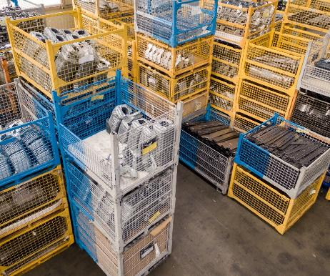
LoGistics
We manage all logistics processes in-house, from packaging and labeling to dispatch and delivery. We ship over 2 800 000 parts annually and our products reach customers on time, anywhere in the world – with no geographic or commercial limitations.
o
MUSA
PITESTI 96’
18

Slide 19
COMPANY PERFORMANCE
YEAR | OBSERVATION | TOURNOVER (mil EURO) | CUSTOMER | NO. EMPLOYEE | INVESTMENT EVOLUTION | TOTAL INVESTMENT (mil EURO/year) | QUALITY (Averge RSSC points) | DELIVERY (Averge service rate)
until 2016 | TR2 Automotive+Non-Automotive | 1.5 | GIC NOSAG / MARTUR + ASSA ABLOY | 150 | New plant in Cateasca / press park – 2 mil EURO | 0.3
2017 | Join into the RENAULT panel | 8.4 | RENAULT | 205 | New machinery and equipment – 0.3 mil EURO | 0.3
2018 |  | 10.5 | RENAULT | 239 | New machinery and equipment – 0.3 mil EURO | 0.3
2019 |  | 10.4 | RENAULT | 255 | New machinery and equipment – 0.5 mil EURO Building extension – 0.5 mil EURO | 1
2020 | The pandemic period | 6.8 | RENAULT | 241 | New machinery and equipment – 1 mil EURO | 1
2021 | SOP RJI | 9 | RENAULT | 209 | New machinery and equipment – 0.5 mil EURO | 0.5
2022 |  | 10.8 | RENAULT | 183 | New machinery and equipment – 0.5 mil EURO | 0.5
2023 |  | 23.8 | RENAULT | 214 | New machinery and equipment – 6 mil EURO New building 6200 SQm – 2 mil EURO | 4.3
2024 | SOP P1310 | 39.5 | RENAULT | 475 | New machinery and equipment – 5.5 mil EURO | 6 | 73 | 81%
2025 | Forecast + SOP R1310 | 50 | RENAULT | 525 | New machinery and equipment – 5 mil EURO for new project Renault & Others | 4.5 | 65 | 98%
2026 |  | 65 | RENAULT | 530 |  | 4.8 | 97 | 100%
MUSA PITESTI ‘96
MUSA
PITESTI 96’
19

Slide 20

MUSA
PITESTI 96’
Let’s shape ideas into results with !
THANK YOU!
+40 248 223 406
office@musa.ro
http://musa.ro
20

