Slide 1
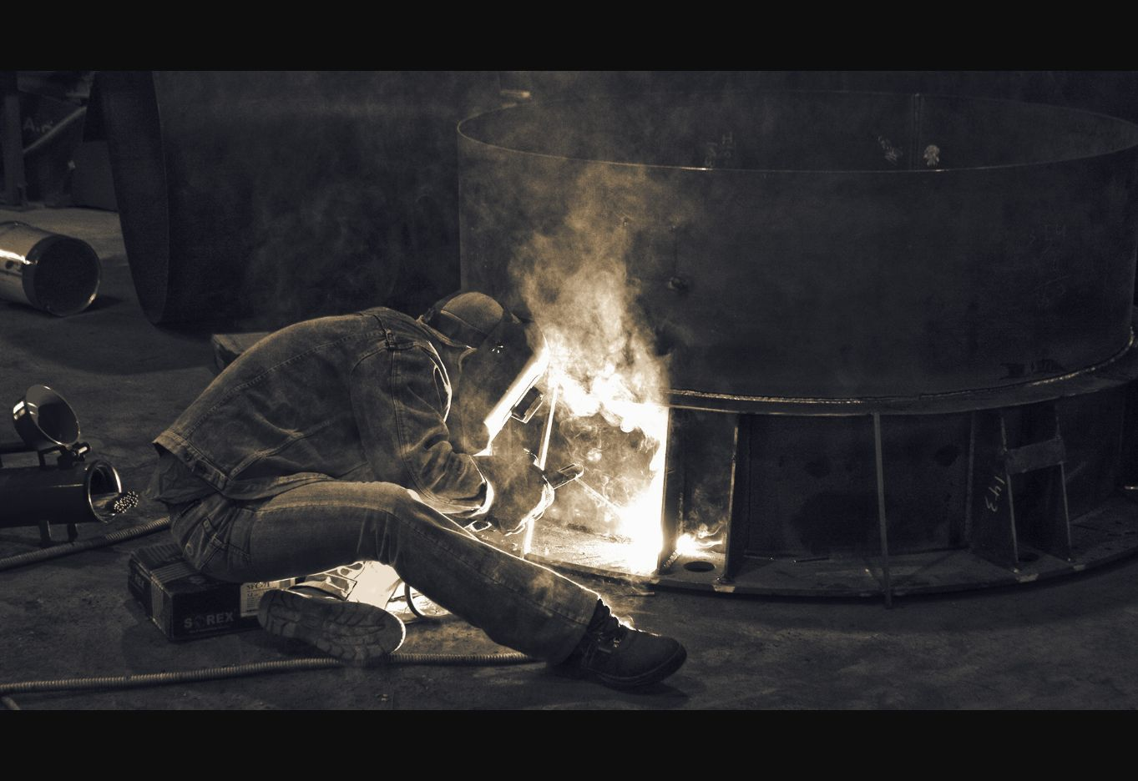
KERVANO
Welding and machining for special components
Steel fabrications and post-weld machining up to 1.5 t
kervano-metal-flow.com
Illustrative industry image
Notes:
Image: Welder At Work by Mohamed El Naggar. CC BY-SA 3.0. https://commons.wikimedia.org/wiki/File:Welder_At_Work_(123631085).jpeg Cropped for layout. Illustrative industry image; not KERVANO premises or personnel.

Slide 2
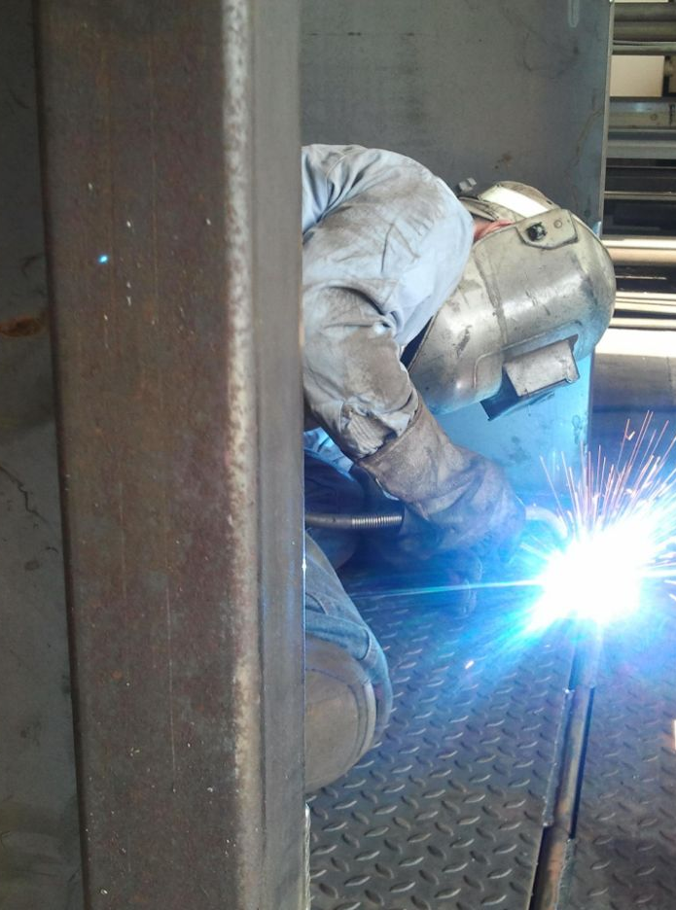
KERVANO
kervano-metal-flow.com
A focused manufacturing partner
Core service: welding of special steel parts and assemblies
Post-weld milling brings reference surfaces, bores and interfaces to final geometry
One point of contact from cut material to a delivery-ready component
Best fit: special components and technically demanding welded structures
Illustrative industry image
Notes:
Image: Welding Steel Plate.JPG by Kgequipment. CC BY-SA 3.0. https://commons.wikimedia.org/wiki/File:Welding_Steel_Plate.JPG Cropped for layout. Illustrative industry image; not KERVANO premises or personnel.

Slide 3
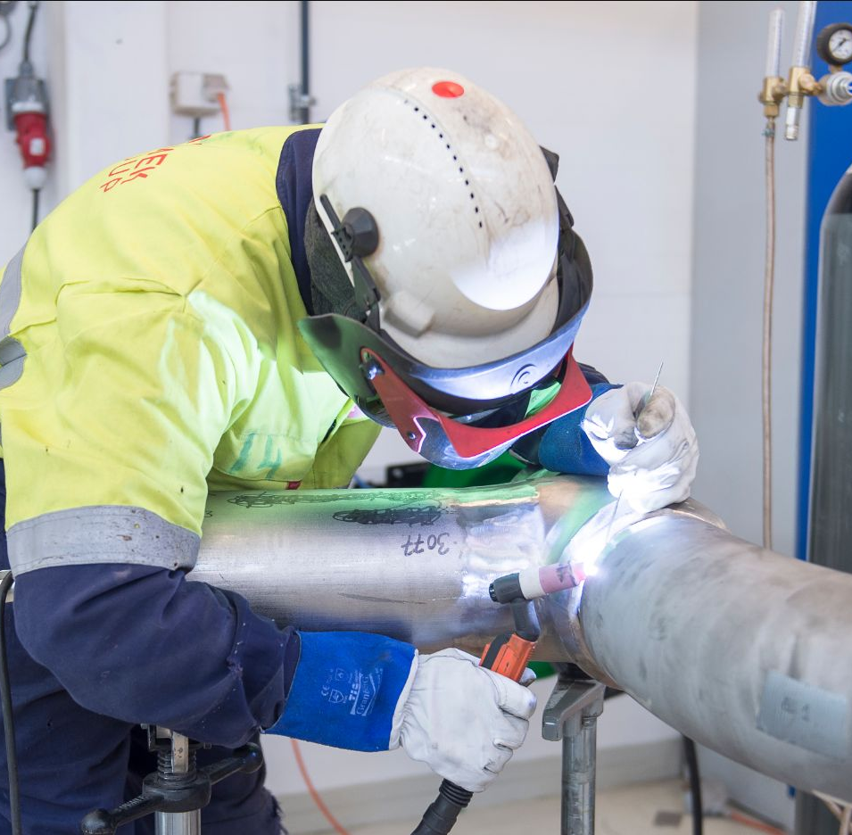
KERVANO
kervano-metal-flow.com
Welding as the core capability
Fit-up, assembly and welding of steel components
Special parts where geometry, access, distortion and downstream machining must be considered together
Welding sequence planned with the finished component in mind
Joint preparation and execution aligned with project requirements
Illustrative industry image
Notes:
Image: MomekIndustrimekanikerSveiser.jpg by Bjorn Leirvik. CC BY 4.0. https://commons.wikimedia.org/wiki/File:MomekIndustrimekanikerSveiser.jpg Cropped for layout. Illustrative industry image; not KERVANO premises or personnel.

Slide 4
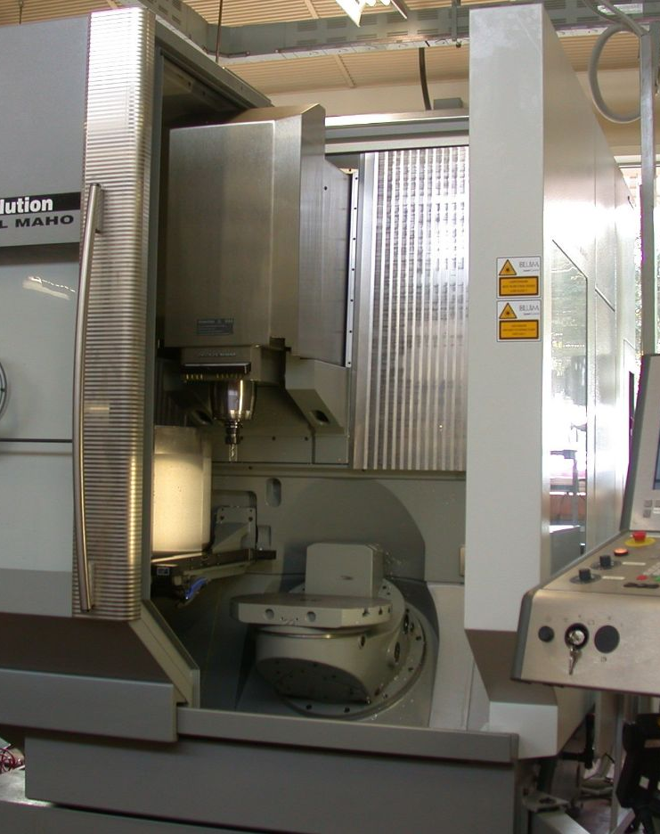
Post-weld machining closes the tolerance loop
Milling of reference faces, interfaces, bores and functional features after fabrication
Machining setup considers distortion and remaining stock
One partner coordinates the welded condition and final machining requirements
The aim is a component ready for the next assembly step
Illustrative industry image
Notes:
Image: DeckelMaho-DMU50e-MachiningCenter.jpg by Glenn McKechnie. CC BY-SA 2.0. https://commons.wikimedia.org/wiki/File:DeckelMaho-DMU50e-MachiningCenter.jpg Cropped for layout. Illustrative industry image; not KERVANO equipment or premises.

Slide 5
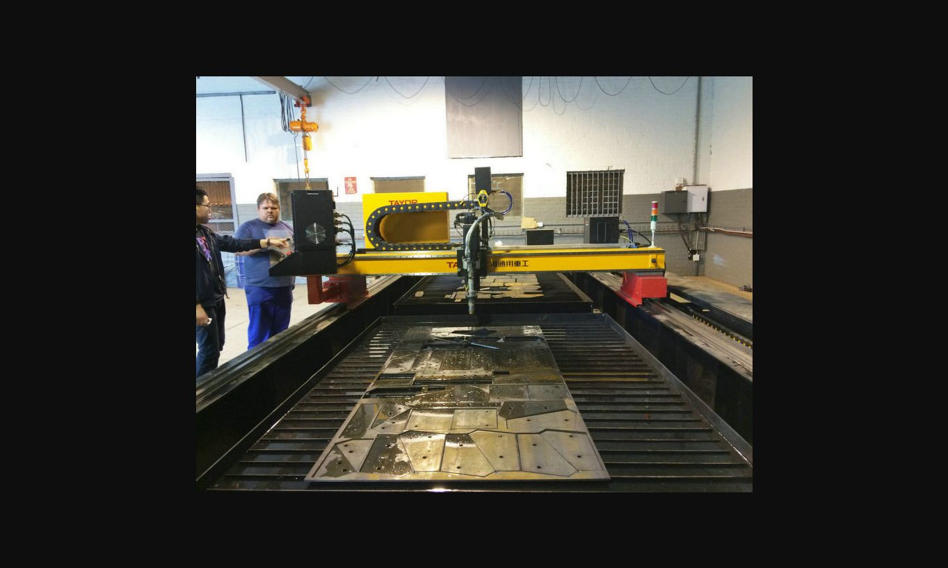
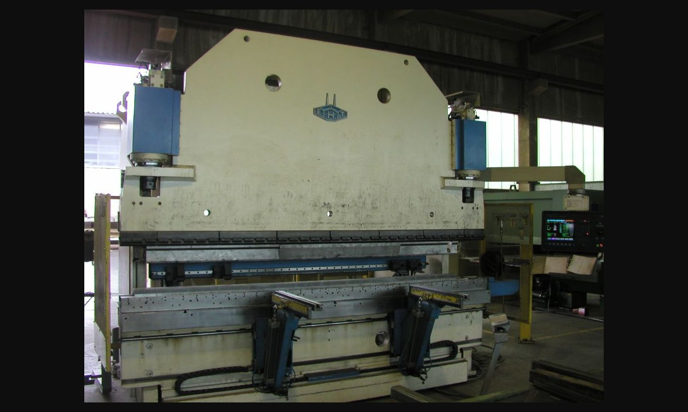
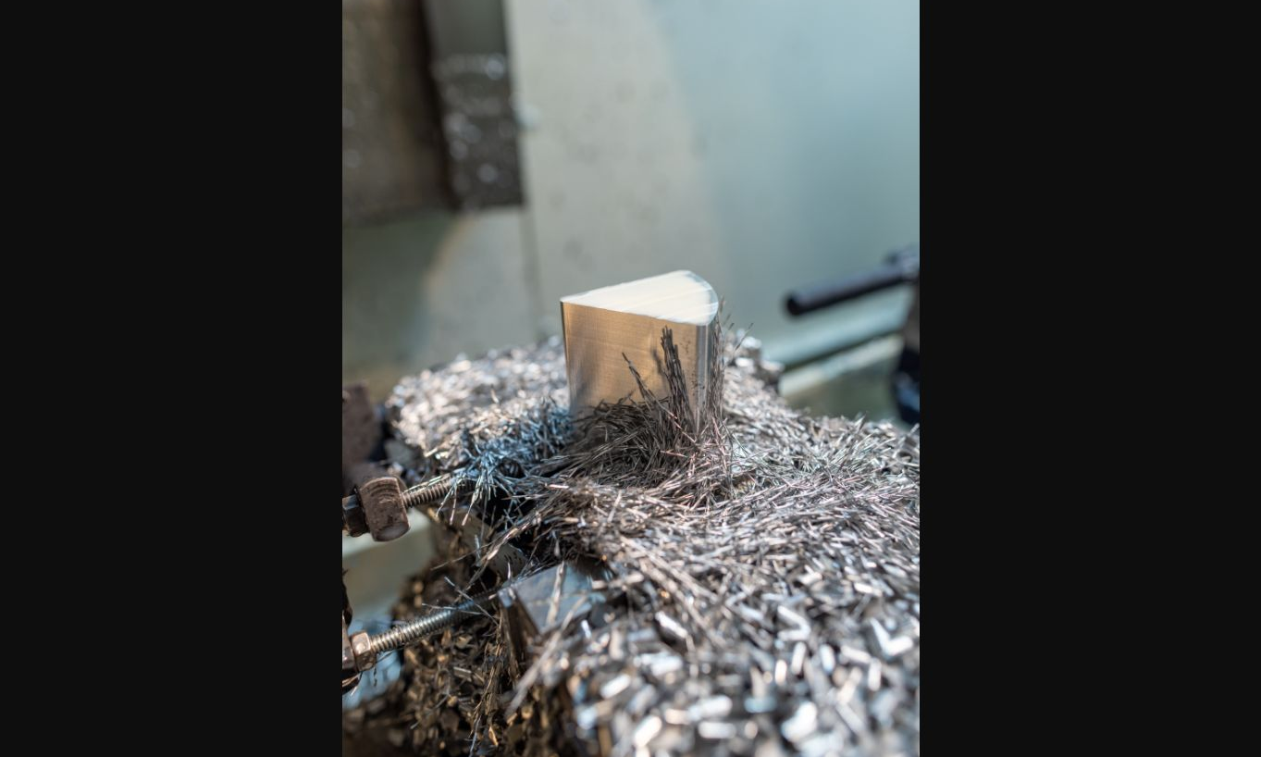
KERVANO
kervano-metal-flow.com
From plate to finished component
Illustrative industry image
01
02
03
04
Plasma or laser cutting
Bending
Fit-up and welding
Milling and final checks
Notes:
Image: 2X6m-Steel-Plate-CNC-Laser-Plasma-Cutting-Table by Zgyricky. CC BY-SA 4.0. https://commons.wikimedia.org/wiki/File:2X6m-Steel-Plate-CNC-Laser-Plasma-Cutting-Table_.jpg Cropped for layout. Illustrative industry image; not KERVANO equipment or premises.
Image: EHT-Biegepresse.jpg by Wolfgang Feld. CC BY-SA 2.0 Germany. https://commons.wikimedia.org/wiki/File:EHT-Biegepresse.jpg Cropped for layout. Illustrative industry image; not KERVANO equipment or premises.
Image: Machining NICER’s Patches by NASA/Scott Wiessinger and credited partners. Public domain in the United States as a NASA work. https://commons.wikimedia.org/wiki/File:Machining_NICER%E2%80%99s_Patches_(SVS14610_-_NICER_MachineShop-01).jpg Cropped for layout. Illustrative industry image; not a KERVANO component.

Slide 6
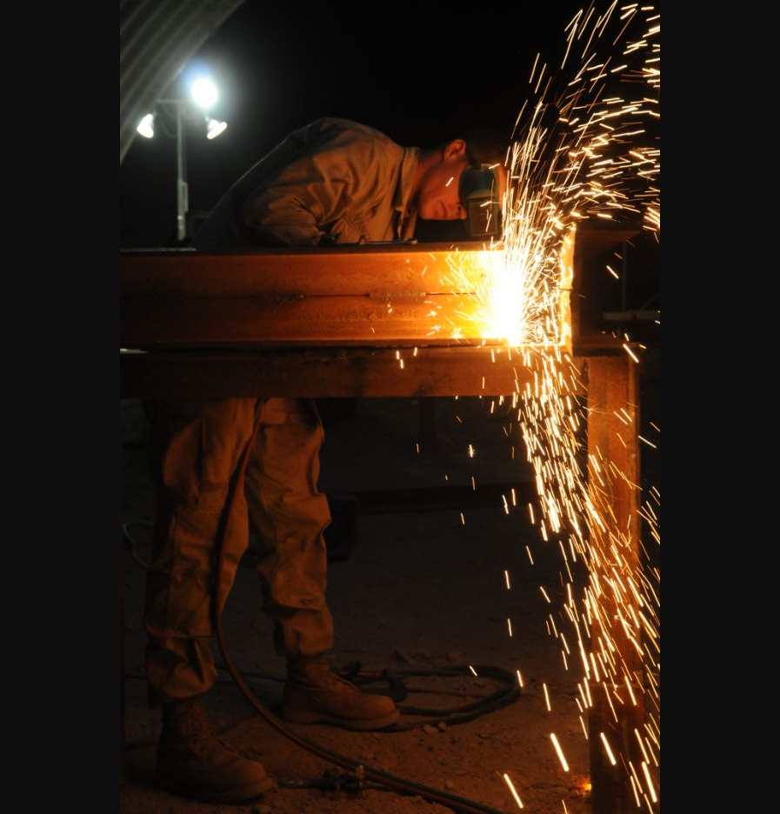
KERVANO
kervano-metal-flow.com
A compact team with welding engineering support
3
3
1
metal fabricators / fitters
welders
IWE welding engineer
The IWE can prepare project-specific welding technology and technical documentation. Fabrication, welding and machining coordinate directly around the same component.
Qualification and documentation scope follows customer and project requirements.
Illustrative industry image
Notes:
Image: Shower of sparks by Petty Officer 3rd Class Christopher Carson. CC BY-SA 4.0. https://commons.wikimedia.org/wiki/File:Shower_of_sparks_110524-N-TC501-018.jpg Cropped for layout. Illustrative industry image; not KERVANO premises or personnel.

Slide 7
KERVANO
kervano-metal-flow.com
Typical enquiries
1.5 t
Welded machine bases, frames, supports, housings and similar special parts
Single components and custom fabrications
Parts where welding sequence and final machining determine the result
Special components up to 1.5 t
For a fast review, send the drawing or 3D model, material, quantity, part weight, critical tolerances and target delivery date.

Slide 8
KERVANO
kervano-metal-flow.com
Technical preparation for every weldment
01
Review requirements
Drawing, material, interfaces and critical dimensions
02
Plan the route
Cutting, bending, fit-up, welding sequence and machining allowance
03
Define welding technology
IWE support and technical documentation as required by the project
04
Verify the final condition
Critical dimensions and agreed project documentation
Inspection and documentation are agreed for each project.

Slide 9
KERVANO
kervano-metal-flow.com
A clear RFQ process
01
Send the drawing or 3D model
PDF, STEP or another agreed format
02
State the key requirements
Material, quantity, weight, tolerances and delivery target
03
Clarify manufacturability
KERVANO reviews open technical points with you
04
Receive the quotation
Scope, manufacturing route and delivery plan
05
Launch the project
Production starts with the agreed documentation
The fastest way to start is to send the most difficult component first.

Slide 10
KERVANO
Send us your difficult welded component
We will review the drawing and propose a manufacturing route covering cutting, bending, welding and post-weld machining.
kervano-metal-flow.com
Illustrative industry image
Notes:
Image: Welder At Work by Mohamed El Naggar. CC BY-SA 3.0. https://commons.wikimedia.org/wiki/File:Welder_At_Work_(123631085).jpeg Cropped for layout. Illustrative industry image; not KERVANO premises or personnel.

