Slide 1
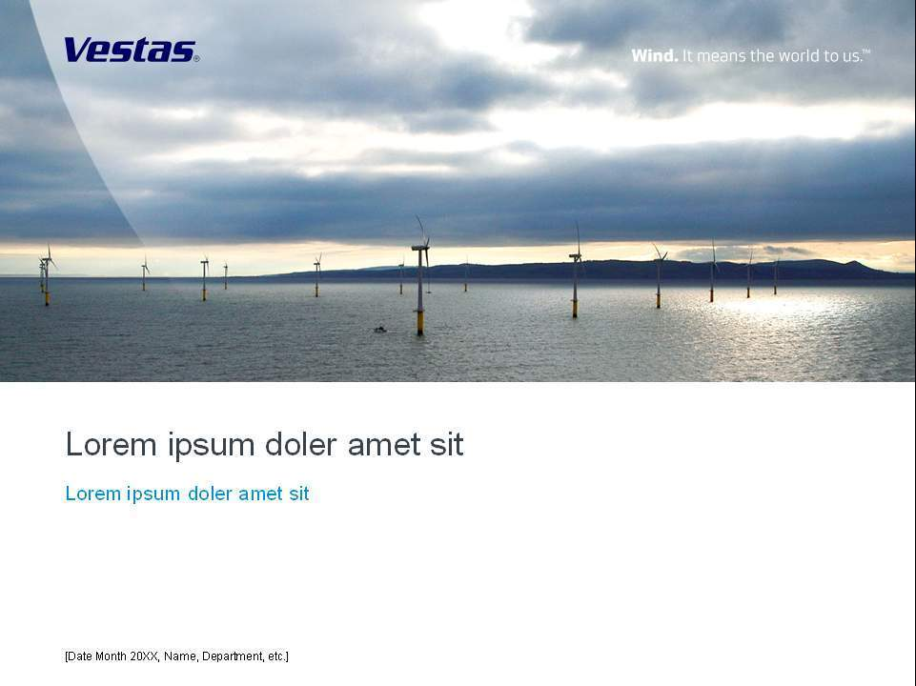
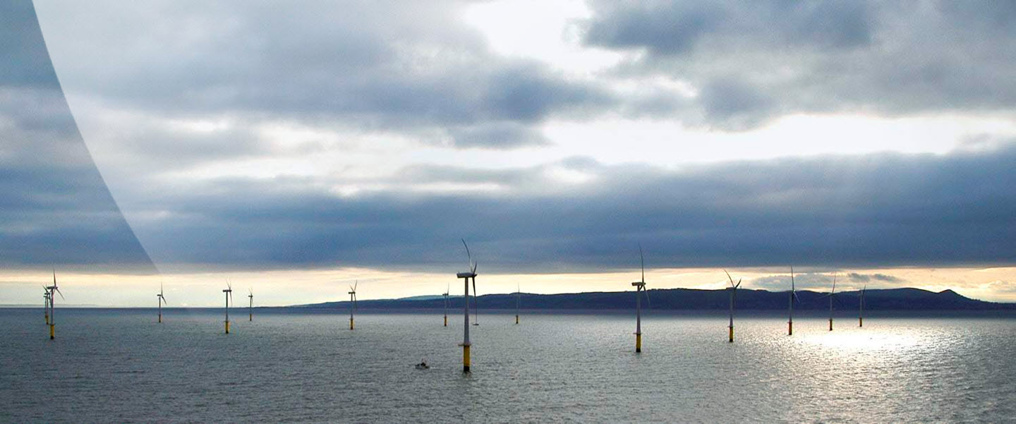
Vestas Casting Magdeburg GmbH

Slide 2

Welcome
1

Slide 3

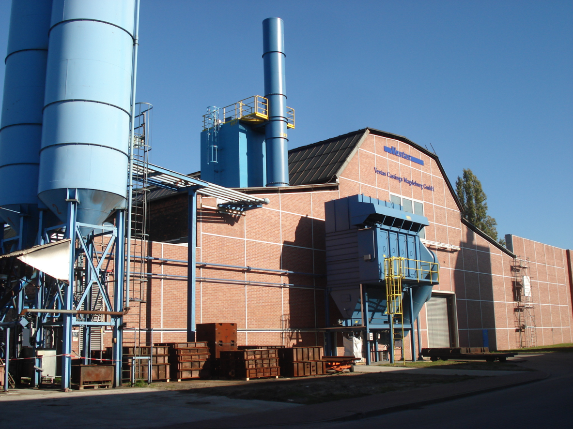
Introduction of Vestas to Renk AG – Mr. Grotschulte
Jochen Höfer Vice President
Claudia Gründel Internal Sales
Our Mission
Vestas Castings and Machining to be No 1in the following:-
Safety – Zero
Quality – 6 Sigma
Delivery - allow flexibility in the supply chain
Cost - To offer the best value at the lowest cost.
Commitment – Casting 6000 Tonnes allocated to External Customers from
Magdeburg

Slide 4
Foundry Dates
Establishement: 1908- Maschinenfabrik Buckau Wolf
Since 2004 Vestas Castings Magdeburg GmbH
120 employees
20.000t possible tonnage per year

Slide 5
Vestas Castings Magdeburg (VCM)
Vestas Castings Magdeburg (VCM), formerly Eisengießerei Magdeburg, became a subsidiary of Vestas in 2004 and is now a part of Vestas Castings Group AS under Vestas Nacelles A/S
VCM is one of four foundries at Vestas (Germany, Sweden, Norway and China)
The number of employees is app. 120 of which app. 80 work in the production

Slide 6
Vestas Castings Magdeburg (VCM)
VCM is certified according to DIN ISO 9002, 14001, 18001 and manufactures:
hubs
torque arms
brake discs
bearing houses
base frames
main shafts
for wind turbines up to 3 MW.
VCM works with cast items ranging from 50 kg to 14 tons and owns a modern electro-melting facility with a fast 4 tons medium-frequency facility and two 10 tons power frequency induction ovens

Slide 7
Vestas Castings Magdeburg (VCM)
VCM works on an ongoing basis to improve and optimise all processes to the benefit of the environment as well as the employees:
To improve the situation regarding noise and dust in the knock-out area, the construction of a new state-of-the-art knockout area with a shake-out grid in a soundproofed and ventilated cabin was finished in 2006.
In 2008 the alcohol-based coating was substituted with a water-based coating system to reduce the risks to health and safety and to cut environmental impact

Slide 8
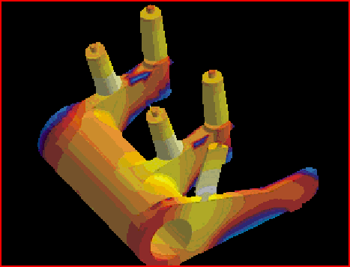

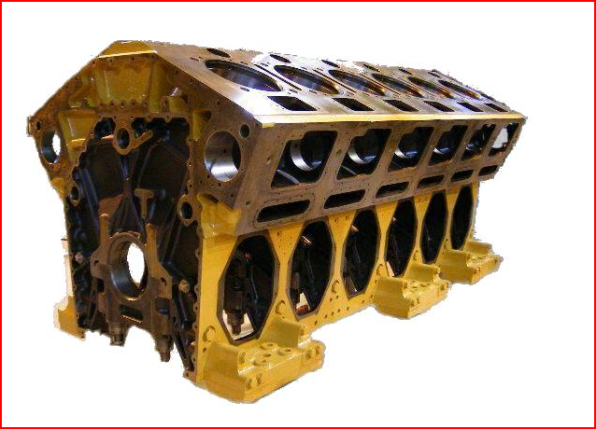
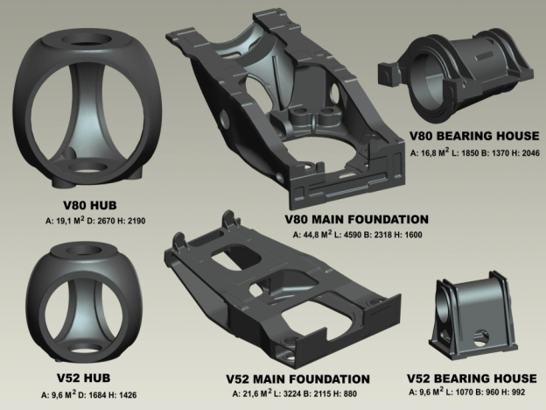
Our Capabilities – Castings
Casting Size
Max 5m x 5m x 5m
Weight 1 - 25 Tonnes
Material Specification
Nodular Cast Iron EN 1563-98 & EN 1561 -98
Design for manufacturing
Magma soft programs
Hybrid Cooling Systems
Full Inspection capability to Vestas TPS 901528 Ver 4
Historic Markets Serviced by Vestas Castings Group
Transport Products
Wind Energy

Slide 9
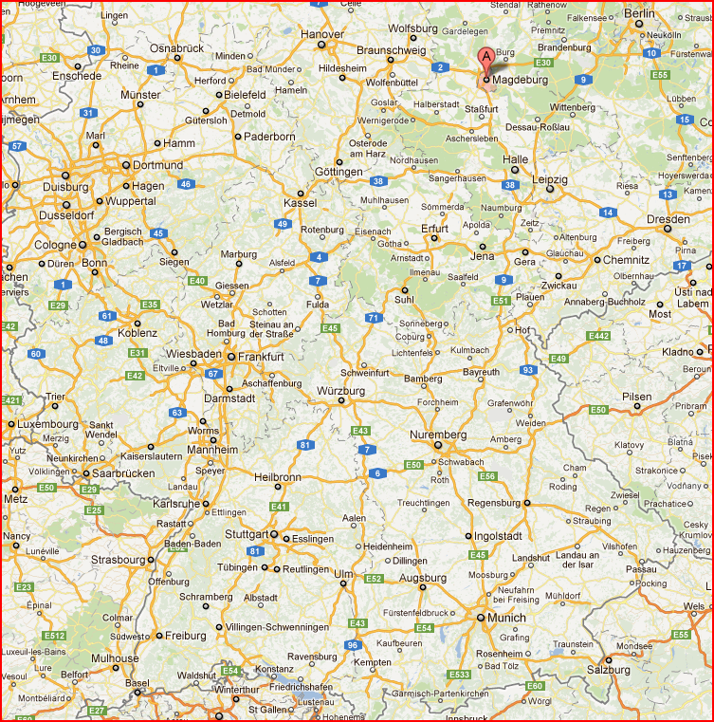
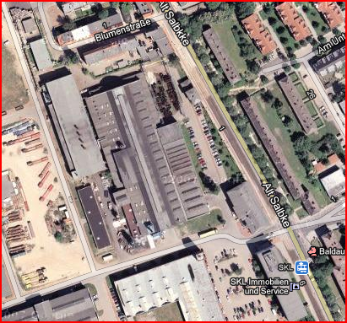

Magdeburg & the global footprint
Europe
Germany – Magdeburg

Slide 10
The Foundry
2

Slide 11
warehouse
melting shop
drying
oven
assembly area
large castings
mixer
shake out
filling area
large castings
coating
coating
mixer
c
filling
small castings
assembly area
small castings
drying
oven
warehouse

Slide 12
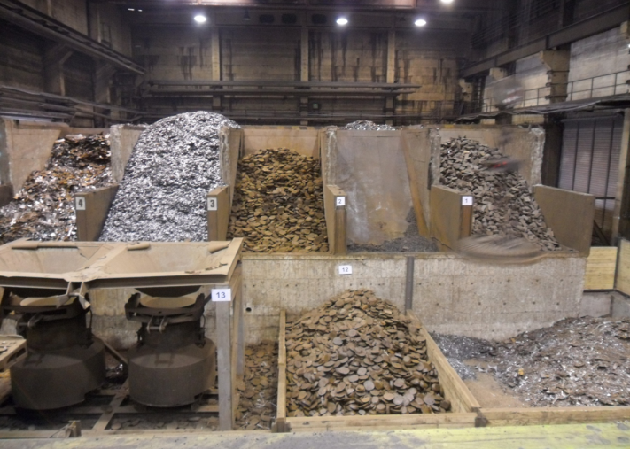
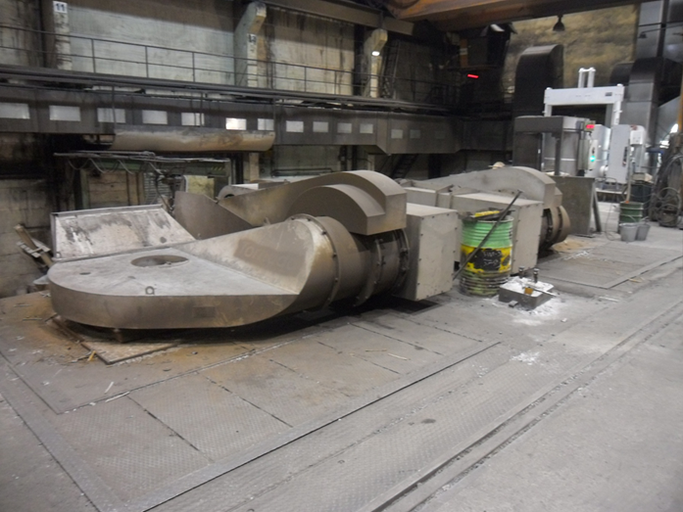
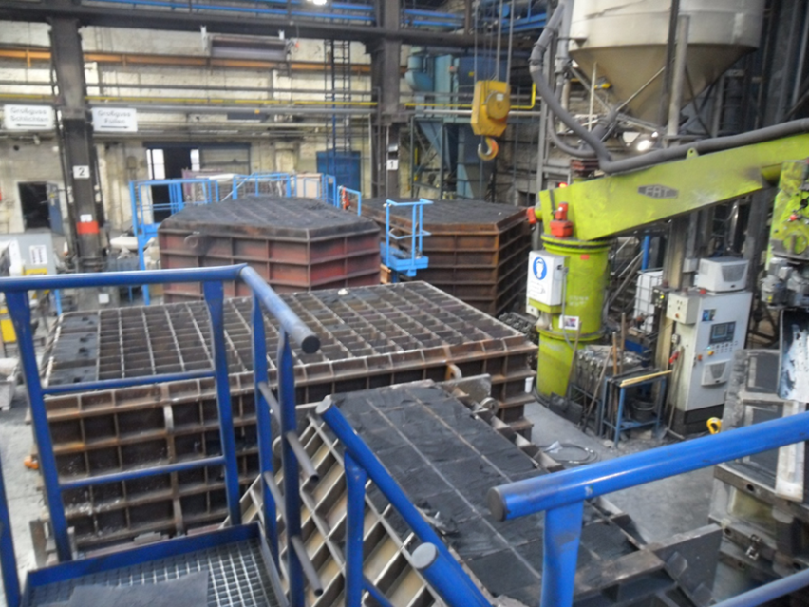
raw material store
melting shop – charging floore
filling area large castings

Slide 13
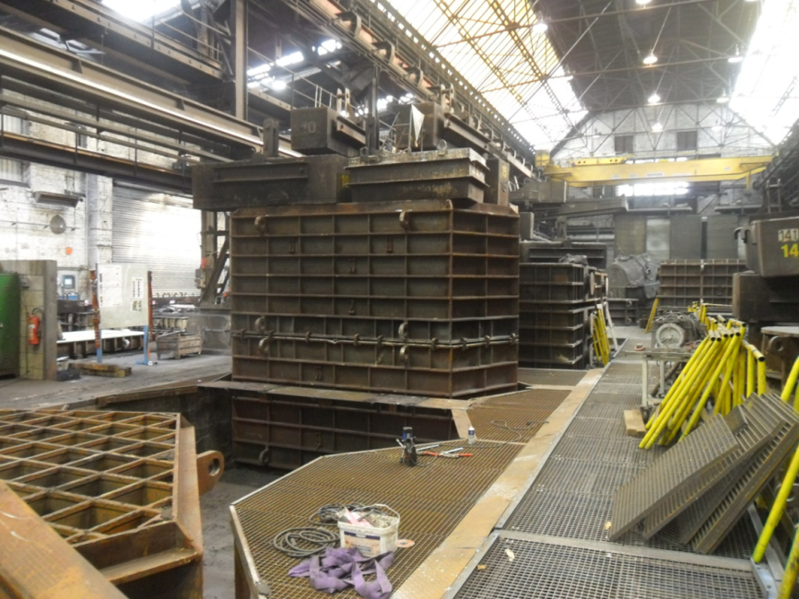
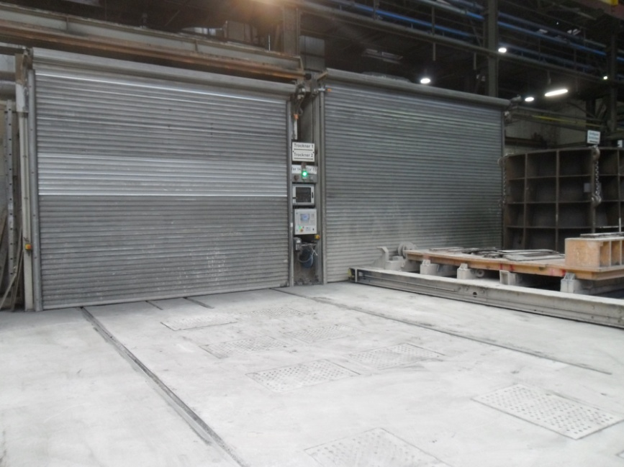
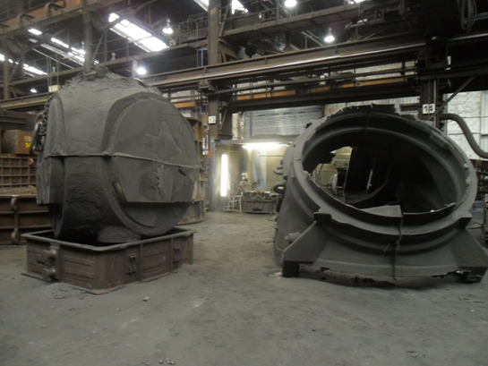
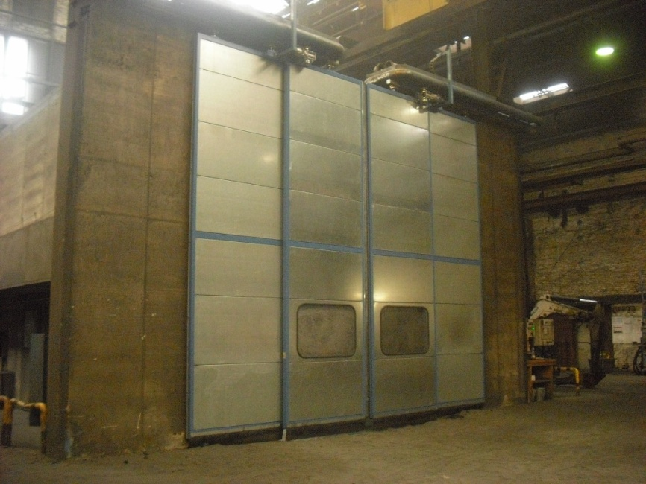
assembly area
large castings
drying chambers
shake out area
shake out station

Slide 14
Quality Assurance
4

Slide 15
Production Inspection Instructions
Sand Flow chart
Testing of new sand
Evaluation of sintering point
Sieve analysis, LOI, Moisture, Leco for sand
Bending test
Compression test
Calculation of theoretical specific surface for sand
Test of sand pH-value
Deviations and corrective actions
Incoming Inspection Steel scrap
Pre-pouring temperature measurement
Sulphur Content Test - sand
New Sand Incoming Inspection
Sand Sample Collection Points
Moisture Content Test
Sieve Analysis Test
Loss On Ignition Test
pH Value Test
Bending test
Compression test
Sintering Point Test
Incoming Inspection Pig iron
Binder & Hardener Incoming Inspection
Mould and core coatings Mixing and Testing
Periodical Inspection of Mouldboxes and Lifting Points
Control and Criteria for Disposal of Mouldbox Components/Lifting Points
Periodic Inspection - Overview
Heavy Section Test Block Metallographic Examination
The Check List
Standardised globally
Full traceability

Slide 16
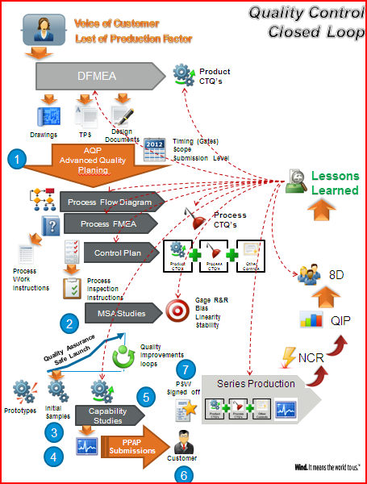
Quality Control Closed Loop
This assists in operating at
5.4 Sigma

Slide 17
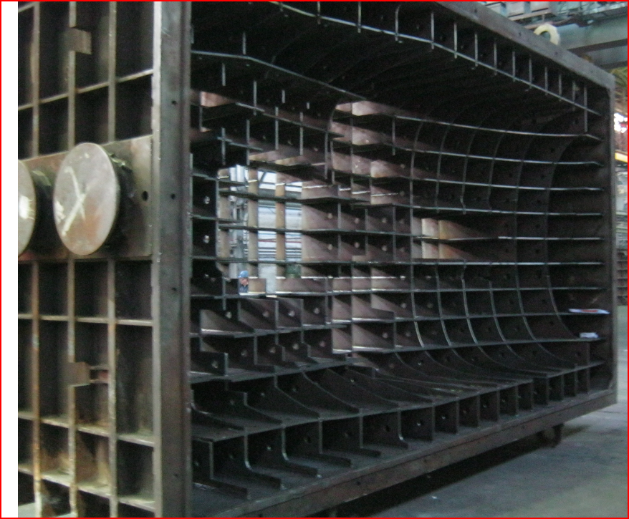
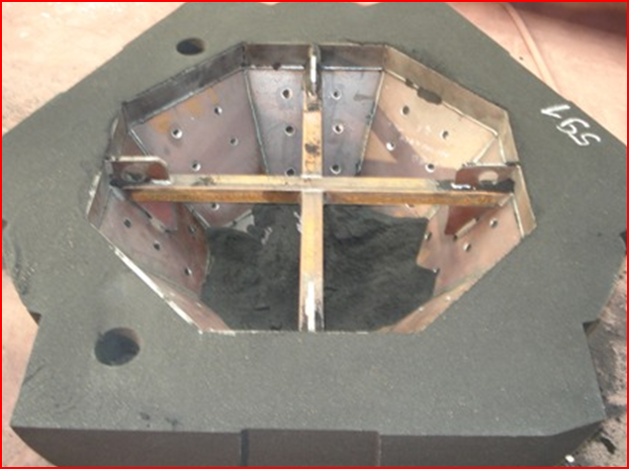
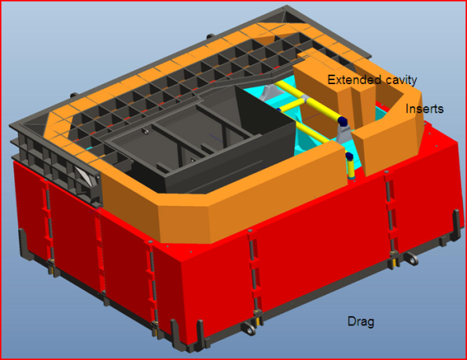
Sand Saving & Cooling Time reduction
Hybrid Cooling Grids
Hollow Core System

Slide 18
