Slide 1

ASSEMBLY SERVICES

Slide 2
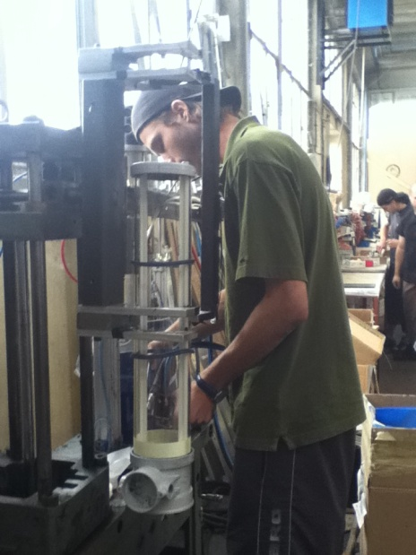
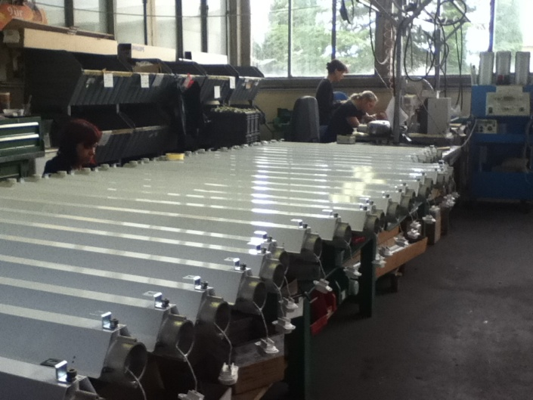
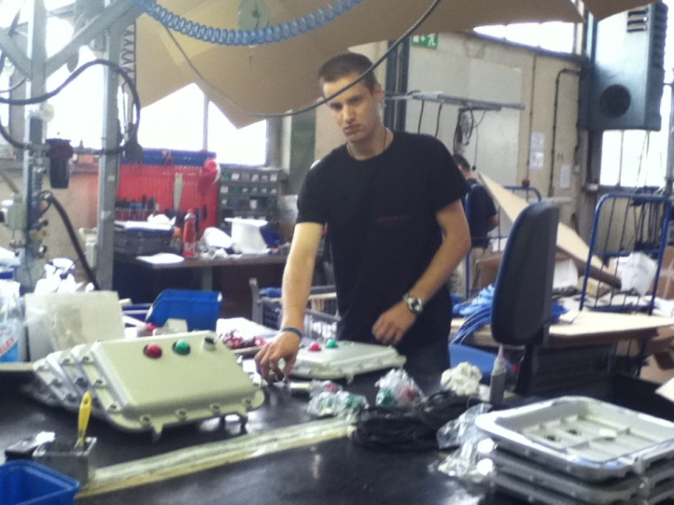
LIGHTING ASSEMBLY LINE
For our customers we assembly:
  Industrial lighting
  Atex lighting
  Indoor and outdoor lighting
  Special pourpose lighting

Slide 3
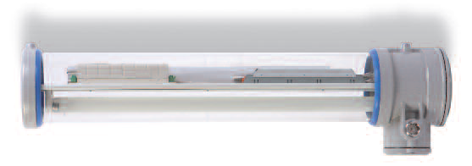
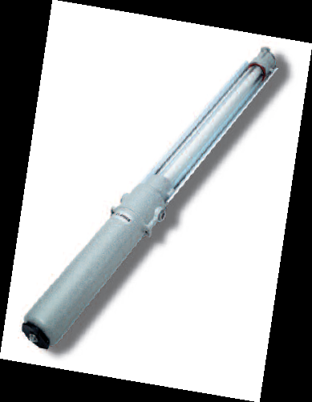
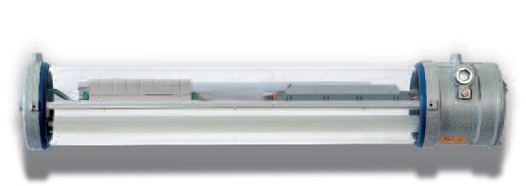
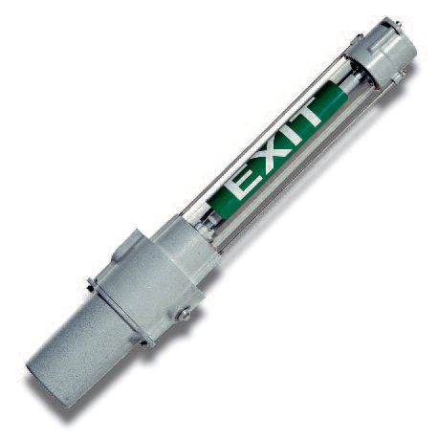
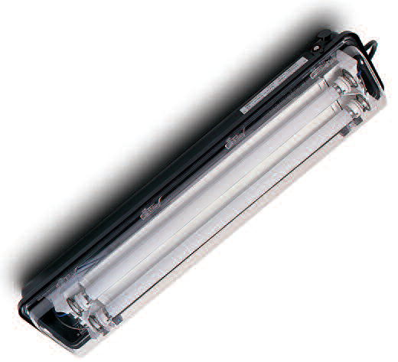
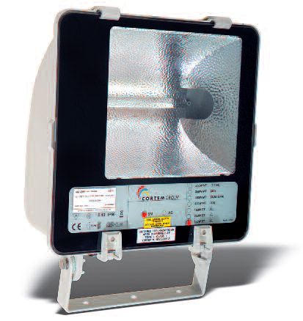
Products:

Slide 4
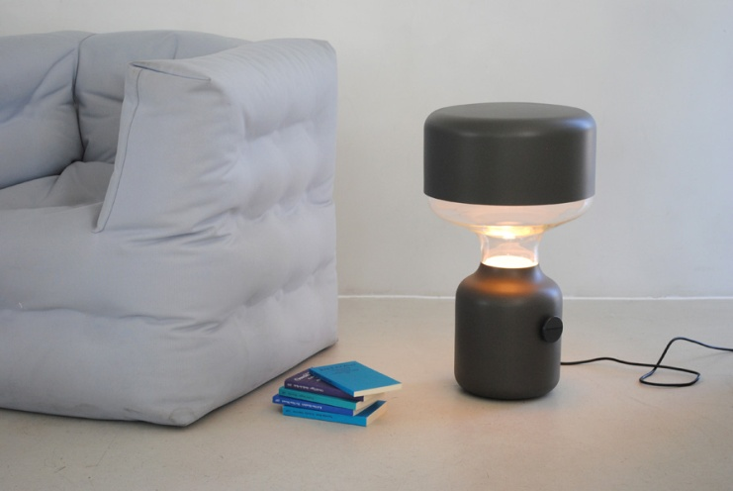
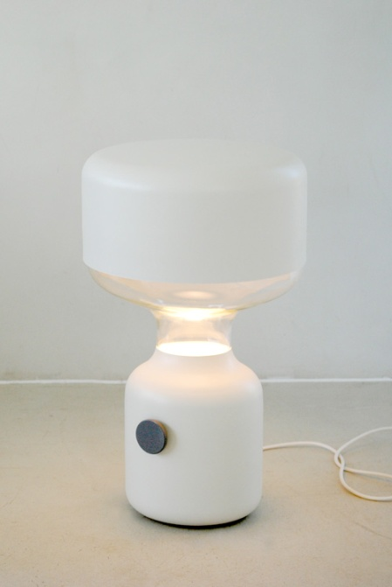
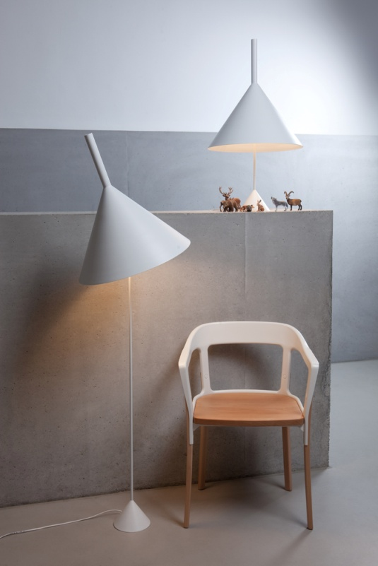
PRODUCTS:

Slide 5
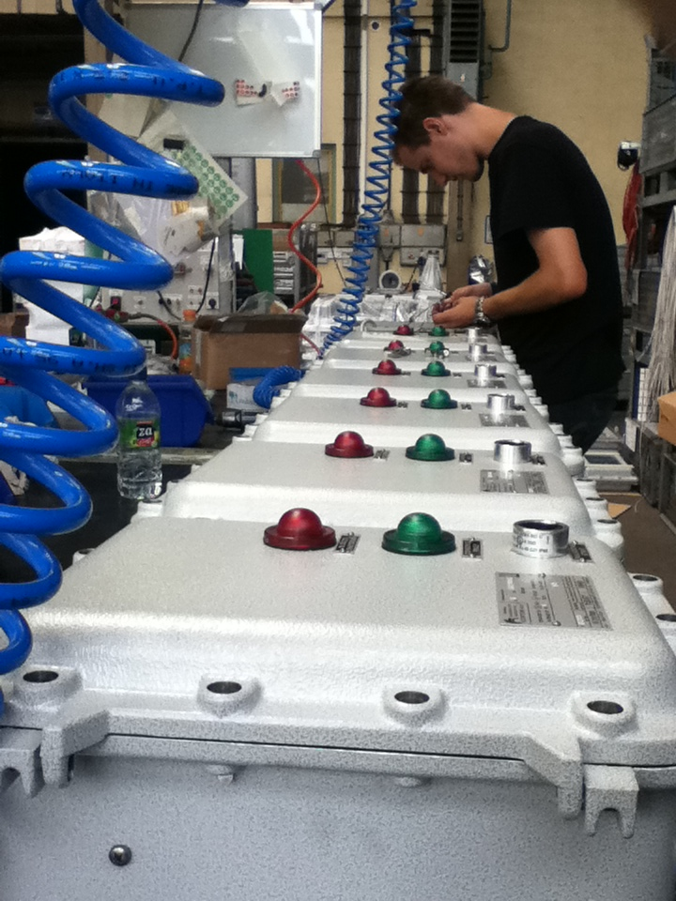
references
CORTEM GROUP S.P.A.
INTRA LIGHTING D.O.O.
FENEX SRL
VERTIGO BIRD D.O.O.

Slide 6
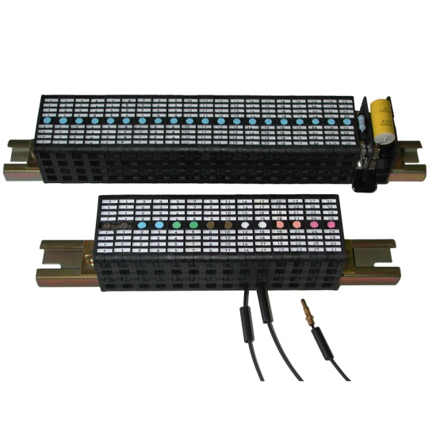
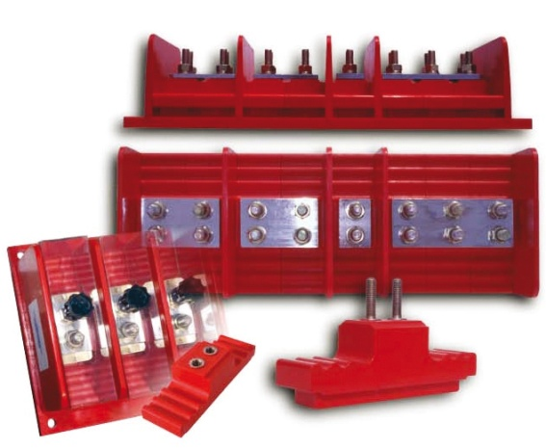
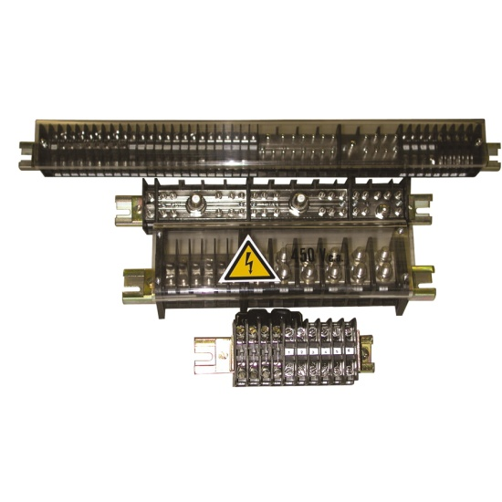
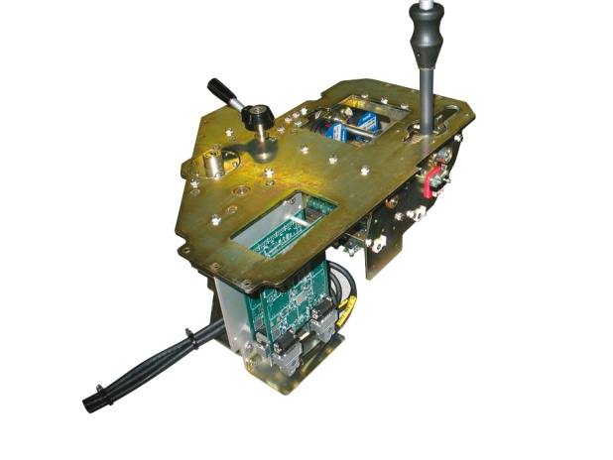
RAILWAY ASSEMBLY LINE
integrated driver desks, control panels and components for trains

Slide 7
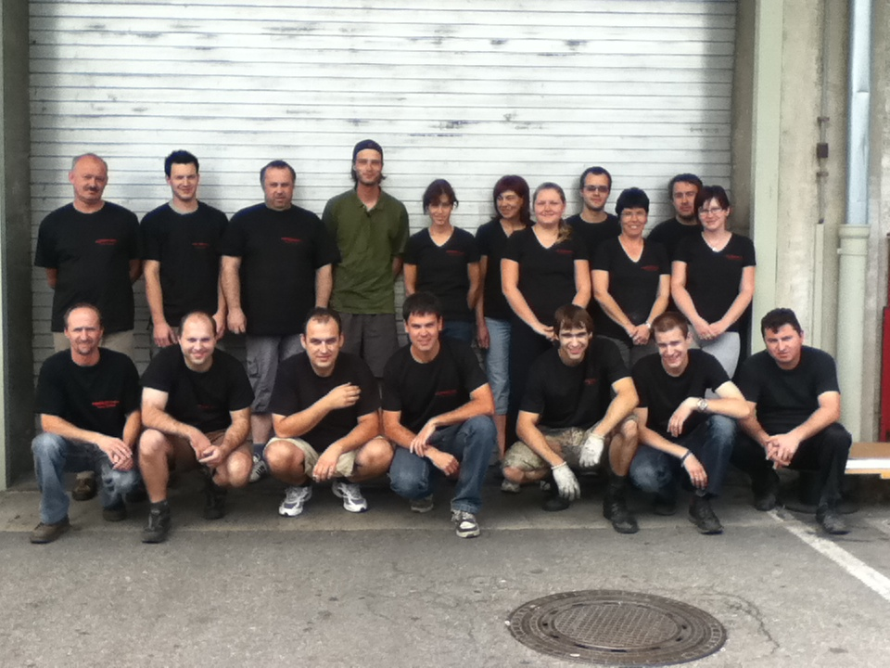
Location:
Sempeter pri Gorici, Slovenia
    Production unit: 1600 m2
    20 specialised employes

Slide 8
Location:
Vipavska cesta 68
5000 Nova Gorica
Tel: 00386 5 3303392 – 3303398
Fax: 003865 3303393
E-mail: Fimtech@siol.net

