Slide 1

COMPANY PRESENTATION
Fevzi Çakmak Mah. Şehit Tugay Karaman Sok. No:49 Kaynarca / Pendik / İstanbul / TURKEY
Phone : +90 216 397 59 86
Fax : +90 216 397 59 05
info@santekmakina.com.tr

Slide 2
BRIEF INFORMATION
SANTEK was established in 2001 as a «Private Company» and in 2008 changed to a «Limited Liability Company» in İstanbul and manufactures machining parts for mainly automotive industry.
The company started with old technology automatic lathes to produce turning parts for marble cutting industry. However, machine collection have been evolved to latest technology CNC machines in last 5 years. Together with this development, strong commercial relations have been conducted with leading automotive «Tier 1» suppliers.
Main customers are:
Arfesan Fren Elemanları www.arfesan.com.tr
Erdoğanlar Otomotiv www.erdoganlarotomotiv.com
Pürplast www.purplast.com.tr

Slide 3
COMPANY FACTS AND FIGURES
Company Name: | Santek Makina San. ve Tic. Ltd. Şti.
Year of Establishment: | 2001
Number of Employees: | 9
Closed Area: | 650 sqm
Quality System: | ISO 9001 : 2008
TURNOVERS
2015 | 1,123,000 TL | ~ 350,000 EUR
2014 | 938,000 TL | ~ 330,000 EUR
2013 | 753,000 TL | ~ 256,000 EUR
In 2016, the turnover is estimated to be 2,000,000 TL with new projects and investments.
New project includes a centerless grinding machine, a sliding headstock automatic lathe and a hard chrome plating facility.

Slide 4
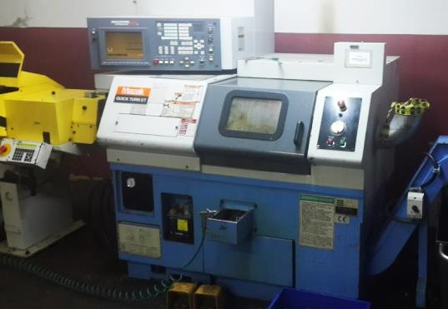
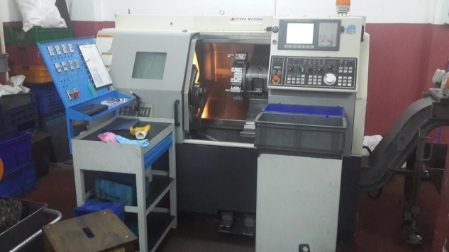
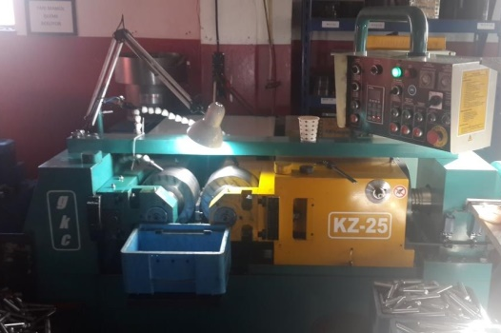
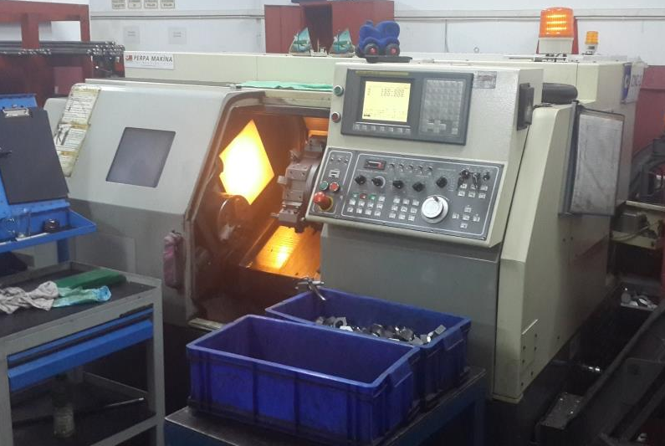
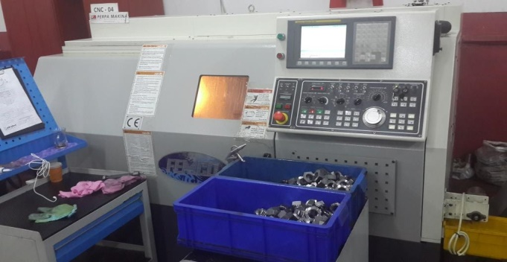
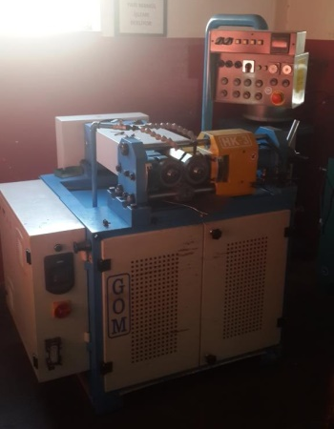
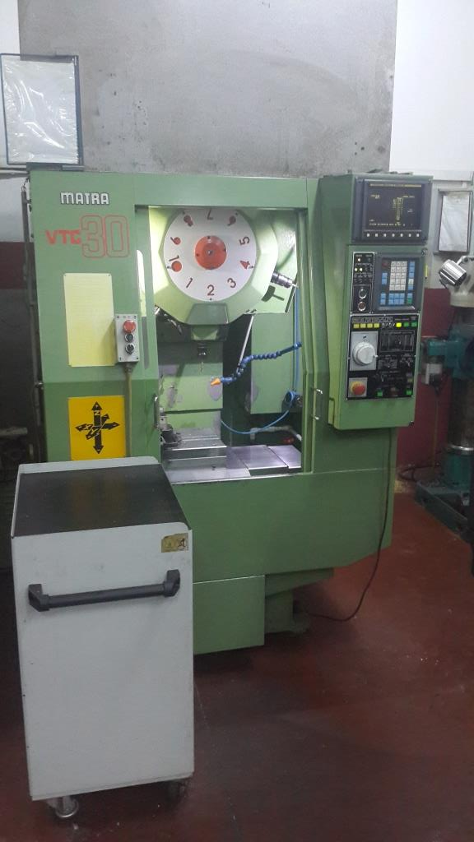
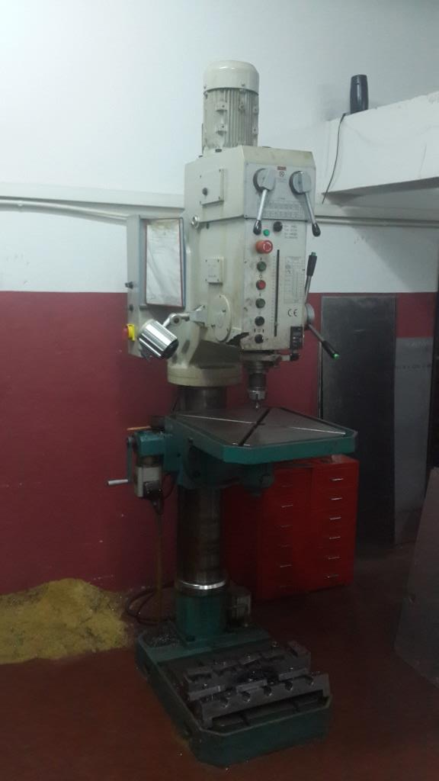
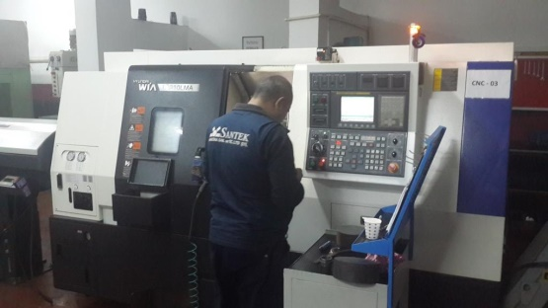
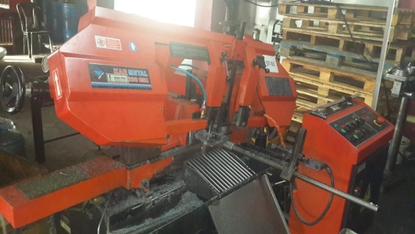
MACHINES

Slide 5
MANUFACTURING CAPABILITY
 | MACHINE DESCRIPTION | BRAND | MODEL | YEAR OF PROD. | OPERATING RANGE
1 | CNC LATHE | HYUNDAI WIA | L210 LMA | 2013 | 10"
2 | CNC LATHE | FEMCO | HL-25 N | 2014 | 8"
3 | CNC LATHE | FEMCO | HL-25 N | 2011 | 8"
4 | CNC LATHE | FEMCO | HL-25 | 2007 | 8"
5 | CNC LATHE | MAZAK | QT-6T | 1999 | 6"
6 | VERTICAL MACHINING CENTER | KIRA | MATRA VTC-30 | 1990 | 430x250x300mm
7 | THREAD ROLLING MACHINE | GÖKÇÜOĞLU | HK-03 | 2012 | 3 ton
8 | THREAD ROLLING MACHINE | GÖKÇÜOĞLU | KZ-25 | 2013 | 25 ton
9 | THREAD ROLLING MACHINE | PEE WEE | P10G | 1972 | 8 ton
10 | THREAD ROLLING MACHINE | GÖKÇÜOĞLU | GOM | 1997 | 12,5 ton
11 | 6 SPINDLE AUTOMATIC LATHE | GILDEMEISTER | AS16 | 1972 | 16mm
12 | 6 SPINDLE AUTOMATIC LATHE | GILDEMEISTER | AS16 | 1974 | 16mm
13 | AUTOMATIC LATHE | INDEX TRAUB | B42 | 1988 | 42mm
14 | AUTOMATIC LATHE | INDEX TRAUB | A25 | 1973 | 25mm
15 | AUTOMATIC LATHE | INDEX TRAUB | A25 | 1973 | 25mm
16 | GEAR HEAD DRILL PRESS | JETCO | JGDP-50 | 2011 | 50mm
17 | CHAMFERING MACHINE | SOCO | EF-AC60 | 2009 | 60mm
18 | BANDSAW MACHINE | KARMETAL | 280 OSA | 2009 | -
19 | REVOLVER LATHE | KAMSAN | - | 1985 | -
20 | CONVENTIONAL LATHE | ÖRN | - | - | -
21 | TABLE TYPE DRILLING MACHINE | EKÇELİK | - | - | -
22 | TABLE TYPE DRILLING MACHINE | EKÇELİK | - | - | -
23 | TABLE TYPE DRILLING MACHINE | EKÇELİK | - | - | -

Slide 6
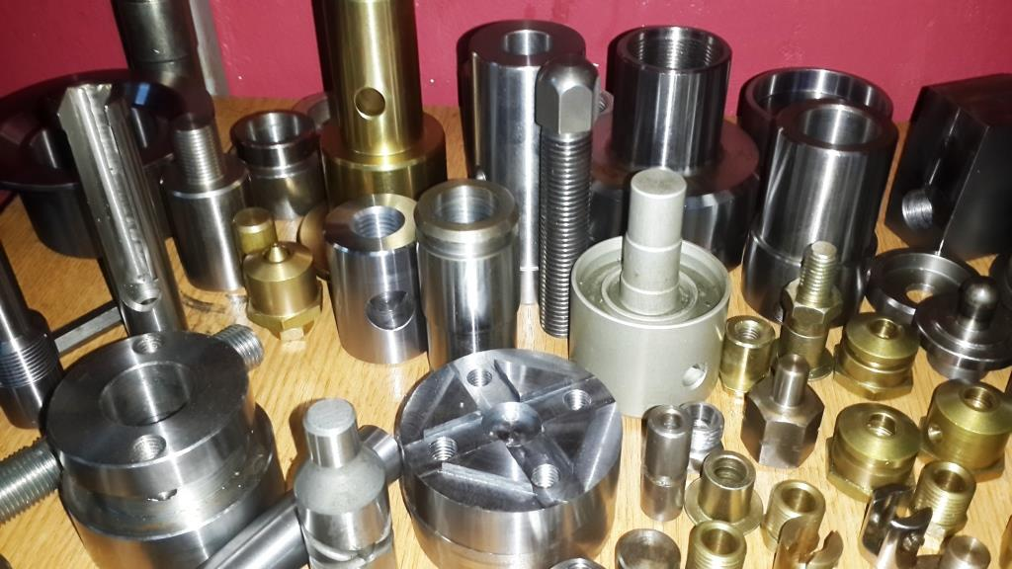
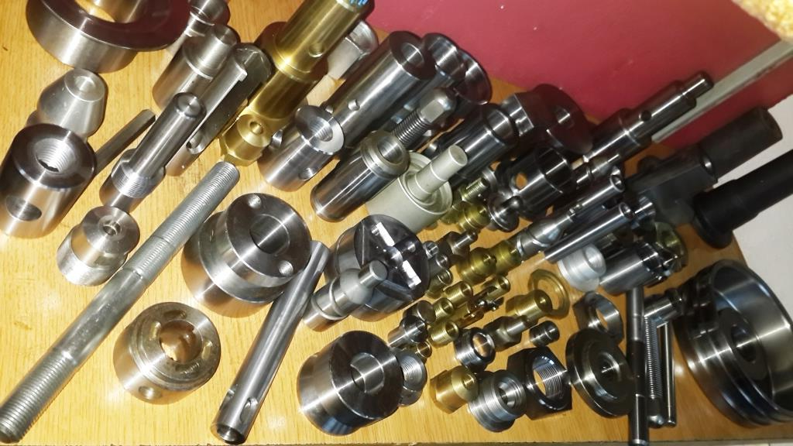
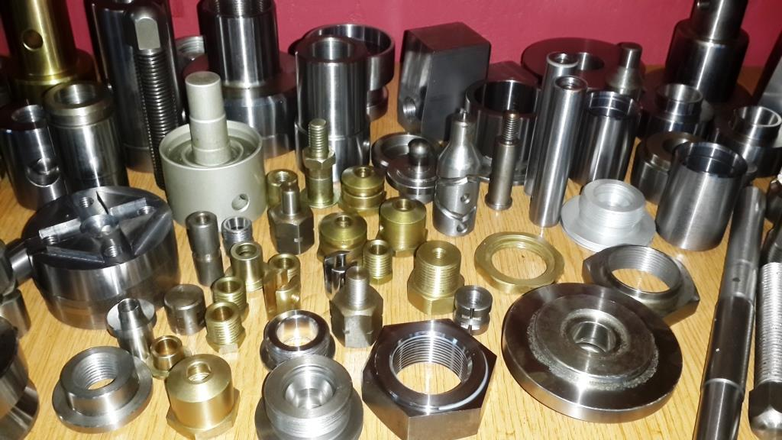
SAMPLE PRODUCTS

